Slide 1
Fee Management Workshop

Slide 2
Overview
Program and course fee managers are responsible for the following
Quarterly reviews of fee accounts (budget office)
Annual review/Review and report of fee expenditures (Fee Committee)
If the fee was determined to be the type that requires BOR approval then an annual application for the fee must be submitted (Fee committee)
Role of fee committee
To simply make recommendations
Final decisions are made by the provost’s office and president

Slide 3
From BOR Manual
Any elective fee or special charge that is required to be paid by all students in a specific degree program or in a specific course with the exception of laboratory fees and supplemental course material fees shall be approved by the BOR, but shall not require review by a student fee committee.
What are lab and supplemental course fees?
They “cover specific costs such as art materials, course packets/kits, museum admissions, travel to off-campus learning sites, safety equipment, software/videos, and special equipment (BOR Minutes)

Slide 4
Outline
Fee Reviews
How to prepare them
What the committee considers
Fee applications
How to prepare them
What the committee considers
BOR approval

Slide 5
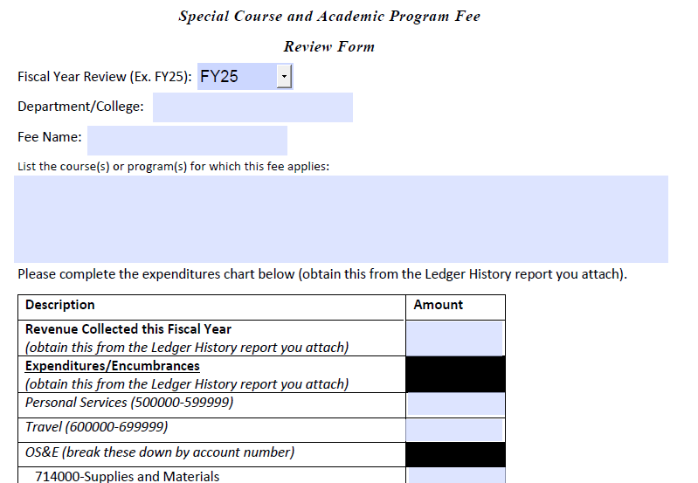
Fee Review Report Form C
Must use the PDF form.
Revenue Collected is found on the Ledger History report.
Make sure to only add numbers in the fields.

Slide 6
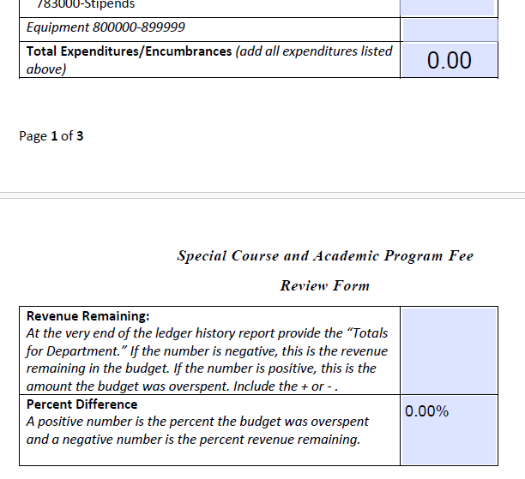
Fee Review Report Form C
If you added the numbers correctly the form will sum up your expenditures.
If you have remaining encumbrances in a field then add them to the expenditures.
Make sure to include the + and – sign when you add revenue remaining.
The form will calculate percent difference.

Slide 7
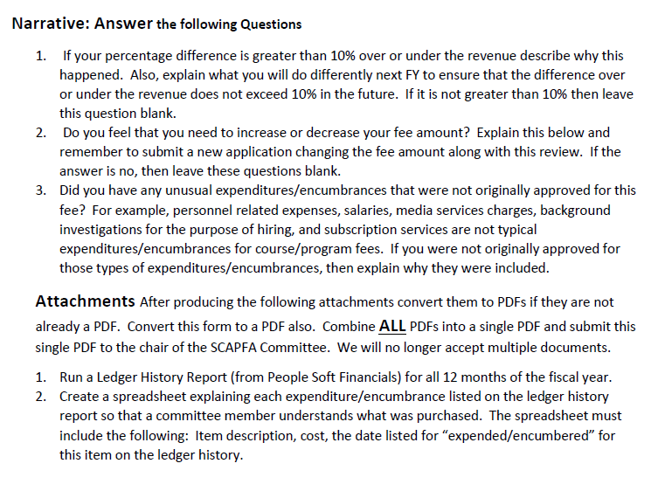
Fee Review Report Form C
Address all questions in your narrative. #2 is optional.
Make certain the attachments that you are required to have are converted to PDF and are added to your report.
Going forward we will ONLY accept a single PDF file for your reviews.

Slide 8
How to Run a Ledger History Report
Use this guide for instructions
https://clayton.edu/budget/docs/Ledger%20History%20Report%20Screenprints_PS%209.2.pdf
When running the report make sure to:
Check Detail Report and Summary Report
The Ledger is: Actuals
Run the correct FY and accounting periods should be 1 and 12.
Use your fee department code.
Accounting code should be 400000 to 999999
Fund 10600
Class %
Project %
Program 11100
See picture on next slide

Slide 9
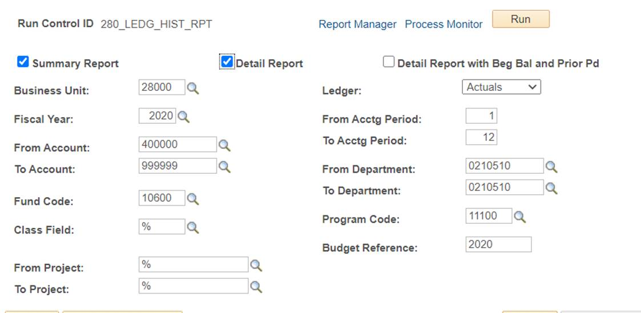

Slide 10
Ledger History Report
First look at the summary to give you an idea of revenue you had remaining or if you over spent.
Negative values represent revenue collected.
Positive values are what you spent.
At the bottom you will see a total and if it is negative then you had funds remaining from the revenue you collected. If the value is positive then you spent more than the revenue collected.

Slide 11
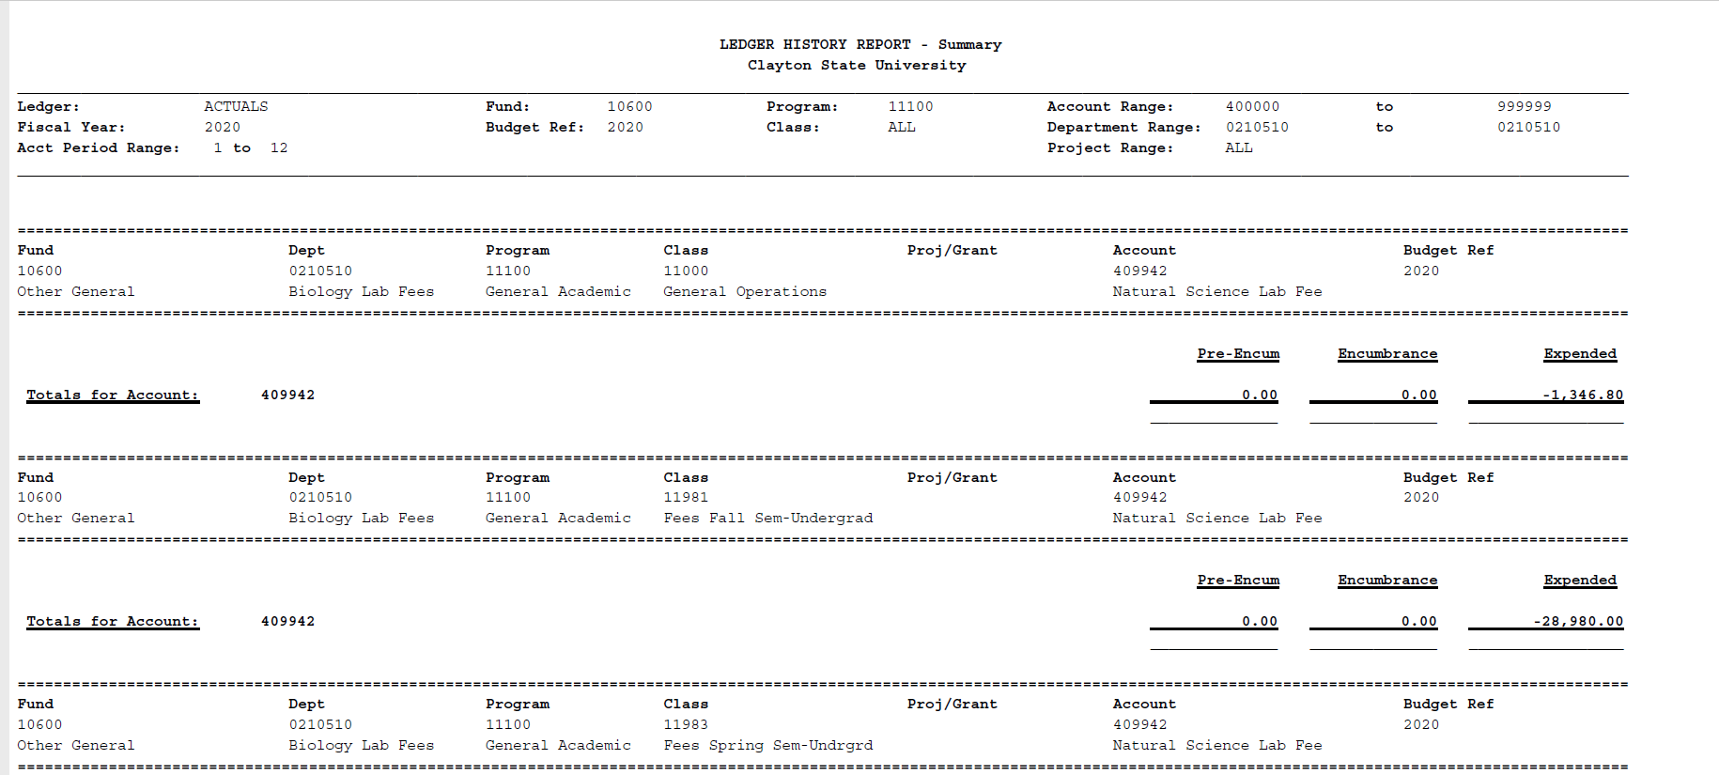
Samples-Negative=Revenue collected or remaining

Slide 12
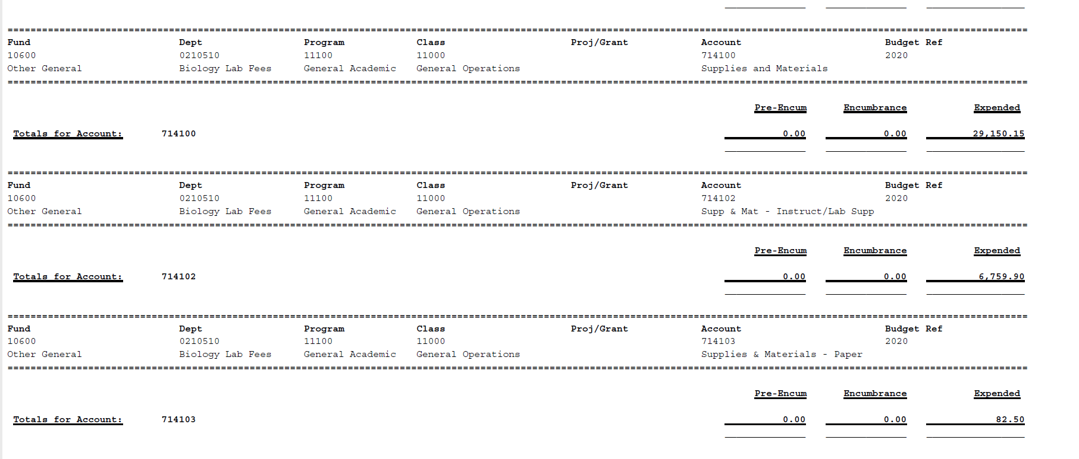
Samples-Positive =what you spent

Slide 13
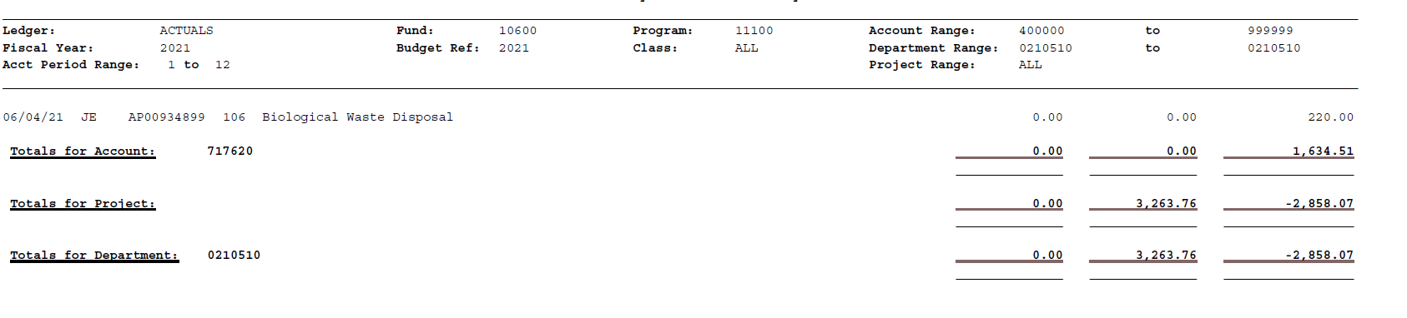
Totals
Encumbrance
Expended
$2,858.07 remaining – $3,263.76 encumbered=
-$405.69 Remaining; slightly over budget
Totals for Department
Last column shows a negative value so this means $2,858 was left remaining so far in this Department revenue account.
The middle column is encumbered so this means that $3,263 is still encumbered in this account. When you subtract the amount encumbered from the amount remaining you get -$405, which means the account was overspent by that amount.

Slide 14
Ledger History Report
Now look at detailed report.
On the detailed report you can view the Banner Journal entries which show the revenue collected daily. If you see a positive value that is a revenue reimbursement back to students.

Slide 15
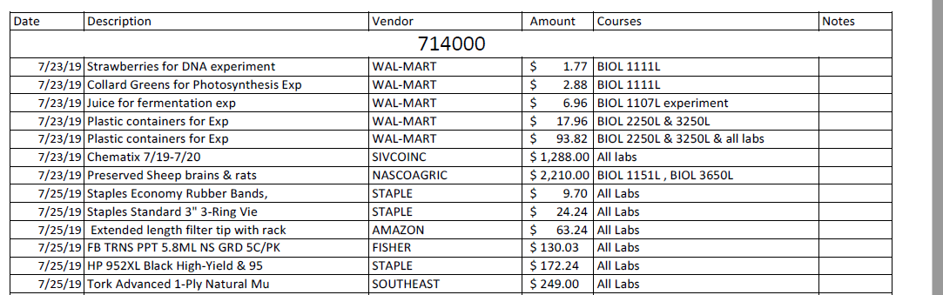
Ledger History Report
On the detailed report you can also view the expenditures like you viewed on your budget activity reports. It will show you some of the expenditure detail descriptions (Pcard, Epro, etc.) and vendors.
Use this to compare to your budget spreadsheets you should be keeping to manage your funds.

Slide 16
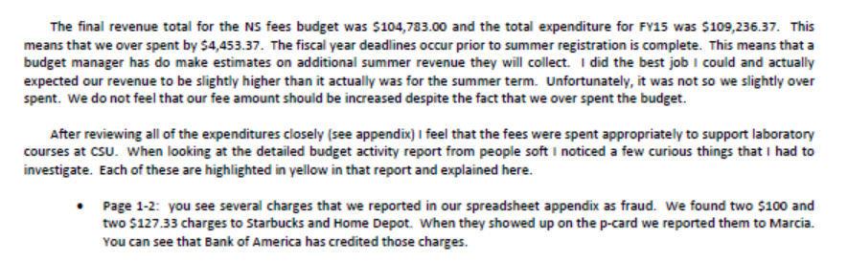
Sample of wording from a sample memo

Slide 17
What the Committee Considers
When you don’t spend your fees this is bad and the committee may suggest to reduce or eliminate the fee.
Last year we noted several fees that had greater than 40% of their fee revenue remaining. We gave a gentle warning that if it happens again then we will reduce the fee this year.
Over spending fees is not good either. It happens sometimes as you have to monitor your revenue during the spring and guestimate how much fee money you will collect from summer registration.
The amount listed on your budget activity report for your fee budget is just an estimate by budget and finance. It is frequently not accurate. It is essential that you use the Ledger History Report for spending revenue!

Slide 18
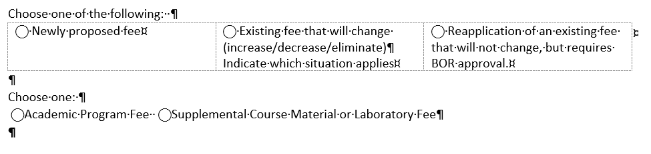
Fee Applications
When you need to do this?
You were informed if you have a fee that requires BOR approval and therefore requires you to reapply for your fee annually (highlighted in yellow on summary).
If you are proposing a new fee you also have to apply even if it doesn’t require BOR approval.
If you are changing (increase, decrease or eliminate) an existing fee.
Program versus course fee
Program fee typically charged once per year or once per semester for all students in the program (these require BOR approval annually)
Course fee is charged to students enrolled in a course (these typically only require BOR approval once).

Slide 19
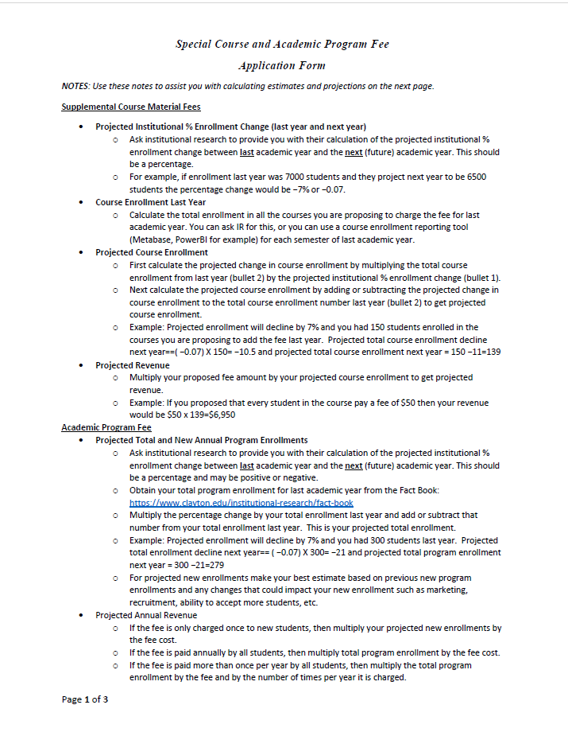
Fee Applications
Page one has instructions on how to obtain the values you need for the form. Please follow the instructions carefully.

Slide 20
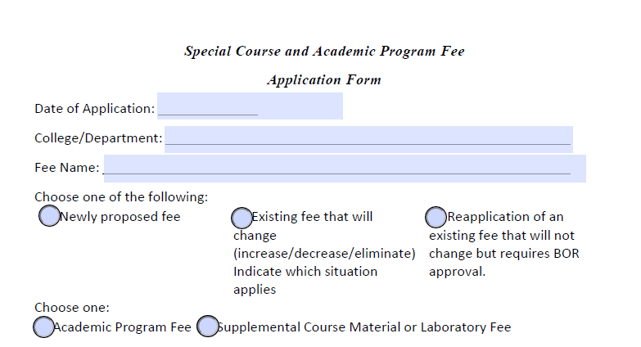
Fee Applications
When you select program fee, the form will hide the course fee area and only allow you to fill in program fee information.
When you select course fee then you will have only the course fee fields to fill in.
If you accidentally select the wrong one, close the form with out saving and reopen it and start over.

Slide 21
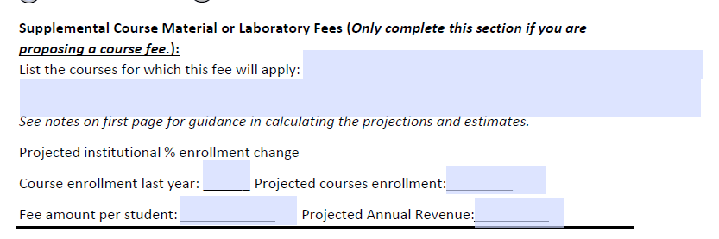
Fee Applications—course fee
Follow the instructions carefully on the first page to obtain the values that go into these fields.

Slide 22
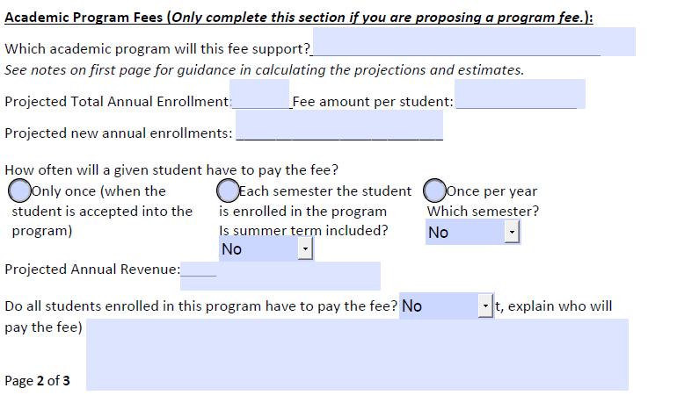
Fee Applications—Program fee
Follow the instructions carefully on the first page to obtain the values that go into these fields.

Slide 23
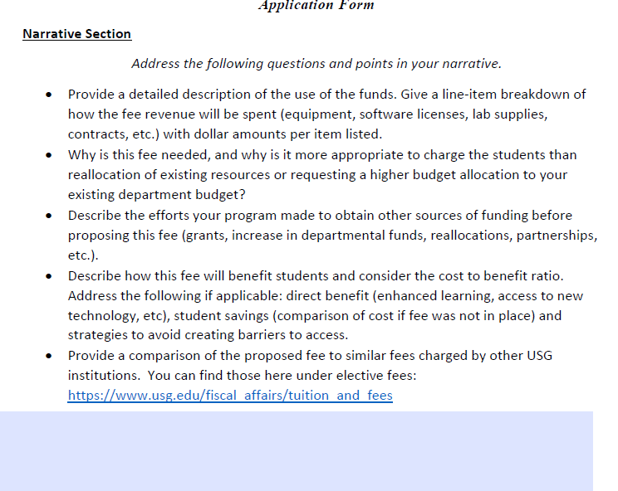
Narrative is Key
The narrative must address every bullet listed else it will not be approved.
Look at the rubric so you understand what the committee is looking for.
Charging fees to our students can create hardships for them so you really need to convince us that there is a true benefit to the student that outweighs the cost.

Slide 24
What the Committee Considers
Is there any other way we can defer these costs away from the student?
How would this fee benefit the student and is the benefit worth more than the expense?
The department tried in earnest to find another way to cover the cost by reallocating expenses or seeking other funding sources.
Is the fee too high or too low for the proposed use? Can a typical student afford the fee?
Do other programs in the USG charge similar fees to the proposed fee?

Slide 25
Questions?
Send them to Mfurlong@clayton.edu

Slide 26
Review of Dates 2025
Oct 3: Fee Reviews and Fee Applications will be submitted to the Chair (Furlong)
Oct. 6: All Reviews and Fee Applications will be placed in a shared drive and shared with the committee
Week of Oct. 6: Fee Committee will meet to review fee applications and revenue expenditures
Week of Oct. 13: Fee Committee recommendations on fees will be sent to provost and fee manager
Oct. 24: Appeals due (send to Furlong)
Week of Oct. 27: Fee Committee will review appeals (if necessary).
Nov. 7: Final Fee Committee recommendations on fee reviews and new fees will be provided to provost and fee manager

