Slide 1
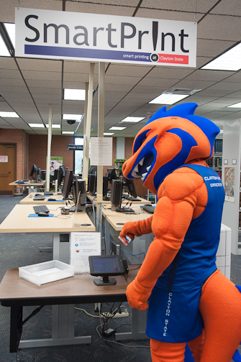
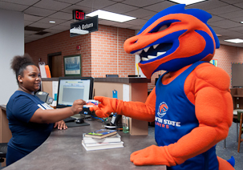
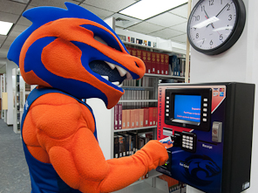
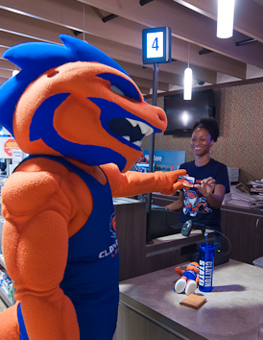

LakerCard Fee Use Update
October 2014

Slide 2
LakerCard Functions
Identification
LakerBucks (flexible spending)
Meal Plans
Dining Dollars
Library Access
Financial Aid Book Money
Copying
Printing
Vending
Laundry
Fitness Center Access
Event Access
Door Access at Clayton Station
- Attendance Tracking
LakerCard Fee Use Update

Slide 3
LakerCard Center Supports
Student Account Program (LakerBucks, Bookstore Bucks, Dining Dollars, Meal Plans)
Online and Mobile Card Services
Access Control (Clayton Station)
Point of Sale Support (Dental Hygiene, Public Safety, Health Services, SAC, Dining-6 locations)
Higher One
Laundry
SmartPrint & Copying
Vending
Faxes and mailing services
Collection of various fees
Sr. Class Gift Initiative (supports Office of Development)
GoGreen Initiatives (new employees, cell phone and battery recycling)
Tell Us! Customer Service Initiative Program
LakerCard Fee Use Update

Slide 4
Current LakerCard fee
$20 per student, per semester
LakerCard Fee Use Update

Slide 5
Use of the LakerCard Fee
- Funds operation of LakerCard program
- Software licensing
- Hardware maintenance
- Card supplies
- Staff salaries and operating expenses
Supports the expansion of card services across campus
Provides reserve funds for renewal and replacement
of system hardware
Funds the maintenance and renovation of LakerCard
Center facilities
LakerCard Fee Use Update

Slide 6
Recent Additions to LakerCard Services
LakerCard Online and LakerCard Mobile ($18,000 per year)
5% Discount on vending purchases made with LakerBucks
New SmartPrint station for Edgewater Hall
Increased HigherOne support for student Athletes
Badgeholder giveaways for incoming Freshmen at Orientation
Access control for Clayton Station
Administration for Tell Us! Surveys (USG Service Excellence Initiative)
Go Green Initiative Support
LakerCard Fee Use Update

Slide 7
Expected Additions to LakerCard Services
Online Photo Upload Tool
SmartPrint station for new Science Building
Additional POS register for Jazzman’s to decrease wait time
New replacement registers for all retail locations (end of life)
Increased attendance tracking
Potential changes Dining Services administration
LakerCard Fee Use Update

Slide 8
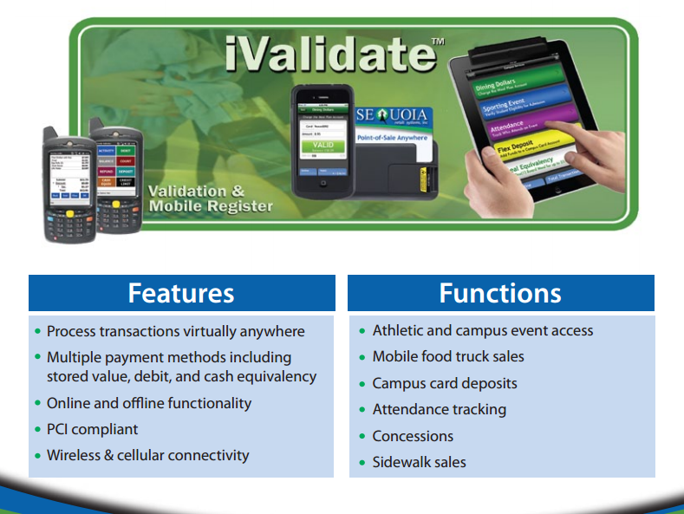
Wish List – Mobility!!
LakerCard Fee Use Update

Slide 9
Revenues for FY2014
Student Fees: $311,452 (includes waivers for dual-enrolled students)
Lost Card Fees: $5,365
Other Revenue: $14,321
Total Revenue: $331,138
Revenue Variances for FY2014
Variances in revenue compared to prior FY because:
  Total Revenue down 12.7% from FY13
  Increased number of fee waivers for all dual enrolled students
  Abandoned LakerBucks deposit sweep was much less for the 2nd year
LakerCard Fee Use Update

Slide 10
Expenses for FY2014
Personal Services (salaries and benefits)
  LakerCard Center: $193,265
Operating Expenses: $154,286
  License and Maintenance
  Supplies
  Repairs
  Utilities
  Overhead and allocations
  Employee Travel $2,606
  Equipment $0
  Total Operating Expenses $350,157
LakerCard Fee Use Update

Slide 11
Expense Variances for FY2014
Variances in expenses compared to prior FY because:
  Personal services higher because of organizational restructuring
  Software license fee increased 24%
  LakerCard Center office renovation costs
LakerCard Fee Use Update

Slide 12
Anticipated reserve balance at the end of FY2014
Total Revenue: $331,138
  Total Operating Expenses $350,157
  Net income before adjustments ($19,019)
  Prior year fund balance $49,270
  Total reserve balance $30,251
LakerCard Fee Use Update

Slide 13
Anticipated budget changes for FY2015
Increased software licensing (annual increase)
Proposed chargeback model (FY15 or FY16)
LakerCard Fee Use Update

