Slide 1
Fee Usage & Accountability Presentation
Department of Athletics

Slide 2
Agenda
Purpose of fee
Department functions (if appropriate)
Services funded by fee
Current fee
Details of how fee is used
Financials
    Budget, fee history, and trends for up to 3 years max
    Reserve balance at start of current fiscal year
    Purpose and anticipated usage of reserve balance
    Anticipated budget changes for upcoming fiscal year

Slide 3
Purpose of Fee

Slide 4
Athletics Functions
    The Department of Athletics serves as an outreach, auxiliary unit of Clayton State University. The department supports 137 students, has 14 full-time, 8 part-time, and 6 volunteer employees. Athletics is a member of the Peach Belt Conference and sponsors the following 12 sports:
      Men’s & Women’s Cross Country
      Men’s & Women’s Basketball
      Men’s & Women’s Indoor Track & Field
      Men’s & Women’s Outdoor Track & Field
      Men’s & Women’s Soccer
      Men’s Golf
      Women’s Tennis

Slide 5
Services Funded by Fee
Scholarships
Personnel Services
Non-Personnel Services

Slide 6
Current Athletics Fee
$160 per full-time student, per semester
$80 per part-time student, per semester

Slide 7
Use of Athletics Fee
The Athletics fee funds 95% of the operating budget for the Department.
  Student-Athlete Scholarships
  Travel Expenses
  Uniforms
  Equipment
  Officials
  Salaries & Benefits
  Recruiting
  Medical Insurance

Slide 8
Financials

Slide 9
Budget and Fee History
FY13:
Fall 2012 $1,056,433.60
Spring 2013 $1,032,333.60
Summer 2013 $528,899.92
Total $2,617,667.12

Slide 10
Budget and Fee History
FY14:
 | On-Campus
 | 3 crhrs or < | 4+ crhrs
Summer 2013 50% | 300 | 1412
Fall 2013 | 249 | 6468
Spring 2014 | 250 | 6350
Summer 2014 50% | 295 | 1161
Totals | 1094 | 15391
Athletics Fee | 80.00 | 160.00
 | $87,520 | $2,462,560 | $2,550,080

Slide 11
Budget and Fee History
FY ‘15
 | On-Campus
 | 3 crhrs or < | 4+ crhrs
Summer 2014 50% | 296 | 1161
Fall 2014 | 262 | 6107
Spring 2015 | 250 | 6400
Summer 2015 50% | 285 | 1152
Total Enrollment | 1093 | 14820
Athletics Fee | 80.00 | 160.00
Total SF Revenue | $87,440 | $2,371,200 | $2,458,640

Slide 12
Reserve Balance at the Start of FY 15
FY ‘15 Reserve Balance
  ($175,746.26)

Slide 13
Plan to Erase Deficit
Manage non-personnel line items more efficiently
Examine current organizational structure
Increase current revenue streams
Explore new revenue streams

Slide 14
Anticipated Budget Changes for FY ‘16
Increased scholarships for female student-athletes
Increased operational budgets for female programs
Facilities renovations
  Athletic Training Room
  Locker Rooms

Slide 15
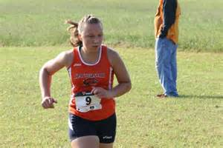
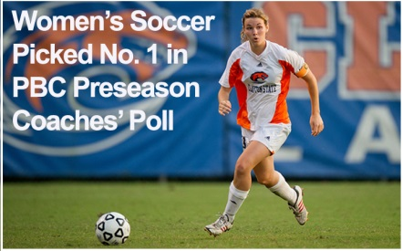
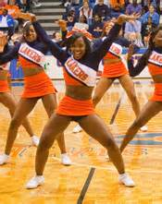
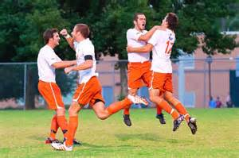

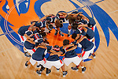
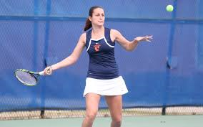
Thank You!

