Slide 1

Faculty Office
Workshop
Summary Report
Clayton State University
April 11, 2019
Notes:
Welcome and introductions
Note: This presentation is about education trends and research, not SES as an organization. Consider using the SES one-page overview as a handout to accompany this presentation.

Slide 2
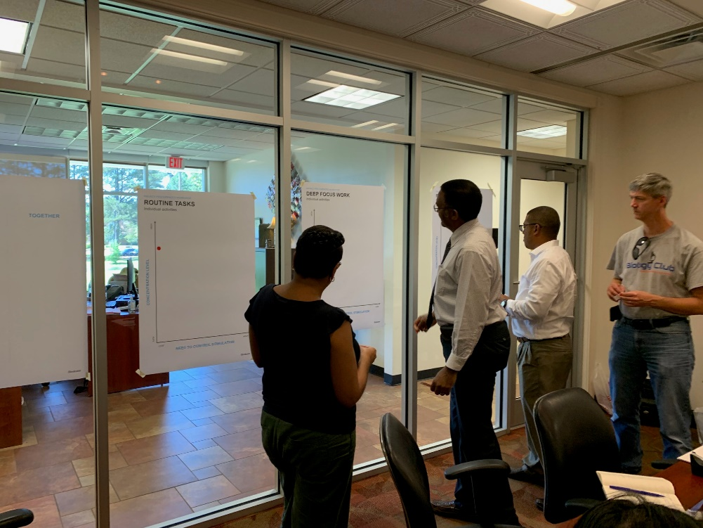
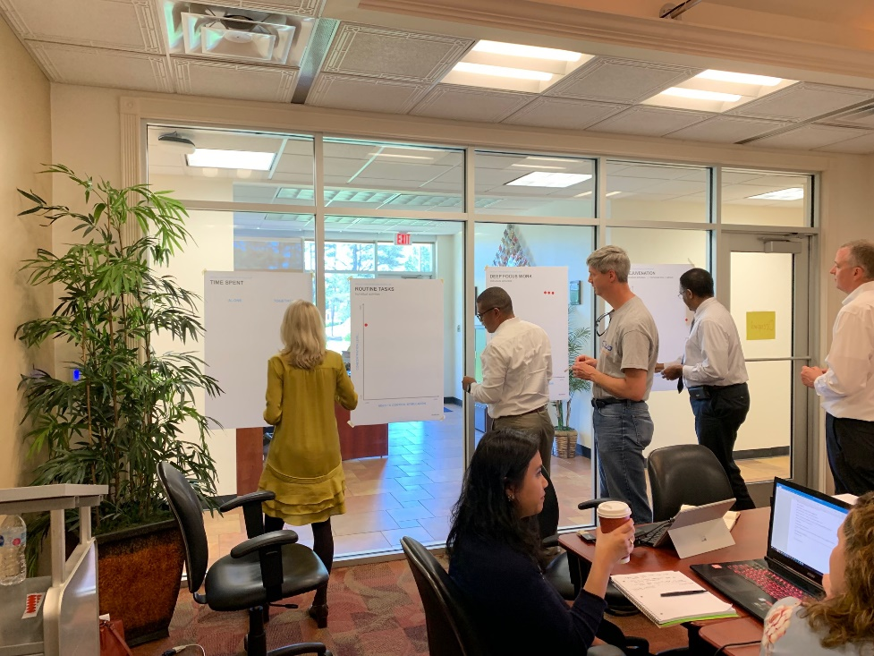
Workshop Overview:
*Brief share of research on the key trends and issues colleges and universities face today: Introduce the idea of “hop, skip, jump” regarding Private Office deskgn
*Group activity and share around where work is being done today: Discuss what opportunities and challenges that CSU has with these key elements today
*trending Design Application review

Slide 3
discovery exercise discussion summary
In a Discovery Exercise discussion, we explored a broad range of issues focusing on where work gets done. Our goal was to prioritize and align on the top issues that impact your institution. We discussed the physical space implications of each and opportunities to explicitly support students and instructors within your institution.
Within this document, we have summarized the issues that were identified as the highest priorities. Let’s review the discussion and understand potential next steps.
contents include
Intent
Issues and priorities
Space implications and next steps
Discovery Exercise | Education

Slide 4
issues and priorities

Slide 5
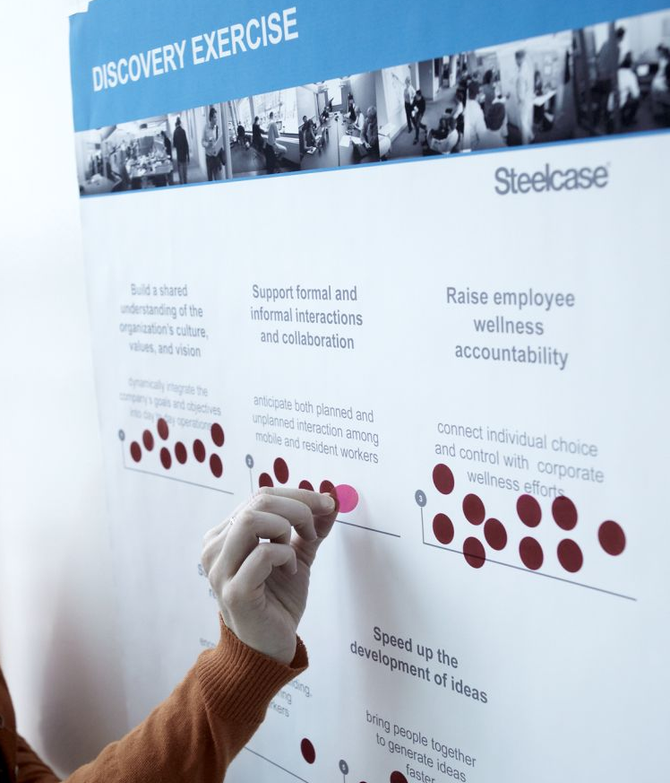
discovery exercise
intent
prioritizing faculty office issues
Our discussion included:
Identification of key issues and priorities that may be impacting your institution
Determination of the multiple places and spaces faculty both work and meet with students.
A dialogue regarding statements for the
collective group
A group discussion helped us understand the results and discover key insights for your institution.
Photo of a Discovery Exercise poster
Discovery Exercise | Education

Slide 6
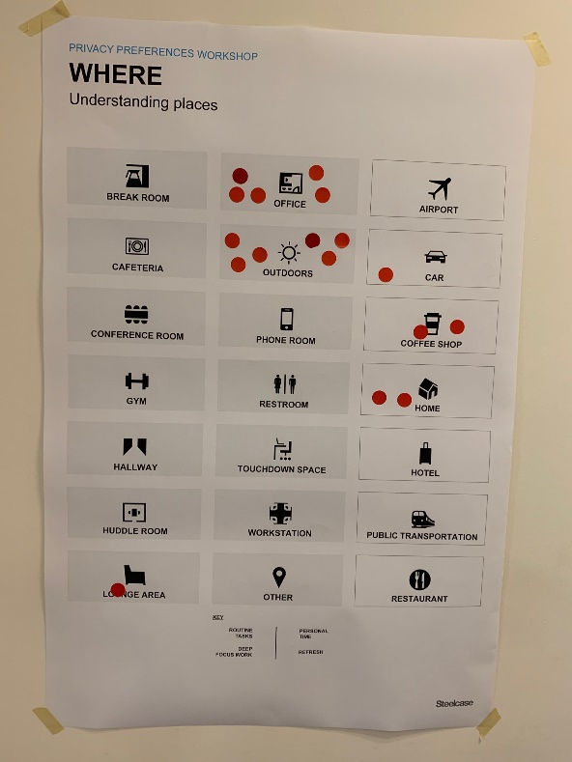
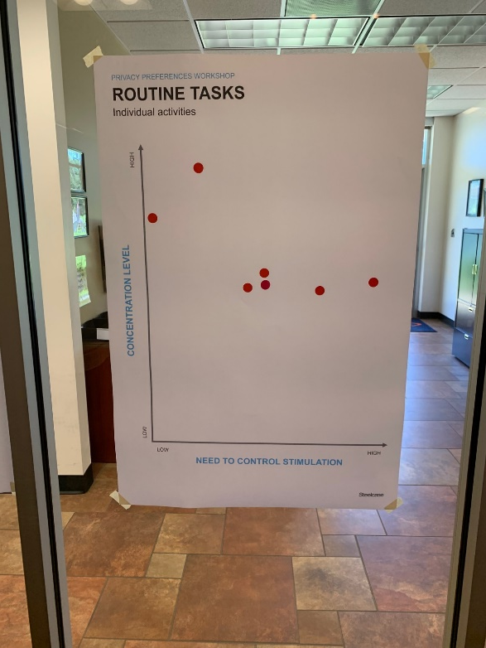
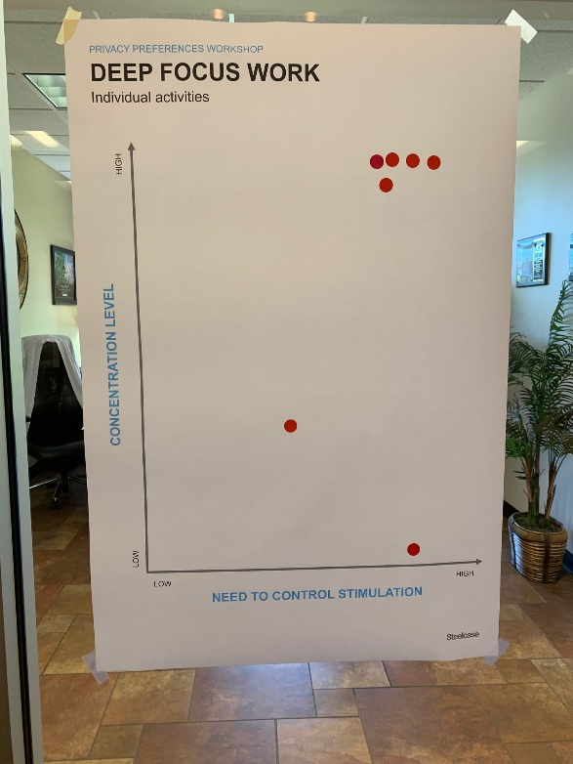
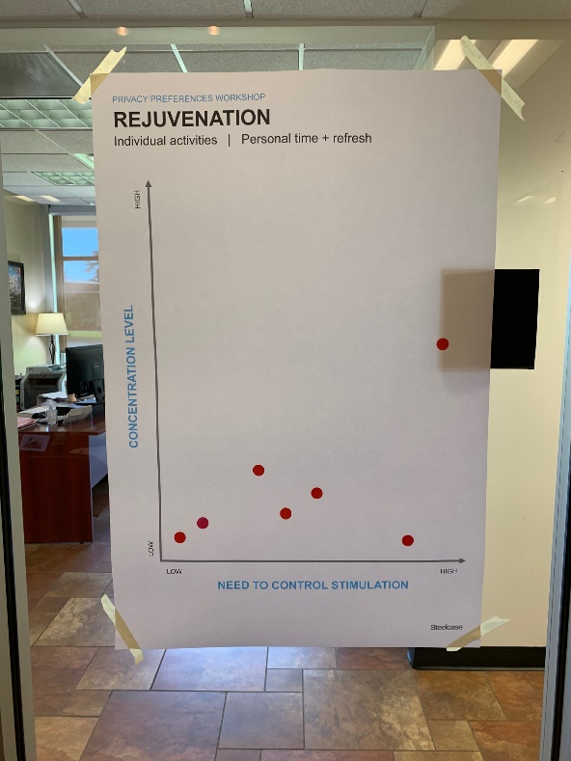
WHERE AND HOW DIFFERENT
TYPES OF WORK ARE DONE

Slide 7
discovery exercise discussion
where
The places faculty are doing their non- classroom work:
1. Lounge Areas: No dedicated faculty spot. Currently utilizing the dining area, bookstore, various areas with lounge type furniture
2. Outdoors: Rejuvenation type activities, walking to clear head
2. The Office: Office used primarily when there is a need to control stimulus
2. Car: Great down time to gather thoughts and priorities
5. Coffee Shop: Enables some work anonymity while also making them available
6. Home: It was noted that when doing shadow work at home, they use a relaxed posture (sofa) but if getting into serious work they will likely move to a table or desk
.
Discovery Exercise | Education

Slide 8
discovery exercise discussion
issues and priorities
Significant comments from discussion:
1. Sterile, empty spaces are not good for students or faculty
2. Importance of being able to close an office door for privacy when a student is upset etc.
2. Faculty need their privacy throughout the day – isolation is valuable for heads down work
2. Digital office hours are hit or miss – software not effective outside of office
5. Popup lectures are a possible opportunity in some of the space ideas we shared
6. Collaboration can be random but varies by department
7. The variety of spaces was a positive
.
Discovery Exercise | Education

Slide 9
space impacts behavior…
Notes:
As a student, as a teacher, as a superintendent, as a college president, leverage space as a tool to improve learning and student success…

Slide 10
…and new behaviors are needed to support better learning
Notes:
As a student, as a teacher, as a superintendent, as a college president, leverage space as a tool to improve learning and student success…

Slide 11
how might you leverage your faculty spaces as a strategic tool to improve student success?
Notes:
As a student, as a teacher, as a superintendent, as a college president, leverage space as a tool to improve learning and student success…

Slide 12

5/31/2019 Steelcase Inc.
©

