Slide 1
June 2024| Morrow, GA
Bridging the Divide: Opportunity Gaps Impacting Students of Color
Wil Del Pilar, Senior Vice President
© Copyright 2018 The Education Trust @EdTrust /edtrust edtrust www.edtrust.org
Notes:
Add "FY" to 2021 and/or July 1, 2020 to June 30, 2021 so everyone clear

Slide 2
Session Overview
Why This Work is Important to Me
Current Context & Education
Grounding in the Data
Discussion

Slide 3
Over the next five years, we will:
Build a national narrative that focuses on the aspirations and excellence of all students, but especially students of color.
Work to influence federal policy to better support students of color and students from low-income backgrounds.
Expand our influence at the state level to have the greatest impact on students of color and students from low-income backgrounds.
Re-emphasize our focus on improving the practices that influence student opportunities.

Slide 4


Slide 5
Current Context & Education

Slide 6
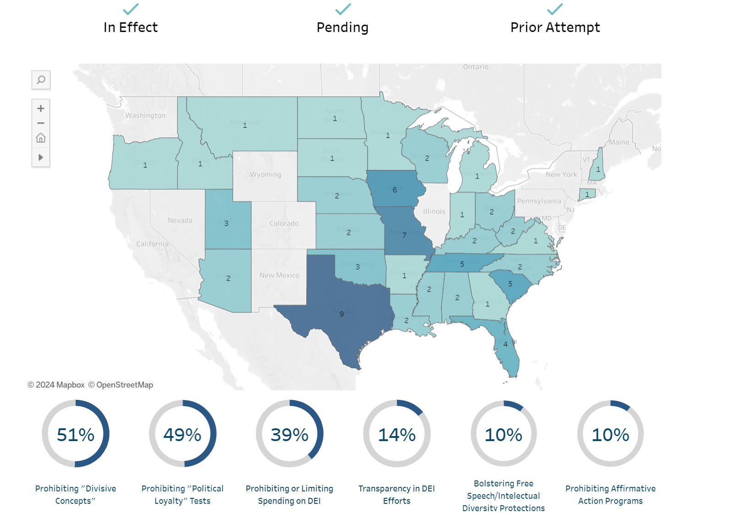
Ed Trust Anti-Dei Tracker

Slide 7
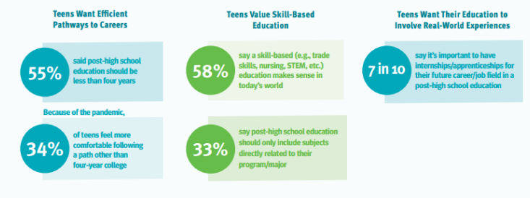
What Does This Generation Want?

Slide 8
Post-High School Plans

Slide 9
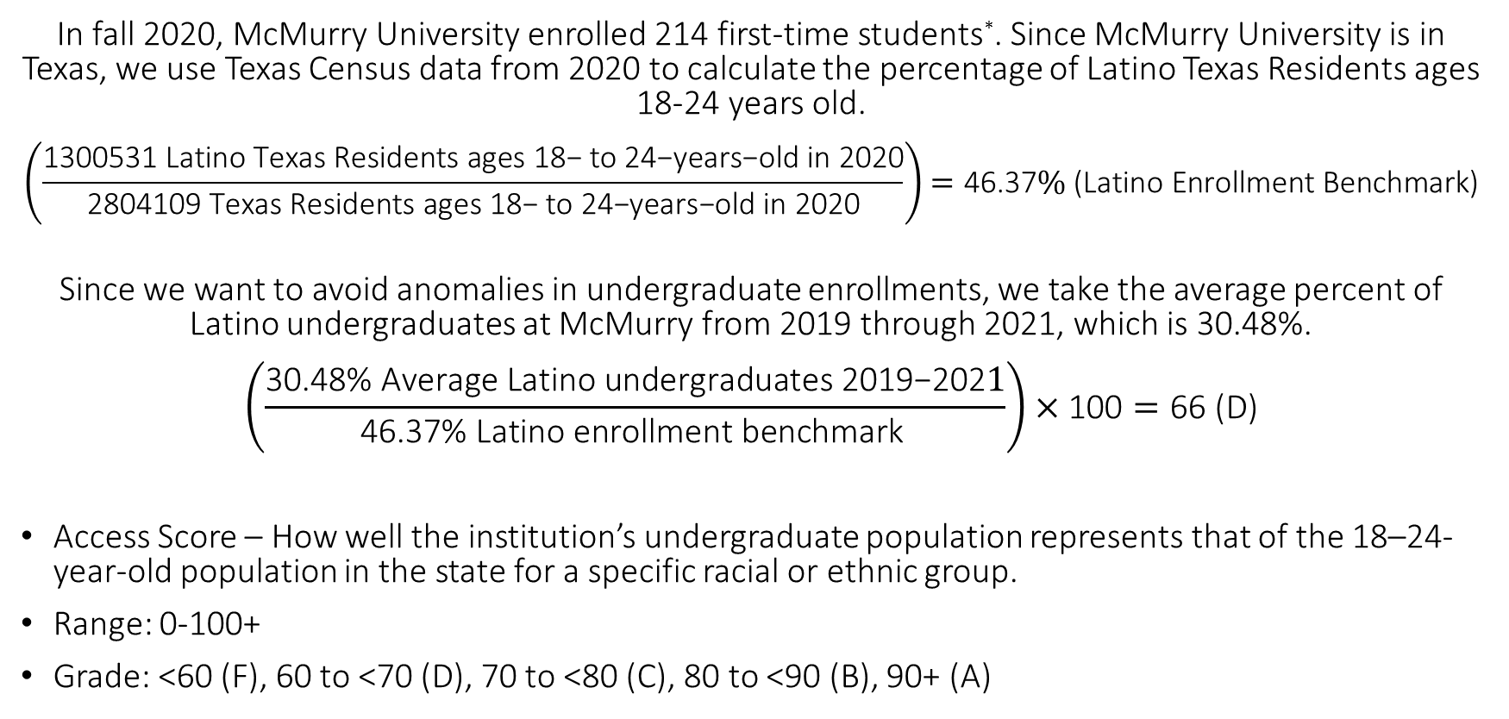
McMurry University 2020 SR Latino Access Score
In fall 2020, McMurry University enrolled 214 first-time students*. Since McMurry University is in Texas, we use Texas Census data from 2020 to calculate the percentage of Latino Texas Residents ages 18-24 years old.
$$\left(\frac{\text{1300531 }\text{Latino} \text{Texas} \text{Residents} \text{ages} \text{18− }\text{to}\text{ 24−}\text{years}\text{−}\text{old} \text{in}\text{ 2020}}{\text{2804109 }\text{Texas} \text{Residents} \text{ages}\text{ 18− }\text{to}\text{ 24−}\text{years}\text{−}\text{old} \text{in}\text{ 2020}}\right)=\text{46.37}\% \text{(}\text{Latino} \text{Enrollment} \text{Benchmark}\text{)}$$
Since we want to avoid anomalies in undergraduate enrollments, we take the average percent of Latino undergraduates at McMurry from 2019 through 2021, which is 30.48%.
$$\left(\frac{\text{30.48\% }\text{Average} \text{Latino} \text{undergraduates}\text{ 2019−202}1}{\text{46.37\%} \text{Latino} \text{enrollment} \text{benchmark} }\right)×\text{100}=\text{66 (}\text{D}\text{)}$$
Access Score – How well the institution’s undergraduate population represents that of the 18–24-year-old population in the state for a specific racial or ethnic group.
Range: 0-100+
Grade: <60 (F), 60 to <70 (D), 70 to <80 (C), 80 to <90 (B), 90+ (A)

Slide 10
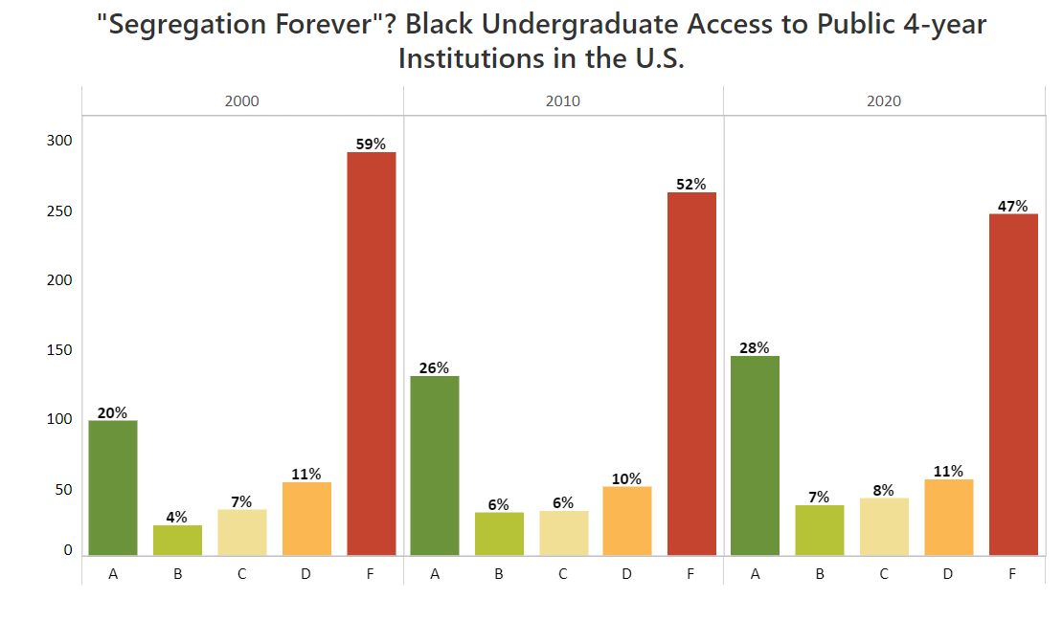
Access Nationally for Black Students
The average change in enrollment of Black students nationally is 1.22%
338 Institutions Increased enrollment
Enrollment of Black students decreased at 157 institutions

Slide 11
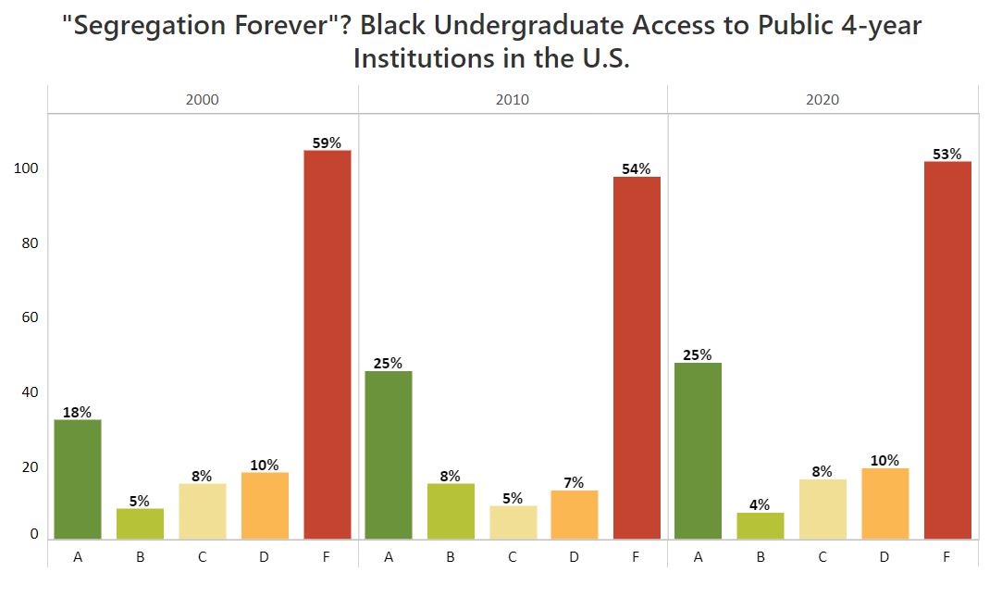
Access in the South for Black Students
The average change in enrollment of Black students in the South is 1.65%
113 Institutions Increased enrollment
Enrollment of Black students decreased at 65 institutions

Slide 12
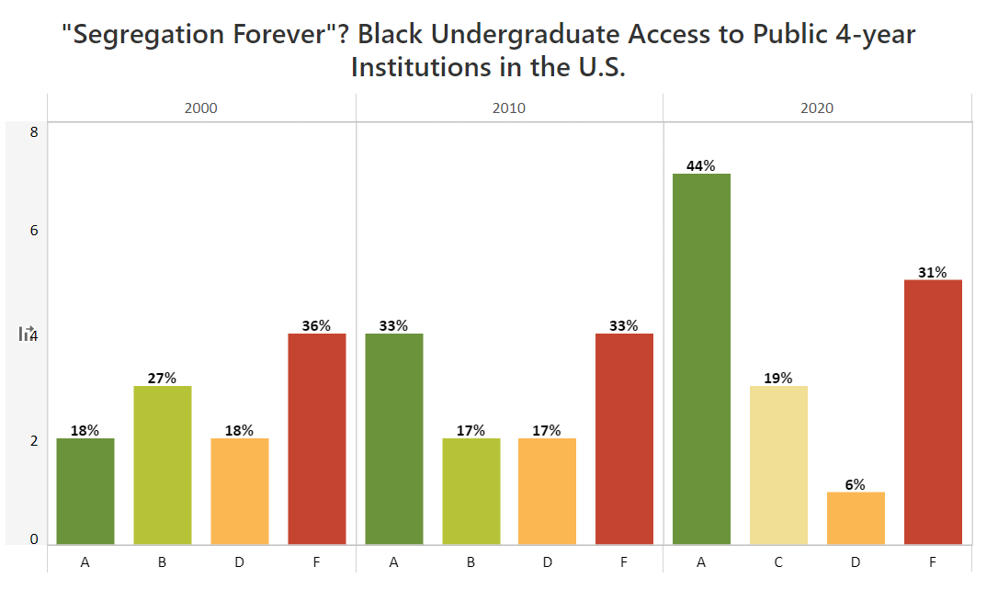
Access in Georgia for Black Students
The average change in enrollment of Black students in the South is 6.04%
7 Institutions Increased enrollment
Enrollment of Black students decreased at 4 institutions

Slide 13
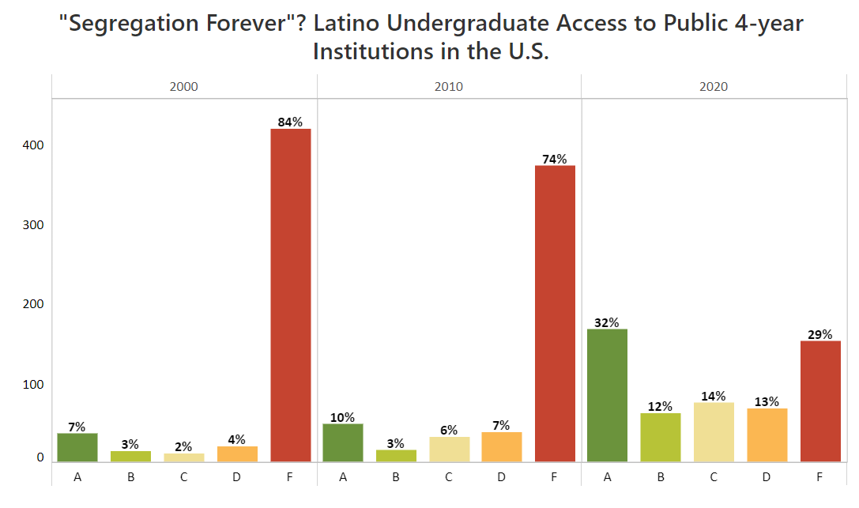
Access Nationally for Latino Students
The average change in enrollment of Latino students nationally is 8.41%
491 Institutions Increased enrollment
Enrollment of Latino students decreased at 4 institutions

Slide 14
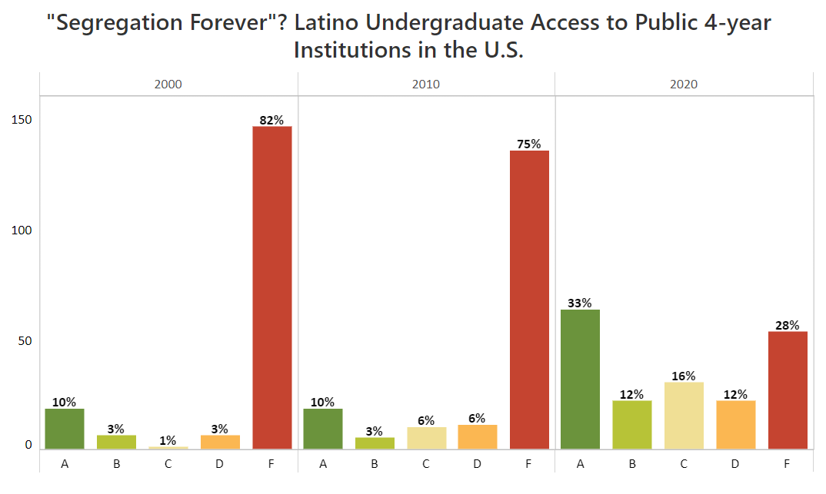
Access in the South for Latino Students
The average change in enrollment of Latino students in the South is 7.84%
175 Institutions Increased enrollment
Enrollment of Latino students decreased at 2 institutions

Slide 15
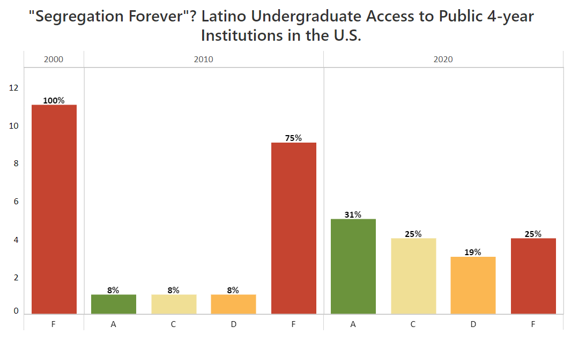
Access in Georgia for Latino Students
The average change in enrollment of Latino students in Georgia is 8.40%
Every public Institution in Georgia Increased enrollment
No institutions decreased enrollments of Latino students.

Slide 16
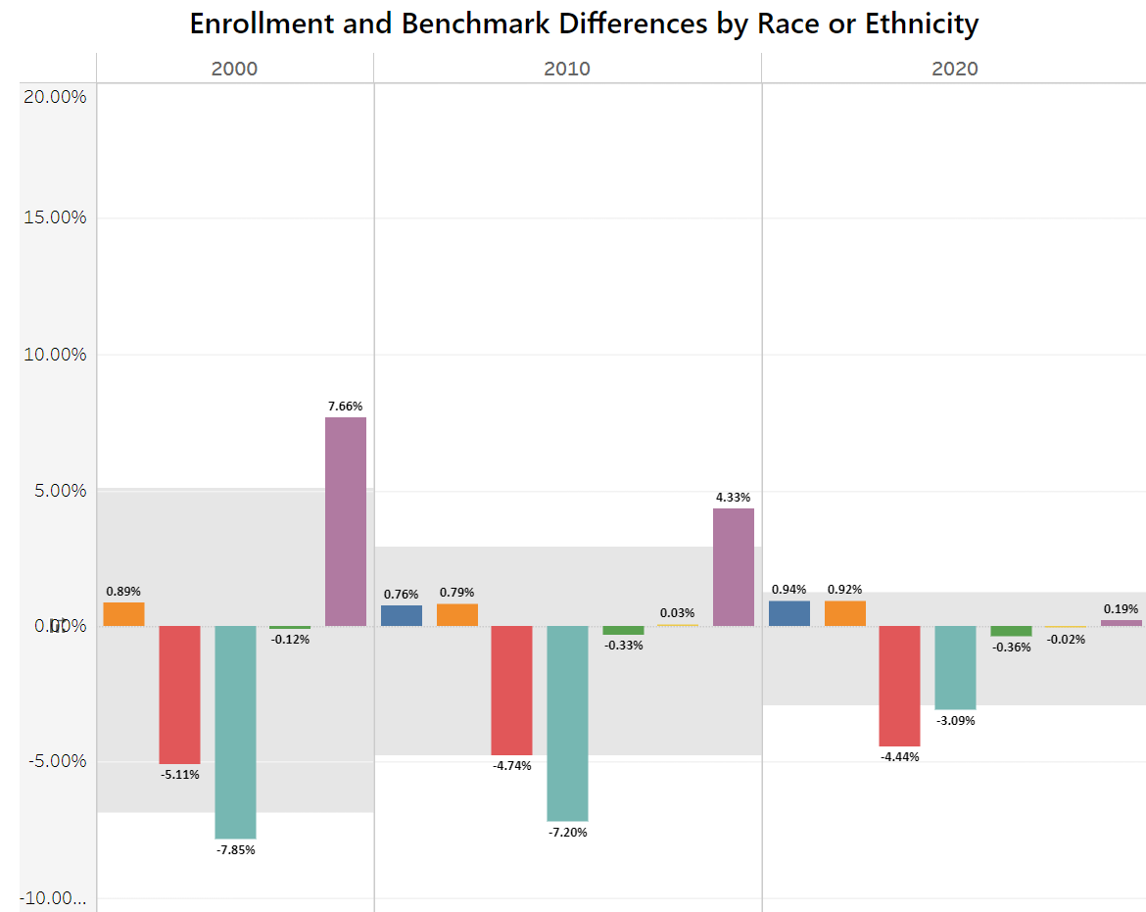
National Enrollment Trends
White students enrollment is close to the benchmark
Black student access has decreases minimally in the last 20 years
Latino student enrollment has made significant progress

Slide 17
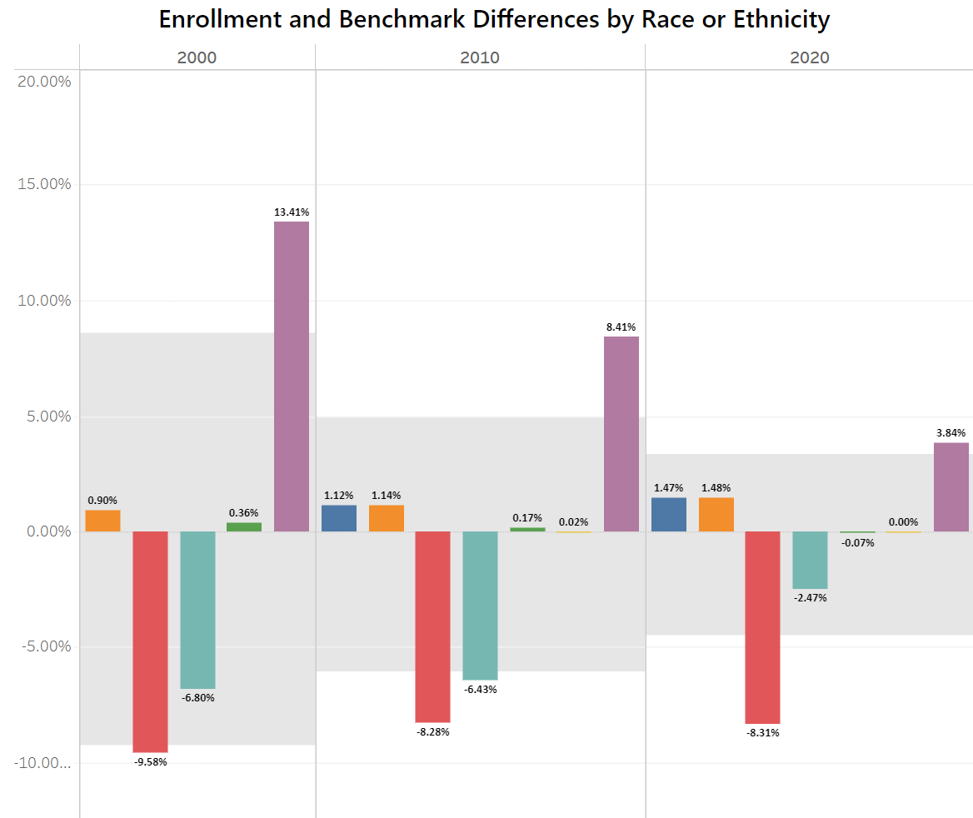
Enrollment Trends in the South
White students are overenrolled in the South compared to their percent in the population
Black student access has barely moved and needs to make significant improvements
Latino student enrollment has made progress but is still below the benchmark

Slide 18
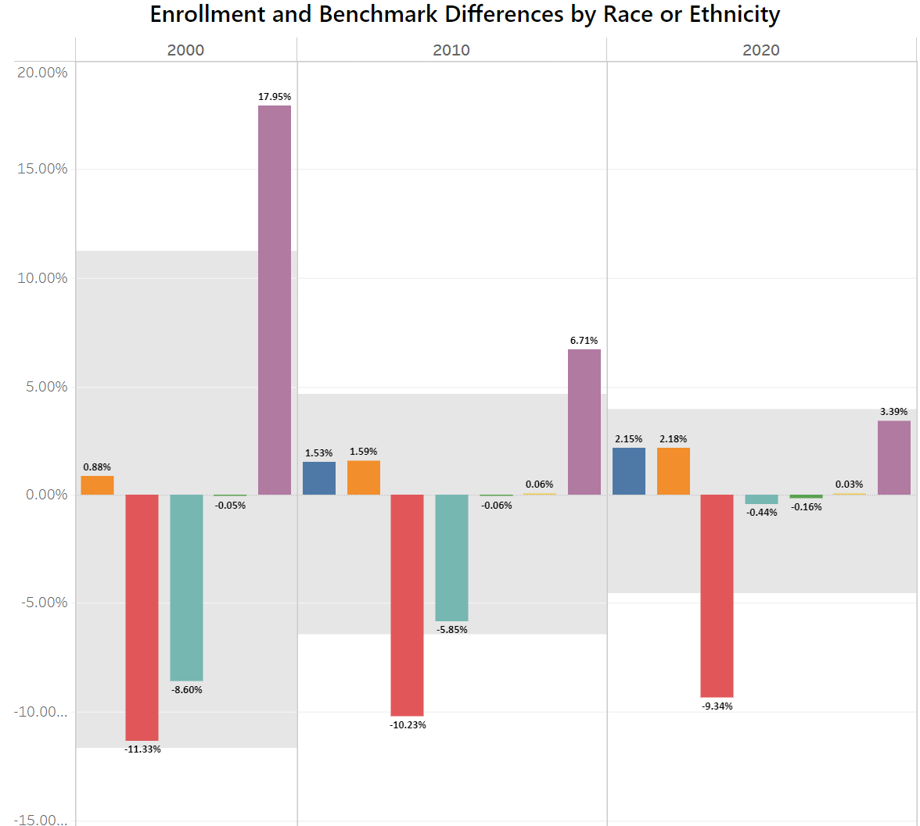
Enrollment Trends in Georgia
White students are overenrolled in the Georgia compared to their percent in the population
Black student access has barely moved and needs to make significant improvements
Latino student enrollment is nearly at the benchmark

Slide 19
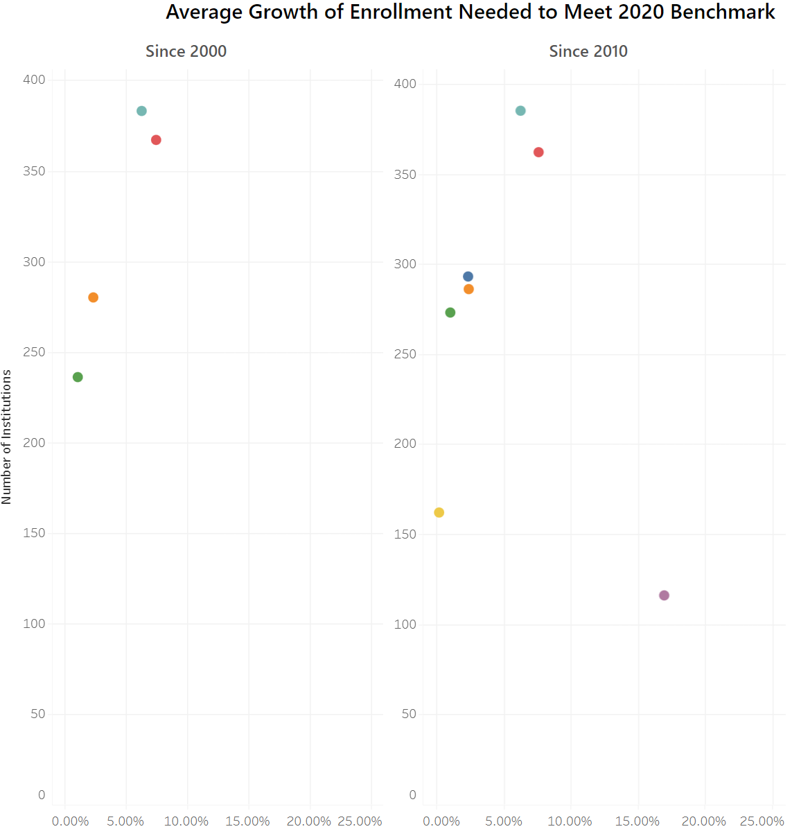
Growth Needed to Reach Benchmark Nationally
On average enrollment of Black students at 362 institutions would need to improve by 7.61%
On average enrollment of Latino students at 385 institutions would need to improve by 6.27%

Slide 20
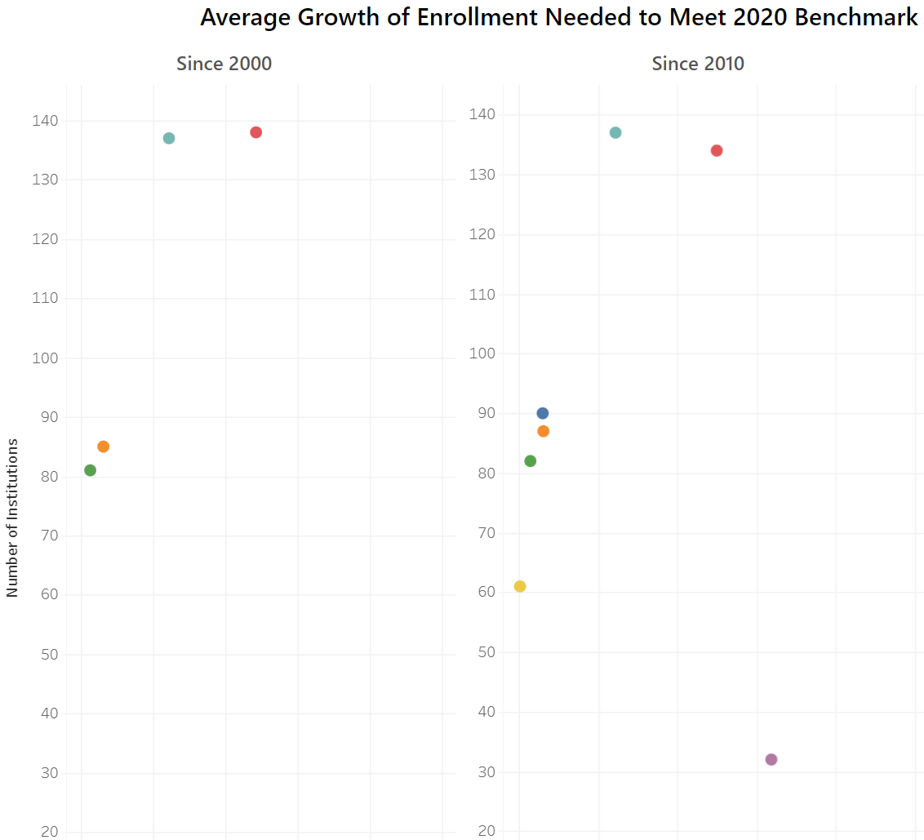
Growth Needed to Reach Benchmark in the South
On average enrollment of Black students at 134 institutions would need to improve by 12.49%
On average enrollment of Latino students at 137 institutions would need to improve by 6.31%

Slide 21
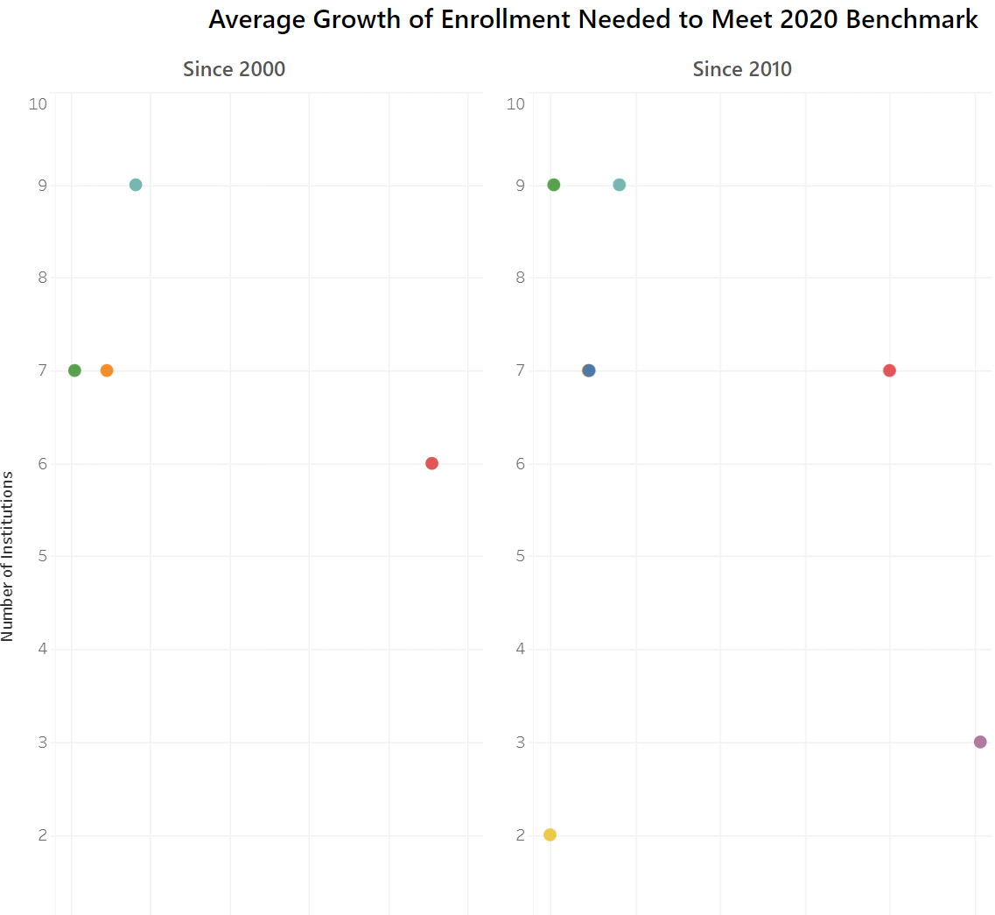
Growth Needed to Reach Benchmark in Georgia
On average enrollment of Black students at 7 institutions would need to improve by nearly 20%
On average enrollment of Latino students at 9 institutions would need to improve by 4.09%

Slide 22
Discussion
What needs to change at the institutional level to address these disparities in enrollment?
What can be done at the state level to address these disparities?
Is there a federal response?

Slide 23
Questions?

