Slide 2
STRATEGIC PLAN
TRANSFORMING TODAY FOR TOMORROW
Dr. Georj Lewis
President

Slide 3
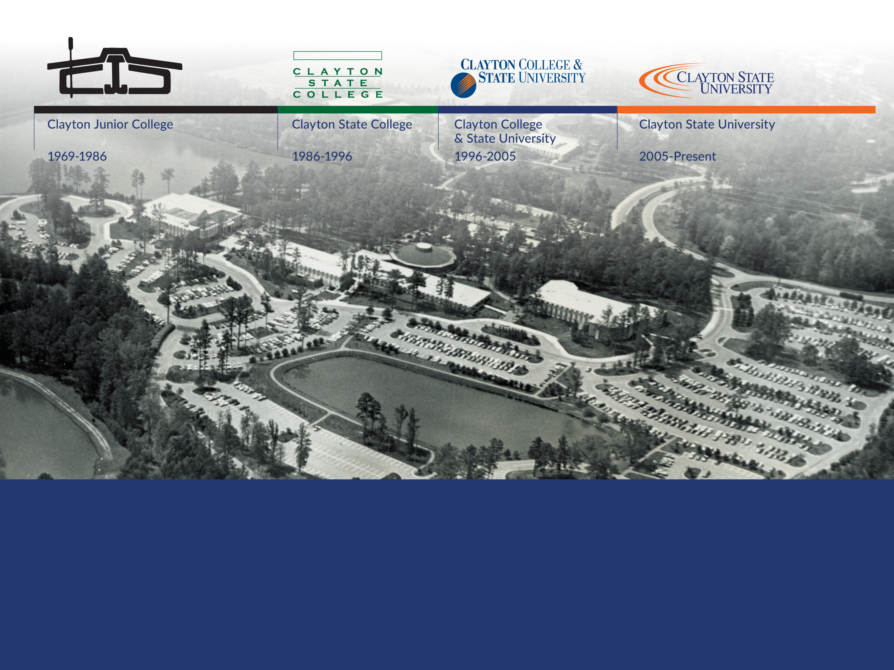
HISTORY
In the institution’s 54-year history, it has grown from a junior college offering
associate degrees with fewer than 1000 students, to a university of nearly 6000
students ranging from dual enrollment to graduate students.
Notes:
During our 54 Year History, we have grown from a associate degree granting Jr. College... that served as a "feeder" for other instutitions ...to now we are a destination institution for many.
September 1969: Clayton Junior College opens as a two-year college offering associate’s degrees, with an inaugural class of 942 students.
February 1986: Board of Regents authorizes the college to become a four-year university, offering both associate’s and bachelor’s degrees, effective July 1, 1986.
Note- 26-Institutions (Research, Comprehensives, State Universities, and State Colleges)
November 1990: The college enters intercollegiate athletic competition with the men’s basketball program.
January 23, 1991: Spivey Hall holds its first concert with violinist Itzhak Perlman
November 1996: Board of Regents authorizes change to university status and approves the name Clayton College & State University. Growth in Associates, Bachelors, and Master Degrees
May 2005: Clayton College & State University becomes Clayton State University
Today we are... a 214 Acre Campus located a few short miles south of Atlanta Hartsfield-Jackson International Airport in Morrow, GA (Southern Crescent)
Park like Setting w/7-lakes

Slide 4
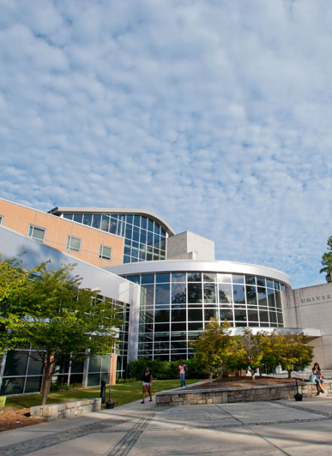
QUICK FACTS
Accredited by the Southern Association of Colleges and Schools Commission on Colleges (SACSCOC)​
214 Acre Campus located a few short miles south of Atlanta Hartsfield-Jackson International Airport in Morrow, GA (Southern Crescent)​
Park like Setting w/7-lakes​
Faculty/Staff Count - ~600​
Minority Serving Institution, Predominantly Black Institution (PBI), with a Large Non-Traditional Student Body​
Average Student Age is 26​
Student Adjusted Family Income of $29,020 (2021-22 Financial Aid Year)​
University Housing – 1,248 Beds (Suite and Apartment Style)​
Division II Athletics (Peach Belt Conference)​
Ranked #38 in Top Performers on Social Mobility by U.S. News & World Report in 2023
Notes:
Minority Serving Institution with a Large Non-Traditional Student Body
Average Student Age is 26
Student Adjusted Family Income of $29,020 (2021-22 Financial Aid Year)
University Housing – 1,248 Beds (Suite and Apartment Style)
Division II Athletics (Peach Belt Conference)
Ranked #38 in Top Performers on Social Mobility by U.S. News & World Report in 2023
his slide would like a picture or something.

Slide 5
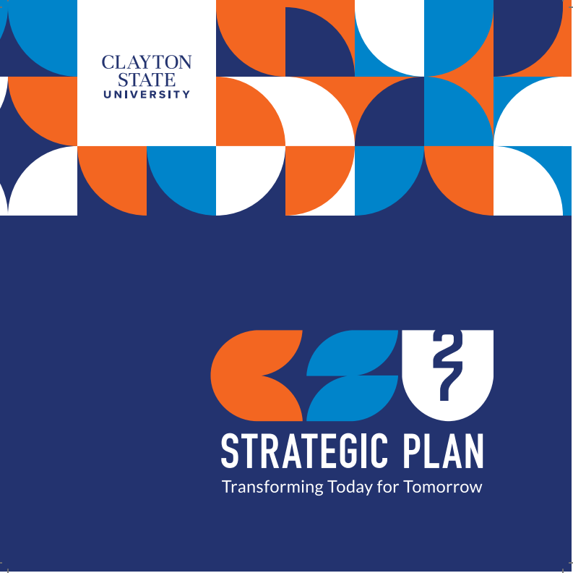
Notes:
The remaining slides will be focused on our Strategic Plan... Titled "Transforming Today for Tomorrow"

Slide 6
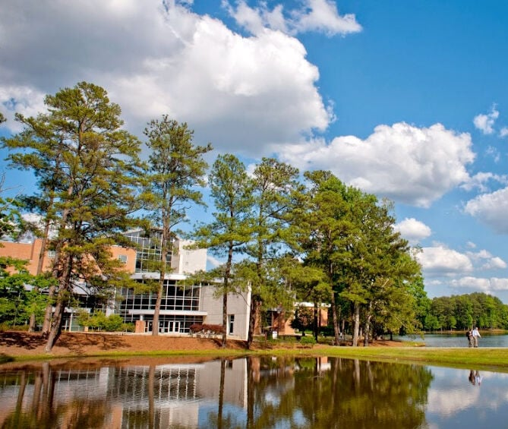
THE PROCESS
Notes:
The next 2 slides I will briefly acknowledge the process and who was involved

Slide 7
STRATEGIC PLANNING TIMELINE
1. Build a Shared Understanding
2. Prioritize Strategic Options
3. Draft Strategic Plan
4. Finalize Plan and Prepare for Execution
0. Pre-Planning
Clayton State University is engaged in a five-phased strategic planning process.
Jun. 2023
Jun. – Oct. 2023
Oct. – Nov. 2023
Nov. 2023 – Jan. 2024
Feb. – Mar. 2024
Key Activities | Align on desired outcomes Surface key themes to be addressed Charge Steering Committee of faculty and staff | Strengthen our current state understanding Conduct market scan and benchmarking Engage community members through focus groups and survey | Develop strategic options and prioritization framework Prioritize strategic options | Synthesize inputs to create a strategic plan outline Draft the strategic plan Socialize and refine the draft strategic plan | Finalize the strategic plan Develop implementation resources
Notes:
Our timeline included 10 months of rigorous work ….there was 5 phases of the process.
Pre-planning Phase- Development of a Steering Committee
Phase of Building a shared understanding- We needed to understand who we were and who the community perceived us to be.
There was a prioritization phase where we looked at options moving forward
We had to draft the plan
And ….finally it was the finalization and execution of the plan

Slide 8
COMMUNITY ENGAGEMENT UPDATE
Steering Committee Focus Groups June 2023
22 Steering Committee Members Sessions discussed the strengths, challenges, and opportunities present at Clayton State.
Board of Trustees Focus Group October 2023
20 Trustees Conversation to gather information on important areas of focus, perception, and actions to strengthen community and corporate partner ties.
Faculty & Staff Workshops September 2023
45 Faculty and Staff Workshops provided space for the discussion of institutional strengths and differentiators, opportunities for growth, and external threats and internal barriers present.
External Stakeholder Interviews Sept.-Oct. 2023
~10 External Stakeholders engaged by President Lewis and the Huron team Targeted discussions about the current perception of Clayton State within the community and opportunities for growth.
External Survey October 2023
85 Alumni and External Community Member Responses Survey to gather information on perception of the mission and values, as well as opportunities for the future.
Student Focus Groups September 2023
65+ Students, including students from PARA 1101, CSU 1000, and student org. leaders Sessions presented the opportunity for students to describe the current state of Clayton State and hopes for its future.
Alumni Focus Group September 2023
8 Alumni Conversation identified strengths, opportunities, and challenges and/or threats perceived by alumni of Clayton State.
Internal Survey October 2023
116 Students, Faculty, Staff, & Administrator Responses Targeted survey to gather information on perception of the mission and values, as well as opportunities for the future.
Notes:
Through out this process we involved several constituent groups-
Steering Committee Focus Groups
Faculty Staff Workshops
Student Focus Groups
Alumni Focus Groups
External Stakeholders (Business and Industry Executives, School District Superintendants, USG BOR, Alumni, and our current Foudation Board members)

Slide 9
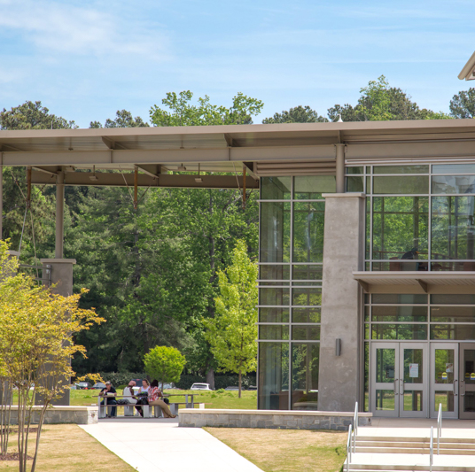
STAKEHOLDER FEEDBACK SHAPED
Mission
Vision
Values
Notes:
During the next series of slides I want to provide some clarity and DECLARE…based on the Strategic Planning Process
What we do- (Mission)
Identify Where we are going for the next 3 years or so (VISION)
Identify What we believe in (Our Values)

Slide 10
MISSION STATEMENT
A mission statement says…
This is our broad and enduring purpose.
Mission Statement
Our mission is social mobility. We transform lives through teaching, scholarship, and service.
A mission statement…
Establishes the foundational, high-level, long-term commitments of the institution that everyone in the community is working to fulfill.
Notes:
Our mission describes what we do everyday! This is our primary business.

Slide 11
VISION STATEMENT
A vision statement says…
These are our priority aspirations to be realized within a defined and limited period of time.
Vision Statement
We will have a positive impact on the State of Georgia and beyond by serving students and our community through broadening access to high-quality education and advancing workforce development.
A vision statement…
Sets the agenda for the next several years that will guide the allocation of resources and assessment of institutional impact.
Notes:
Our vision for the next 3 years is to have an impact on-
The state of GA (particularly the South Metro Area) and beyond… while this is our home and market, we want to extend a bit as well
And we will focus on providing access to opportunities for the social mobility we are discussing through quality programs so that we may
Provide a workforce for the business/industry/healthcare/education …but we want to transform our students

Slide 12
CORE VALUES
Core Values
Adaptability: We are agile and responsive in the face of change.
Collaboration: We leverage our diverse knowledge and skillsets to achieve institutional goals.
Excellence: We give our best effort and seek continuous improvement in all our initiatives.
Integrity: We promote ethical behavior, taking responsibility for our attitudes, actions, and results.
People-Centered: We value and invest in our students, faculty, staff, and community.
Core Values …
are the norms, behaviors, and commitments that guide our actions.
Core Values…
Set the behavioral standards to which the community will be held accountable.
Notes:
This is what we believe in....
We need to be nimble (as we have been in the past)
Partnerships will be the key to the success of our students, this community, and our institution
Excellence is an expectation
Integrity is an value that we will not compromise
And we want to focus on people… our students, our faculty, and our staff!

Slide 13
How Do We Get There?
Notes:
Need a good graphic here… my narrative is….
Since I have identified, what we do, who we are, where we are going, and what we believe in…. Our Strategic Plan will guide…
HOW WE GET THERE…

Slide 14
2024-2027 STRATEGIC PLAN
Transforming Today for Tomorrow
Adaptability • Collaboration • Excellence • Integrity • People-Centered
Building Academic and Career Pathways
Driving
Student
Success and Social
Mobility
Growing Enrollment
Increasing Community and Corporate Engagement
Priority Areas of Focus
Achieving Financial Sustainability
Foundational Capabilities
Advancing Operational Excellence
Enhancing University Well-Being
Strengthening Reputation and Brand Awareness
Notes:
And this is the plan…. Our plan is like a house!
The foundation is on the bottom… if we don’t take care of these… The items above may not be stable…
I will describe the chart here.

Slide 15
THE PLAN IN ACTION
Building Academic and Career Pathways
  Current Example – Ignite Teacher Residency Program with Dekalb County -
  Driving Student Success and Social Mobility
  Current Example - Child Care Grants - This is an example of creating a support model to build student capacity to persist and graduate
Increasing Corporate and Community Engagement
  Current Example(s) - Coca Cola - 1 million investment in first generation student scholarships
  Current Example - AT&T- Career and Internship Fairs, “Laker Trek”
Growing Enrollment
  Example - Communities In Schools, One Goal , Achieve Atlanta, College Aim - Each focuses on low-income students and while they also work with other colleges, each has a direct pipeline into Clayton State University

Slide 16
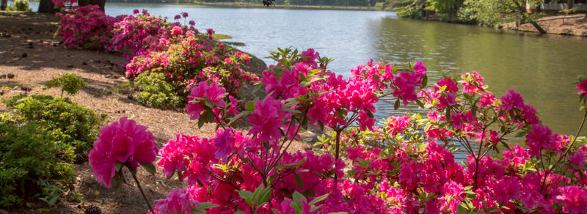
OUR NEXT STEPS?
Priority Identification
Strategy Development
Implementation
Measure, Adjust, Refine
Notes:
This is the “Fit in” Slide. Where we will need a graphic and examples…

Slide 17
HOW DO YOU FIT INTO THE PLAN?
Internships
Scholarships
Mentoring Relationships
Sponsorship of
Academic Programs
Parental Support
Grant Funding
Daycare
resources
Notes:
Lets talk about this page…

Slide 18
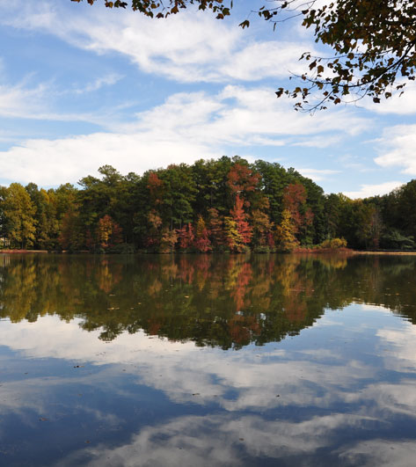
PRESIDENTIAL ROUNDTABLES
Thursday, October 17 (11:30 am – 1:00 pm) K-12 Education
Thursday, November 7 (11:30 am – 1:00 pm) – Business & Industry Partners
Thursday, November 14 (11:30 am – 1:00 pm) – Community Leaders

Slide 19
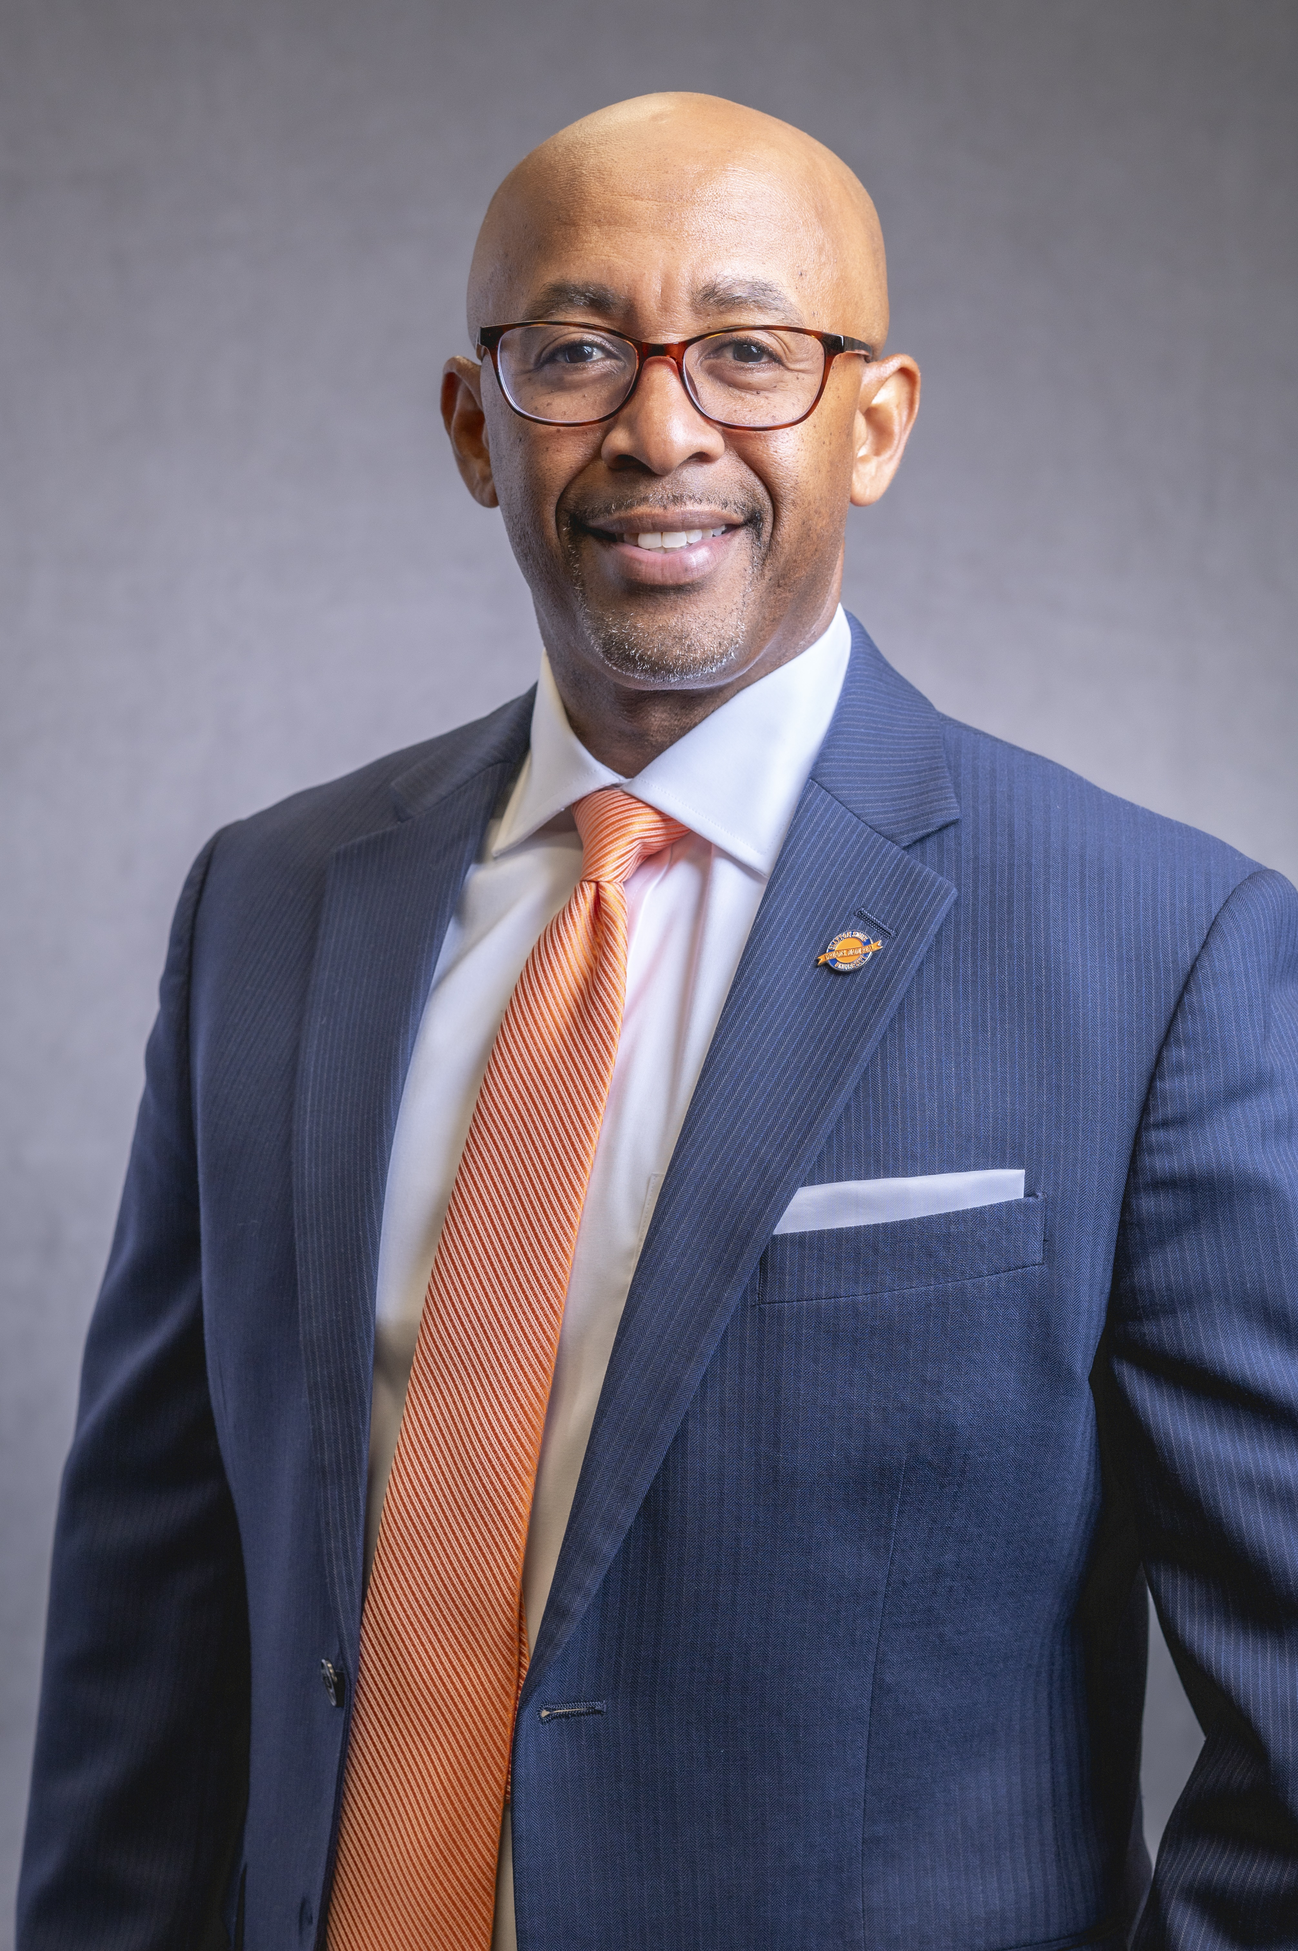
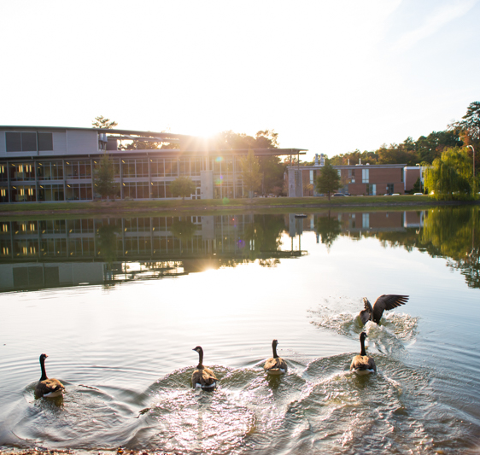
SAVE THE DATE
Investiture Ceremony of Georj L. Lewis, Ed.D.
Friday, September 20, 2024 at 10:00 A.M in Spivey Hall
Notes:
Include the save the date

Slide 20
