Slide 2
Beyond Demographics of Disadvantage to Champions of Change
Taralyn Keese, MSW
Dept. of Social Sciences
Senior Lecturer

Slide 3
Purposes of Liberal Arts Education
Civic Engagement – A liberal arts education provides students with broad knowledge of the wider world to prepare them to deal with the diversity and change in human society and its many complexities.

Slide 4
CSU: A PBI-Beyond Demographics
PBI’s must meet three main eligibility requirements to qualify for federal Predominately Black Institution (PBI) grant funding:
(1) Enrollment –enrollment of undergraduate students that is at least 40% Black American
65% of CSU Students identify as Black
82% of CSU Students identify as people of color
https://www.clayton.edu/institutional-research/spring2024fastfacts.pdf
(2) Needy students as defined by Title III, Part F, Section 371 of the HEA.
63% of degree/certificate-seeking undergraduate students at CSU were awarded Federal Pell grants in Academic year 2021-22
https://nces.ed.gov/ipeds/dfr/2023/ReportHTML.aspx?unitId=139311

Slide 5
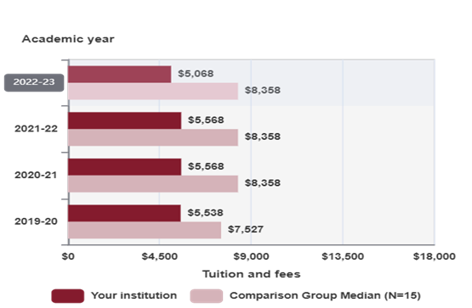
CSU: A PBI-Beyond Demographics
(3) Core Expenses Requirement - have an average educational and general expenditure that is low, per full-time equivalent undergraduate student compared to the average educational and general expenditure costs of institutions that offer similar instruction.
​
https://nces.ed.gov/ipeds/dfr/2023/ReportHTML.aspx?unitId=139311

Slide 6
Culturally Responsive Teaching and Design:
Our students’ identities and experiences can inform interventions and strategies that promote social change and upward social mobility.
As a PBI, we have a unique opportunity to prepare students to be change-makers by addressing the social conditions they have navigated or observed.
Reframing deficit thinking about our students to an asset mindset enables us to produce culturally responsive curriculums affirming our students' agency and resilience.

Slide 7
Culturally Responsive Teaching and Design
A set of practices designed to build on students’ backgrounds as teaching and learning occur.” Cruz, R. et.al. (2019).
A strength-based approach to teaching that is grounded in the belief and expectation that minoritized students are capable of high academic achievement when provided with appropriate resources and support.
Incorporates culturally relevant instruction that values the diverse backgrounds and lived experiences of students and encourages students to develop an in-depth awareness of social inequities and power dynamics that shape the learning environment and society at large. (Ladson-Billings, 1995).

Slide 8
Culturally Responsive Teaching and Design:
Requires faculty to develop and demonstrate culturally responsive teaching skills and engage in cultural humility. (Aronson & Laughter, 2016).
How are we leveraging our students’ identities and experiences to shape our pedagogy and praxis with intentionality?

Slide 9
References
Aronson, B., & Laughter, J. (2016). The theory and practice of culturally relevant education: A synthesis of research across content areas. Review of Educational Research, 86(1), 163–206. https://doi.org/10.3102/0034654315582066
Cruz, R., Manchanda, S., Firestone, A., & Rodl, J. (2019). An Examination of Teachers’ Culturally Responsive Teaching Self-Efficacy. Teacher Education and Special Education The Journal of the Teacher Education Division of the Council for Exceptional Children. 10.1177/0888406419875194.
Clayton State University Institutional Research. Fast Facts (2024) https://www.clayton.edu/institutional-research/spring2024fastfacts.pdf
Institution of Education Sciences. IPEDS Data Feedback Report (2023). https://nces.ed.gov/ipeds/dfr/2023/ReportHTML.aspx?unitId=139311

