Slide 2
Social Mobility and the Social Sciences

Slide 3
What are the Social Sciences?
Criminal Justice
Political Science
Sociology
Social Work

Slide 4
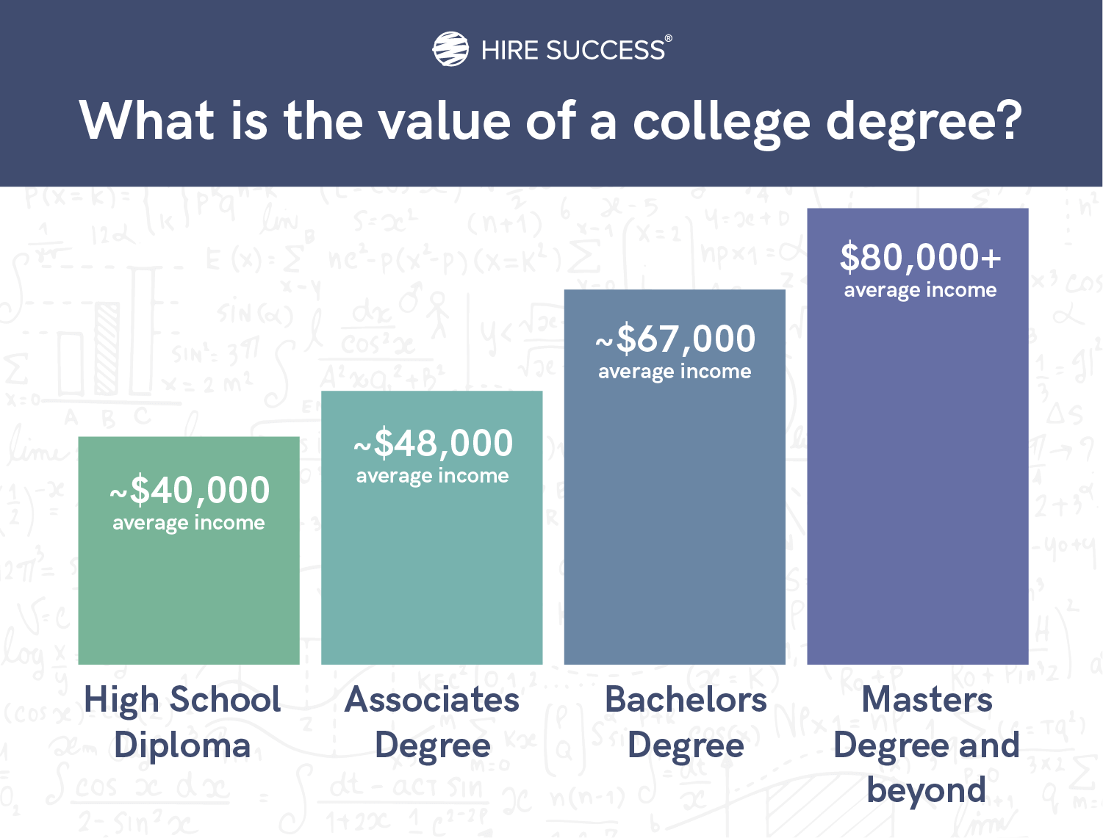

Slide 5
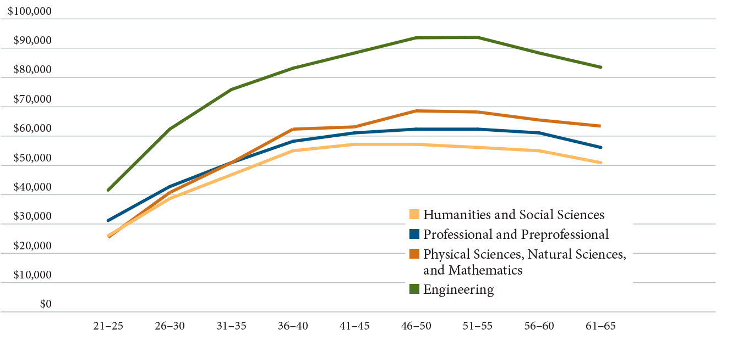
Median earnings for graduates with only baccalaureate degrees (2010-11)
Source: How Liberal Arts and Sciences Majors Fare in Employment. 2013

Slide 6
More To Life Than Just Income
Studies repeatedly find that individuals with a sense of purpose in life tend to report that they’re happier, or they’re more hopeful and more satisfied, than individuals without.
The best major is the one that helps you find purpose in your life. So there’s no one major that makes people the happiest, because people derive purpose from different things.
- Kendall Cotton Bronk, Claremont Graduate University

Slide 7
More To Life Than Just Income
"If you don’t have a passion about it, you’re not going to do well enough in that career field to make as much money as people say they make.”
- Jeffrey Selingo, Former Editor of the Chronicle of Higher Education

Slide 8
Skills Translation Problem
Higher education, “speaks a language of learning outcomes; industry speaks a language of skills....there are all sorts of skills that we are teaching in higher education, but which we don’t claim credit for.”
- The New Learning Economy, Jeffrey Selingo 2023

Slide 9
Common Skills for Social Science Degrees
The eight most common skills for social sciences research scientists in 2024 based on resume usage.
Data Collection
Market Research
Research Projects
Literature Reviews
GIS
Regression
Social Science Research
https://www.zippia.com/social-sciences-research-scientist-jobs/skills/

Slide 10
Improving Job Prospects for Liberal Arts Graduates
Burning Glass
2012 - 2013

Slide 11
Job Opportunities for Liberal Arts Graduates
 | Entry-Level Job Postings | Average Entry-Level Salary | Percent of Bachelor’s Entry-Level Jobs
Jobs Traditionally Open to Liberal Arts Graduates | 954,996 | $42,731 | 25%
Jobs Open to Liberal Arts Graduates with Additional Technical Skills | 861,572 | $49,052 | 23%
Total Entry Level Jobs Accessible to Liberal Arts Graduates | 1,816,568 | $45,729 | 48%*

Slide 12
In Demand Skills for Graduates
IT Networking and Support: Skills supporting the installation, maintenance, and troubleshooting of information technology systems and personal computers
Sales: Skills supporting the selling and promotion of products and services, and the management of customer relationships
Computer Programming: Major programming languages used in the development of computer programs and applications
Data Analysis and Management: Skills relating to the collection, management, and analysis

Slide 13
In Demand Skills for Graduates
Marketing: Skills relating to firm-level and product-level marketing strategy
Graphic Design: Skills and software relating to the design of interfaces across multiple media.
General Business: Skills relating to the administration and operations of organizations.
Social Media: Skills needed for the strategic utilization of various social media platforms.

Slide 14
In Demand Skills for Graduates
Skills are changing quickly….37 percent of the top 20 skills considered necessary for the average job have changed since 2017. One in five skills is entirely new.
- Making The Bachelor’s Degree More Valuable, 2023

Slide 15
The Value of “Soft Skills”
Soft skills—also known as “people skills” or “interpersonal skills”—are a set of personal attributes and abilities that allow individuals to effectively interact with others in a professional setting. At their core, these include the ability to collaborate effectively, manage time and communicate with clarity, among others. (Forbes, April 28, 2024)

Slide 16
National Bureau of Economic Research

Slide 17
Employers Prioritize Innovation and Transferable Skills
Source: Hart Research Associates, It Takes More Than a Major (2013)

Slide 18
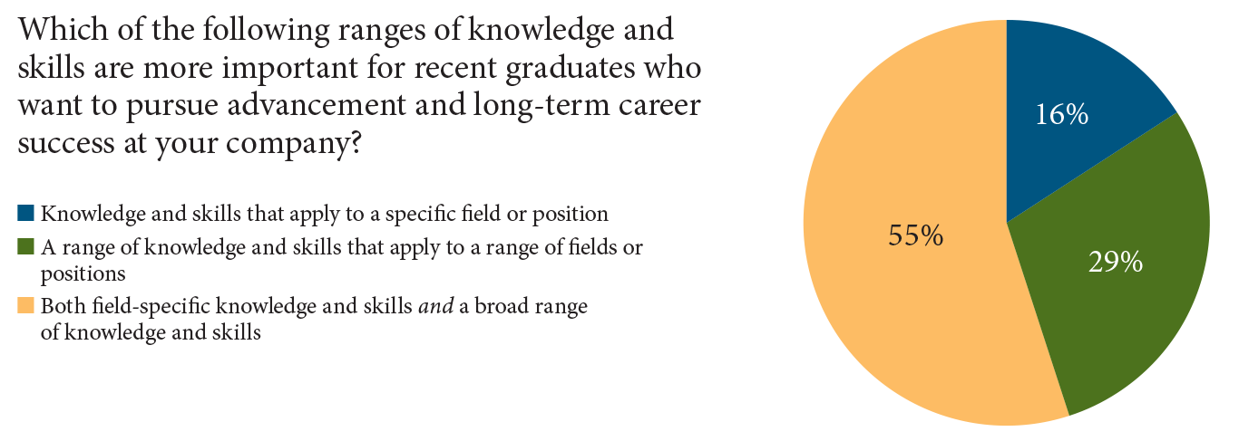
Employers Want Both Broad Knowledge and Specific Skills
Source: Hart Research Associates, It Takes More Than a Major (2013).

Slide 19
The Challenge for Colleges and Students
Clearly identify and articulate the skills embedded in college degrees
Provide a mix of specialized skills and broad range of universal skills
Provide lifelong opportunities for graduates to continue to develop new skills

