Slide 2
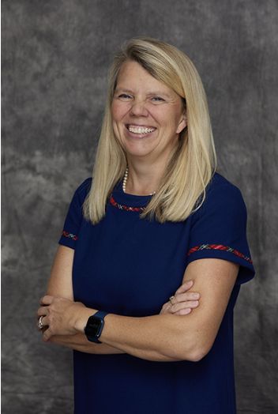
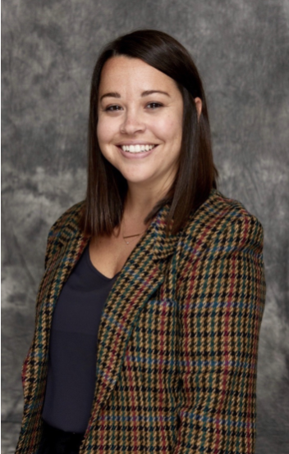
Action Planning
Carin Barber, Ed.D.
California State University
San Marcos
&
Melanie Graham
Old Dominion University

Slide 3
Session Outcomes
ACTION PLANNING
(Re)defining Social Mobility
Serving Clayton State University students
Social Mobility Momentum
*At the end of this session, you’ll have a plan to move forward with
Notes:
By the end of this session, you’ll have a well-defined plan for the next steps

Slide 4
Notes:
The Brookings Institution, often stylized as Brookings, is an American think tank that conducts research and education in the social sciences, primarily in economics, metropolitan policy, governance, foreign policy, global economy, and economic development. While this video is from 2014, it’s still relevant a decade later.

Slide 5
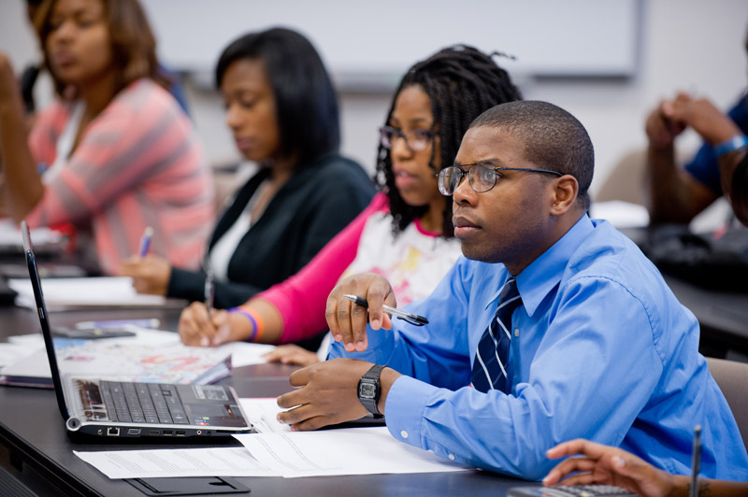
Defining Social Mobility
“A change in social status”
“Improved outcomes related to socioeconomic status”
“Goes beyond making money”
Notes:
https://www.clayton.edu/news/clayton-state-university-set-to-host-inaugural-social-mobility-summit
Clayton State University defines social mobility as, simply, “a change in social status,” further stating its focus as an institution centered on upward social mobility – the “improved outcomes related to socioeconomic status.”
The university further states that upward social mobility “goes beyond making more money” and includes opportunities such as increased job prospects, better healthcare, affordable insurance, retirement benefits, better housing options, and more.
President EN opened our summit this morning by…

Slide 6
(Re)defining Social Mobility
ACTION PLANNING
How do you explain social mobility?
Identify 2-3 talking points to describe social mobility.
Notes:
“When people think of social mobility, they often focus on moving from one income class to the next,” Lewis said. “While income is a part of it, it’s also about access to education, day care for students with families, health care opportunities, and more. All of these social indicators of success really fall under the umbrella of social mobility to me.”
“We're trying to help promote the individual students in the area through long-term generational success,” Meddaugh said. “By investing in the local area, helping our students obtain their education, and raising their social mobility, they can help revitalize the greater Clayton community and south metro Atlanta.”

Slide 7
(Re)defining Social Mobility
ACTION PLANNING
What does social mobility mean for Clayton State?
What does social mobility mean for your students?
Notes:
“When people think of social mobility, they often focus on moving from one income class to the next,” Lewis said. “While income is a part of it, it’s also about access to education, day care for students with families, health care opportunities, and more. All of these social indicators of success really fall under the umbrella of social mobility to me.”
“We're trying to help promote the individual students in the area through long-term generational success,” Meddaugh said. “By investing in the local area, helping our students obtain their education, and raising their social mobility, they can help revitalize the greater Clayton community and south metro Atlanta.”

Slide 8
THE LANDSCAPE OF
SOCIAL MOBILITY IN GEORGIA
Quality Coaching (Foundational 0%-20%)
Everyone should have access to coaching that helps them reflect on their talents and interests, choose a career goal, map pathways through education, and navigate challenges.
74% ROI for Bachelor’s Degrees
Work-Based Learning (Developing 21%-40%)
All students should have access to quality work-based learning experiences, such as paid internships and apprenticeships, that help connect their education and their career aspirations.
(Strada Education Foundation, 2024)
Notes:
Building on the ROI data presented by President Neufeldt, here are additional elements...
https://stradaeducation.org/state-opportunity-index-states/
Strada collaborates with students, policymakers, educators, and employers across the U.S. to strengthen the link between education and opportunity.
State Opportunity Index produces state-by-state profiles which provides a breakdown of state progress for return on investment and the five priority areas.
Clear outcomes: empowering individuals to make informed decisions about their education
Quality Coaching ** highlighted because of student affairs/institutional connections. YOU are empowered to positively impact this area.
Affordability: equitable opportunities for success
Work-Based Learning ** highlighted because of student affairs/institutional connections. YOU are empowered to positively impact this area.
Employer Alignment: degree programs that lead to quality jobs and mobility

Slide 9
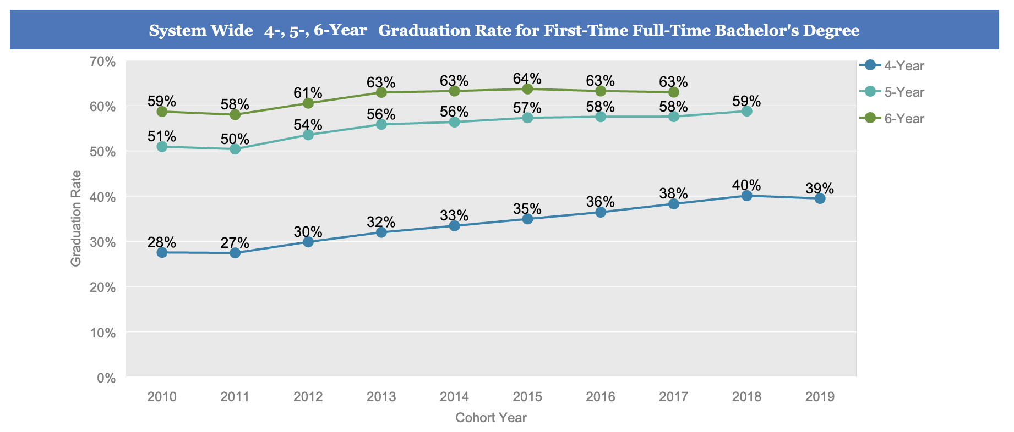
THE LANDSCAPE OF
SOCIAL MOBILITY IN GEORGIA
https://www.usg.edu/research/data_dashboards
Notes:
https://www.usg.edu/research/data_dashboards
University of Georgia System
Enrollment reports, credit hour reports, degree reports, transfer student reports, financial aid reports, data dashboards…

Slide 10
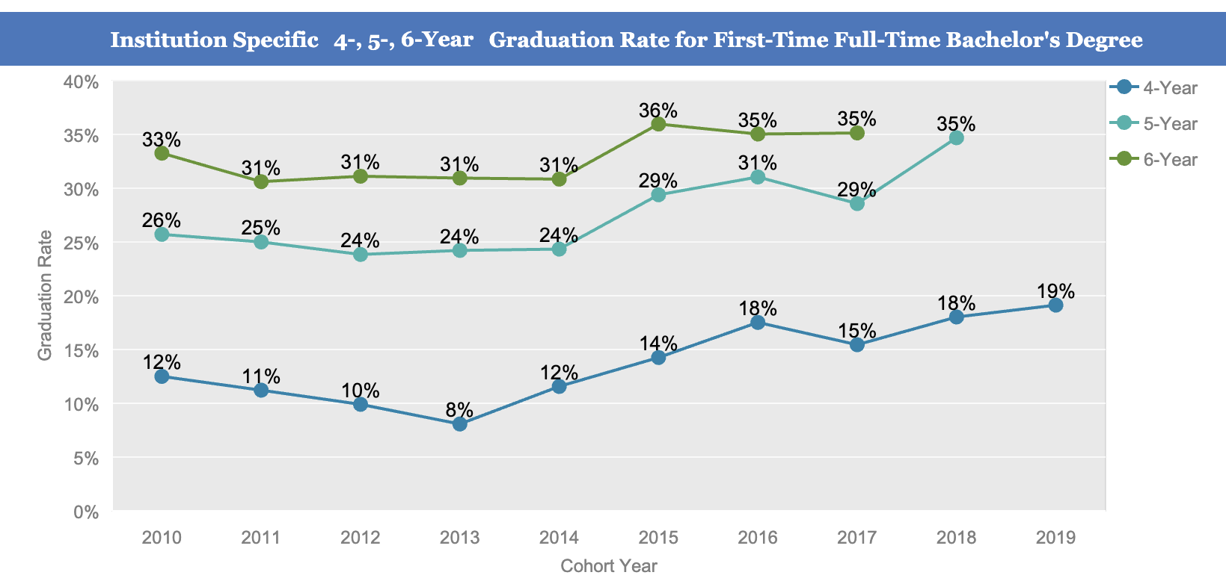
THE LANDSCAPE OF
SOCIAL MOBILITY @ CLAYTON STATE
https://www.usg.edu/research/data_dashboards
Notes:
Note: these data came from IPEDS: https://nces.ed.gov/collegenavigator/?q=clayton+state+university&s=all&id=139311#retgrad
Data varies on the Georgia System Reports: https://www.usg.edu/research/usgbythenumbers

Slide 11
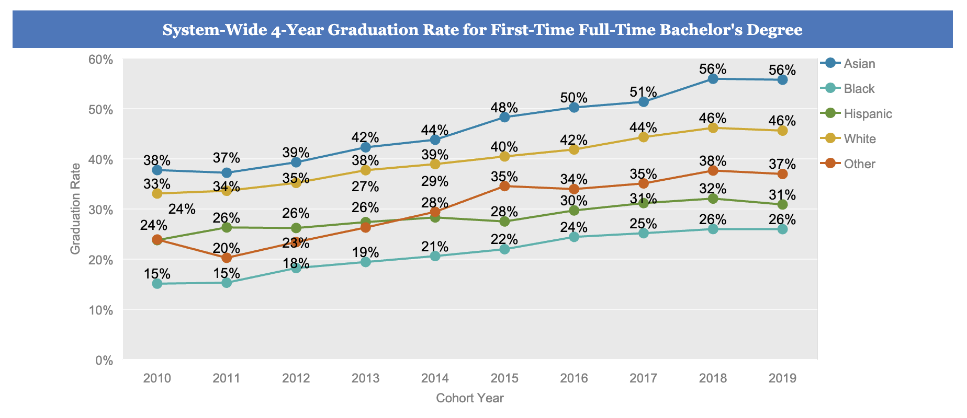
THE LANDSCAPE OF
SOCIAL MOBILITY IN GEORGIA
https://www.usg.edu/research/data_dashboards
Notes:
https://www.usg.edu/research/data_dashboards
You can disaggregate by gender, ethnicity, institutions, degree levels, and even customize your own reports.

Slide 12
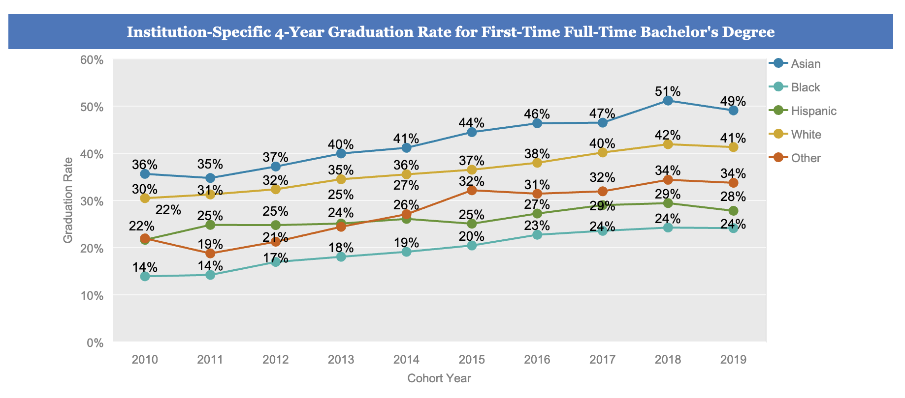
THE LANDSCAPE OF
SOCIAL MOBILITY @ CLAYTON STATE
https://www.usg.edu/research/data_dashboards
Notes:
Note: these data came from IPEDS: https://nces.ed.gov/collegenavigator/?q=clayton+state+university&s=all&id=139311#retgrad
Data varies on the Georgia System Reports: https://www.usg.edu/research/usgbythenumbers

Slide 13
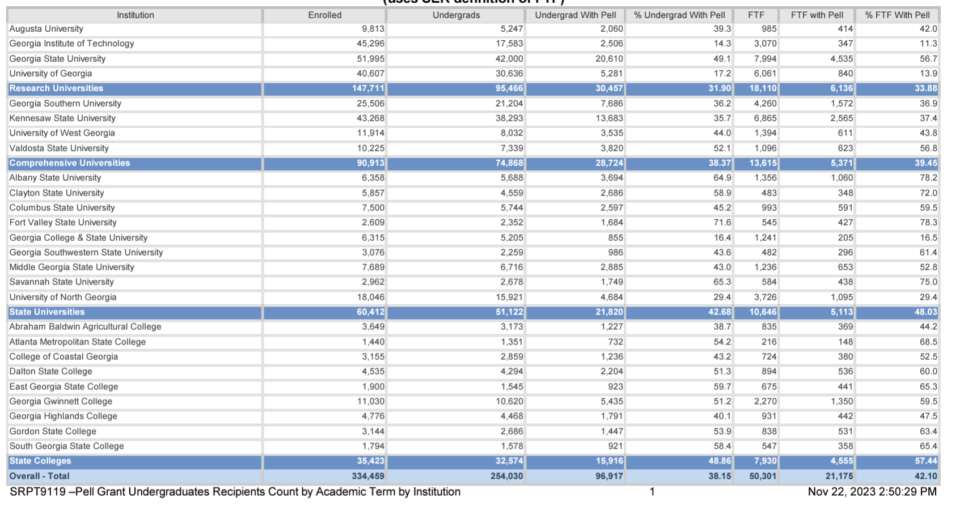
THE LANDSCAPE OF
SOCIAL MOBILITY IN GEORGIA
https://www.usg.edu/research/financial_aid_hope_scholarship_reports
Notes:
https://www.usg.edu/research/financial_aid_hope_scholarship_reports
CSU ranks #4 for highest percentage of Pell Grant recipients at 72%
Only trailing…
Fort Valley State University 78.3%
Albany State University 78.2%
Savannah State University 75%

Slide 14
Serving Clayton State Students
Reflect on your college experiences. Which faculty or staff member comes to mind? Why are they memorable?
Notes:
As you think through serving CSU students, the following reminders may be helpful:
60% Retention
35% 6-year Graduation
72% Pell Grant
43% Part-time
Average Family AGI $29,020
Average for In-state On-Campus Experience $21,369

Slide 15
Serving Clayton State Students
ACTION PLANNING
What did you learn about CSU students today?
How can you leverage data/adjust your practices to serve Clayton State students?
Notes:
As you think through serving CSU students, the following reminders may be helpful:
60% Retention
35% 6-year Graduation
72% Pell Grant
43% Part-time
Average Family AGI $29,020
Average for In-state On-Campus Experience $21,369

Slide 16
CARNEGIE
CLASSIFICATION
A proposed new classification would divide colleges into four categories based on access (enrollment of low-income and minoritized learners) and students’ economic outcomes.
Notes:
https://www.insidehighered.com/news/students/careers/2024/05/16/socioeconomic-mobility-criterion-sorting-colleges?utm_source=Inside+Higher+Ed&utm_campaign=35c17c263e-DNU_2021_COPY_02&utm_medium=email&utm_term=0_1fcbc04421-35c17c263e-197578273&mc_cid=35c17c263e&mc_eid=bd1a2b43b3
In U.S. News & World Report’s 2023 Best Colleges rankings, Clayton State University ranked #38 in Top Performers on Social Mobility – Regional Universities South.
Pres. Lewis also spoke highly on the inaugural Social Mobility Summit alongside his decorated faculty, stating his ultimate vision for Clayton State University is to be the “number-one school for social mobility in Georgia” while receiving additional nationwide recognition upon the ranking’s fruition.

Slide 17
CLAYTON STATE
VISION
We will have a positive impact on the State of Georgia and beyond by serving students and our community through broadening access to high-quality education and advancing workforce development.
CLAYTON STATE
MISSION
Our mission is social mobility. We transform lives through teaching, scholarship, and service.
Notes:
How might you in your role realize the Clayton State Mission?

Slide 18
TRANSFORMING TODAY
FOR TOMORROW
Driving Student Success and Social Mobility
Increasing student retention and success at Clayton State University and after graduation through student support services, proactive outreach, and institutional data gathering.
Signature Initiatives
Design and measure comprehensive student services with a tiered advising and case management support model to build student capacity to persist and graduate.
Expand alumni network and services including mentoring and continuing education programs.
Leverage institutional data and predictive modeling to drive student success and retention.
Notes:
Four foundational capabilities and four priority areas of focus –
One of the four priority areas of focus is driving student success and social mobility. Three signature initiatives have also been identified within this priority area. Remember these signature initiatives as we transition to a conversation about maintaining this social mobility momentum we’ve generated today.

Slide 19
Social Mobility Momentum
ACTION PLANNING
Identify 1-2 ongoing student success strategies that could be scaled for greater outcomes.
What will you do?
Who will you collaborate with?
What are the short-term goals?
What are the long-term goals?
Notes:
“The Summit is our official kickoff of our discussion in really helping folks understand ‘what does social mobility mean for us as a campus?’” Stansberry said. “What I’m really excited about is our potential – what we can do collectively to improve the lives of our students and their families. I really see this as the catalyst to get us moving.”
Strategies to continue
Strategies to elevate
Strategies to innovate
Faculty folders
Resource Cards
One-stop Shop Webpages
Think inside the classroom (syllabus information)
Think outside the classroom

Slide 20
Social Mobility Momentum
ACTION PLANNING
Identify 1-2 new student success strategies to drive upward social mobility.
What will you do?
Who will you collaborate with?
What are the short-term goals?
What are the long-term goals?
Notes:
“The Summit is our official kickoff of our discussion in really helping folks understand ‘what does social mobility mean for us as a campus?’” Stansberry said. “What I’m really excited about is our potential – what we can do collectively to improve the lives of our students and their families. I really see this as the catalyst to get us moving.”
Strategies to continue
Strategies to elevate
Strategies to innovate
Faculty folders
Resource Cards
One-stop Shop Webpages
Think inside the classroom (syllabus information)
Think outside the classroom

Slide 21
ADVANCING SOCIAL MOBILITY
YOU CAN MAKE A DIFFERENCE!

