Slide 1
Eperformance

Slide 2
Eperformance Module
WHAT IS IT?
Self-Service evaluation management application for managers and employees housed within OneUSG HCM system.
Launching January 2022.
Training: December 2021 & January 2022 (TBD)
WHAT’S DIFFERENT?
Five Point Standardized Rating Scale
Option of nominating or adding additional evaluators to provide input.
Optional mid-year checkpoints to facilitate discussion.
Additional sections for goals, USG core values and institutional values.

Slide 4
Eperformance sections
Rating Scale | Criteria | % of Evaluation
Goals | Completion of last year’s goals Creation of goals for upcoming evaluation period. | 25% to 30%
Job Duties | Assigned job duties located in job description (job profile) Additional assigned tasks | 40%
Performance Factors | Job Knowledge Quality of Work Communication Critical Thinking Initiative Reliability/Attendance Adherence to Policies Interpersonal Relationships Customer Service Innovation | 15% to 20%
Leadership Factors (Additional Factors added to Leadership Evaluation) | Strategic Planning Fiscal/Budget Management Delegates/Directs Effectively | 15% to 20%
USG Core Values/Institutional Values | USG Core Values Clayton State Institutional Values | 15%

Slide 5
Behavior Anchored rating scale
Rating Scale | Definition | Behavioral Indicators
Exemplary | Outstanding performance that consistently exceeds milestones. | Displays advanced knowledge and skills Proactively seeks new challenges.
Superior | Good, solid performance that fully meets milestones and on occasion exceeds milestones. | Demonstrates strong, consistent leadership. Results add value.
Successful | Good solid performance that meets all milestones. | Shares knowledge and skills appropriately. Meets expectations.
Partially Successful | Performance falls short of the minimum criteria and standards of milestones. Immediate and substantial improvement is needed to address this area. | Work behavior occasionally fall below required levels. Improvement is required. Could be attributed to newness on the job, missing skills, etc.
Not Successful | Performance in this area is inconsistent and does not meet milestone. Performance feedback and efforts to reinforce competency may provide the tools to achieve success | Lacks the knowledge of the position to accomplish goals. Has not demonstrated the ability to retain key job knowledge. Does not seek development opportunities.

Slide 6
process review
ePerformance Evaluation

Slide 7
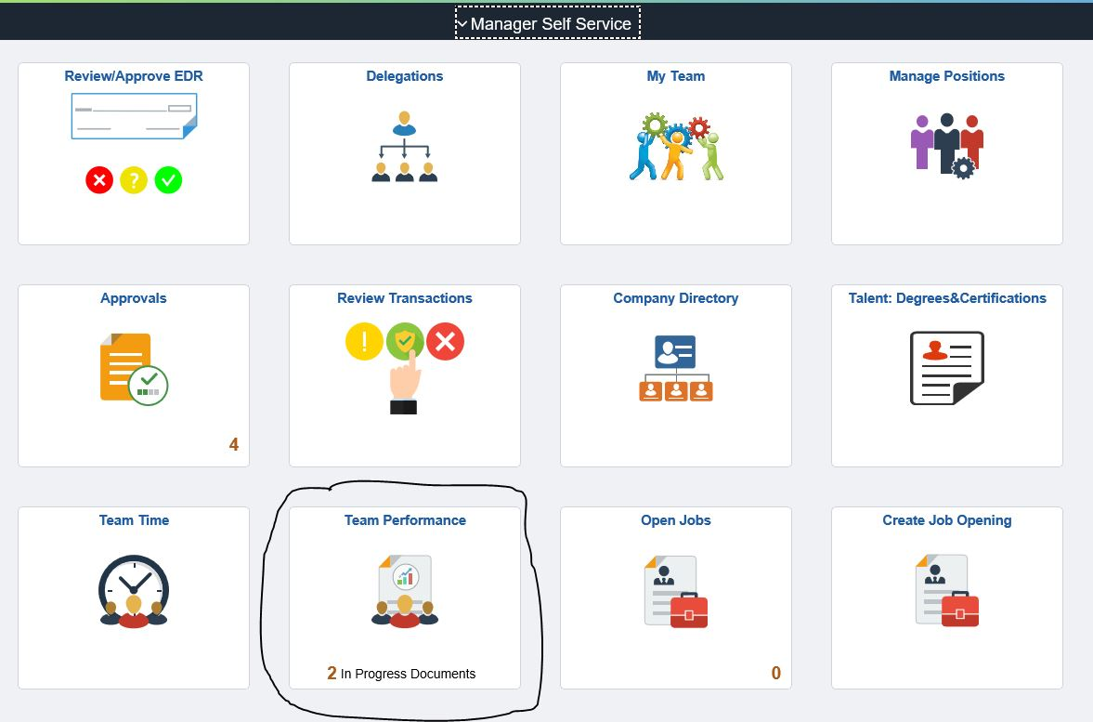
Step 1: Log into OneUSG. Choose Team Performance Tile.

Slide 8
Step 2: Under “Current Documents”, choose the team member you will be evaluating.

Slide 9
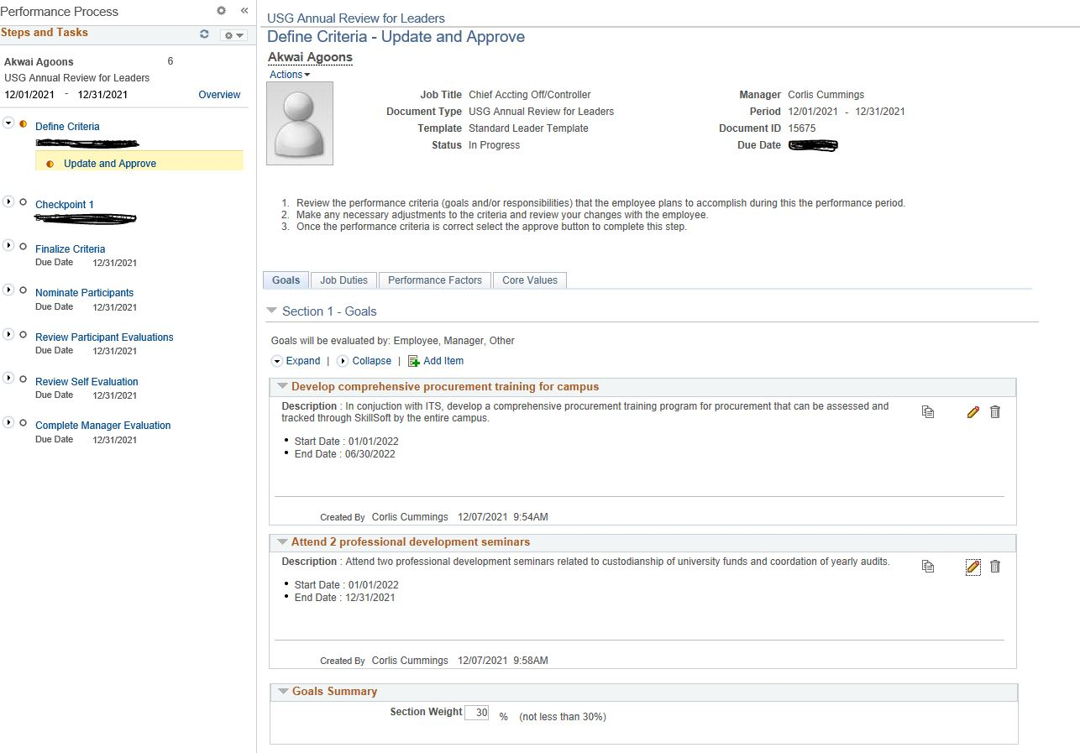
Step 3: Define Criteria.

Slide 10
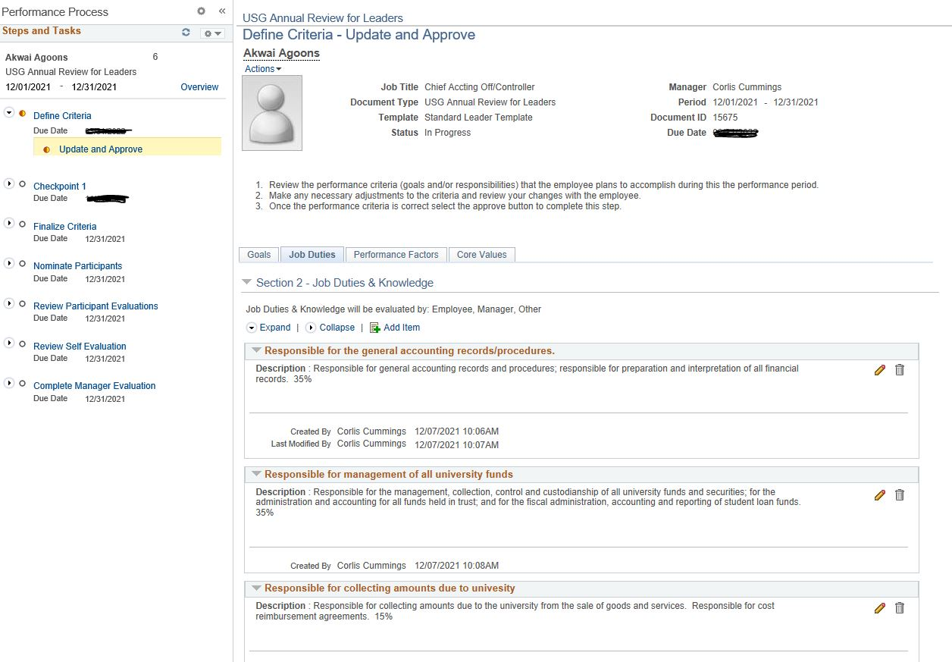

Slide 11
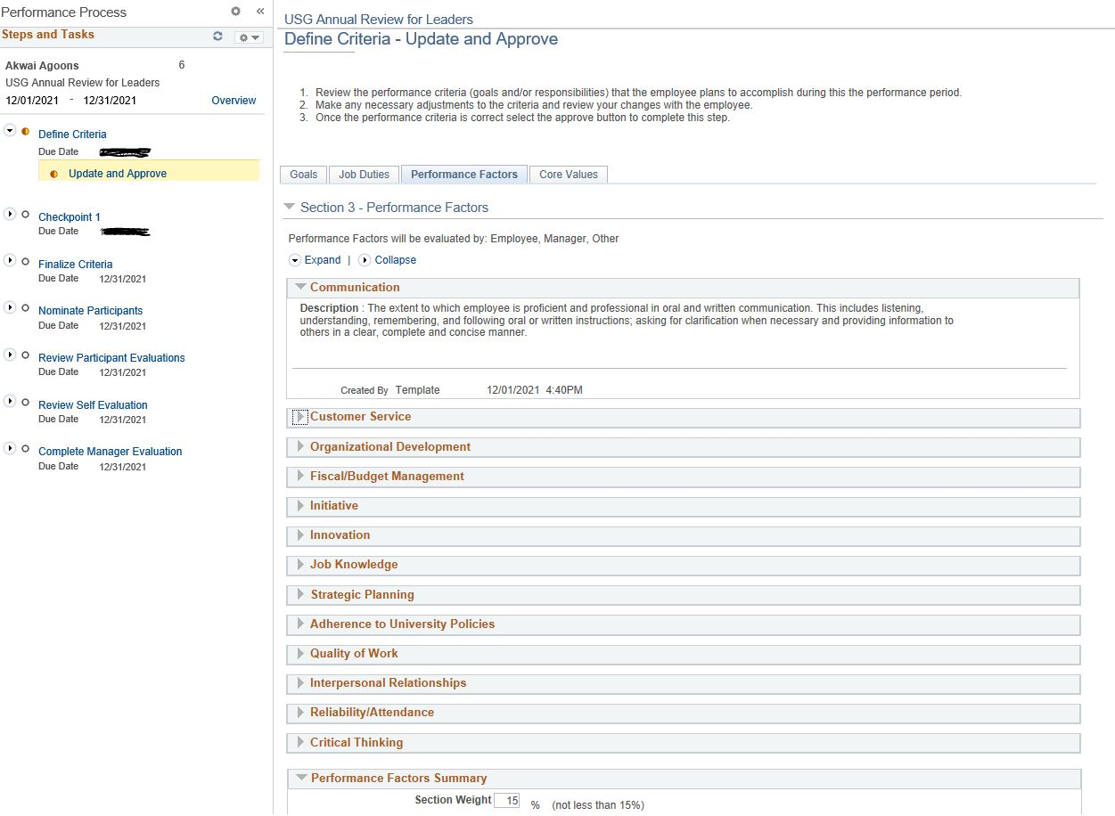

Slide 12
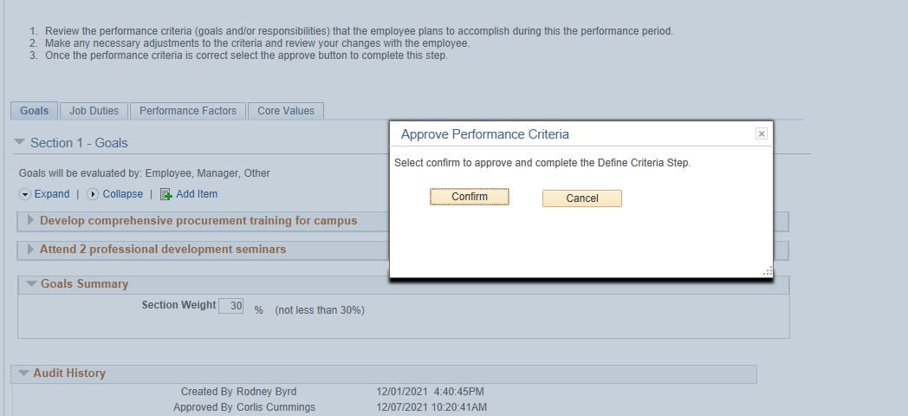
Step 4: Confirm Criteria

Slide 13
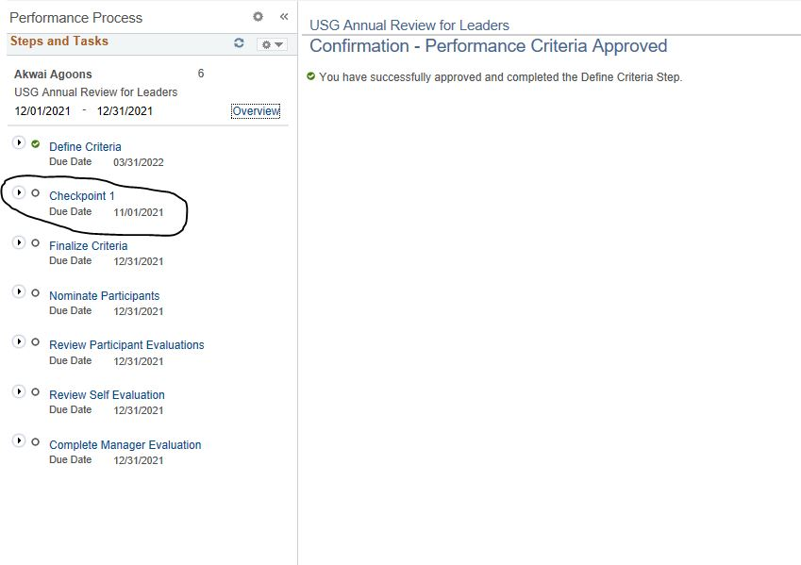

Slide 14
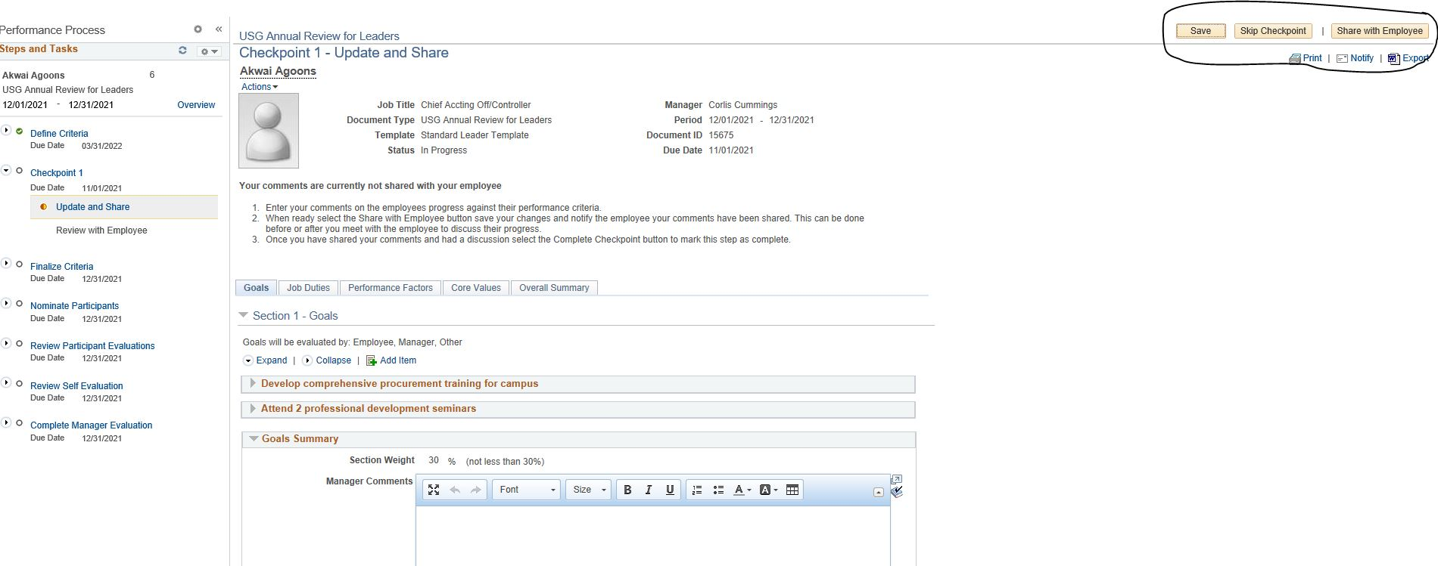
Step 5: Choose “Skip Checkpoint” from top menu.

Slide 15
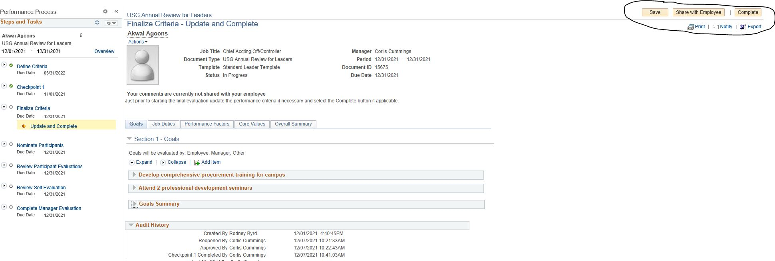
Step 6: Click Finalize Criteria. Choose “Complete” from top menu.

Slide 16
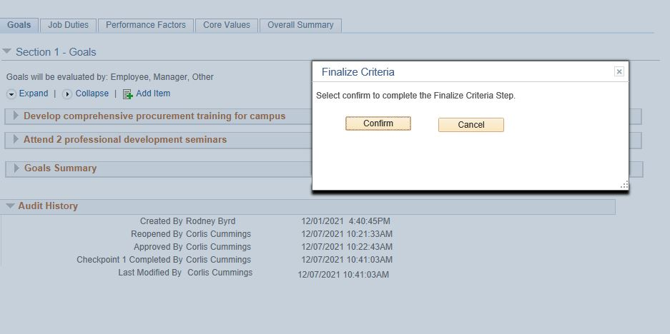
Step 7: Confirm you want to finalize criteria.

Slide 17
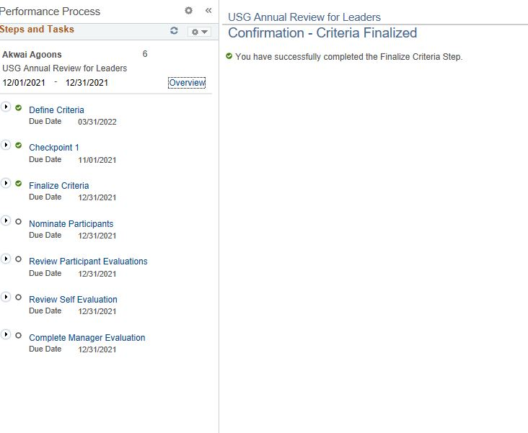

Slide 18
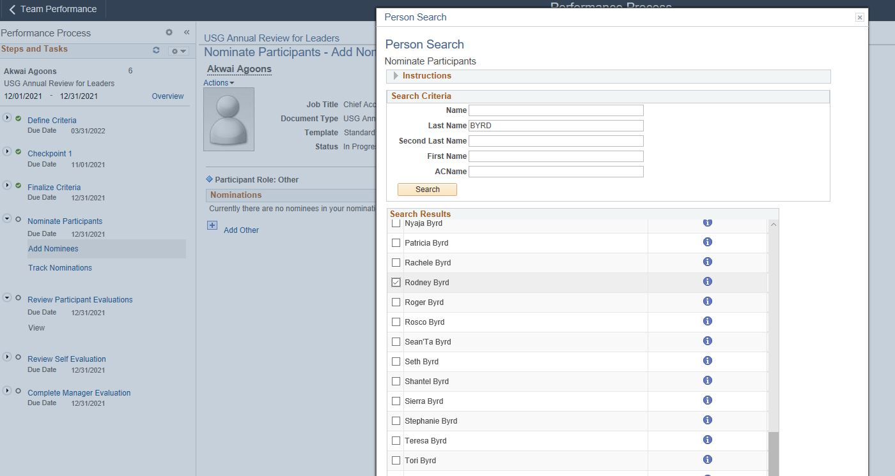
Step 8: Click “Nominate Participants” ONLY if you are inviting someone to participate in the evaluation (i.e. previous supervisor). SKIP THIS SECTION if you are not inviting anyone else to comment on the evaluation.

Slide 19
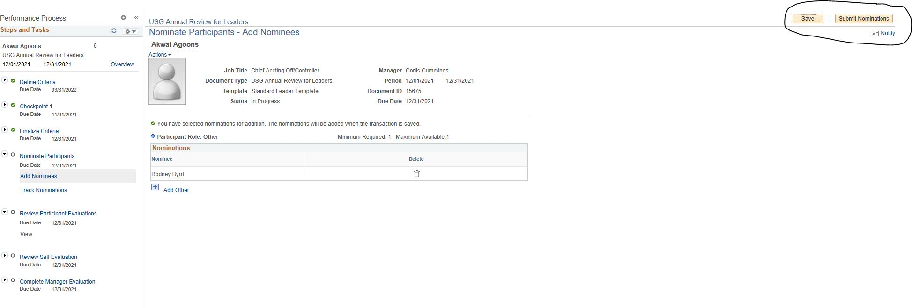
Step 9: Submit & Confirm Nominations (if applicable).

Slide 20
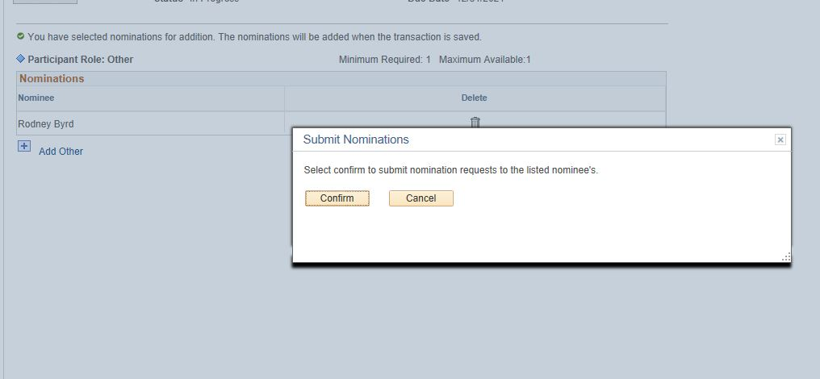

Slide 21
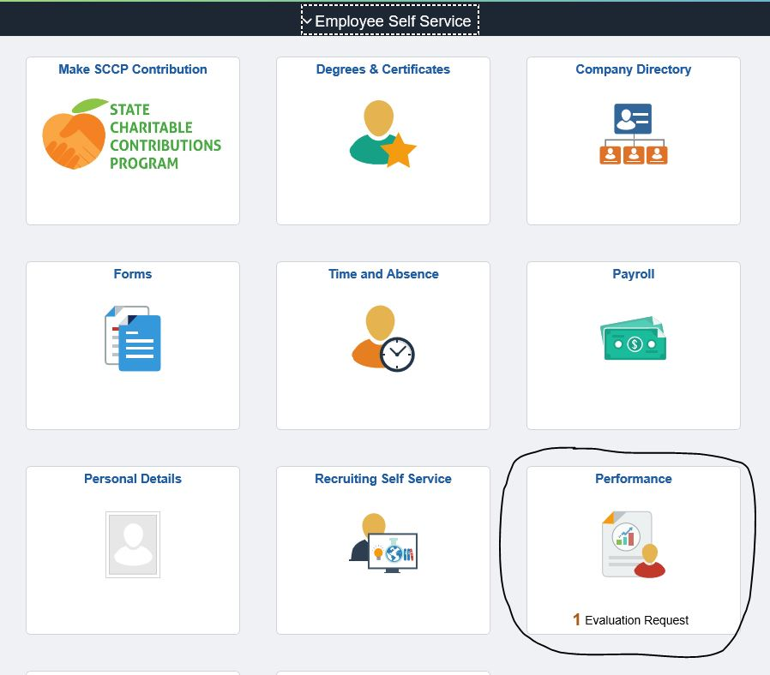
Step 10: Supervisor nominated will see request in his/her “Performance” tile.

Slide 22
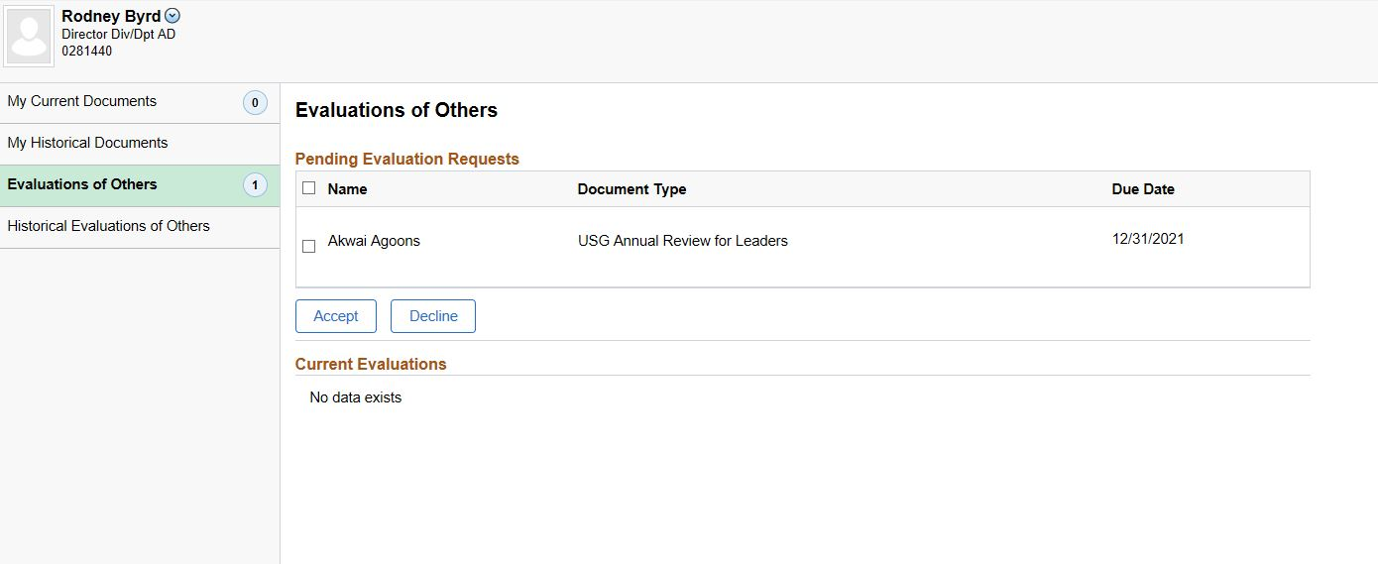

Slide 23
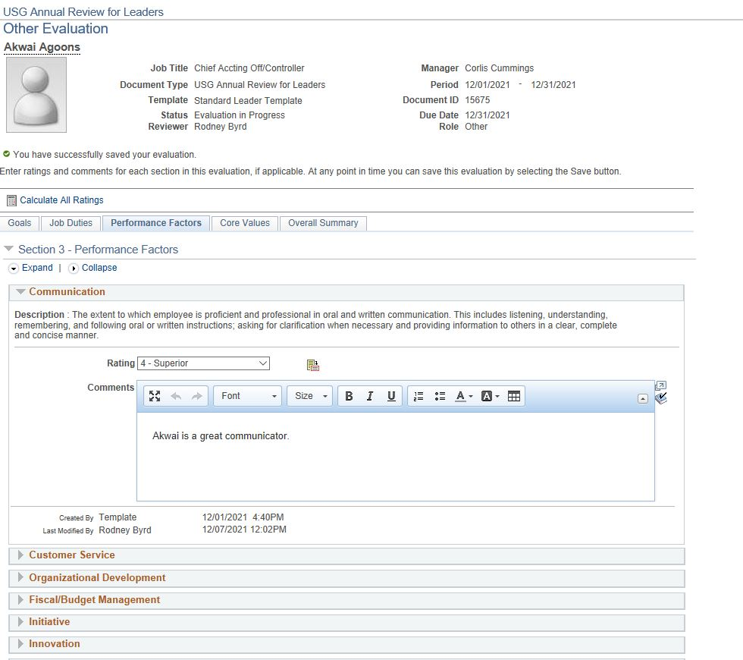

Slide 24
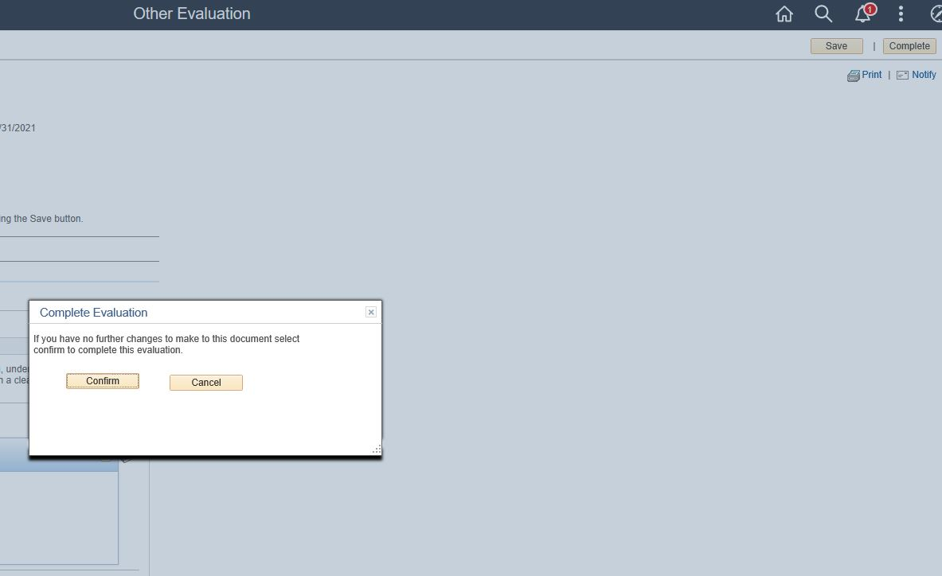
Step 11: Once finished. Added evaluator will choose complete and confirm.

Slide 25
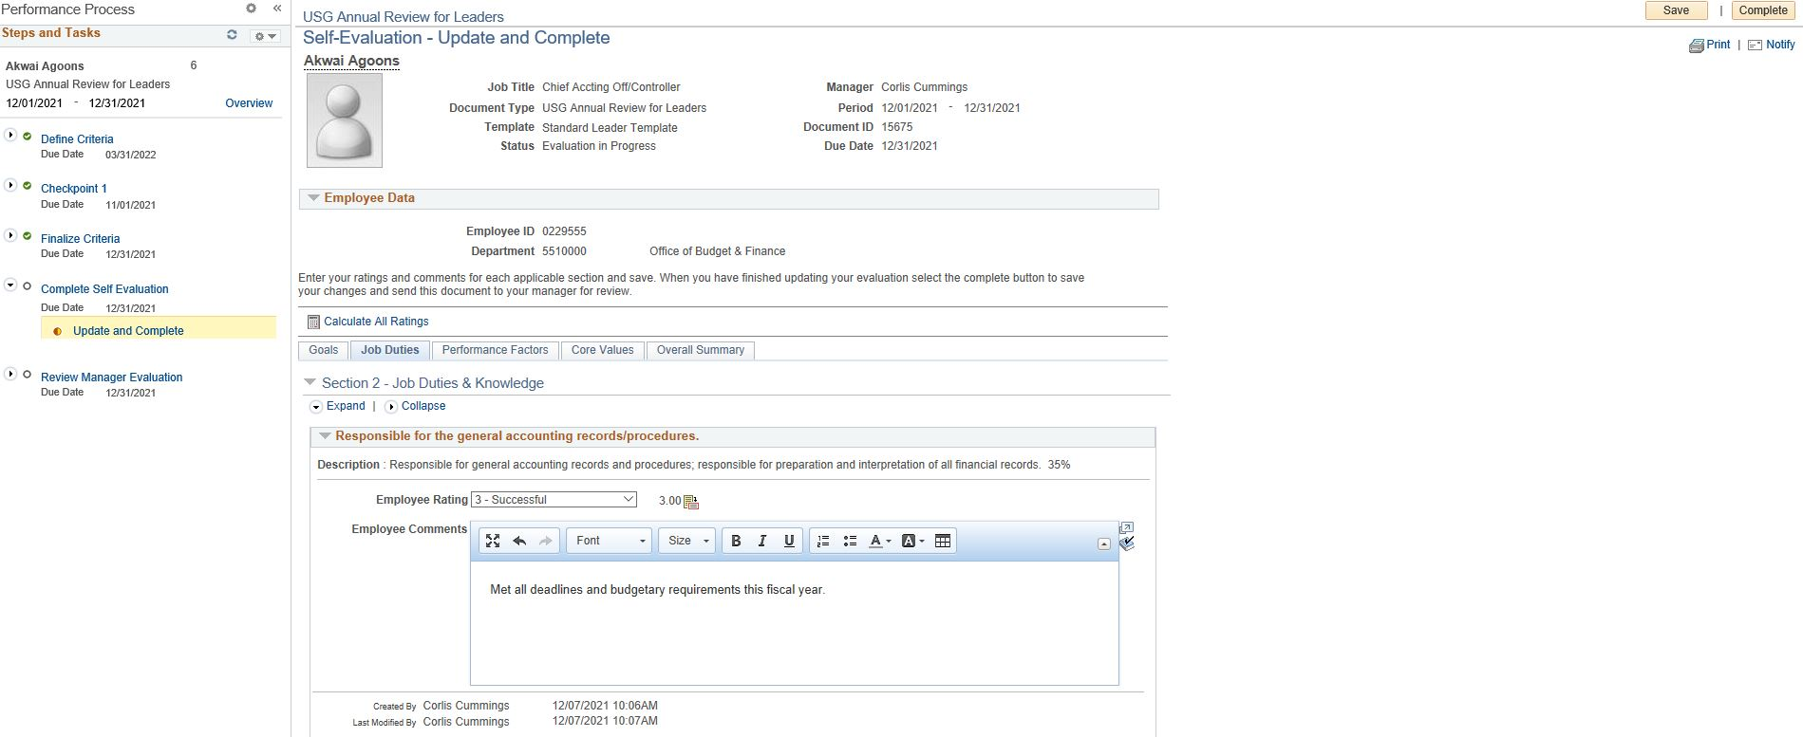
Step 12: After the “Finalize Criteria” step. Employee will be able to complete the “Self Evaluation” section of the evaluation.

Slide 26
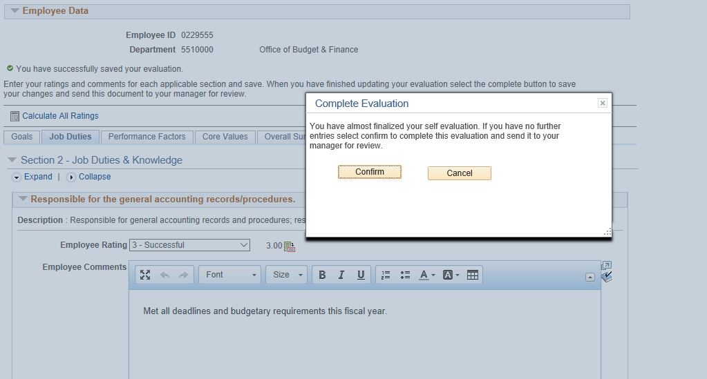

Slide 27
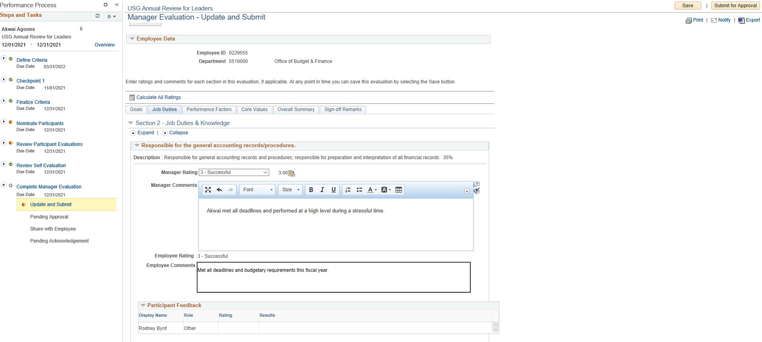
Step 13: Manager will then be able to review the “Participant Evaluation” and the “Self Evaluation”. Complete the “Manager’s Evaluation” for CY2021.

Slide 28
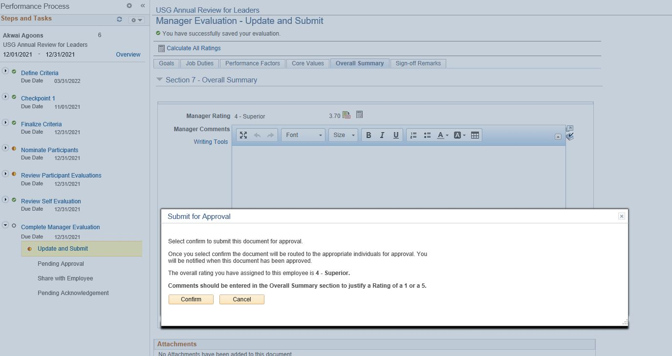
Step 14: Once complete, submit for next level supervisor approval.

Slide 29
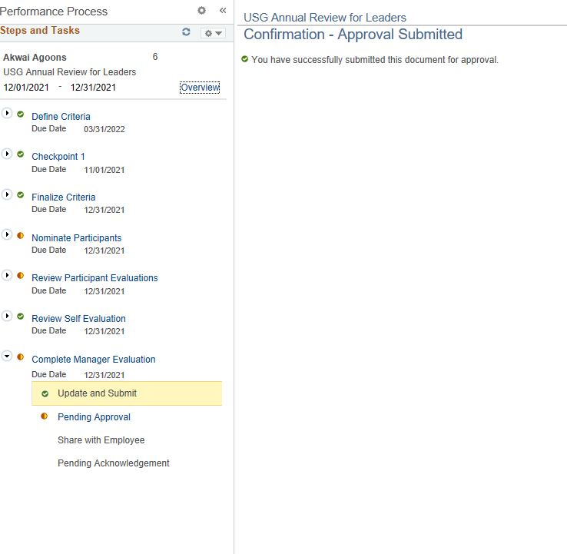

Slide 30
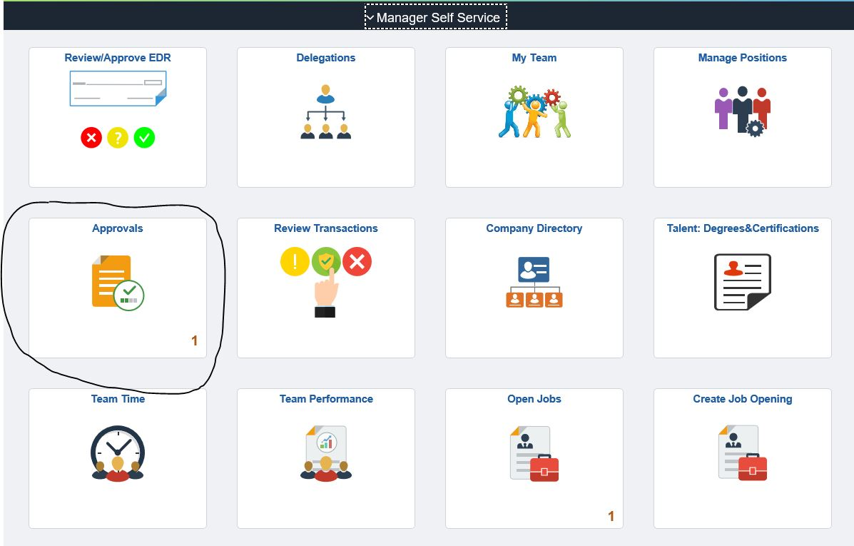
Step 15: Next level supervisor will sign in to OneUSG in MSS and choose “Approvals”.

Slide 31
Step 16: Choose the evaluation to review/approve.

Slide 32
Step 17: Next level supervisor can view the evaluation, add comments, and then approve or deny the evaluation.

Slide 33
Step 18: Manager signs in and evaluation will be as Approved. Choose evaluation and “Share Evaluation with Employee”. Hold meeting with employee.

Slide 34
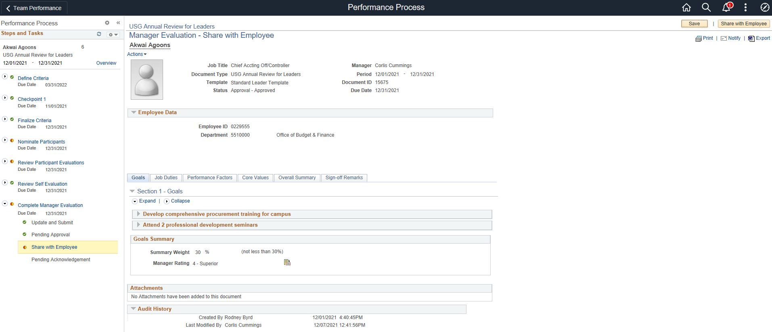

Slide 35
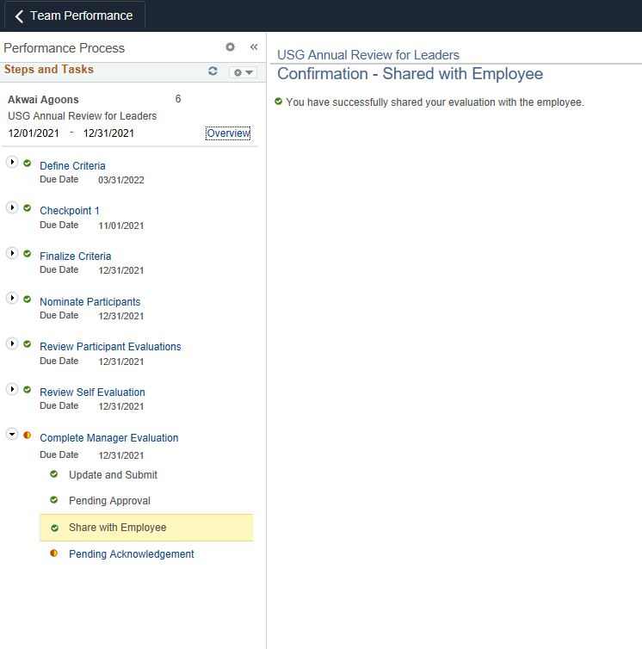

Slide 36
Step 19: Employee signs into OneUSG. Selects “Performance” tile and selects the shared evaluation.

Slide 37
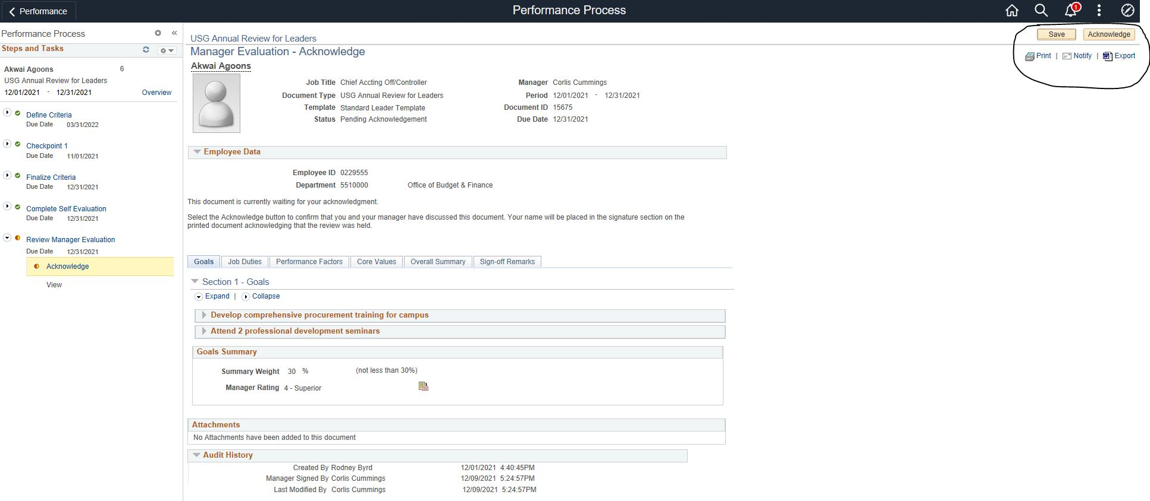
Step 20: Employee must review evaluation AND meet with manager to review, ask questions, give feedback, etc. Once meeting is complete, employee will “acknowledge” or “sign” the evaluation.

Slide 38
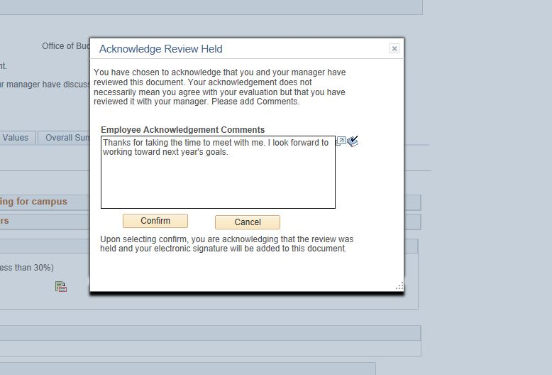

Slide 39
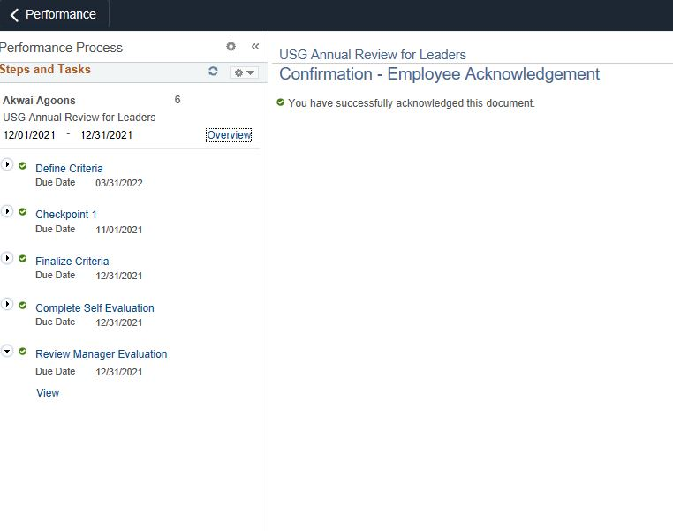

Slide 40
Performance document will be maintained in the “My Historical Documents” section of the Performance Tile in Employee Self Service.

