Slide 1
USG New Sexual Misconduct & Title IX Investigator Training
Na’Tasha Webb-Prather
System Director for Equity & Investigations
Legal Counsel
Brandi Williams
Equity Compliance Investigator & Trainer

Slide 2
Title IX Overview
Force-Incapacity-Consent Construct
Case Studies
USG Sexual Misconduct Policy
Formal Investigation Process

Slide 3

Who’s Here in the Room?
What’s your day job?
What do you believe it means to be an Investigator?
Does anyone have prior experience serving on panels or as an investigator?

Slide 4
Primary Function of the Investigator
Be a neutral fact finder
  Hear the facts and circumstances of an alleged policy violation
  Gather additional relevant information
Determine whether the evidence supports a charge of a policy violation
Communicate findings in a clear and concise manner

Slide 5
Title IX Overview

Slide 6
Title IX
The law states that:
"No person in the United States shall, on the basis of sex, be excluded from participation in, be denied the benefits of, or be subjected to discrimination under any education program or activity receiving Federal financial assistance..."
—United States Code

Slide 7
Administrative Action on Title IX
2011 & 2014
Obama Guidance
2017
Trump Guidance
2018
Rule Making Notice & Comment
May 2020
Final Rule Issued
August 2020
Final Rule effective
Board Policy updated

Slide 8
What is Sex Discrimination?
Sex Discrimination
Discriminatory Acts
Sexual Harassment
Retaliation

Slide 9
Title IX Sexual Harassment §106.30
Conduct on the basis of sex that satisfies one or more of the following:
  (i)An employee conditioning education benefits on participation in unwelcome sexual conduct (i.e quid pro quo); or
  (ii)Unwelcome conduct that a reasonable person would determine is so severe, pervasive, AND objectively offensive that it effectively denies a person equal access to the school’s education program or activity; or
  (iii) Sexual assault (as defined in the Clery Act), dating violence, domestic violence, or stalking as defined in VAWA

Slide 10

Title IX Jurisdiction
Institution’s program or activity in the United States
  Institution property
  Institution sponsored or affiliated events [substantial control is key]
  Buildings owned or controlled by officially recognized student organizations
This Photo by Unknown Author is licensed under CC BY-ND

Slide 11
System Wide Sexual Misconduct Policy

Slide 12
Sexual Misconduct Policy
Title IX
Other Sexually Based Behavior

Slide 13
Key Categories of Prohibited Conduct
Sexual Misconduct
Dating Violence
Domestic Violence
Nonconsensual Sexual Contact
Sexual Exploitation
Sexual Harassment
Nonconsensual Sexual Penetration
Stalking

Slide 14
USG Prohibited Conduct Definitions

Slide 15
Dating Violence
Violence committed by a person who is or has been in a social relationship of a romantic or intimate nature with the alleged victim.
Includes sexual or physical abuse
Includes threats of such abuse
The existence of a covered relationship is based on the totality of the circumstances

Slide 16
Domestic Violence
Violence committed by:
a current spouse, former spouse or intimate partner
a person whom shares a child
a person who is cohabiting with or cohabitated with the alleged victim

Slide 17
Stalking
Engaging in a course of conduct directed at a specific person that would cause a reasonable person to fear for his or her safety or the safety of others OR suffer substantial emotional distress.
Can be direct actions or through third parties
Could include the use of devices or other methods
Includes following, monitoring, observing, surveilling, threatening, communicating to or about a person, or interfering with a person’s property

Slide 18
Sexual Exploitation
Taking non-consensual or abusive sexual advantage of another for one’s own advantage or benefit, or for the benefit or advantage of anyone other than the one being exploited.
Examples include:
Non-consensual photos, videos, or audio of sexual activity
Non-consensual distribution of photo, video, or audio of sexual activity, even if the sexual activity was consensual
Intentionally and inappropriately exposing one’s breast, buttocks, groin, or genitals in non-consensual circumstances

Slide 19
Nonconsensual Sexual Contact
Any physical contact with another person of a sexual nature without the person’s consent.
Includes:
Touching of another’s intimate parts (genitalia, groin, breasts, buttocks)
Touching a person with one’s own intimate parts; or
Forcing a person to touch his or her own or another person’s intimate parts

Slide 20
Nonconsensual Sexual Penetration
Any penetration of another’s body parts without the person’s consent.
Includes:
Penetration of the vagina, anus, or mouth by a penis, object, tongue, finger, or other body part
Contact between the mouth of one person and the genitals or anus of another person

Slide 21
Sexual Harassment (Student on Student)
Unwelcome verbal, nonverbal, or physical conduct based on sex (including gender stereotypes), determined by a Reasonable Person to be so severe, pervasive, and objectively offensive that it effectively denies a person equal access to participate in or to benefit from an institutional education program or activity

Slide 22
Sexual Harassment (Other)
Unwelcome verbal, nonverbal, or physical conduct, based on sex (including gender stereotypes) that may be any of the following:
Implicitly or explicitly a term or condition of employment status in a course program or activity
A basis for employment or education decisions; OR
Sufficiently severe, persistent, or pervasive to interfere with one’s work or educational performance creating an intimidating, hostile, or offensive work environment
Note: Behavior may rise to the level of a Title IX violation

Slide 23
Understanding
The Force-Incapacity-Consent Construct

Slide 24
Overview of the Construct
Was force used by the Respondent to engage in the sexual activity?
Was the Complainant Incapacitated?
  Did the Respondent know OR
  Should the Respondent have known that the Complainant was incapacitated?
What clear words or actions by the Complainant gave the Respondent indication that the sexual activity was mutually agreed upon?
Was the Complainant’s consent withdrawn during the sexual activity?

Slide 25

Consent
Words or actions that show a knowing and voluntary willingness to engage in a mutually agreed upon sexual activity
Past consent ≠ Present consent
The scope of consent matters
Can be invalidated by: force, intimidation, incapacitation, or withdrawal

Slide 26
Force
Was force used by the Respondent to engage in the sexual activity?
Because consent must be voluntary (an act of free will) consent cannot be obtained through use of force
Types of Force to consider:
  Physical violence -- hitting, restraint, pushing, kicking, etc.
  Threats -- anything that gets the other person to do something they wouldn’t ordinarily have done absent the threat

Slide 27
Force Continued
  Intimidation - an implied threat that menaces and/or causes reasonable fear
  Coercion – the application of an unreasonable amount of pressure for sexual access
    Consider:
      Frequency
      Intensity
      Duration
      Isolation

Slide 28
Force Analysis
Did the Respondent utilize force or intimidation to engage in the sexual activity with the Complainant?
  If yes = violation of policy
  If no = Move on with the analysis

Slide 29




Consent and the Role of Alcohol and Drugs

Slide 30
Incapacitation
Physical and/or mental inability to make informed, rational judgments
  Could the Complainant make rational, reasonable decisions ?
  Could the Complainant appreciate the situation and address it consciously?
More than mere intoxication or drunkenness

Slide 31
Determining Incapacitation
Incapacitation is a determination that will be made after the incident in light of all the facts available
Assessing incapacitation is very fact dependent analysis of the incident in question
Various forms of incapacity
  Alcohol or other drugs
  Mental/cognitive impairment
  Injury
  Sleep

Slide 32
Two-Part Incapacitation Analysis
Part One
Was the Complainant incapacitated?
Subjective analysis based on the facts surrounding the incident
Part Two
Did the Respondent know of the Complainant’s incapacity?
  Or would a Reasonable Person have known?
  Objective analysis based on the facts surrounding the incident

Slide 33
Common Factors that Impact the Effect of Alcohol
Rate of consumption
Strength of drink
Food in the stomach
Body Weight
Body Type – body fat percentage
Gender
Enzymes, hormones, water in body
Medications
Illness & dehydration
Fatigue
Caffeine
Genetics

Slide 34

Possible Signs of Incapacitation
Lack of control over physical movements
  Ex. Inability to dress or walk without assistance
Lack of awareness of circumstances or surroundings
Inability to communicate coherently
Vomiting
Total or intermittent unconsciousness

Slide 35
Respondent’s Awareness
The Respondent [or a Reasonable Person] must have been aware of the Complainant’s incapacity
The Respondent’s own intoxication does not negate their obligation to comply with policy standards

Slide 36
Incapacitation Analysis
If the Complainant was not incapacitated, move on to the 3rd question.
If the Complainant was incapacitated, but:
  The Respondent did not know it = analysis fails. Move on to the 3rd question.
  The Respondent should not have known it = analysis fails. Move on to 3rd question.
If the Complainant was incapacitated, and:
  The Respondent actually knew it = violation of policy
  The Respondent should have known it = violation of policy

Slide 37
Consent
What clear words or actions by the Complainant gave the Respondent permission for the specific sexual activity that took place?

Slide 38
Consent Is…
Informed (knowing)
Voluntary (freely given)
Active (not passive)
Clear words or actions
Indicates permission to engage in mutually agreed upon (sexual) activity

Slide 39
Rules to Remember
No means no, but nothing also means no Silence and passivity do not equal permission
To be valid, consent must be given prior to or contemporaneously with the sexual activity
Consent can be withdrawn at any time

Slide 40

Withdrawal
Remember consent can be withdrawn at any time
The person withdrawing consent is expected to clearly communicate with words or actions they are withdrawing consent
Other person is required to cease sexual activity until consent is regained

Slide 41

!
…
?
…
?
!

Slide 42
Title IX Investigation Overview
Weighing & Evaluating Information
Writing the Investigation Report
Overview of Investigator Responsibilities

Slide 43
Investigator Roles & Responsibilities

Slide 44

Role of the Investigator
Fair and unbiased review of matter
Follow the Policy
  Standard of proof
  Avoid burden shifting
Make a preliminary determination regarding the violation(s) and possibly recommend sanction(s)

Slide 45
Recognize and Avoid Your Own Bias
Role of Alcohol
Own experiences…
Student-Athletes
Fraternity/Sorority Life
International Students
Sex/Gender
Gender Identity
Race
Ethnicity
Nature of the Violation
Religion or religious beliefs
Academic Field of Study/Major
Politics
Attitude
Others?

Slide 46
Title IX Investigation Overview

Slide 47

Steps in the Investigation Process
Report is made
Intake by Title IX Coordinator
Filing of a Formal Complaint
Assignment to the Investigator
Development of an Investigation Plan
Fact Gathering
Analysis of Information & Report Writing
Case Resolution/Adjudication

Slide 48

Complaint Intake
Typically handled by the Title IX Coordinator
Determination that the alleged conduct falls within the Sexual Misconduct Policy
May determine which process to follow
Identification of the involved parties
IS NOT THE INVESTIGATION

Slide 49
Interim Measures
Examples
Housing changes
No Contact Directive
Class changes
Employment schedule or location changes
Administrative Leave
Interim Suspension*
May be implemented at any point by the Title IX Coordinator
Must be available to both parties
Must be implemented in an equitable manner designed to protect the parties and/or the campus community
*Require approval of System Director

Slide 50
Formal Complaint §106.30
A document filed by a Complainant OR signed by the Title IX Coordinator
Alleges Sexual Harassment (Title IX)
Requests an investigation
Note: must be filed while the Complainant is participating in or attempting to participate in an education program or activity

Slide 51
Developing an Investigation Plan
Review the Complaint Intake and any available information
Review the Sexual Misconduct Policy
Review relevant investigation procedures
Determine order of interviews
Gather preliminary evidence
Develop preliminary questions

Slide 52

Key Aspects in the Investigation Process
Written notice to parties
  Pending investigation
  Possible charges
  Possible sanctions
  Available support resources
  Identify the assigned investigator
Opportunity for written response

Slide 53
Key Aspects in the Investigation Process
Parties’ right to an Advisor
  May be an attorney
  Purpose: provide advice and counsel
Parties’ right to remain silent or otherwise not participate
  Non-response = general denial
  Non-response ≠ adverse inference

Slide 54
Fact Gathering
Interviews
Provided Evidence
Additional Evidence

Slide 55
Interview Strategies
Set a professional non-accusatory tone
Introduce yourself and outline your role
Acknowledge what emotions they may be experiencing
Review the amnesty and retaliation policies
Outline an expectation of truthfulness
Discuss confidentiality
Reminder that there may be follow-up interviews

Slide 56
Retaliation and Amnesty Policies
Anti-Retaliation Policy
Applies to students and employees equally
Individuals involved in the investigation should be free from any adverse action due to their participation
Amnesty Policy
Only applies to students
Designed to foster candor during investigations
Personal usage of drugs or alcohol will not be held against them in disciplinary matters

Slide 57

Effective Questioning
Questions should be used to determine:
    Who
    What
    When
    Where
    How
Be mindful of how a question could be perceived and develop them with caution

Slide 58
Effective Questioning
What are your goals?
Learn the facts
Establish a timeline
Determine what is more likely than not to have occurred [if possible]
What are NOT your goals?
Satisfying your curiosity
Answering every unknown to get the “Truth”

Slide 59
Effective Questioning Tips
Prepare preliminary/guiding questions in advance
Ask open-ended questions to start the conversation
  What are you able to remember about…?
  Tell me more about….
  Help me understand your thoughts when….
LISTEN, ask follow-up questions at the end
  Targeted and specific questions
If you get stuck conduct a recap

Slide 60
Additional Interviewing Tips
Don’t be afraid of silence
Don’t be afraid to ask for clarification
Take breaks if necessary
Maintain your professionalism at all times

Slide 61
How to Deal With…
A Challenging/Reluctant Participant
Address their concerns
Remain calm and professional
Explain the advantages of cooperating
A Lying Participant
Ask them to reconcile inconsistent statements
Try to determine motivation for lying [fearful, protecting a friend, embarrassed etc.]

Slide 62

Note-Taking
Handwritten or electronic record of the interview
  Remember you are creating a publicly available record
  Try to include verbatim statements
Include the date and names of all those present

Slide 63
Note-Taking Considerations
Use of audio recordings
Sending an interview summary for the participant to review and edit
Tip: Schedule time after an interview to review and type narrative summary

Slide 64
Evidence Gathering
Think of all the places and sources of information
  Involved parties, witnesses, physical locations, social media etc.
  Be timely
Document who provided what and when
Consider verifying the evidence provided
  Phone numbers, social media accounts, etc.

Slide 65
Understanding Evidence
Formal rules of evidence do not apply. If the information is considered relevant to prove or disprove a fact at issue, it should be admitted. If credible, it should be considered
Evidence is any kind of information presented with the intent to prove what took place
Certain types of evidence may be relevant to the credibility of the witness, but not to the charges

Slide 66
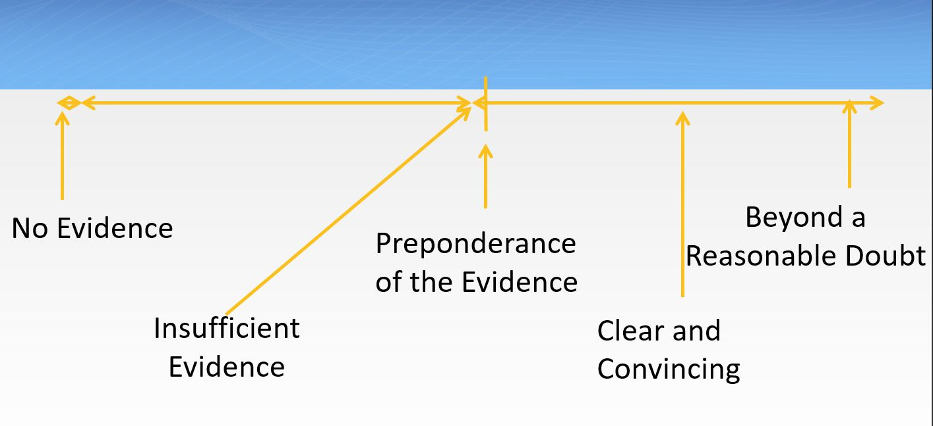
Understanding Evidence Thresholds

Slide 67
Types of Evidence
  Documentary evidence (supportive writings or documents)
  Electronic evidence (photos, text messages, videos)
  Real evidence (physical object)
  Direct or testimonial evidence (personal observation or experience)
  Circumstantial Evidence (not eyewitness, but compelling)
  Hearsay Evidence (statement made outside the hearing, but presented as important information)
  Character Evidence (generally of little value or relevance)

Slide 68

Weighing Evidence
Weighing evidence means assessing the impact of the information
The following factors impact the assessment:
  Relevance
  Reliability
  Persuasiveness
  Bias

Slide 69
Weighing Evidence: Impact Factors
Relevance
  Must relate to the incident at issue and be of sufficient value in the overall determination
  Must be offered by an individual with actual knowledge of the event
Irrelevant
Questions and information regarding the Complainant’s sexual history or sexual predisposition unless to prove
  Someone else other than the Respondent committed the alleged misconduct
  Consent between the parties

Slide 70
Weighing Evidence: Impact Factors
Reliability
  Information that can be trusted
  Comes from individuals who are able to have assumed the role they claimed to have or those with actual training or experience to support their claim of expertise
Persuasiveness
  Induces others to believe through understanding; tries to convince
  Must be believable, consistent, and establishes a dependable narrative
  Note: be mindful of the rehearsed narrative

Slide 71

Weighing Evidence: Impact Factors
Bias
  Understand who the person is and their relationship to the parties and incident at issue
  Bias can manifest in multiple ways:
    Towards the parties
    Towards the incident
    Towards the process
This Photo by Unknown Author is licensed under CC BY-SA-NC

Slide 72
Credibility
“To assess credibility is to assess overall the extent to which you can rely on a witness’ testimony to be accurate and helpful in your understanding of the case”
  Credible is not synonymous with the absolute truth
  Memory errors do not necessarily destroy a witness’ credibility, nor does some evasion or misleading
  Refrain from focusing on irrelevant inaccuracies and inconsistencies
Potential Assessment Factors
  Demeanor
  Non-cooperation
  Logic/Consistency
  Corroborating evidence

Slide 73
Other Evidentiary Exclusions
Legally privileged information is protected
A party’s treatment records cannot be used without their voluntary, written consent
Duplicative evidence may be deemed irrelevant
If an individual does not submit to cross examination, at a Title IX hearing, their statements cannot be relied upon

Slide 74
Understanding Evidence Thresholds

Slide 75

Avoid Common Pitfalls
Interview each party and witness separately*
Apply the correct policy
Maintain your sensibilities
  Difficult parties
  Attorneys

Slide 76
Writing the Investigation Report

Slide 77

The Investigation Report
Executive Summary
Relevant Policy Provisions
Information Gathered During the Investigation
An Analysis of the Information Gathered
Recommendations for Informal Resolution OR Conclusion
Investigation Timeline
Necessary Attachments

Slide 78
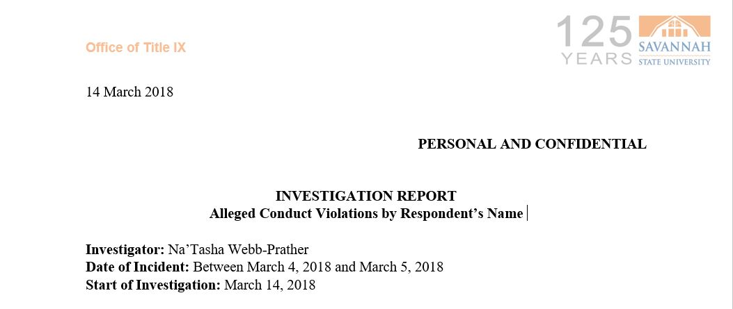
Basic Formatting
University Letterhead
Date
Title of Document
Investigator Name(s)
Names of the Involved Parties

Slide 79
Executive Summary
Big picture investigation information
  Who reported the incident?
  To whom did they report?
  When did they report?
  Who was assigned to investigate?
  How was the investigation conducted?
  What were the overall findings of the investigation?
Noteworthy occurrences

Slide 80

Relevant Policy Provisions
Copy and paste verbatim RELEVANT portions
Footnote link to full policy or provide as attachment

Slide 81
Information Gathered During The Investigation
Narrative summaries of information NOT transcriptions
  Laid out in a logical manner
  Limit witness portions to information relevant to analysis
Include quotes where deemed appropriate
Adopt one writing style
Discuss individuals not interviewed

Slide 82

Information Gathered During The Investigation
Discuss individuals not interviewed
Discuss any other evidence gathered and the source even failed attempts
TIP: Schedule time after each interview to begin writing narrative summary

Slide 83

Investigative Findings/Analysis
A synthesis of the information gathered in light of our policy
Walk through the policy violation
Remember: You’re a NEUTRAL fact-finder
  Include not only corroborating information but also exculpatory information
Credibility Assessments

Slide 84
Walking Through Policy Violations
Nonconsensual Sexual Contact
  Was there physical contact of a sexual nature?
  Was there consent?
  Was the consent invalid because of:
    Force
    Intimidation or Coercion
    Incapacitation
  Was the consent withdrawn?

Slide 85
Walking Through Policy Violations
Incapacitation
  Part One = Subjective Test
    Physical and/or mental inability to make informed decisions
    SOME Signs: unconsciousness, lack of control of physical movements, inability to communicate clearly
  Part Two = Objective Test
    Judged from a Reasonable Person’s perspective

Slide 86

Recommendations for Informal Resolution/ Conclusion
Short and sweet
Based on the totality of the evidence a preponderance of the evidence supports/does not support a charge of (insert policy violation)
Remember: NOT ISSUING FINDINGS OF RESPONSIBILITY
Broad range of sanctions at play

Slide 87

Determining Appropriate Sanctions
“Must be made as a proportionate response to the violation.”
Should prevent the recurrence of sexual misconduct
Should remedy the effects of the sexual misconduct

Slide 88
Common Sanctions
Warning
Probation
Loss of Privileges
Counseling
No Contact
Residence Hall Relocation, Suspension or Expulsion
Limited Access to Campus
Service Hours
Online Education
Alcohol & Drug Assessment and Counseling
Termination
Suspension*
Expulsion*
*Must be supported by substantial evidence at the hearing

Slide 89
Understanding Substantial Evidence
Required to suspend or expel a student
MUST be able to clearly state what evidence exists to support the finding
Cannot be merely a feeling!

Slide 90
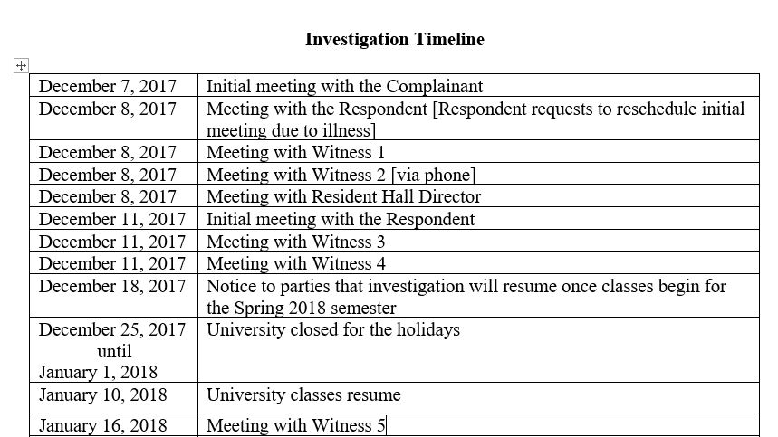
Investigation Timeline
Procedural History
Key dates and events throughout the process
Does not have to be a narrative

Slide 91
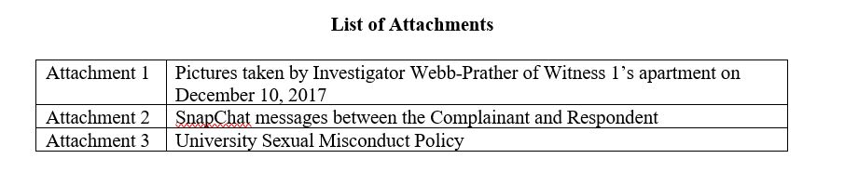
Necessary Attachments
Documentary Evidence
Written Statements
Optional: Full Policy

Slide 92

Optional Aspects of the Investigative Report
Incident Timeline
Incapacitation Timeline
Chart of Involved Parties
Disputed v. Undisputed Facts

Slide 93
Key Aspects in the Investigation Process
Parties right to review and respond to the investigation report
  Provide adequate and equitable time
Sharing the final investigation report
  The parties (and advisor*)
  Hearing Panel

Slide 94

Things to Avoid
Merely transcribing interviews
Writing a one-sided report
Steering or otherwise influencing the hearing proceedings
Assuming reader knowledge

Slide 95
The Resolution/Adjudication Process

Slide 96

Informal Resolution
Available throughout the investigation process
The nature of the incident permits a less formal approach
The institution determines that informal resolution is in the best interest of the parties and the campus community
Both parties AND the institution have to agree to the terms
Handled by the Title IX Coordinator

Slide 97
The USG Adjudication Processes
Students
All matters not informally resolved will be heard by a Hearing Panel
Hearing Panels comprised of trained faculty and staff
Employees
Title IX matters not informally resolved will be heard by a designated decision-maker
  Single decision-maker OR panel
Sexual Misconduct matters not informally resolved will be resolved according to previously established procedures
  Institutions may choose to offer a hearing

Slide 98
Live Hearing §106.45(b)(6)
The Final Rule mandates a bifurcated process
Final determinations of responsibility and sanctions are made by decision-makers
  CANNOT be the Title IX Coordinator or assigned investigator
New due process considerations
  Cross examination
  Relevancy determinations
  Impact of party or witness refusal to submit to cross-examination
Institutions can establish rules of decorum

Slide 99
Title IX Hearings
Advisors required to conduct cross examination
Relevancy determinations must be made before a question may be answered
If an individual does not submit to cross examination panelists may not rely on their statements
Sexual Misconduct Hearings
Hearing Panelist or Officer performs all questioning
Relevancy determinations are made before and during the hearing
Panelists permitted to rely on statements provided during the hearing and in the investigation report

Slide 100
Typical Order of a Hearing
Opening by Decision Maker
Opening statements by both parties
Questioning of the Complainant
  By the hearing panel or chair
  By other party (through their advisor or hearing panel/chair)
Questioning of the Respondent
  By the hearing panel or chair
  By other party (through their advisor or hearing panel/chair)
Questioning of any Witnesses
  By the hearing panel or chair
  By other party (through their advisor or hearing panel/chair)
Closing statements by both parties
Closing by Decision Maker

Slide 101

Appeals
Parties will continue to have both institutional level and Board level appeal opportunities
Grounds for an appeal:
  New information
  Procedural Error
    Ex. Bias or conflict of interest of Title IX personnel
  Finding inconsistent with the weight of the information
This Photo by Unknown Author is licensed under CC BY-NC-ND

Slide 102
Additional Considerations

Slide 103
Retaliation §106.71
Who is protected: Reporters, Complainants, Witnesses, Respondents, even those who choose to not participate
What is protected: Intimidation, threats, coercion, discrimination
  Ex. Charging individuals for code of conduct violations that arise out of the same facts or circumstances
  Ex. Not keeping the identity of the Complainant, Respondent, or any witnesses confidential

Slide 104

Record Keeping §106.45(b)(10)
7-year records retention mandate:
  Reports [supportive measures, why not deliberately indifferent and what measures taken to restore or preserve equal access]
  Investigations [determinations, recording of hearing, sanctions and remedies implemented]
  Appeals
  Informal resolutions [results]
  Training materials
This Photo by Unknown Author is licensed under CC BY-SA-NC

Slide 105
!
…
?
…
?
!

