Slide 1
Viruses, Prions and Viroids Infectious Agents of Animals and Plants
Chapter 14

Slide 2
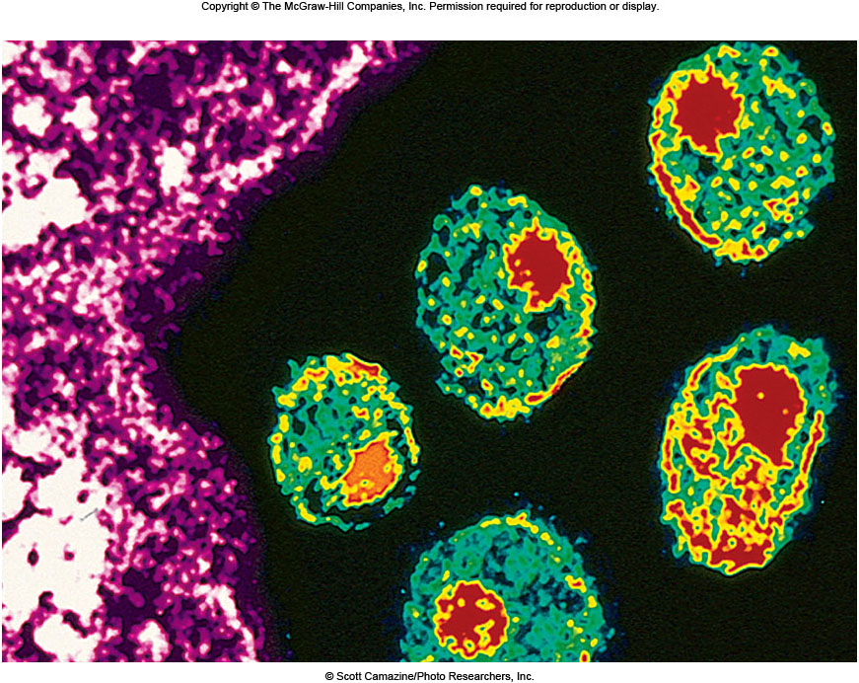
What am I?

Slide 3
Structure and Classification of Animal Viruses
Classification of animal viruses
Taxonomic criteria based on
Genomic structure
DNA or RNA
Single-stranded or double-stranded
Virus particle structure
Isometric
Pleomorphic
Helical
Presence or absence of envelope

Slide 4
Structure and Classification of Animal Viruses
Groupings based on route of transmission
Disease-causing viruses often grouped by route of transmission
Enteric viruses (Polio)
transmitted via fecal-oral route
gastroenteritis
Respiratory viruses (coronavirus)
Inhaled respiratory droplets
localized in respiratory tract
Zoonotic viruses (WestNile, rabies)
animal vector
Sexually transmitted viruses (herpes, HIV)

Slide 5
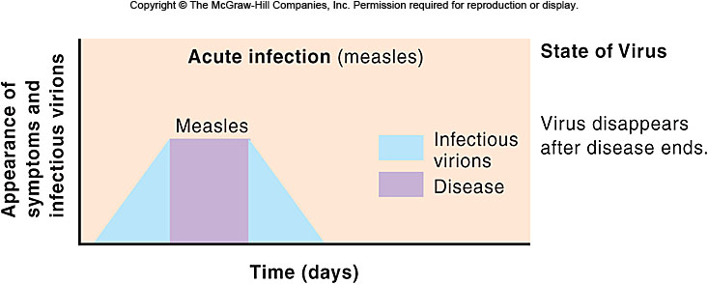
Interactions of Animal Viruses with Their Host: Acute infections
Short in duration
Develop long-lasting immunity
Productive infections
Disease symptoms result from tissue damage and infection of new cells

Slide 6
Interactions of Animal Viruses with Their Host
Acute infections
Essential steps include
Attachment
Entry
Targeting site of reproduction
Uncoating of virion
Replication of nucleic acid and protein
Maturation
Release from cells
Shedding outside host
Transmission to next host

Slide 7
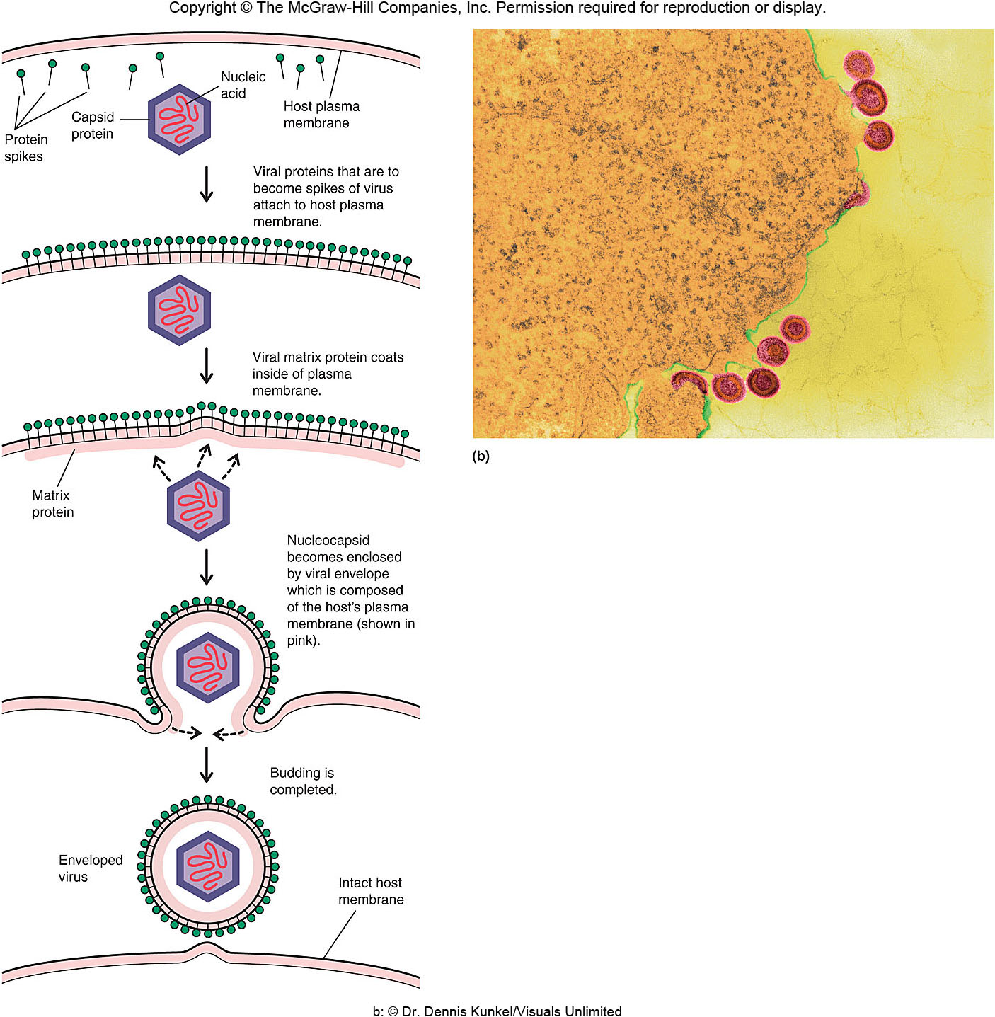
Interactions of Animal Viruses with Their Host
Persistent infections
Viruses continually present in host
Release from infected cell via budding
Three categories distinguished by detection of virus during period of persistence
Latent infections
Chronic infections
Slow infections

Slide 8
Interactions of Animal Viruses with Their Host: Persistent Infections
Latent infections
Infection is followed by symptomless period, then reactivation
Infectious particles not detected until reactivation
Symptoms of reactivation and initial disease may differ
Example
Herpes simplex viruses 1 and 2 (HSV1 and HSV2)
Shingles (zoster, chicken pox)

Slide 9
Interactions of Animal Viruses with Their Host: Persistent Infections
Chronic infections
Infectious virus can be detected at all times
Disease may be present or absent during extended times or may develop late
Best known example
Hepatitis B
a.k.a serum hepatitis

Slide 10
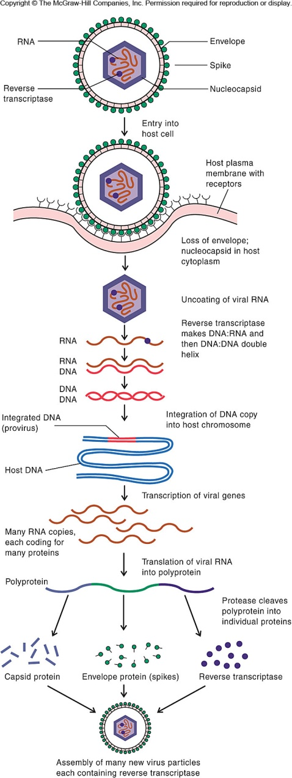
Interactions of Animal Viruses with Their Host: Persistent Infections
Slow infections
Infectious agent gradually increases in amount over long period of time
Two groups of infectious agents cause slow infections
Retroviruses which include HIV
Prions
Similar to the lysogenic cycle of λ-phage

Slide 11
Viruses and Human Tumors
Double-stranded DNA viruses responsible for most virus-induced tumors in humans
Cancers caused by DNA viruses result from integration of viral genome onto host DNA
Transformed genes are expressed
Uncontrolled growth results

Slide 12
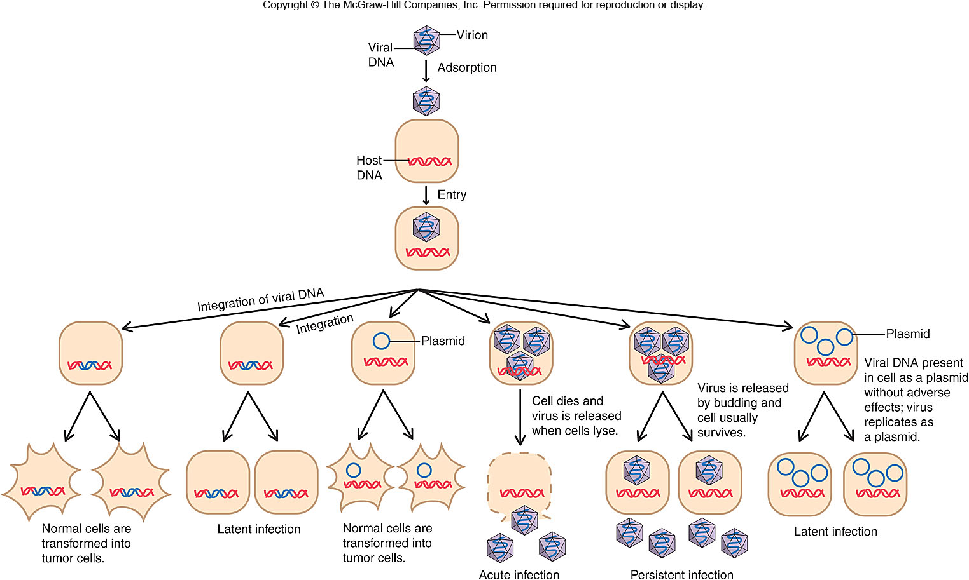
Viruses and Human Tumors: Effects of Animals Viruses

Slide 13
Viral Genetic Alterations
Viruses can alter properties via
Mutation
Genetic reassortment
Genetic reassortment of viruses results from two viruses infecting the same cell
Each virus incorporates segments of viral DNA
One segment comes from one virion
Rest of segments come from other virion
Reassortment responsible for antigenic shift and antigenic drift in Influenza virus

Slide 14
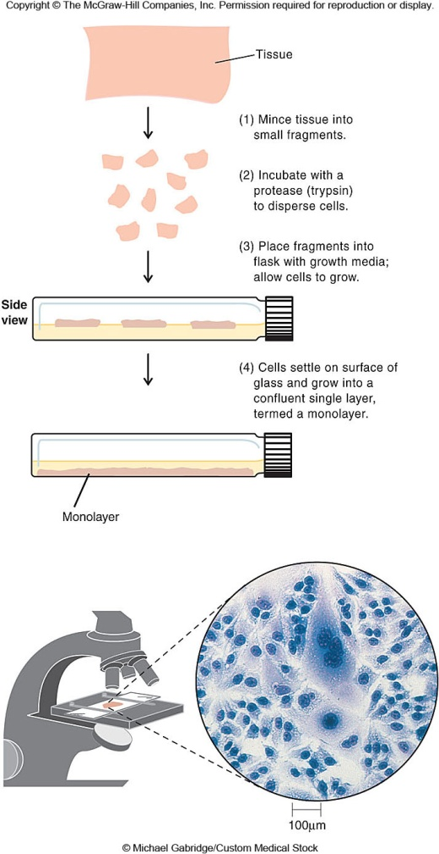
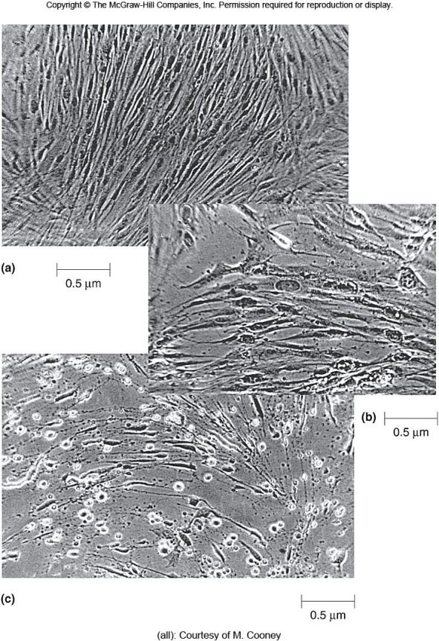
Methods of Studying Viruses
Cultivation of host
Viruses multiply only inside host cell
Host cells are cultivated in the laboratory in cell culture or tissue culture

Slide 15
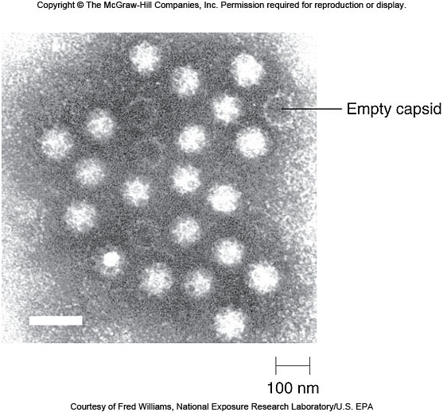
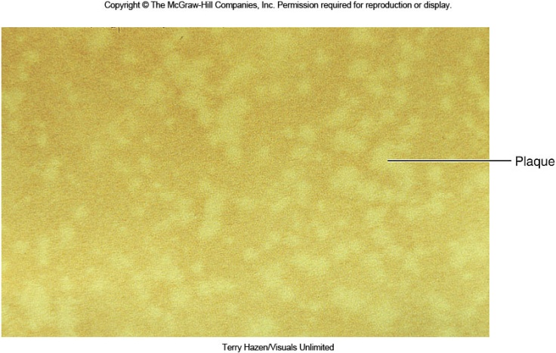
Methods of Studying Viruses
Quantitation
TEM direct count
Plaque assay
Determines number of viruses in solution
Each plaque represents one virion

Slide 16
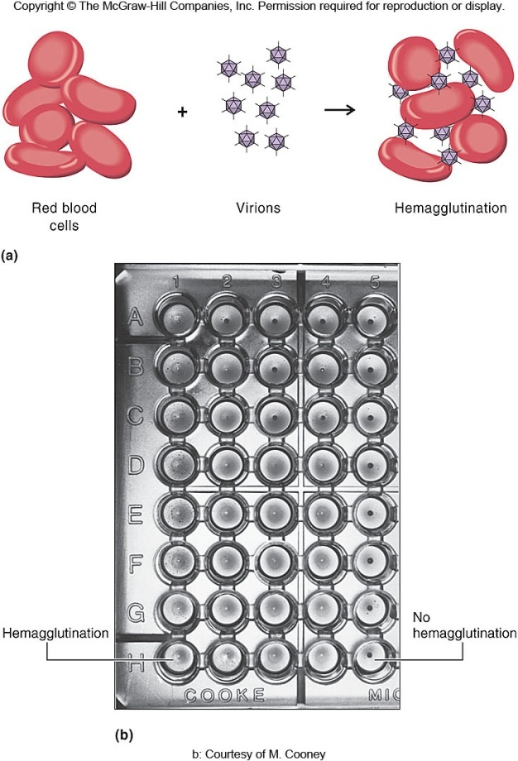
Methods of Studying Viruses
Hemagglutination
Hemagglutination
Some animal viruses clump or agglutinate with red blood cells
The highest dilution showing maximum agglutination is titer of the virus

Slide 17
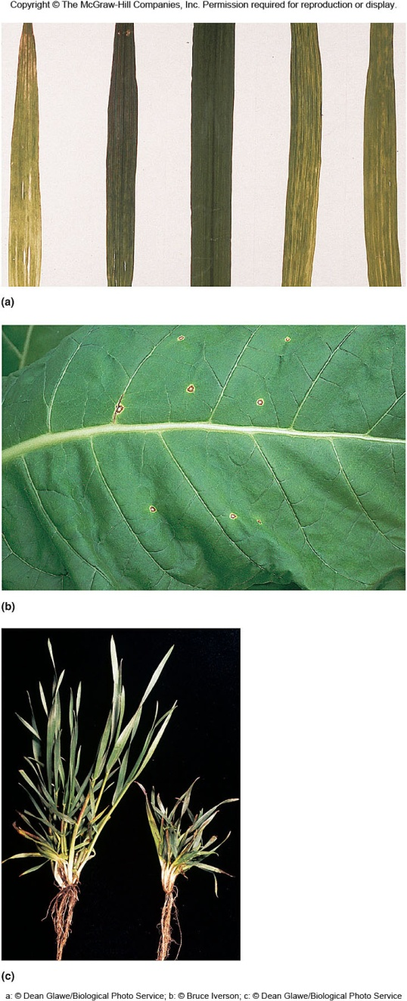
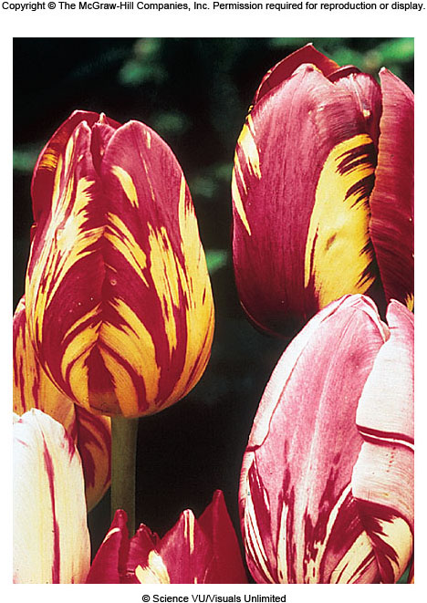
Plant Viruses
Number of plant diseases are caused by viruses
Infection may be recognized via outward signs including
Pigment loss
Marks on leafs and fruit
Tumors
Stunted growth
Plants generally do not recover from viral infections

Slide 18
Other Infectious Agents
Prions
Proteinaceous infectious agent
Linked to a number of fatal human diseases
transmissible spongiform encephalopathies
Brain tissue develops sponge-like holes
Symptoms may not appear for years after infection

Slide 19
Other Infectious Agents
Prions
Apparently arose following gene encoding normal prion protein
Mutation caused protein to have different folding properties
Mutated protein resistant to proteases
Inactivated by chemicals that denature proteins

Slide 20
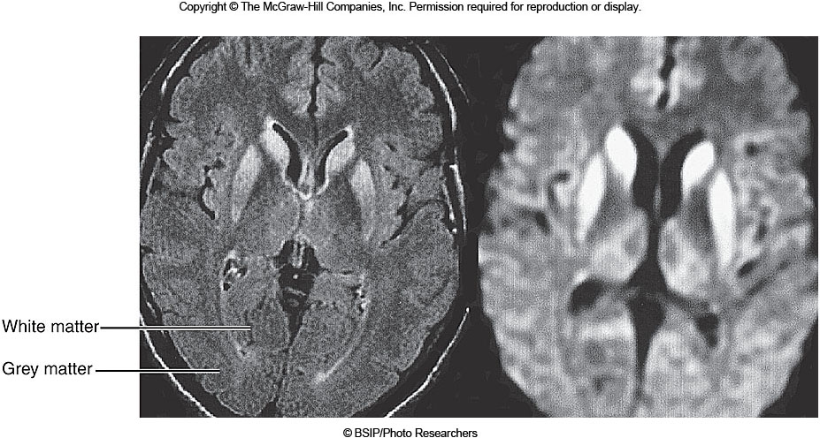
Other Infectious Agents
NORMAL SPONGIFORM

Slide 21
Other Infectious Agents
Viroids—infect plants
Define group of pathogens much smaller and distinctly different from viruses
Consist solely of small single-stranded RNA molecule
Have no protein coat

Slide 22
Other Infectious Agents
Viroids
Other viroid properties include
Replicate autonomously in susceptible cells
Viroid RNA is circular and resistant to nuclease digestion
Diseases include
Potato spindle tuber
Chrysanthemum stunt
Cadang-cadang

