Slide 1
Diversity of
Prokaryotic Organisms
Chapter 11

Slide 2
Early Beginnings
Anaerobic Chemotrophs were among some of the first prokaryotes
  Organisms in this classification
    Anaerobic chemolithotrophs
    Anaerobic chemoorganitrophs
  Use alternative molecules for terminal electron acceptor (not O₂)
Notes:
Found in soil, aquatic environments and the human body

Slide 3
Chemolithotrophs
Chemolithotrophs oxidize reduced inorganic chemicals (e.g. H₂) to produce energy
  Rare organisms
  Not O₂ tolerant
  Terminal electron acceptor usually carbon dioxide or sulfur
  Members of the domain Archaea

Slide 4
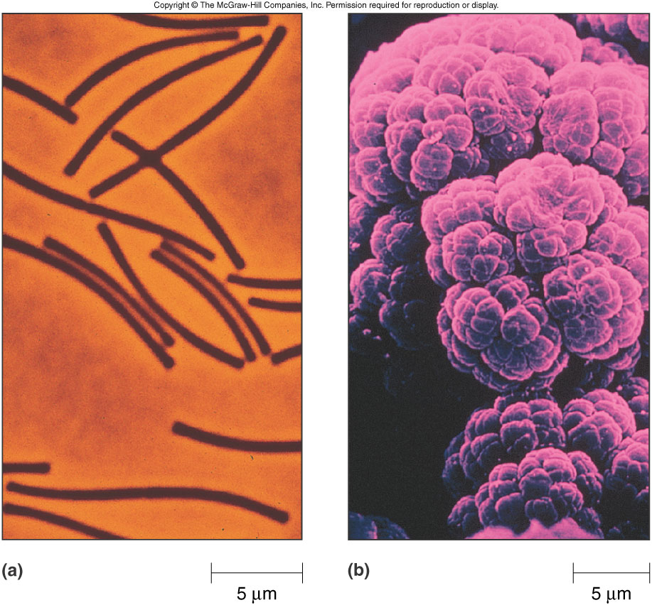
Chemolithotroph: Methanogens
Members of Domain Archaea
Found in sewage, swamps, marine sediments and digestive tract of mammals
Highly sensitive to oxygen
Produce energy (ATP) the reaction:
  4H₂ + CO₂ → CH₄ + 2 H₂O

Slide 5
Anaerobic Chemoorganotrophs:
-Anaerobic Respiration
Produce ATP via anaerobic respiration through the oxidation of organic molecules
  Also use terminal electron acceptor other than oxygen
    Sulfur and sulfate reducing bacteria
      Generally found in mud rich in organic matter and sulfur
Organic compounds + S CO₂ + H₂S
(energy source) (terminal electron
acceptor)

Slide 6
Anaerobic Chemoorganotrophs: -Fermentors
Genus Clostridium
  Gram-positive rods found in soil
  Endospores
Ferment wide variety of compounds
Representitives:
  C. tetani,
  C. perfringens,
  C. botulinum

Slide 7
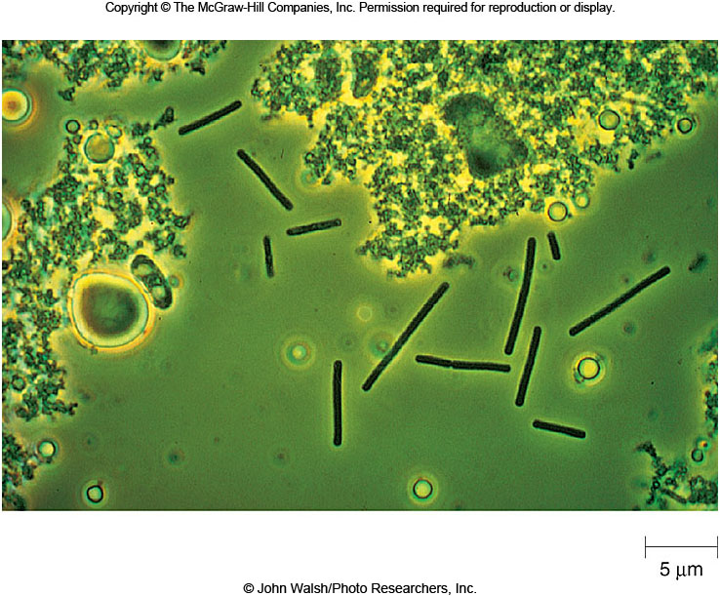
Anaerobic Chemoorganotrophs: Fermentors
Lactic acid bacteria are Gram-positive organisms that produce lactic acid as an end product of fermentation
Obligate fermenters, not O₂ sensitive.
Lack catalase
Notes:
Streptococcus, Enterococcus, Lactococcus, Lactobacillus, Leuconostoc

Slide 8
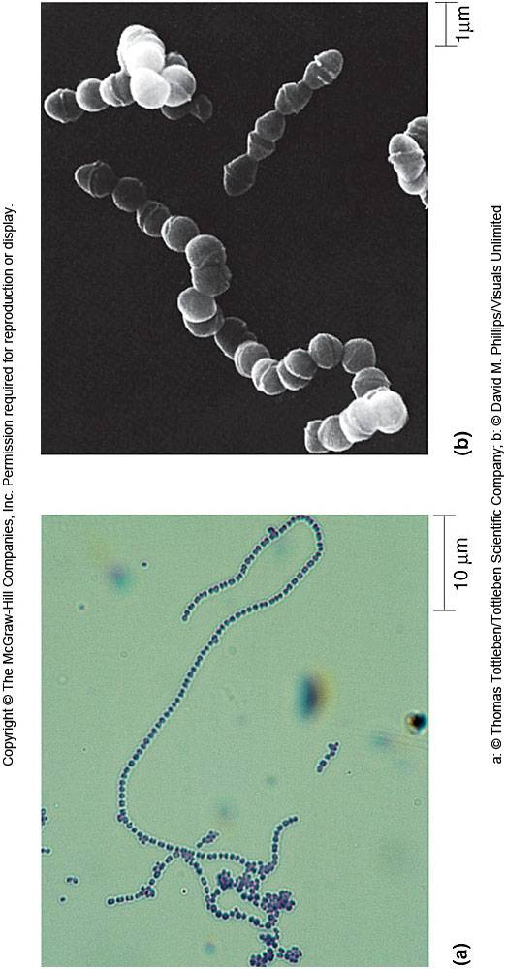
Anaerobic Chemoorganotrophs: Fermentors
Streptococci:
  Normal flora
  S. pyogenes
Lactobacillus
  Normal flora of mouth and vagina

Slide 9

Anaerobic Chemotrophs
Propionibacterium species are Gram-positive rods
Organisms produce propionic acid as end product of fermentation
  Found in anaerobic micro environments
  Essential in the production of Swiss cheese
  Also ferment lactic acid

Slide 10
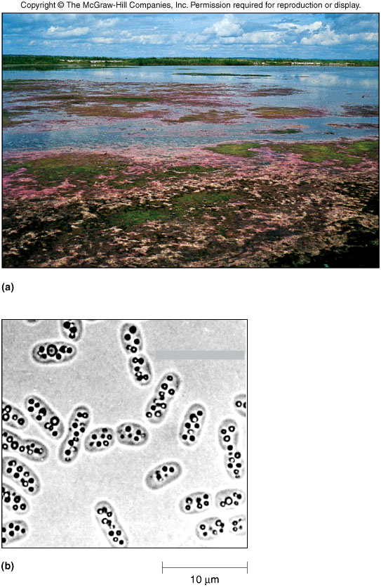
Anoxygenic Phototrophs:
--Earliest Photosynthesizers
Anoxygenic Phototrophs oxidize hydrogen sulfide or organic molecules when making NADPH
  An example is:
  6 CO₂ + 12 H₂S C₆H₁₂O₆ + 12 S + 6 H₂O
  (carbon (electron source)
  source)
Do not produce O₂ as consequence of photosynthesis
Notes:
Purple non-sulfur bacteria
Found in Moist soil, bogs and paddy fields
Prefer to use organic source of electrons for reducing power
Most can grow aerobically and in absence of light
Purple sulfur bacteria
Hydrogen sulfide to generate reducing power
Most are strict anaerobes and phototrophs

Slide 11
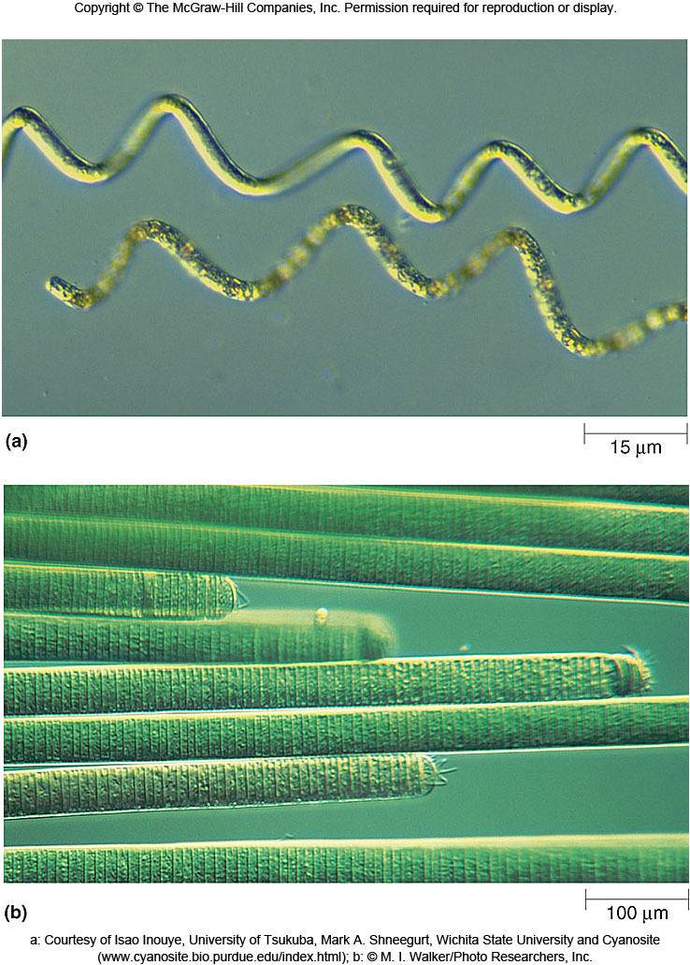
Oxygenic Phototrophs: Cyanobacteria
Photosynthetic bacteria that use water as source of electrons and supplies O₂, and organic N
  Nitrogenase, enzyme required to fix N is O₂ sensitive
Primary producers

Slide 12
Aerobic Chemolithotrophs
Obtain energy-oxidizing reduced inorganic chemicals
  Oxygen as terminal electron acceptor
  Includes sulfur-oxidizing bacteria, nitrifiers and hydrogen-oxidizing bacteria

Slide 13
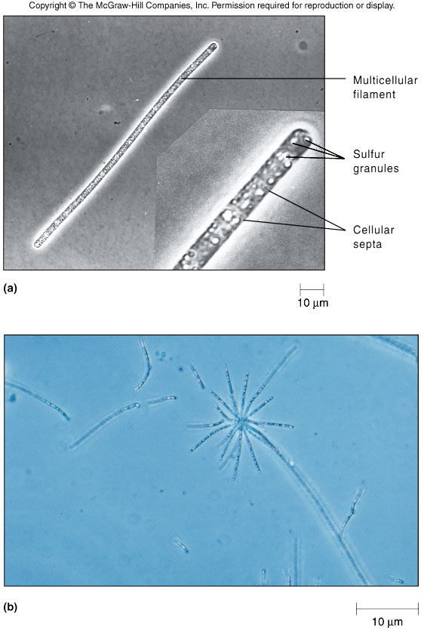
Aerobic Chemolithotrophs: Sulfur-Oxidizing Bacteria
Gram-negative rods or spirals
  Sometimes grow in filaments
Obtain energy through oxidation of reduced sulfur
  Molecular oxygen serves as terminal electron acceptor
S + 1½ O + H₂O H₂ SO₄
Notes:
An example of this is:
(energy (terminal
source) electron)
live in sulfur springs, sewage-polluted waters and on surface of aquatic sediments

Slide 14
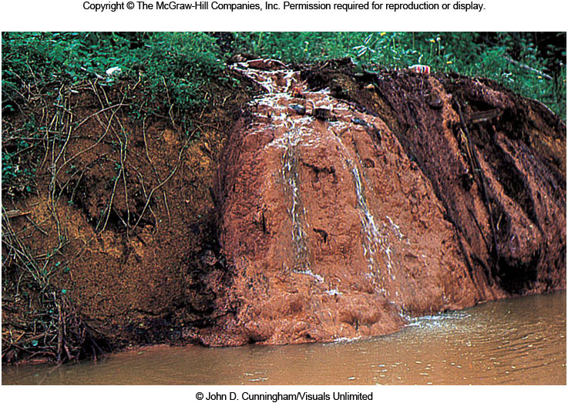
Aerobic Chemolithotrophs: Sulfur-Oxidizing Bacteria
Unicellular sulfur oxidizers
  found in both terrestrial and aquatic environments
  Oxidation of metal sulfides producing sulfuric acid and soluble metal
  Some species produce enough acid to lower pH to 1.0

Slide 15
Aerobic Chemolithotrophs: Nitrifiers
Diverse group of Gram-negative bacteria
Oxidize inorganic nitrogen to obtain energy
  Nitrogen such as ammonia and nitrite
    NH₄ + 1½ O₂ NO₂⁻ + H₂O + 2H⁺
    (energy (terminal electron
    source) acceptor)

Slide 16
Aerobic Chemolithotrophs: Hydrogen-Oxidizing Bacteria
Gram-negative bacteria
Tend to be thermophilic
  Found in hot springs, up to 95°C
  H₂ + ½O₂ H₂O
  (energy source) (terminal electron
  acceptor)

Slide 17
Aerobic Chemoorganotrophs
Include tremendous variety of organisms
Oxidize organic compounds to obtain energy and oxygen as terminal electron acceptor
Classified as
  Obligate aerobes
  Facultative anaerobes
  Organic compounds + O₂ CO₂ + H₂O
  (energy source) (terminal electron
  acceptor)

Slide 18
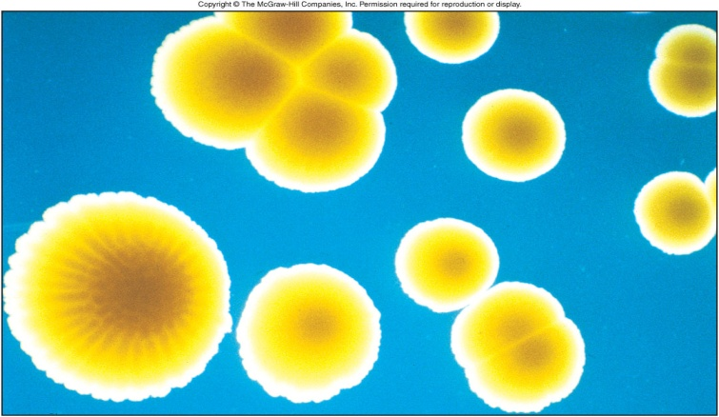
Aerobic Chemoorganotrophs: Obligate Aerobes
Obligate aerobes obtain energy using aerobic respiration exclusively
Characteristic genera include
  Micrococcus
    Gram-positive cocci found in soil and dust
    Produce yellow pigmented colonies
Mycobacterium
  Gram-positive bacterium
  Live on dead and decaying matter
Pseudomonas
  Gram-negative rods
  Motile and often pigmented
  Common opportunistic pathogen
Thermus and Deinococcus
  Both have scientific and commercial uses
    Thermus produces Taq polymerase
    Dinococcus used to clean up radioactive contamination

Slide 19
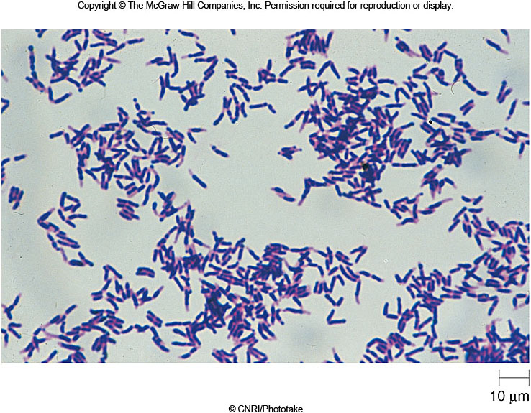
Aerobic Chemoorganotrophs: Facultative Anaerobes
Facultative anaerobes preferentially use aerobic respiration
Characteristic genera include
  Corynebacterium
    Gram-positive rods
    Inhabits soil, water and surface of plants
  Enterobacteriaceae
    Gram-negative rods
    Commonly referred to as enterics
    Reside in intestinal tract

Slide 20
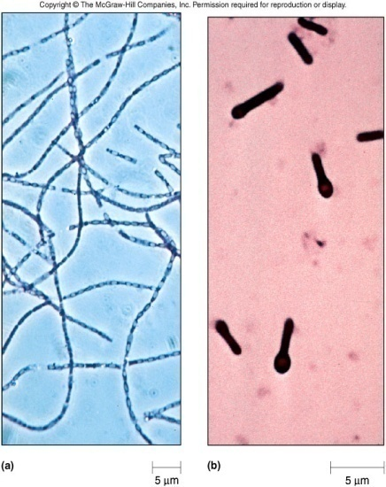
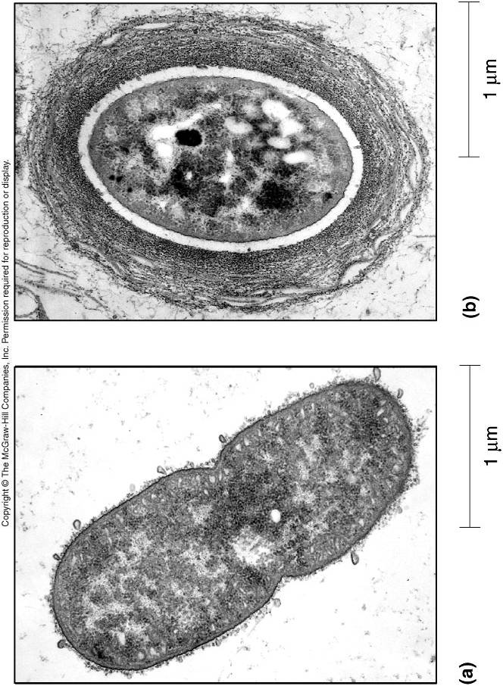
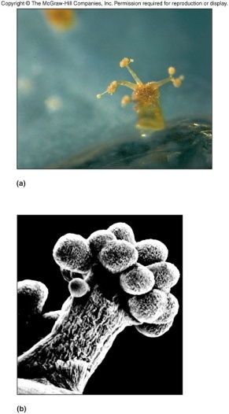
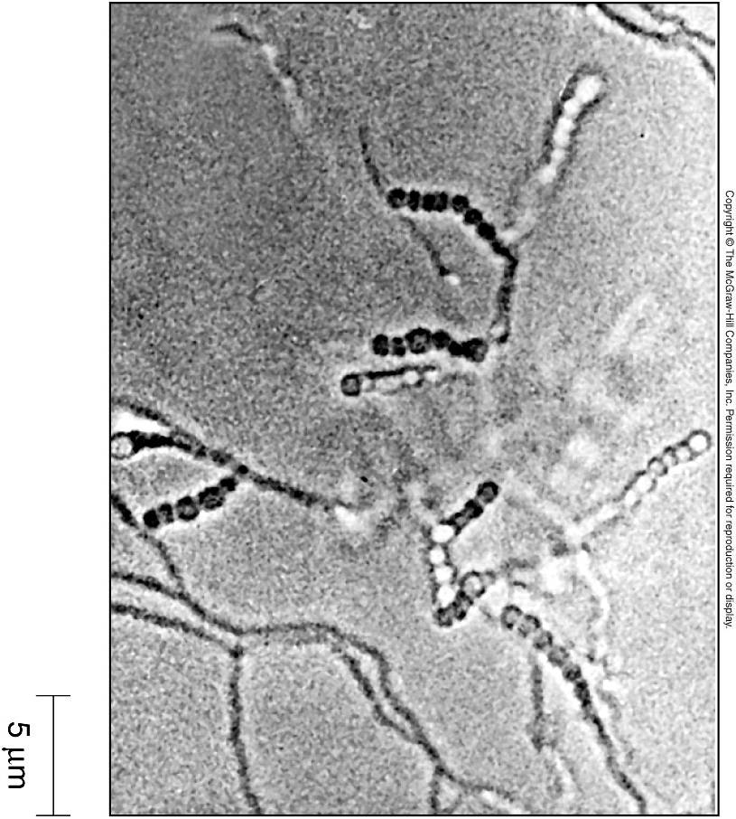
Thriving in
Terrestrial Environments
Produce endospores, cysts, fruiting bodies and mycelium
  Endospores: Bacillus and Clostridium
  Cysts: Azobactor
  fruiting bodies: Myxobacteria
  Mycelium: Streptomyces
Endospores tend to be more resistant to environmental insult than cysts or fruiting bodies

Slide 21
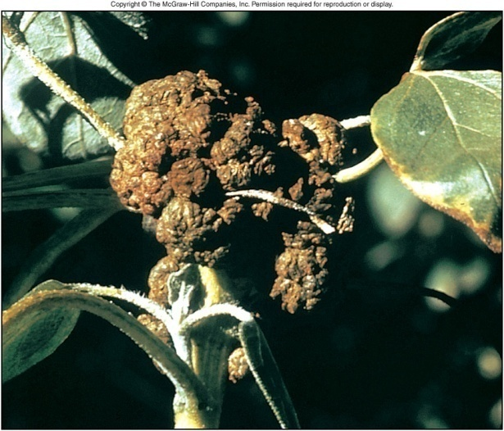
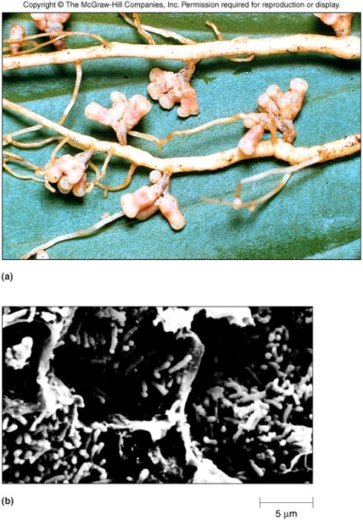
Thriving in
Terrestrial Environments
Bacteria associated with plants use different means to obtain nutrients
  Nitrogen fixing Rhizobium have a mutually beneficial relationship with plants
  Agrobacterium produce plant tumors to gain nutrient

Slide 22
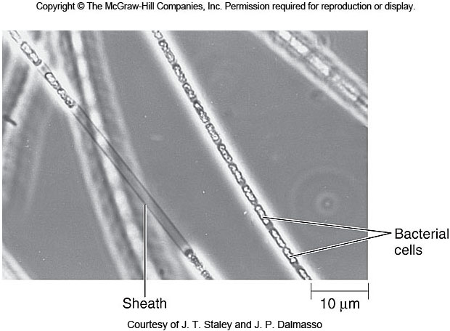
Thriving in
Aquatic Environments
Organisms produce numerous mechanisms for nutrient acquisition and retention
  Clustering within a sheath
    Bacteria form chains encased in tubes which enables them to find favorable habitat

Slide 23
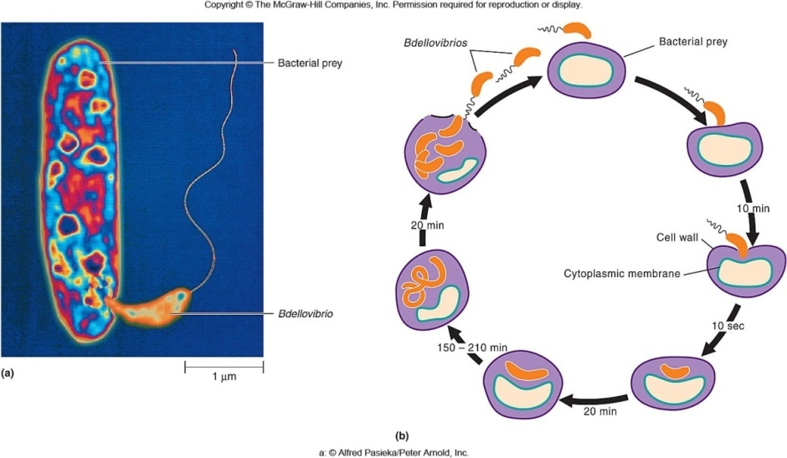
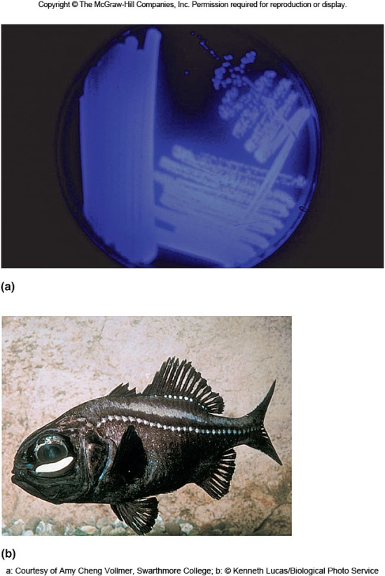
Thriving in
Aquatic Environments
Derive nutrient from other organisms
  Bdellovibrio prey on other organisms
  Bioluminescent bacteria establish relationships with other animals for food and protection
  Legionella live inside protected confines of protozoa

Slide 24
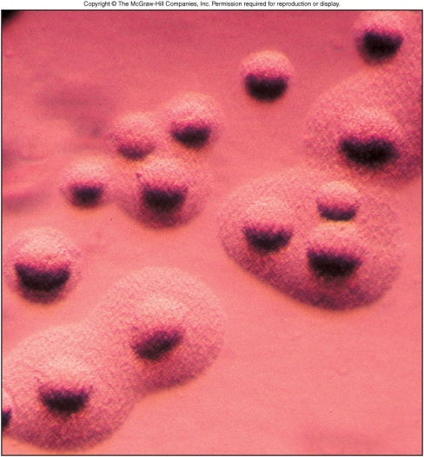
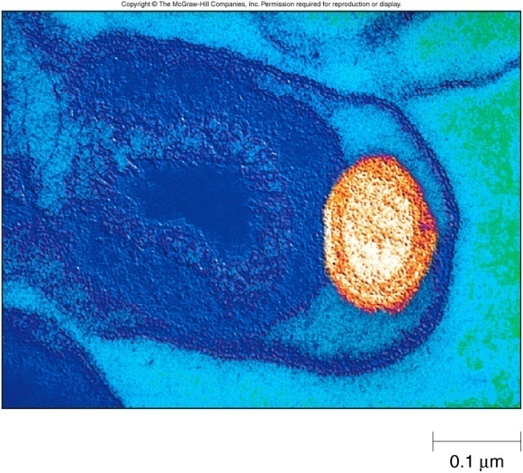
Animals as Habitats
Bodies of animals provide wide variety of ecological habitats for bacteria
  Skin inhabited by Staphylococcal species
  Mucous membranes are inhabited by numerous genera including Bacteriods, Bifidobacterium, Campylobacter and Helicobacter, Neisseria and Treponema
  Obligate intracellular parasites include Rickettsia, Orientia and Ehrlicia reside in blood-sucking arthropods

Slide 25
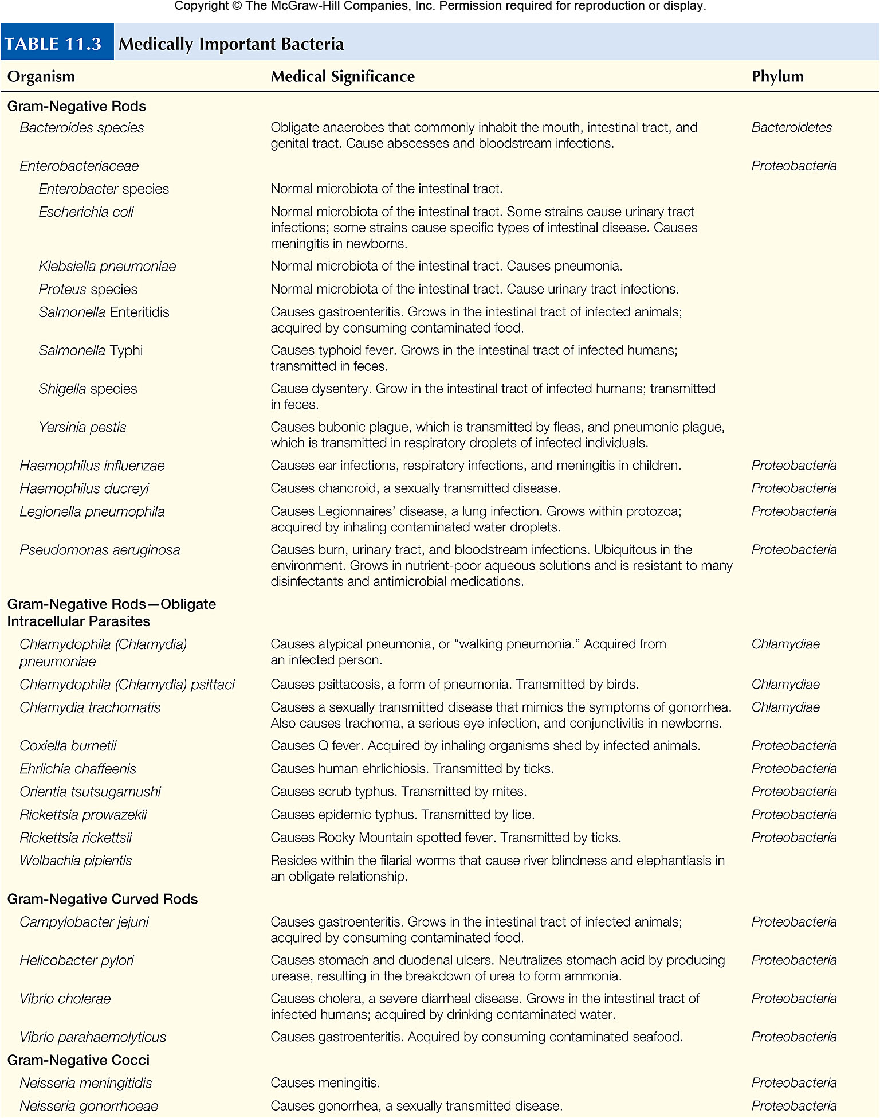
Table 11.3

Slide 26
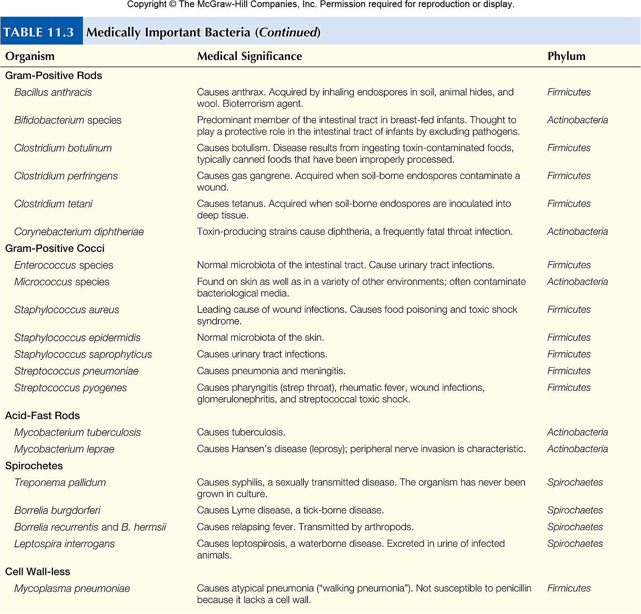
Table 11.3cont

