Slide 1

Single Stream Recycling Pilot Program

Slide 2
Background
Clayton State University partnered with Waste Management to promote:
Environmental awareness
Responsible resource management
Reduction in waste costs

Slide 3
What is Single Stream Recycling?
Single stream recycling allows participants to co-mingle or mix all their recyclables into one single container for collection.

Slide 4
Acceptable Recyclables
Plastic containers
Aluminum cans
Glass (all colors)
Mixed office paper
Cardboard
Newspaper, magazines
Spiral notebooks
Phone books

Slide 5
Non-acceptable Items
Food waste & containers
Used tissues
Used paper towels
Plastic bags
Styrofoam products
Light bulbs
Batteries
Film
Magnets

Slide 6

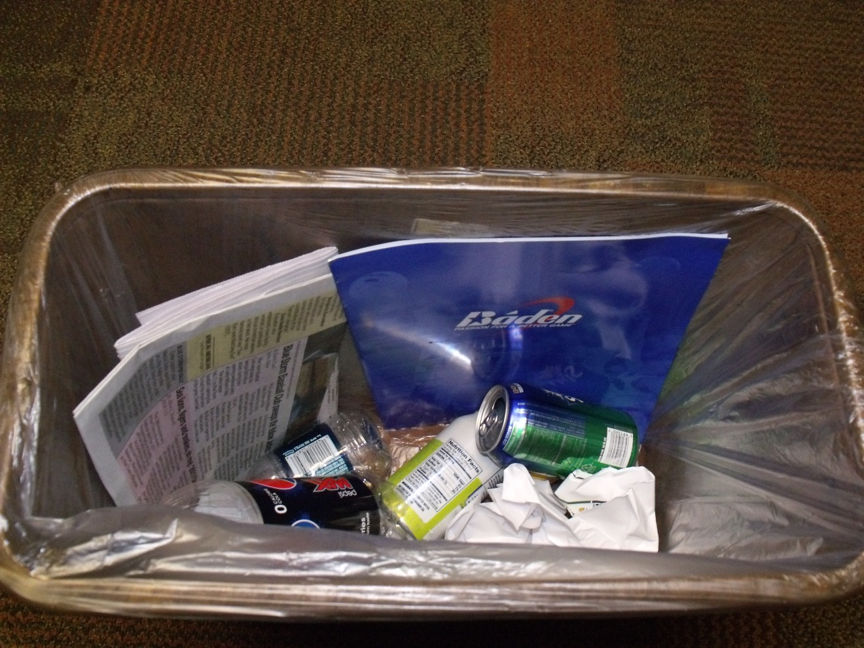
Example of a recycling container that needs to be emptied.

Slide 7

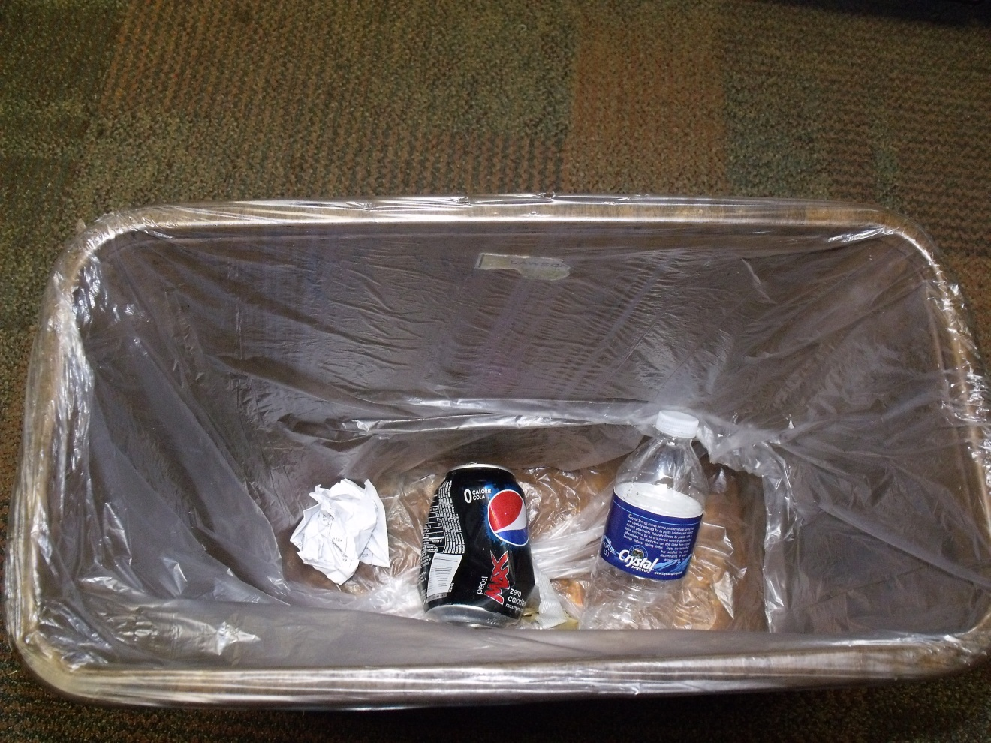
Example of a recycling container not ready to empty.

Slide 8
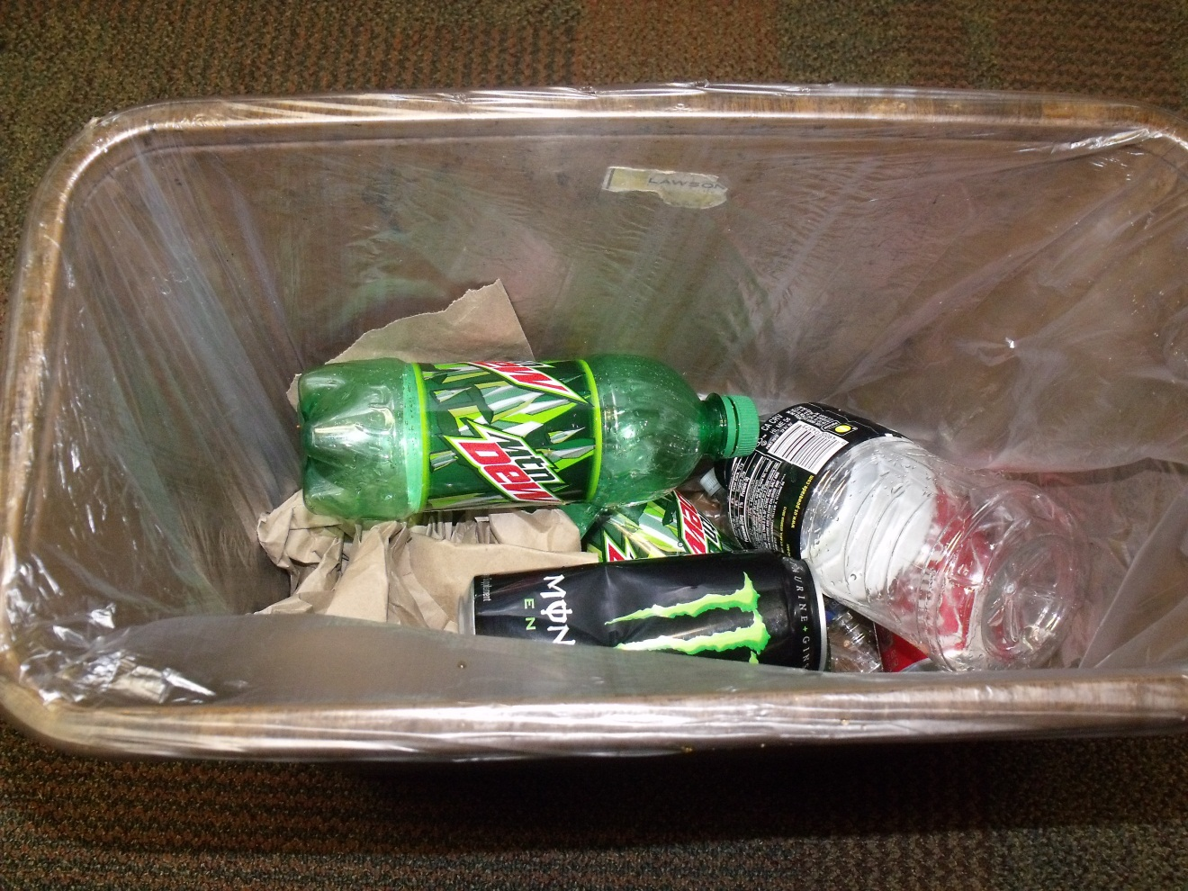
Example of a container that is a judgment call to empty.

Slide 9
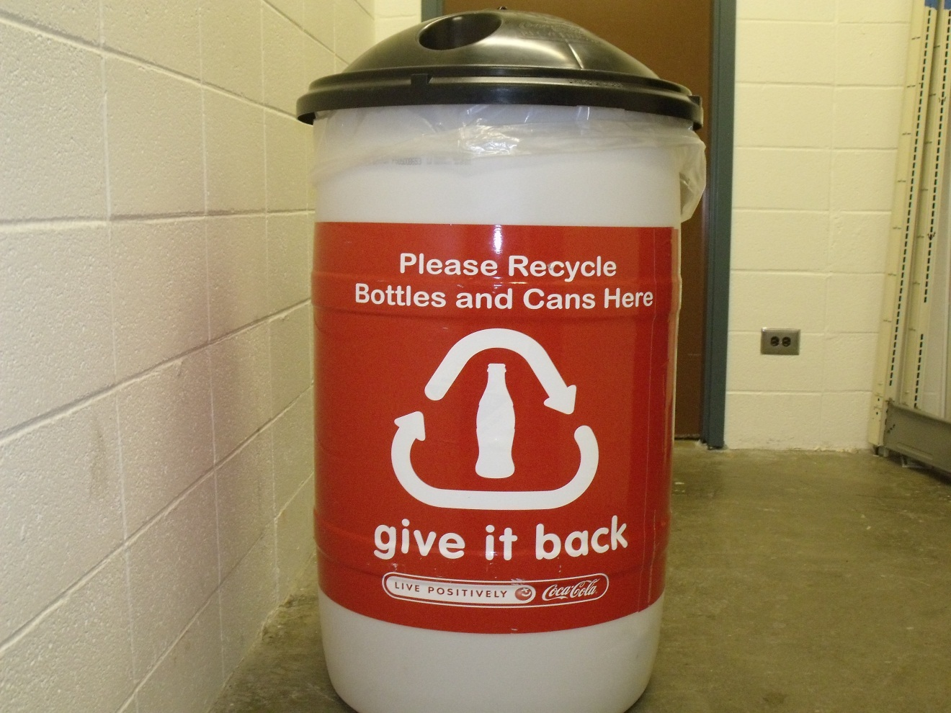
Container NOT to empty
This container is the responsibility of the Go Green student volunteer organization to empty.

Slide 10
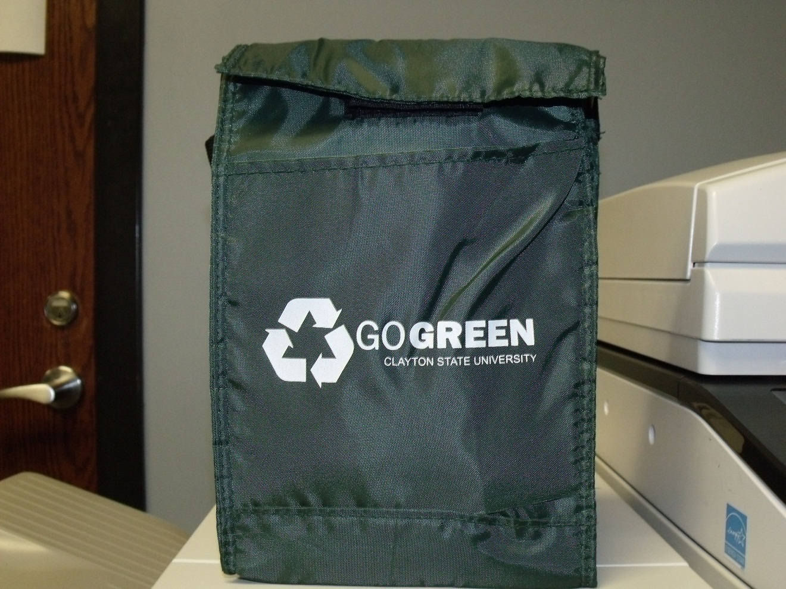
Container NOT to empty
This container is the responsibility of the owner to empty.

Slide 11
Reminder Cards

Slide 12
Thank you for helping to make this program a success!
For more information visit: http://adminservices.clayton.edu/ehs/campussustain.htm

