Slide 1
What is Common Between Random Numbers and Cosmic Rays
By: Dmitriy Beznosko
Chemistry and Physics Dept
For Mathematics Seminar

Slide 2
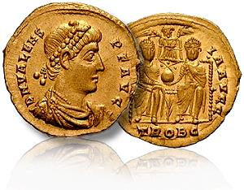
von Neumann's Procedure for Unfair Coin
  P(1)=p, P(0)=1-p
  P(11)=p², P(00)=(1-p)², P(10)=p(1-p),P(01)=(1-p)p
  P(10)=P(01) QED
Start with 1 and 0 sequence that is uneven
Fold in half, 00 and 11are skipped
From 01, 10 use first only, discard used, get equal seq.
Can go further and fold resulting in half again
Comes from un-biasing the unfair coin – the transitions between 2 binary states are always ‘fair’
Example:
  101111101010111010111011010111011011111010101001011111: fold
  101111101010111010111011010
  111011011111010101001011111
  Take one of the lines with used removed (1st here) and fold again
  11111101
  11011011

Slide 3

Short intro to secure computing
Good random numbers are fundamental to ~all secure computer systems.
Simple example of an attack:
  log into a web site - assigned a unique ID for that session
  Needs to be unique to you and not guessable by someone else.
  If someone else can guess it, they can impersonate you. Same is true for a private key, phone card or coupon #, etc…
Although pseudo-random number generators (PRNG) can generate a sequence of apparently random numbers, they have weaknesses (e.g. they all need a starting seed, numbers repeat after some time…).
Suppose PRNG used is seeded with the current time, in μs.
  Attacker assumes your machine time, say, within 10 seconds.
  Attacker knows which PRNG is used or has same code/library
  Then a seed for your PRNG is known within ~ 10 seconds range; N = 10 000 000 possible seeds. A modern PC will take no time to generate and try these keys.

Slide 4

PRNGs and HRNGs
Random numbers are used in simulations (more on the next slide), encryption, security, calling card number generation, lotteries etc…
Fast PRNG – weak key. Slow PRNG – few keys, still limited in strength. Result typically is repeatable if given same seed.
Hardware random number generator (HRND) works by providing a source of truly random numbers that don't come from a mathematical process.
Source of randomness can be from radioactive decay (slow), the chaotic motion of fluids (very slow), atmospheric noise (slow), quantum-based, or from other unpredictable systems that can not be guessed by an attacker even if they have access to a similar or even exactly same device.
Need FAST and SECURE operations

Slide 5
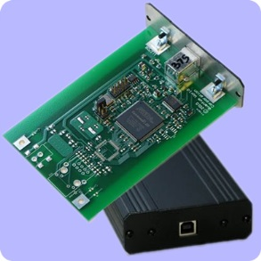
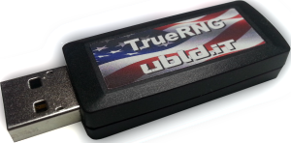
Possible uses of affordable HRNG
banks, various communications and cell phone companies, lotteries
government planning offices in their simulations of the economy growth
scientific Monte-Carlo simulations
      Instead of TRandom1,2,3 ☺
(end-user?) data cryptography
computer games
in classrooms
any other place where large number of true random numbers is required.
Such units exist, some are USB key sized. Based on various principles. Cost varies from about $50 to $10k
EAS animation, parent – proton at 10¹⁶ eV using CORSIKA¹
¹CORSIKA: a Monte Carlo code to simulate extensive air showers., by Heck, D.; Knapp, J.; Capdevielle, J.~N.; Schatz, G.; Thouw, T..~ Forschungszentrum Karlsruhe GmbH, Karlsruhe (Germany)., Feb 1998, V + 90 p., TIB Hannover, D-30167 Hannover (Germany

Slide 6
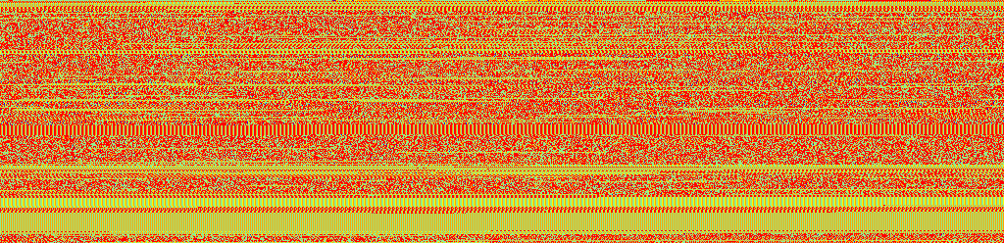
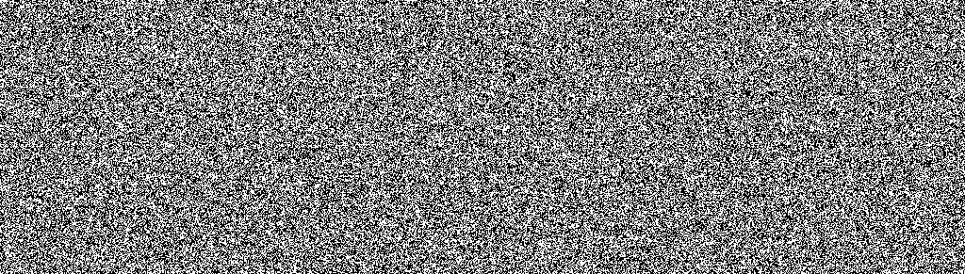
Output Tests¹
Same graphical representation of .pdf file in [¹], patterns visible
For each test, a theoretical result is known for a sample of ‘perfect’ random data, thus allowing a comparison
Show only most illustrative tests.
Graphical.
  The bits are read by 8 as a single unsigned integer
  Resultant value (0-255) is plotted as a pixel brightness
  No patterns are visible
  ‘Birthday’ test also shows good quality, lengthy result and description in ¹
¹D. Beznosko, T. Beremkulov, A. Duspayev, A. Iakovlev, A. Tailakov, M. Yessenov. "A Physical Principle for Fast and Miniature Random Number Hardware Generator Using MPPC Photo Detector." JOURNAL OF ADVANCES IN PHYSICS [Online], 7.3 (2015): 1970-1975. Web. 19 Jun. 2015
D. Beznosko, T. Beremkulov, A. Duspayev, A. Iakovlev, A. Tailakov, M. Yessenov "Random Number Hardware Generator Using Geiger-Mode Avalanche Photo Detector", January 2015, arXiv:1501.05521

Slide 7
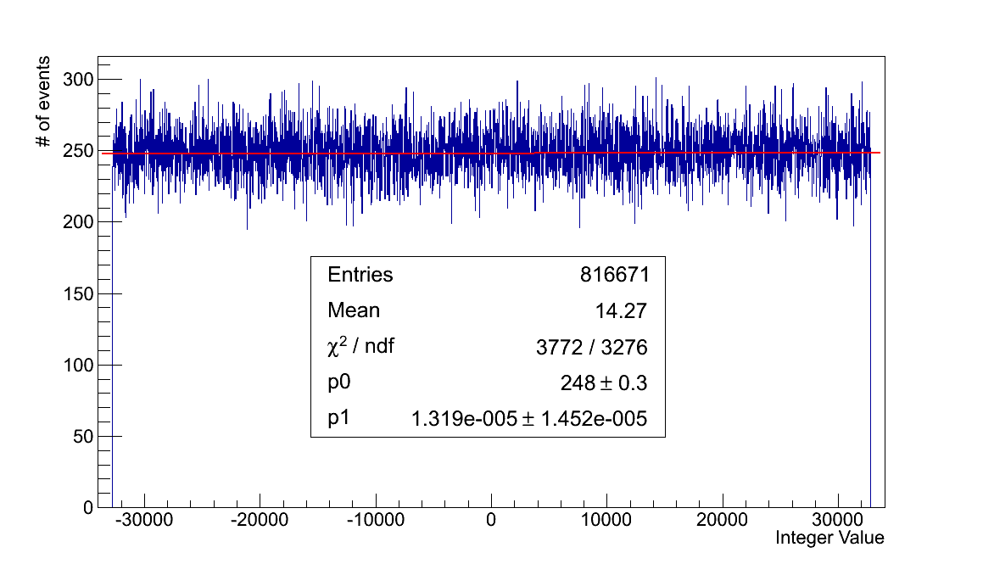
Output Tests cont’d
read the data as 16bit signed integers and plot them as a histogram
ENT¹ test (sample size dependence. Ideal values for infinite set only)
  ‘ideal’ values: Entropy=8, mean=127.5, chi-test between10% and 90%, correl.=0
Test Name | Result
Entropy | 7.999888 bits per byte
Chi-square Test | 252.64 for 1633342 samples, randomly exceed this value 53% of times
Arithmetic Mean | 127.4651
Monte Carlo Value For Pi | 3.140154916
Serial Correlation Coeffcient | 0.000009
¹Walker, John. A Pseudorandom Number Sequence Test Program. http://www.fourmilab.ch/random/

Slide 8
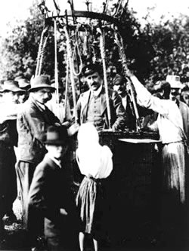
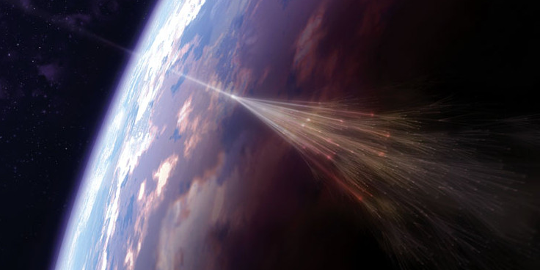
What are cosmic rays - intro
Cosmic rays (CR) first shown to come from space in 7/8/1912 by Victor Hess
CR are high energy particles and nuclei coming from space
Local source (The Sun, below ~GeV range that is mostly diverted by Earth B-field) and galactic/extra galactic (?) sources
CR physics – part of HEP (high energy physics) studies CR using their interactions with Earth atmosphere to infer properties and origins of CR
Extensive Air Shower (EAS) – energy above ~10¹⁴ eV
https://www.aps.org/publications/apsnews/201004/physicshistory.cfm

Slide 9
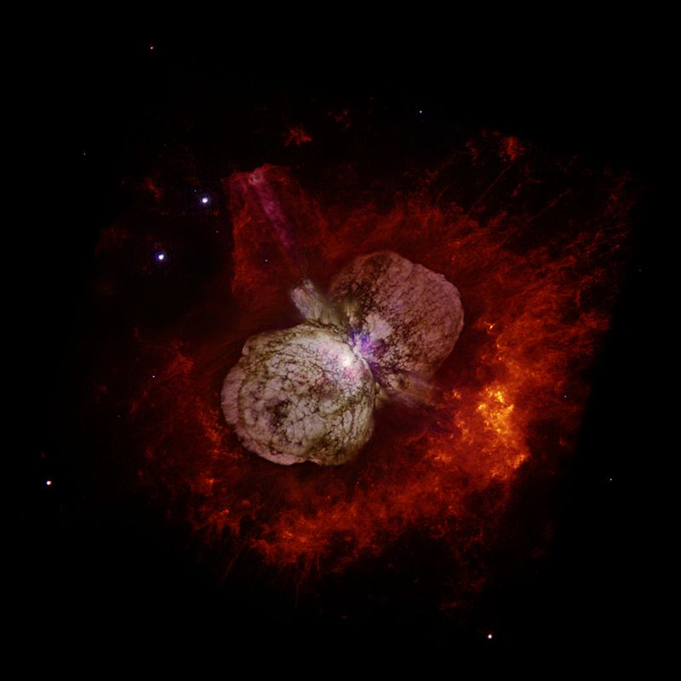
Cosmic rays and astrophysics:
Sources of Ultra-high energy (UHE) CR
Energy of UHECR from ~10¹⁶ up to 10²¹ eV and above
The large mystery today is the origin and the nature of UHECR
Possible sources?
  Neutron Stars
  Active Galactic Cores
  (converting dark matter into high energy protons?)
  Hypernova Explosions (Fermi acceleration mechanism?)
  Decay of unknown massive particles or dark matter
http://en.wikipedia.org/wiki/Hypernova

Slide 10
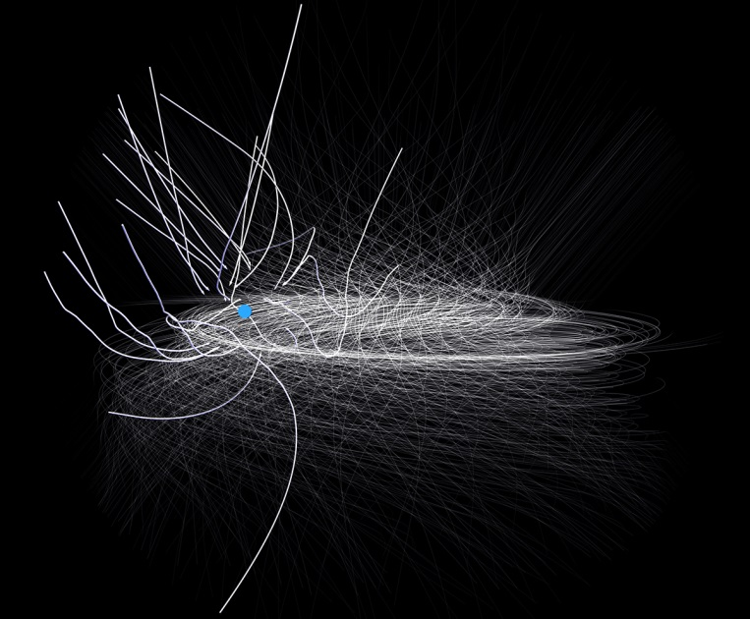
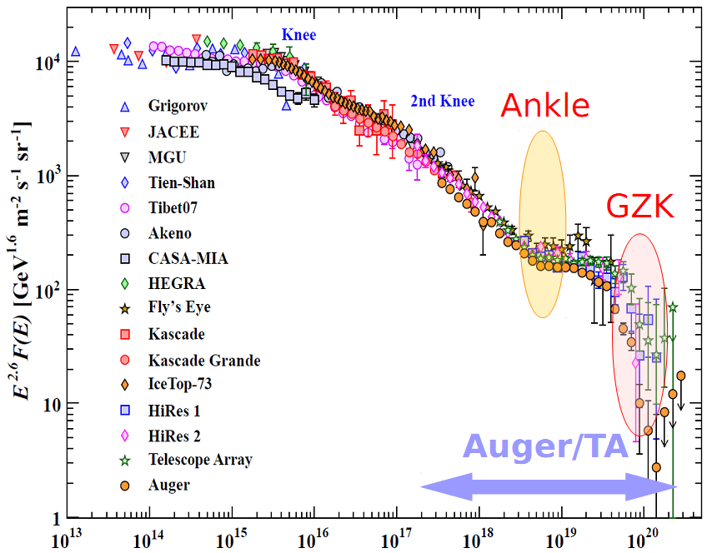
Mystery of UHECR
Knee? Ankle?
https://www.nas.nasa.gov/SC14/demos/demo4.html
Due to galactic magnetic field, charged particles loose direction to origin
Trapped in galaxy for E<10¹⁵ eV for protons
For E>10¹⁷ eV, all extra-galactic?
If so, then anisotropy should be present but not found

Slide 11
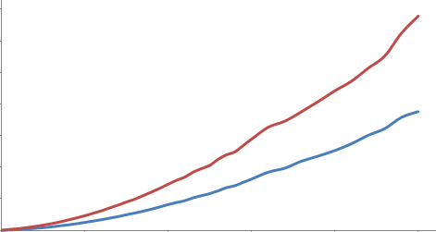
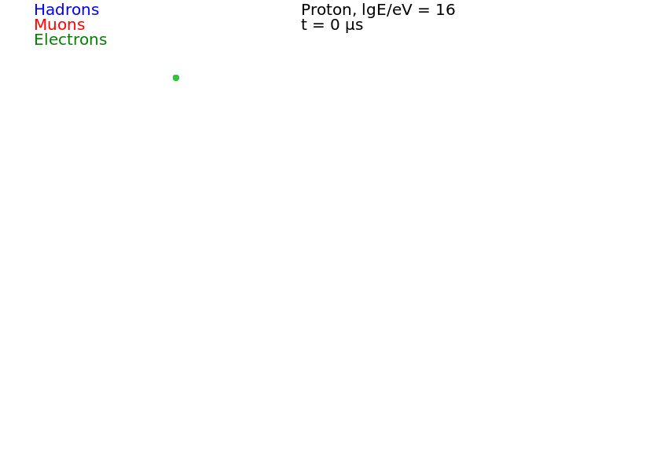

Methods of CR physics
Time, ns
Distance from axis, m
In atmosphere, Extensive Air Shower (EAS) develops
1 parent to billions of particles
Hadronic and (muons + electrons) components form core and disk
Core ~1m, disk many 100s m
Use disk arrival time between detectors to get direction and density distribution to get energy of primary
Observation level with detectors

Slide 12
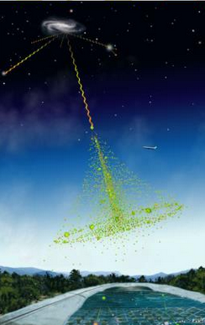
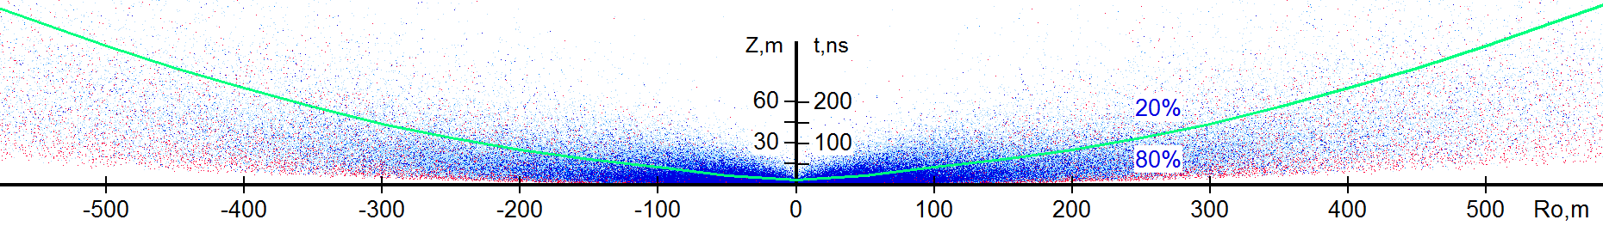
Distribution of particles within disk from CORSIKA
Actual disk composition –
composed of billions of particles!
Primary: proton with E=2⋅10¹⁵ eV; 3340m above sea level
Red – muons, Blue – electrons
Like stardust or galactic spice

Slide 13
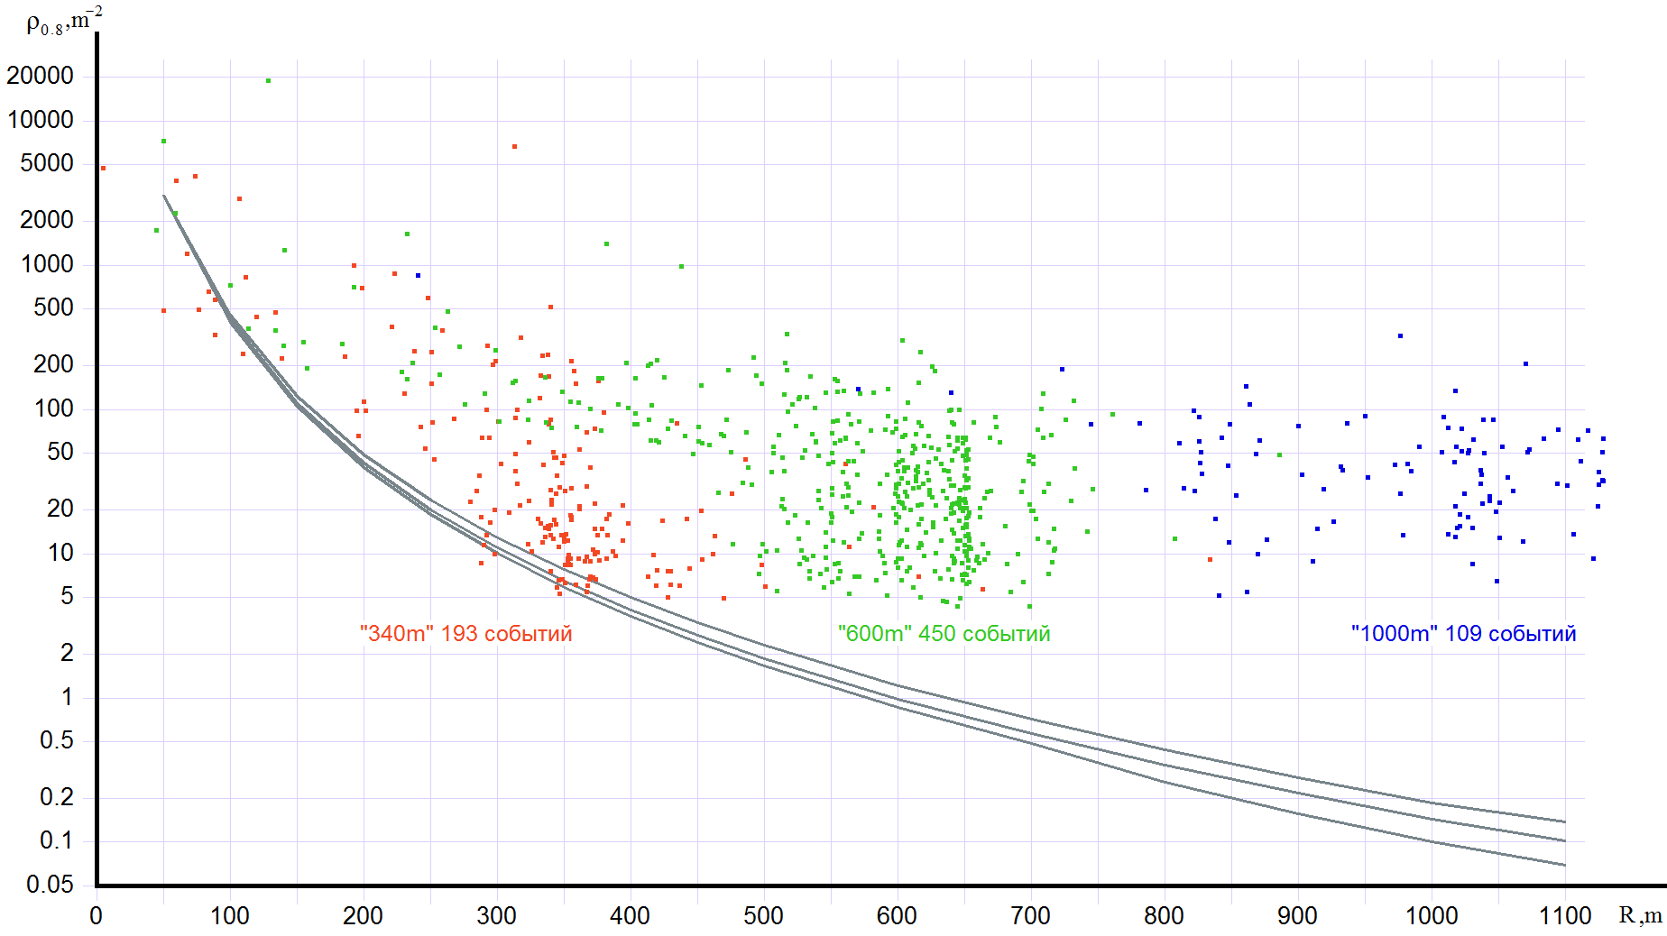
EAS particle density (bimodal events)
For 752 EAS
Particle density

Slide 14
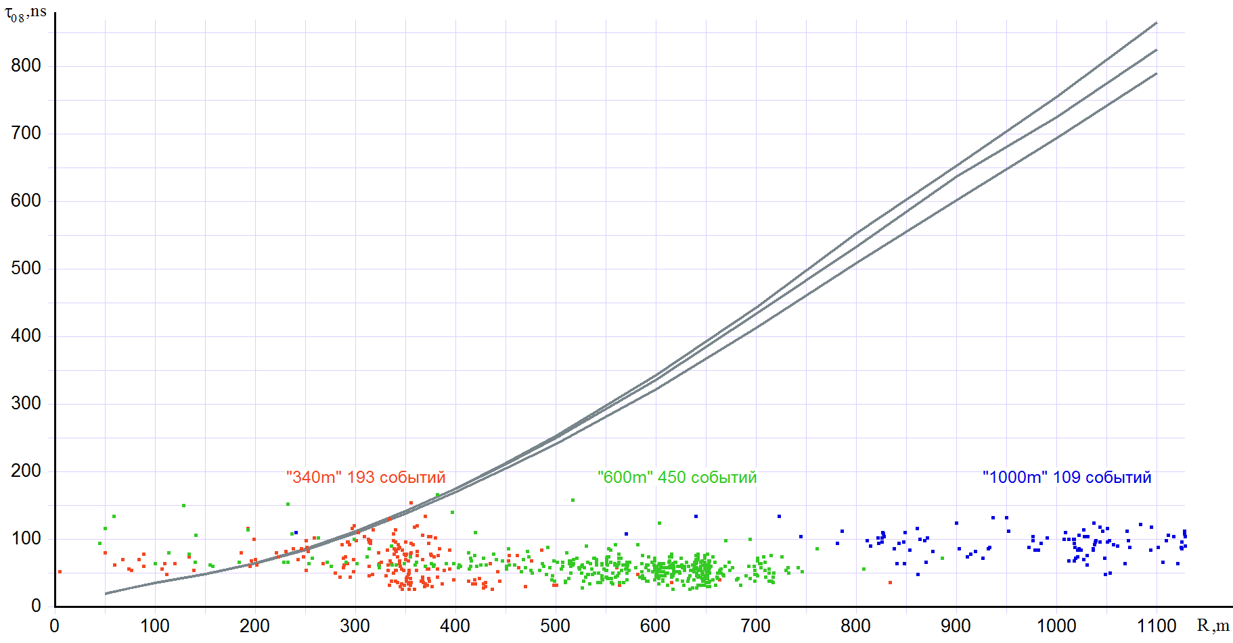
EAS pulse widths (bimodal events)
For 752 EAS
Pulse width

Slide 15
Conclusion
Random numbers are used in multiple areas including scientific simulation
Any software or hardware generators must be tested!
New science discoveries rely on such generators.
Detected cosmic rays events exhibit features that can not be reproduced using CORSIKA simulation package
Comprehensive systematic work affirms these effects to be observables
  Indicator of physics not in the simulation
  Analysis methodology needs to be extended

