Slide 1
Intelligent Agents

Slide 2
What is an intelligent agent?
A software tool that acts on behalf of a person. It allows work to be delegated to the software agent thereby freeing up an instructors time to focus on other tasks.

Slide 3
Use Case #1
No D2L Login
Why?
  To see students that are not “attending” any of their classes. Possible uses for an advisor
When?
  Daily or a couple of times a week
What?
  Send an email to yourself (the instructor), the advisor for that student’s major, and/or the student when they have not logged into D2L during that time period.

Slide 4
Use Case #2
No Course Entry
Why?
  To see which students are not “attending” class
When?
  Daily or a couple of times a week
What?
  Send an email to yourself or directly to the student when they haven’t accessed the course during that time period

Slide 5
Use Case #3
Welcome To The Course
Why?
  To greet students after their first entry to an online course and send additional information.
When?
  Daily, during drop/add period.
What?
  Send an email to the student within 24 hours of first accessing the online course

Slide 6
Use Case #4
Falling Behind In 1st Week
Why?
  To remind students that the term has started and that they are in danger of falling behind (or being no-show dropped)
When?
  At the end of the first week of class
What?
  Send an email to student (could also CC you) when they haven’t accessed the course during that time period

Slide 7
Use Case #5
Success In 1st Week
Why?
  To reassure students they have completed all required activities for the 1st week of class
When?
  Using release conditions, when the student has completed all the activities
What?
  Send an email to the student encouraging them to keep up the good work.

Slide 8
Use Case #6
Dropbox File Submitted
Why?
  To let you and/or the student know that a dropbox submission has been received.
When?
  Within 24 hours of uploading
What?
  Send an email to yourself as a heads-up that there is a file awaiting grading. Could also send to the student and CC you, letting the student know the submission has been received.

Slide 9
Use Case #7
Checklist Completion
Why?
  To let you know that a student has completed a full checklist, or a particular item on a checklist.
When?
  Within 24 hours of a student checking the box(es)
What?
  Send an email as needed to recognize the completion of the actions.

Slide 10
Use Case #8
Low Grade
Why?
  To give a student encouragement for improving their grade after a low score, directing them to support resources on campus, alerting an advisor, etc.
When?
  Within 24 hours of a quiz, discussion forum, paper submission, etc, being graded
What?
  An email to the student with suggestions on how to proceed after getting a low score

Slide 11
Use Case #9
Improved Quiz Scores
Why?
  To congratulate a student on significantly improving quiz scores between two quizzes.
When?
  Within 24 hours of the 2nd quiz being graded
What?
  Send an email to the student congratulating them and encouraging them to continue on their upward momentum.

Slide 12
Other Use Cases
Survey Submission, Number of Discussion Forum Posts authored, Content Topics visited, etc.

Slide 13
Potential Pitfalls
Replace Strings

Slide 14
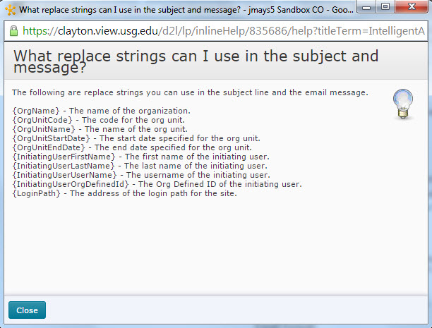
Replace Strings

Slide 15
Potential Pitfalls
Replace Strings
Copying a course term-to-term
Student must “Reply All”

Slide 16
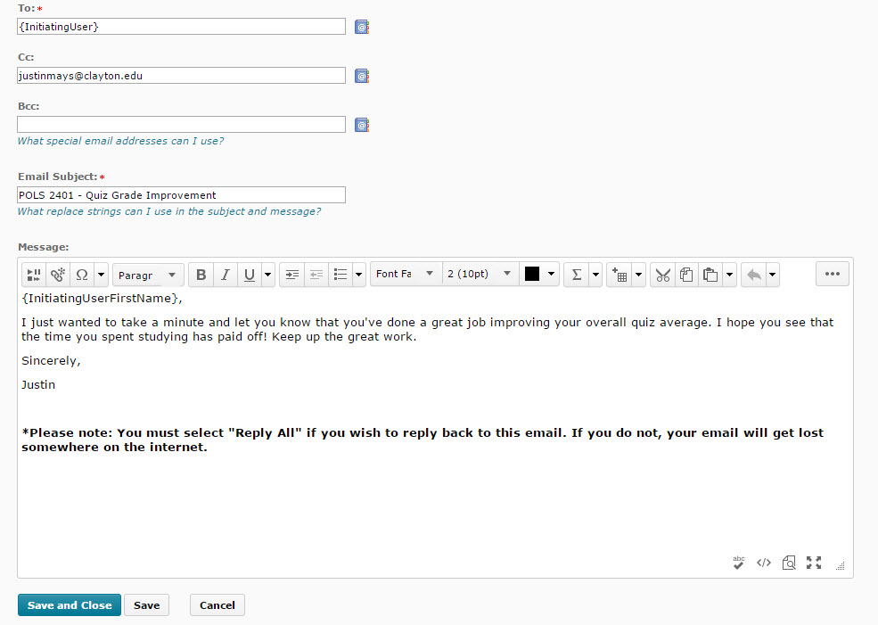
Reply All

Slide 17
Potential Pitfalls
Replace Strings
Course exports
Student must “Reply All”
Calculated grades
What a student did NOT do

Slide 18
Best Practices - 1
Think carefully about whether you want the agent to send an email to the student, to you, an advisor, etc.
Sending the email to yourself gives you one more chance to decide whether to contact the student, or not.

Slide 19
Best Practices - 2
Use the agents sparingly
  Repetitive emails may lose effectiveness

Slide 20
Best Practices - 3
Think carefully about whether the agent should run automatically or manually
  Automatic agents will run as often as you schedule them.
  Manual agents allow you to determine when the timing is right.

Slide 21
Best Practices - 4
Take advantage of the Agent Name and Description field
  Designate which items will change from term to term for you to update (office hours, specific dates, etc)

Slide 22
Best Practices - 5
If you use multiple agents that send/copy you on an email
  Create a rule in Outlook to automatically route these into a special folder.
  Creates less clutter and ensures you don’t miss other important communication.

Slide 23
Best Practices - 6
Agents become more valuable as class size increases
  Automatic messaging can become very valuable when interacting with 30, 50, 100, or more students.

Slide 24
Questions?

