Slide 1

Grant BUDGET MANAGEMENT TRAINING
Scott McElroy
scottmcelroy@clayton.edu
(678) 466-4285

Slide 2
AGENDA
Monthly financials
New Quarterly Review
Grant Budget Activity Report

Slide 3
MONTHLY FINANCIALS REPORT
Accounting Services provides you a monthly financials report if there were any expenses during the month.
This report could possibly have many tabs depending on the type of activity during the month.
1) All Expenses tab – provides a summary by account and type of expense
2) Journal Pivot – shows any miscellaneous JE’s that were posted and should agree with EXT amount on All Expenses tab
3) Payroll Pivot – shows any payroll posted by employee, account, and pay period
4) AP Pivot – shows any vouchers posted by supplier, invoice, description, and date
5) Travel Detail – shows any expense reports by account, date, and employee

Slide 4
MONTHLY FINANCIALS REPORT
All Expenses Tab

Slide 5
MONTHLY FINANCIALS REPORT
Journal Pivot Tab

Slide 6
MONTHLY FINANCIALS REPORT
Payroll Pivot Tab

Slide 7
MONTHLY FINANCIALS REPORT
AP Pivot Tab

Slide 8
MONTHLY FINANCIALS REPORT
Travel Detail Tab

Slide 9
Quarterly Grant Expenditures Review
Reinstate quarterly grant expenditures review process
Effective 2nd Quarter FY21 (October 2020-December 2020)
If you had expenditures during this quarter, you will soon receive an email along with certification letter.

Slide 10
Quarterly Grant Expenditures Review
2nd Quarter Grant Expenditures Review:
2nd Quarter Grant Expenditure Review:
We have all the entries posted through December 31st, 2020, so it is now time to begin your FY21 2nd Quarter grant budget review process. As a Principal Investigator/Project Director, you will now be required to review and certify all expenditures that have posted to your grant during the quarter. All transactions should be reviewed for accuracy. All exceptions should be posted on the Quarterly Grant Expenditures Budget Certification letter.
The deadline for these reports (along with the signed Certification Letter) to be submitted to me is Friday, February 19, 2021. Please return to Jeri Trenova via email at jeritrenova@clayton.edu. .
Please run a Grant Budget Activity Report for your department(s). You can find the instructions, as well as detailed screen shots of how to run the report on the Budget Office website at the link below. There are 2 different versions of this report. I encourage you to run the Full Detail version to review each expense that has posted against your grant.
  In order to find out the employees that make up your Personnel totals, the budget office will be able to send you a quarterly payroll report upon request. If you dispute any of the expenses, please contact either Jeri or myself via email or phone.
After you have done your review of the expenses on your report, print the Summary version of the report, sign and date the report and return to me. Please remember I only want the SUMMARY version submitted to me. If you send me the Full Detail, I’m going to ask you to run the SUMMARY and sign that and submit to me.
Here is the link where you can find the Grant Budget Activity Report: http://www.clayton.edu/budget/budget-managers.
Please note the format for the Grant Budget Activity Report. These are the parameters you will enter on the report set up for the 2nd Quarter:
Grant Budget Activity Detail Report: Check if you want a detailed report Grant Budget Activity Summary Report: Check if you are ready to submit your Summary report to me
Business Unit: 28000 Budget Reference: 2021
All Fiscal Periods: ◻
From Accounting Period: 4 To Accounting Period: 6
From Fiscal Year: 2021 To Fiscal Year: 2021
Grant From: Your Grant # Grant To: Your Grant # All ChartStrings?: ◻
From Fund Code: 20000 From Department: % From Account: 500000
To Fund Code: 20000 To Department: % To Account: 999999
*Please remember to only run the report for Accounting Period 4-6 (And only submit the Summary report)
If you have any questions and/or concerns, please do not hesitate to contact me. I am never too busy.

Slide 11
Quarterly Grant Expenditures Review

Slide 12
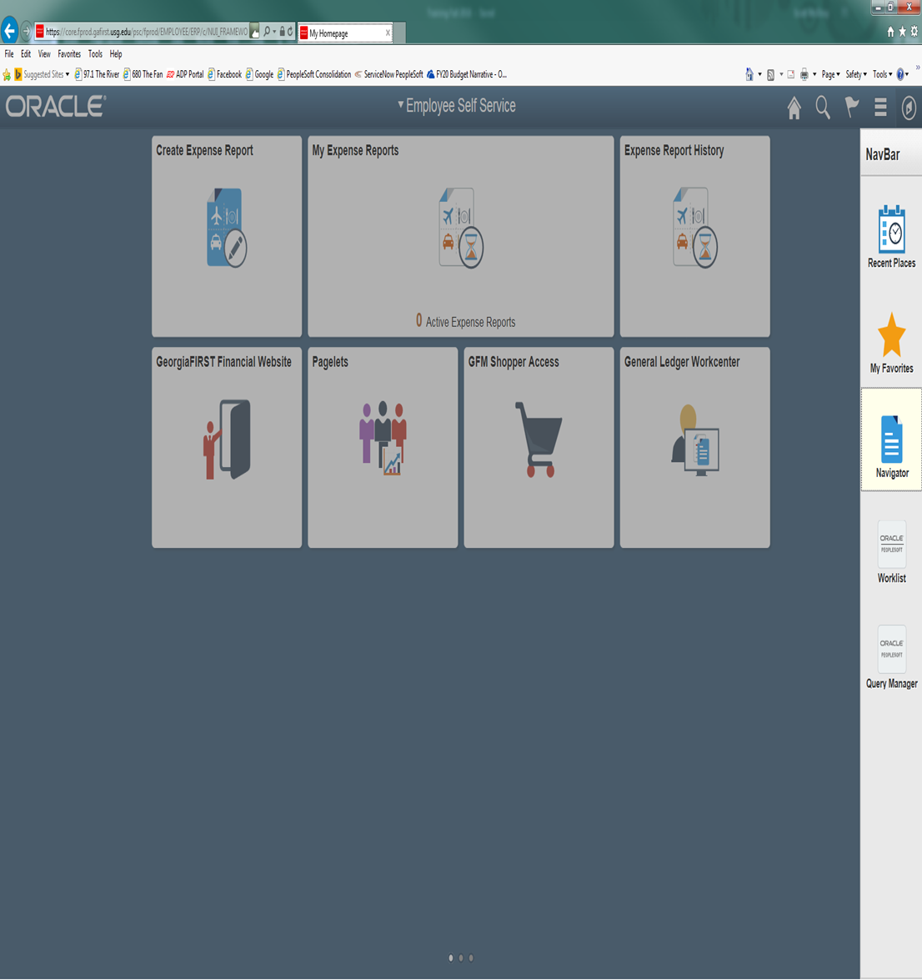
GRANT BUDGET ACTIVITY rEPORT
The following screen shots will show you how to access the Grant Budget Activity Report. The Grant Budget Activity Report will give you either a detailed version of your project/grant budget or a summary version of your project/grant budget depending on the amount of detail you wish to have at the time you run the report. This report will list the activity that hit your grant/project and give you remaining dollars according to what has been budgeted.
You will need to click on icon in the far upper right-hand corner of the panel which looks like a ‘diamond inside a circle’. This will bring up your NavBar. Once you have the NavBar pulled up, you will click on the Navigator link.

Slide 13
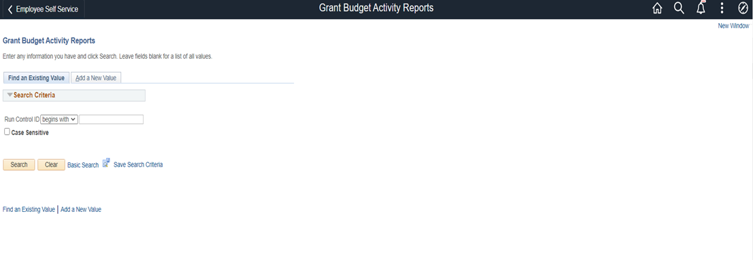
BOR MENUS>BOR GENERAL LEDGER>BOR GL REPORTS>GRANT BUDGET ACTIVITY REPORTS

Slide 14
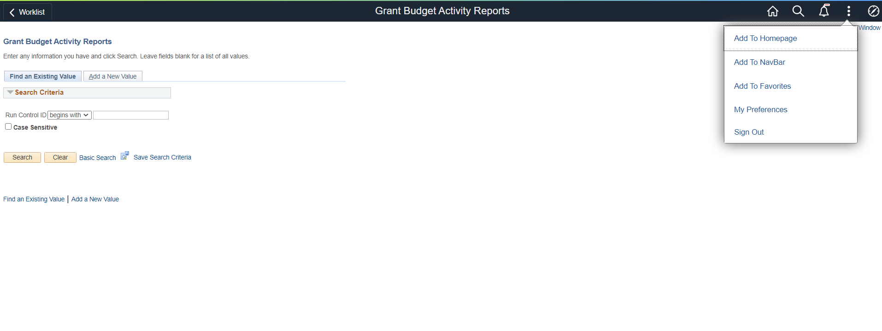
At this time, you can save this process as a favorite for future reference. You just need to click on the icon that has 3 lines in the upper right-hand corner which has a drop-down menu. You will click on Add to Favorites link at the top and enter a description before clicking OK.

Slide 15
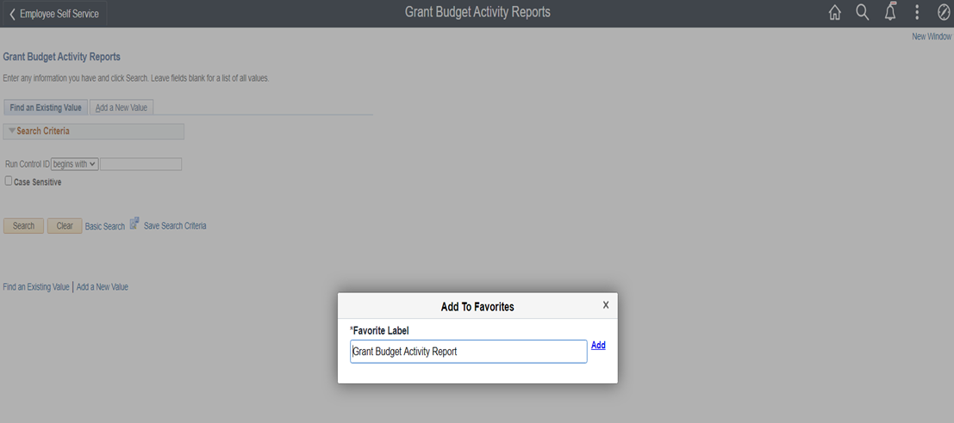

Slide 16
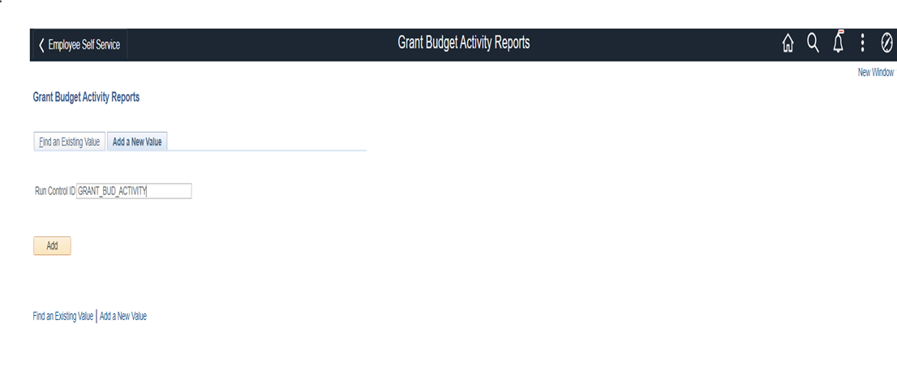

Slide 17
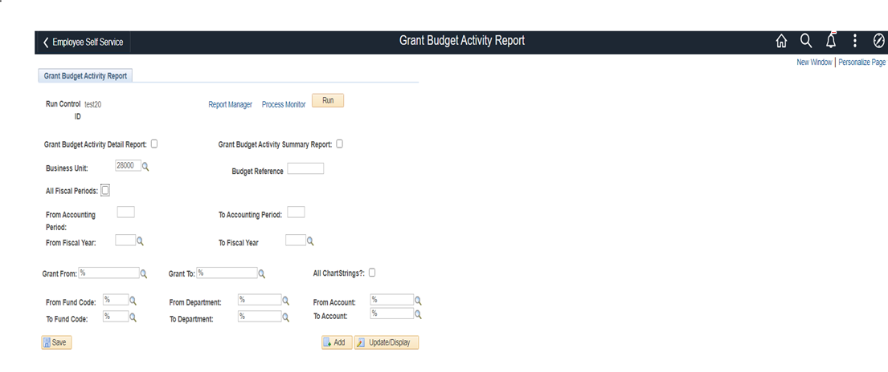
You will then be taken to the screen to add the parameters for running your reports. When completing this screen, please be sure to:
check the box requesting a Grant Budget Activity Detail Report and/or a Summary Report;
Budget Reference- is the current fiscal year
All Fiscal Periods- For the quarterly review process, you need to leave this box unchecked.
DO NOT CHECK ‘ALL CHARTSTRINGS?’ Enter the chart string for your Grants/Projects.

Slide 18
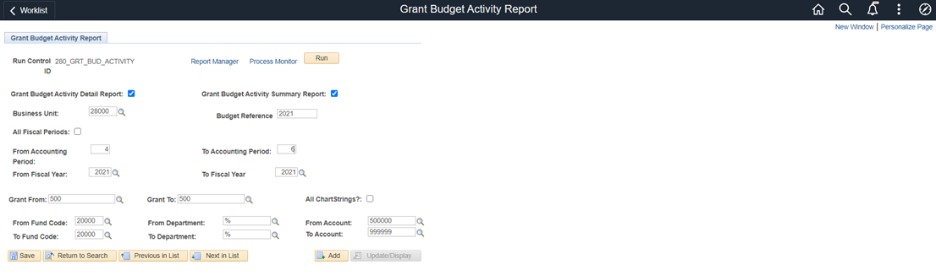
Once you have entered your project/grant information, click on the Save button to save the parameters for the next time you access this report. Click on the Run button at the top to initiate the process.

Slide 19
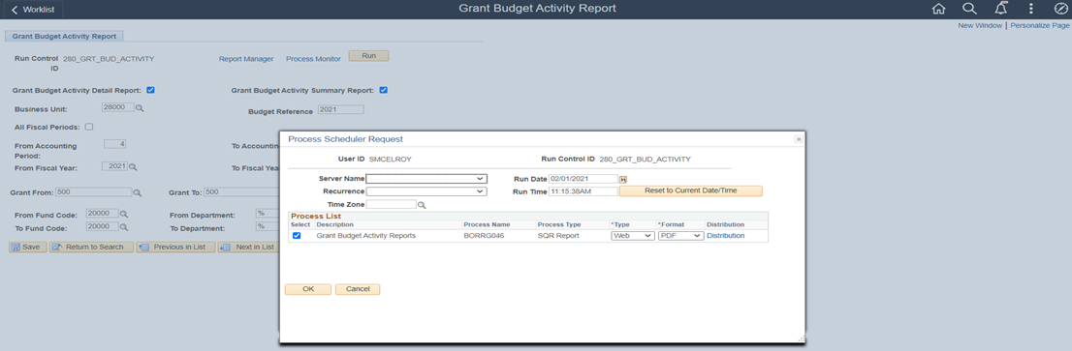
When the Process Scheduler Request screen appears, click on OK to schedule the process.

Slide 20
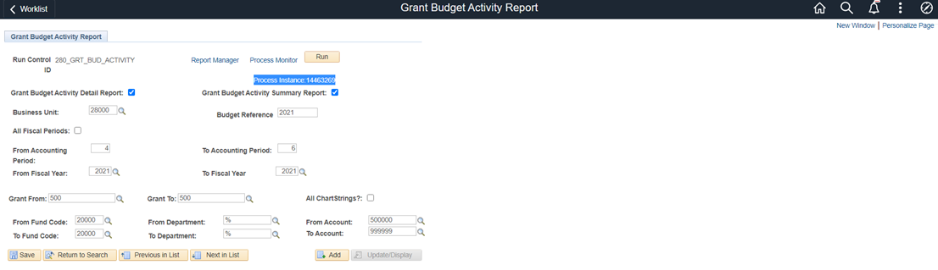
After clicking on OK, it will take you back to the report format screen. You will notice a Process Instance number just under the Run button at the top of the page. You need to make a note of this Process Instance number that will be used in the next section of the process. At this time, you will click on the Process Monitor link.

Slide 21
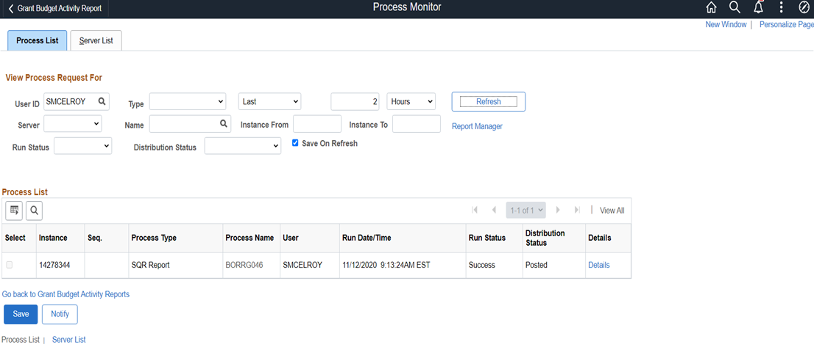
If, at this time the Run Status on your Process Instance doesn’t show as Success or Distribution Status doesn’t show as Posted, you will need to click on the Refresh button at the top until it reaches this status.

Slide 22
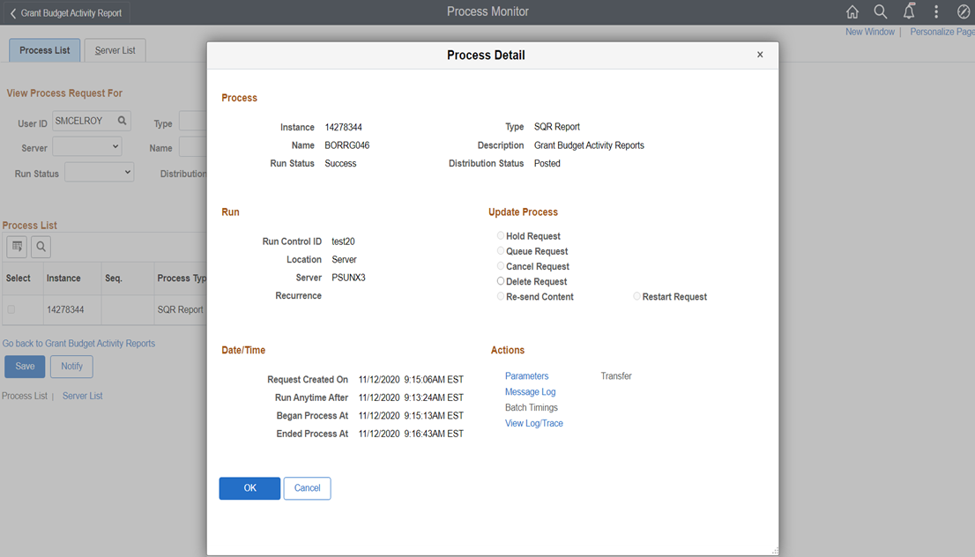
To access the report that you just ran, you will need to click on the Details link in the line for your Process Instance number.

Slide 23
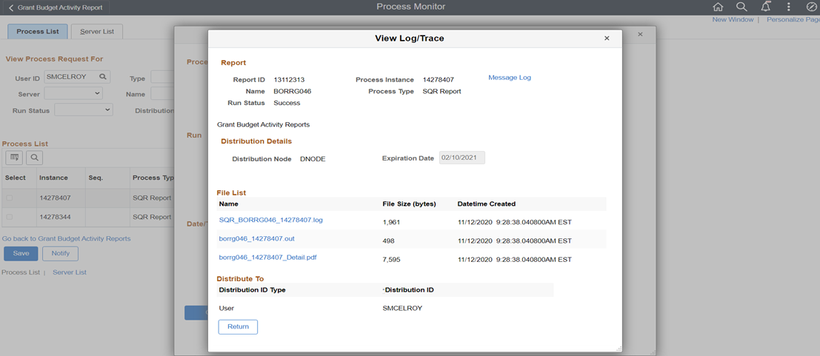
Then from the Process Detail screen, you will click on the link View Log/Trace.

Slide 24
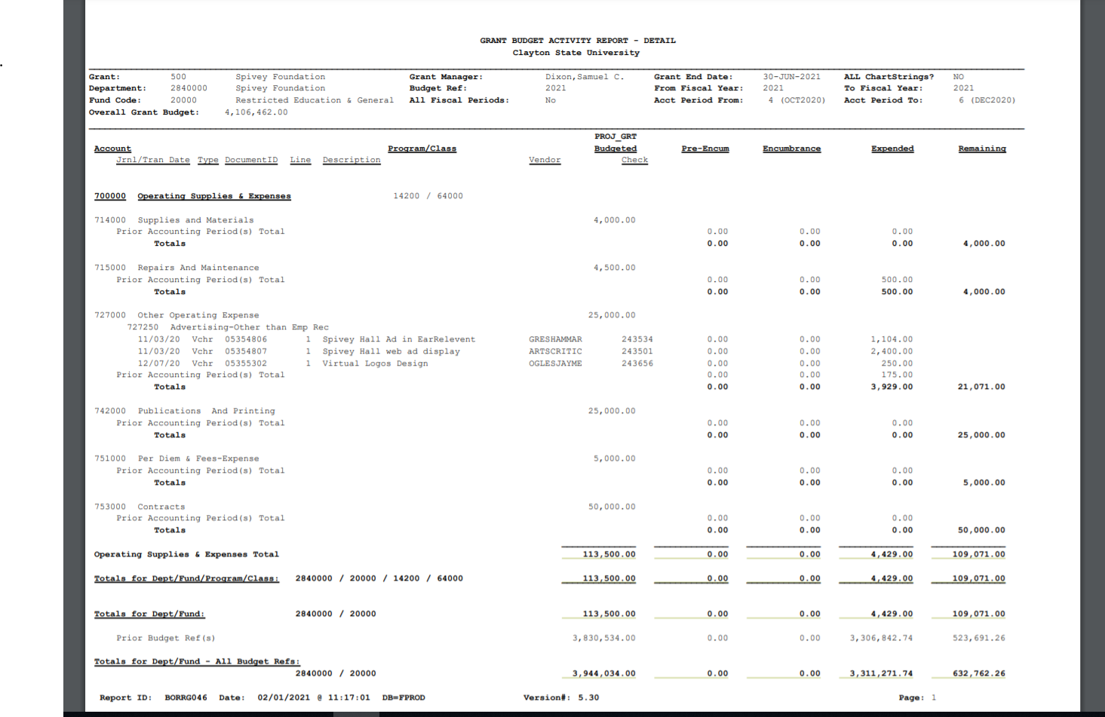
From the View Log/Trace screen, you will click on the link for the PDF file in the File List. This will bring up the Budget Status Report that you just ran. You can then either Download or Print the report.

Slide 25

QUESTIONS

