Slide 1
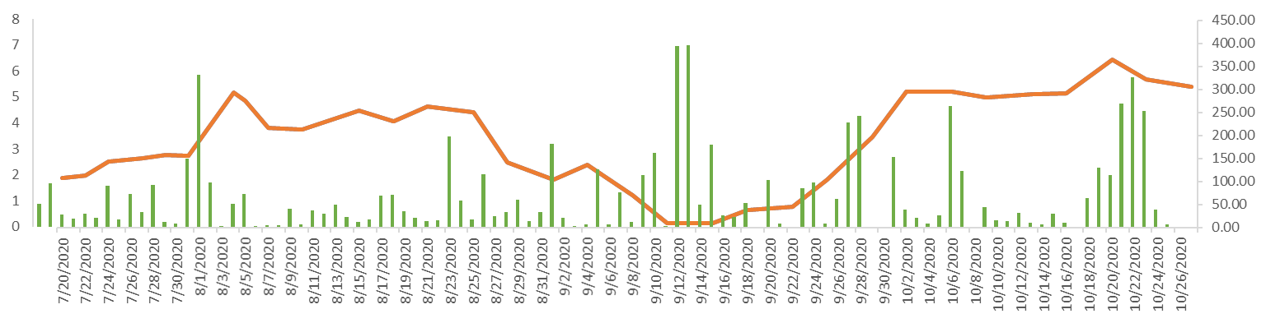
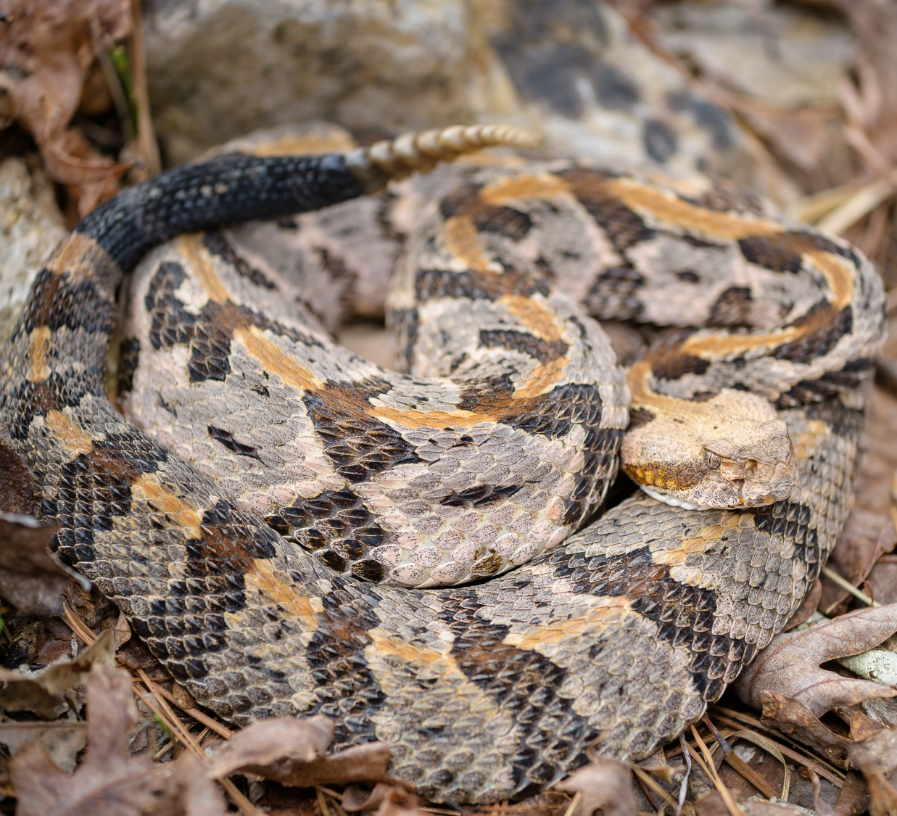
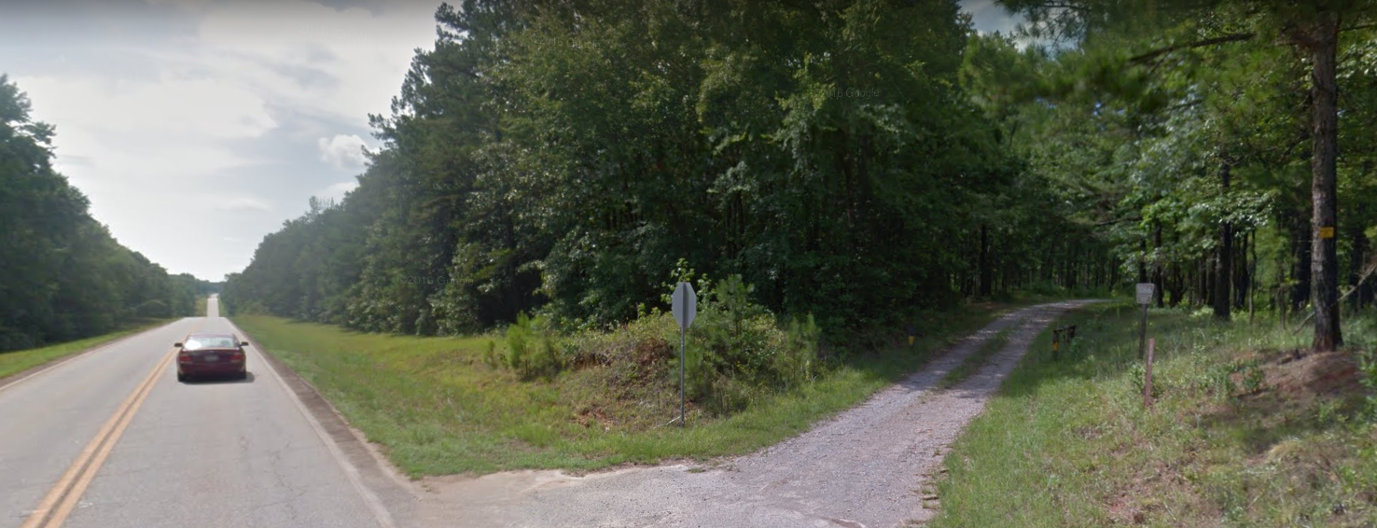
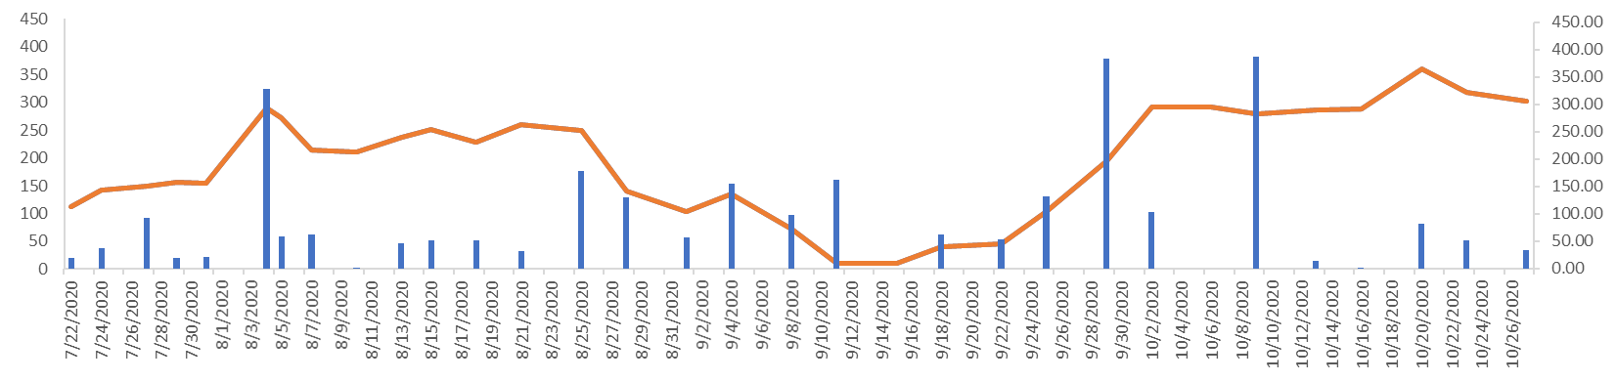
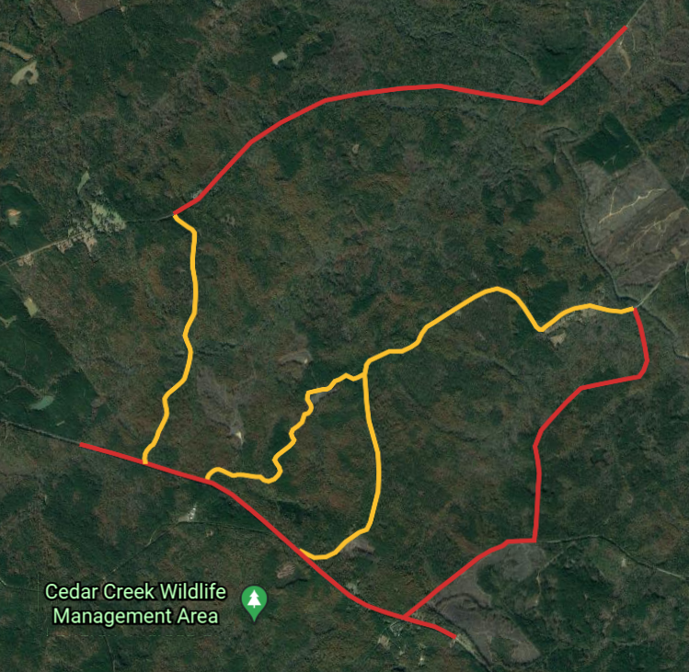
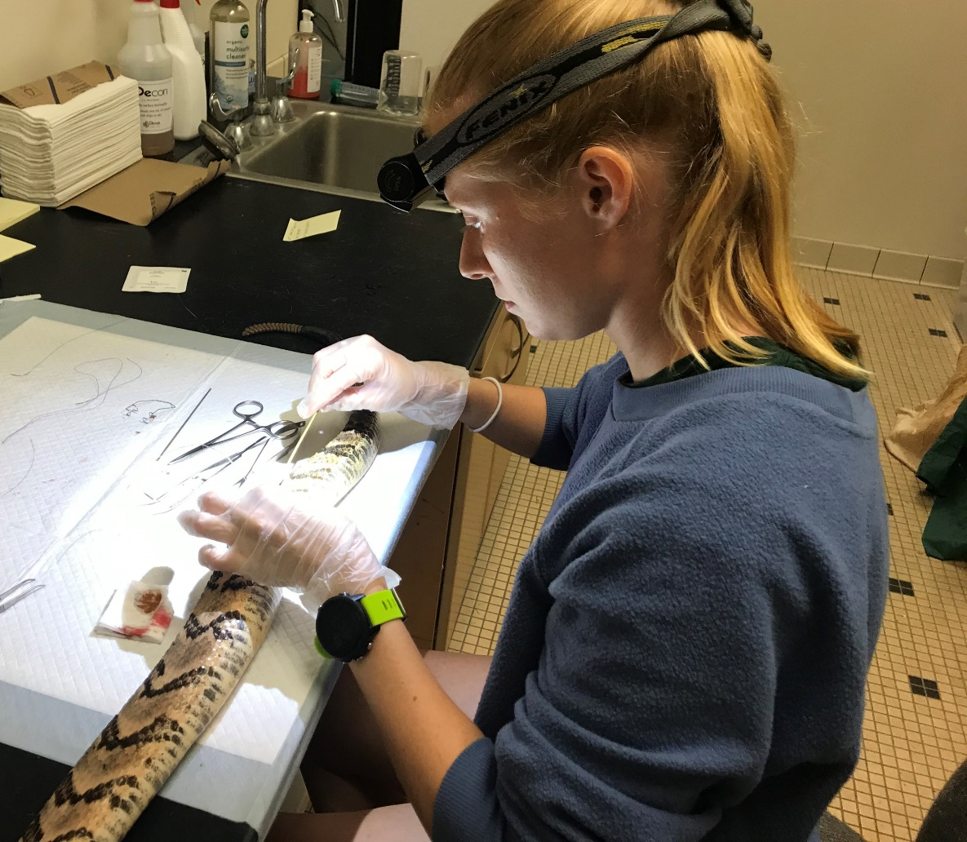

Title
Authors’ Names
Name & Address of the CSU Department
Background
Roadways = one of the most widespread, prominent, and disruptive human land use features that influence animal behavior and movement^{1,2,3,4}
Negative impacts: vehicle-induced mortality, habitat destruction and fragmentation, and creating barriers to movement^{1,4,5}
Radio telemetry derived spatial data historically used to infer movement-based response to landscape heterogeneity
Integrating hand-held radio telemetry with accelerometry (RT-ACT)⁶ can provide a more comprehensive evaluation of animal response to roadways
Methods cont.
Calculated Spatial Response Variables: Meters Per Day (MPD), Distance Per Movement (DPM), Minimum Movement Frequency (MMF), Home range estimators (Kernel Density Estimators: 95% and 50% Utilization Distributions (UDs) and 100% Minimum Convex Polygons), Motion Variance (derived from dynamic Brownian Bridge motion models)
Accelerometry: N= 14 (9 females, 5 males)
Provided continuous recording (1 Hz) of activity in the field→ offload data after extraction
Machine learning: 99% accuracy in activity classification (moving vs immobile) → continuous daily activity budgets → calculated temporal response variables: mean time spent moving/24 hrs (Mov24), mean number of movement bouts/24hrs (Bout24)
Fine Scale Road Effect
Identified snakes with road interactions → extracted 2-week time period before each road interaction and calculated spatial and temporal response variables (DPM; Mov24, respectively)
Pooled data and calculated the same spatial and temporal response variables for all other relocations in which the snake was not interacting with the road
Statistical Analysis
Broad Scale Road Effect
Linear Mixed Effects Models
  Fixed effects: sex, mean distance to roads; Random effects: snake ID; Dependent variables: Spatial and Temporal Response variables
Fine Scale Road Effect
Mann-Whitney U test → compare response variables between road interactions and all other relocations
Results cont.
Fine Scale Road Effect
18 road interactions (16 crossing events, 2 instances of approaching and retreating) across 9 individuals
Snakes increase movement temporally (Mov24; P = 0.03) but not spatially (DPM; P = 0.07) when interacting with roads
A
Time (hours)
Distance to road (meters)
A
B
B
Distance moved (meters)
Distance to road (meters)
Fig. 3. (A) Mov24 (hrs/day; green bars) and distance to roads (meters; orange line) for female C. horridus. (B) MPD (meters; blue bars) and distance to roads (meters; orange line) for female C. horridus. Red shaded area identifies the time frame of a confirmed road interaction.
Discussion
Broad Scale Road Effect
No significant impact of roads detected at broad scale likely due to the abundance of contiguous habitat adjacent to roads.
Road interactions are rare events, only 18 total, so acute behavioral response to roads not captured at a broad scale
2 snakes crossed roads only during migration between foraging and overwintering sites → strong site fidelity might cause snakes to endure increased risks of roads to reach habitat used previously
Fine Scale Road Effect
Snakes increase the time spent moving daily during road interactions, but this response is not detected spatially
Likely an avoidance/indecisiveness response rather than an attraction to the road supported by low number of road encounters
Increased temporal movement response when snakes encounter roads could have cascading negative impacts on fitness in populations with higher rates of road encounters
Accelerometry derived temporal movement metrics reveal variation in the movement response of timber rattlesnakes (C. horridus) to roadways unlike the radio telemetry derived spatial data (Figure 3).
Fig. 1. (A) Female C. horridus obtained for study; (B) Study site, Cedar Creek Wildlife Management Area; unpaved roads outlined in yellow, paved roads outlined in red
Study System
Study species: Timber Rattlesnake (Crotalus horridus) (Fig. 1A)
Ambush predator, forest specialist, long lived with long gestation periods → vulnerable to land use changes
Roads are a range-wide threat to continued population viability for C. horridus
Study site: Cedar Creek Wildlife Management Area, Putnam County, GA (Fig. 1B)
Upland pine and bottomland hardwood forests
Abundance of paved and unpaved roads present
A
B
Objectives
Apply the RT-ACT framework to improve understanding of the broad and fine scale behavioral impact of roads on Timber Rattlesnakes (C. horridus)
Fig. 2. (A) Hand-held radio telemetry, (B) RT-ACT implantation procedure
Results
Broad Scale Road Effect
No significant relationship detected between distance to roads and spatial or temporal response variables
Male C. horridus move greater distances per day (MPD; P = 0.04), move further per movement (DPM; P = 0.04), and move more inconsistently (MV; P = 0.009) compared to females
Methods
Broad Scale Road Effect
Radio telemetry: N= 28 (15 females, 13 males)
Relocated every 3-4 days → recorded GPS coordinate
References
Newbold et al. 2020, Functional Ecology 34, 648-693.
Shine et al. 2004, Ecology and Society 9, 9
Dubey et al. 2009, Amphibia-Reptilia 30, 127-133.
Lomas et al. 2019, Herpetologica 75, 153-161.
Quintero-Ángel et al. 2012, Herpetology Notes 5, 99-105.
DeSantis et al. 2020, Front. in Ecology and Evolution 8, 169.
Acknowledgements
Funding: Georgia College Biology, College of Science, Herpetologists’ League
Field Assistance: Will Tillett, Conor Evans, Reagan Thornton
Logistical Support: Paul Watson, Liz Caldwell, GA-DNR, USFS
Non-author Photo Credit: Fig. 1 (A) – Dr. Matthew Milnes, Fig. 2 (A) – Sarah Ebert

