Slide 1
Open Budget Meeting
Town Hall
June 17, 2021 9:00 a.m.
Via Teams

Slide 2

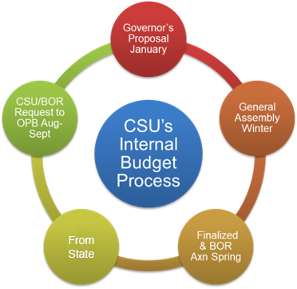

Slide 3
Open Budget Meeting
Overall All funding requests must be in alignment with the university’s strategic priorities. The use of funds and support of the University’s mission from the previous year(s) is considered in developing future budgets. Instructions and criteria for funding requests will be distributed at the start of the budget build process. The budget office will provide reports and timelines to assist in the preparation of funding requests. General Funds Process: Each Vice President will submit funding requests for the new fiscal year. Informal meeting occurs with each Vice President and the President, Vice President for Business and Operations, Assistant Vice President of Budget and Finance and the Director of Budgets; where the VP discusses their budget needs for the next year. Data gathered from sessions will be compiled and distributed to the Planning & Budget Advisory Council (PBAC). Each Vice President will be given the opportunity to review their request(s) before the PBAC meeting. Then each VP’s request goes before the PBAC members for discussion and to answer any questions that the PBAC may have. PBAC members will review the requests in light of the institution’s strategic priorities and assign each request as A; B; C; or D priority. Each priority level is assigned a point value: (5) A; (3) B; (2) C; (1) D All voting sheets are then tallyed and results reported to the PBAC. Results of the priority assignment are reported to the President as recommendations for funding. | The President retains final decision making authority as to what is funded in the new budget. Other Funds: Each director and/or VP will present their budget to the Vice President for Business and Operations, Assistant Vice President of Budget and Finance and the Director of Budgets. The President may elect to attend. The proposed budget will be reviewed for reasonableness and support of the strategic plan. The proposed budget requests/recommendations will be presented to the President for final approval. Budget Finalization: The Vice President for Business and Operations, Assistant Vice President of Budget and Finance and the Director of Budgets will conduct a final review for accuracy and completeness and then post information on the Budget and Finance and the Planning & Budget Advisory Council Websites. The Board of Regents processes will be followed for submission and implementation

Slide 4
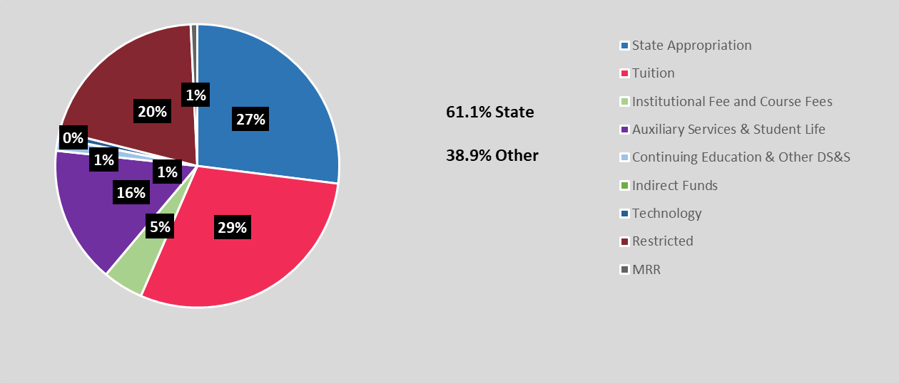
Clayton State University’s Resources
Uses
Restrictions
Realities
Salaries and Wages
Utilities
Supplies and Equipment
Technology
Facilities and Maintenance
Public Safety
Campus Activities and Services
Capital funds can not be used to pay for salaries and wages
State procurement guidelines must be followed
Student fees must be used in conjunction with specific services
Prudent fiscal management required for all sources
State Appropriation varies
Focus on Financial Ratios
Economic conditions have a direct impact on our ability to collect the revenues necessary to satisfy the needs and obligations of the University
Notes:
Budget- NEEDS UPDATE

Slide 5
Open Budget Meeting
CSU’s PRIMARY RESOURCES
State Appropriation $27,140,426
Tuition $29,655,447
Fees
  Mandatory Fees $5,832,851
  Special Institutional Fees $3,584,966
  Other Fees $745,612
PBI Grant funded items $1,015,949
HEERF II
  Student Aid $3,082,836
  Institutional $8,565,007
  MSI $634,557
HEERF III
  Student Aid $10,303,235
  Institutional $9,631,911
  MSI $TBD

Slide 6
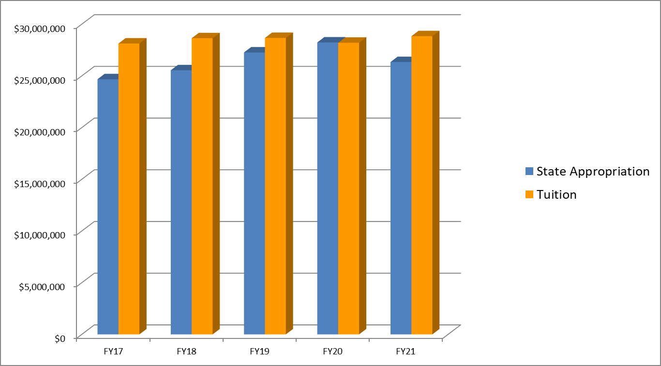
Open Budget Meeting
State Appropriation & Tuition Trends FY 2017-2021
Notes:
done

Slide 7
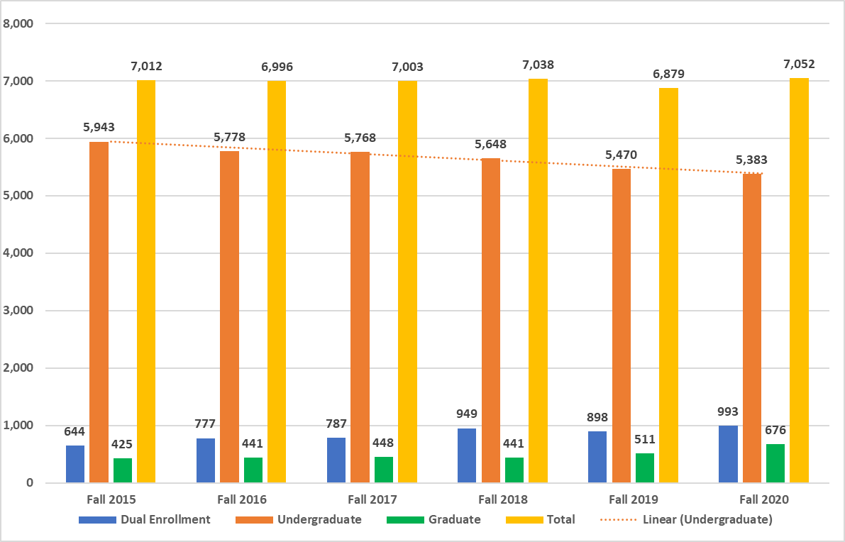
Open Budget Meeting
Fall Enrollment 2015-2020-Impacts State Appropriation & Tuition Revenue
Notes:
done

Slide 8
Open Budget Meeting
Categories that pay less/none: Distance Learning, eCore, Employees/TAP, Fayette County, Henry County, Dual Enrolled, Main Campus - less than 3 hrs, Senior Citizens, WebBSIT, Military
Notes:
NEEDS UPDATE

Slide 9
Open Budget Meeting
Mandatory Fees Shortfalls
Categories that pay less/none: Distance Learning, eCore, Employees/TAP, Fayette County, Henry County, Dual Enrolled, Main Campus - less than 3 hrs, Senior Citizens, WebBSIT, Military
Notes:
NEEDS UPDATE

Slide 10
Open Budget Meeting
Notes:
NEEDS UPDATE

Slide 11
Open Budget Meeting
FY21 Budget Wrapping Up
July 1,2020 - June 30, 2021
Notes:
NEEDS UPDATE

Slide 12
Open Budget Meeting
Notes:
NEEDS UPDATE

Slide 13
Open Budget Meeting
FY21 Year-End Spend Requests
Enrollment Management (18 Requests) | $ 1,587,743
Business & Operations (20 Requests) | $ 320,824
Academic Affairs ( 14 Requests) | $ 298,698
Student Affairs (4 Requests) | $ 1,008,253
Spivey Hall (2 Requests) | $ 17,925
Athletics (3 Requests) | $ 50,994
TOTALS | $ 3,284,437
Notes:
NEEDS UPDATE

Slide 14
Open Budget Meeting

Slide 15
Open Budget Meeting

Slide 16
Open Budget Meeting
HEERF II FUNDING
STUDENT GRANTS
  Under the Coronavirus Aid, Relief, and Economic Security (CARES) Act. $3,082,836 has been designated as Emergency Financial Aid Grants to students.
INSTITUTIONAL
Clayton State University will be provided $8,565,007
MINORITY SERVING INSTITUTION
Clayton State University will be provided $634,557
*HEERF II Phase II Plan under review

Slide 17
Open Budget Meeting
HEERF III FUNDING
STUDENT GRANTS
  Under the Coronavirus Aid, Relief, and Economic Security (CARES) Act. $10,303,235 has been designated as Emergency Financial Aid Grants to students.
INSTITUTIONAL
Clayton State University will be provided $9,631,911
MINORITY SERVING INSTITUTION (MSI)
Amount TBD
Guiding Principles for Spending Institutional and MSI Allocations
Practices to monitor and suppress COVID 19 (mandatory required use)
Outreach to Financial Aid Applicants (mandatory required use)
Lost revenue from state appropriation for FY22
  Student Success Expenditures
  TBD once BOR guidance is received
Student debt discharge
Outstanding lost revenue from PPV projects (housing and SAC), auxiliary units (athletics, parking, etc.), departmental sales and service, student activity fees, and tech fee.
Minor remodeling

Slide 18
FY22 Budget Build Meetings

Slide 19
CSU Internal FY22 Budget Meetings
FY22 Spend Requests from Campus
Academic Affairs (21 Requests) | $ 1,435,308
Enrollment Management (6 Requests) | $ 369,888
ITS (5 Requests) | $ 170,000
Student Affairs (1 Request) | $ 42,300
Business & Operations (23 Requests) | $ 920,656
University Advancement (3 Requests) | $ 165,414
Athletics (2 Requests) | $ 76,000
TOTALS | $ 3,179,566

Slide 20
Open Budget Meeting
Allocation of State Appropriations FY2022
State Appropriation FY 2021 Base Budget $25,355,151
Formula Funding – Enrollment and Other Allocations
Enrollment Earnings $ 680,220
FY21 Formula Allocation Adjustment $ 1,042,219
Health Insurance & Retiree Change $ (17,014)
Teacher’s Retirement System – Rate Change $ 92,217
Teacher’s Retirement System – Payments for ORP members $ (12,367)
Total of Enrollment and Other Allocations $ 1,785,275
Total FY2022 State Funds Budget $27,140,426

Slide 21
CSU’s Budget Build

Slide 22
Summer Budget
Note
  CSU’s Annual Budget is divided into three parts: Fall/Spring/Summer
  Summer Budget is split between fiscal years
    Summer 2021 Revenue split:
      74% FY21
      26% FY22
    Summer 2022 Revenue split:
      60% FY22
      40% FY23

Slide 23
Open Budget Meeting

Slide 24
Open Budget Meeting

Slide 25
Open Budget Meeting

Slide 26
Possible Challenges for FY 22
Enrollment
COVID-19 Uncertainty
Carry Forward Requirements

Slide 27
Questions

