Slide 1
Open Budget Meeting
May 3, 2018

Slide 2
Open Budget Meeting

Slide 3
Clayton State University’s Resources
Uses
Restrictions
Realities
Salaries and Wages
Utilities
Supplies and Equipment
Technology
Facilities and Maintenance
Public Safety
Campus Activities and Services
Capital funds can not be used to pay for salaries and wages
State procurement guidelines must be followed
Student fees must be used in conjunction with specific services
Prudent fiscal management required for all sources
State Appropriation varies
Focus on Financial Ratios
Economic conditions have a direct impact on our ability to collect the revenues necessary to satisfy the needs and obligations of the University
*6% MRR excluded
Notes:
Budget- NEEDS UPDATE

Slide 4
Open Budget Meeting
STATE APPROPRIATION & TUITION TRENDS FY14 - FY18
Fiscal Year | State Appropriation | Tuition
FY14 | $ 23,251,922.00 | $27,338,759.00
FY15 | $ 24,067,121.00 | $27,333,575.00
FY16 | $ 25,198,595.00 | $27,831,086.00
FY17 | $ 24,688,217.00 | $28,129,766.33
FY18* | $ 25,584,910.00 | $29,246,500.00
Based on FY18 Budget data as Actuals are not available until after 6/30/18
* FY18 Tuition is projected
Notes:
done

Slide 5
Open Budget Meeting
Fall Enrollment 2011-2017
Notes:
done

Slide 6
Open Budget Meeting
Fees & Changes
Mandatory Fees
Athletic Fee - $10 Increase
Special Institutional Fees
Other Fees
Distance Learning

Slide 7
Open Budget Meeting
FY18
FY19
Teacher Education Internship Fee Discontinued in FY19
Online Course Fee Reduced to $25 per course with maximum of $75 per term
Notes:
NEEDS UPDATE

Slide 8
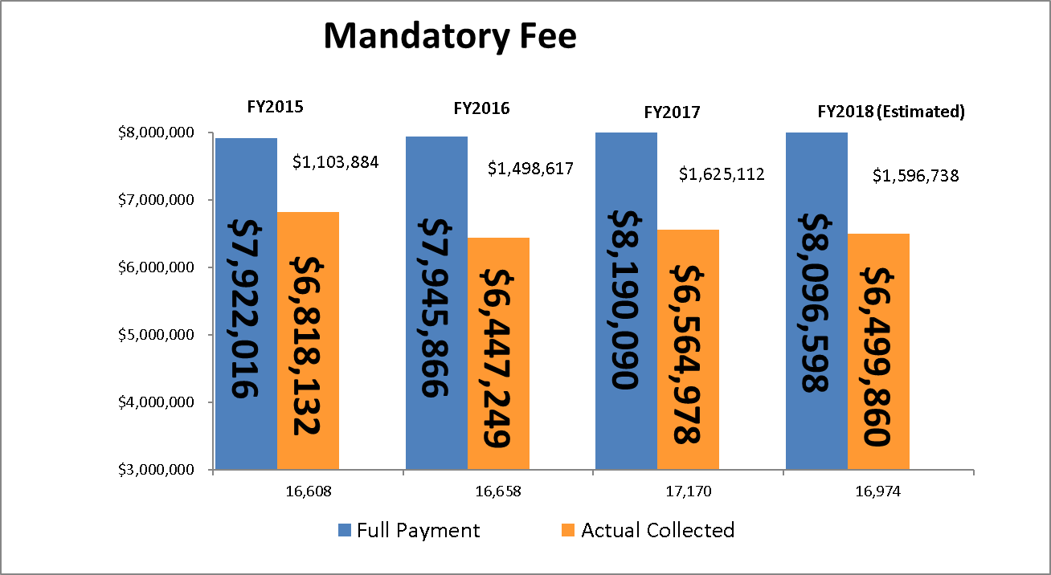
Open Budget Meeting
Total Students
Mandatory Fee Chart | FY 2016 | FY 2017 | FY 2018 | FY 2019
Laker Card | 20 | 20 | 20 | 20
Technology | 57 | 57 | 57 | 57
Student Activity | 60 | 60 | 60 | 60
Athletic | 160 | 160 | 160 | 170
Health | 46 | 46 | 46 | 46
Parking | 34 | 34 | 34 | 34
Student Activity Center | 100 | 100 | 100 | 100
Categories that pay less/none: Distance Learning, eCore, Employees/TAP, Fayette County, Henry County, Joint Enrolled, Main Campus - less than 3 hrs, Senior Citizens, WebBSIT
Notes:
NEEDS UPDATE

Slide 9
Open Budget Meeting
Notes:
NEEDS UPDATE

Slide 10
Open Budget Meeting
FY18 Budget Wrapping Up
Available Funds:
Estimated Salary & Benefits Savings Sweep $1,500,000
Budget Spend Estimate Sweep $ 350,000
Total Funds Available $1,850,000
Uses of Funds:
Tuition Carry Forward $ 830,000
In-Kind SAC & CE (45/200) (Estimated) $ 245,000
Total Uses of Funds $1,075,000
Possible Funds Available for Various Year-End
Items Such as One-Time Funding Requests &
Unresolved Budget Issues $ 775,000
Notes:
NEEDS UPDATE

Slide 11
Open Budget Meeting
 | FY18 Year-End Spend Requests
 | Provost (11 Requests) |  |  | $ 150,237.00
 | ITS(17 Requests) |  |  | $1,176,100.00
 | Business & Operations (21 Requests) |  |  | $ 263,358.00
 | University Advancement (1 Requests) |  |  | $ 340,000.00
 | Student Affairs (2 Requests) |  |  | $ 8,100.00
 | Spivey (3 Requests) |  |  | $ 12,640.00
 | Campus Wide (5 Requests) |  |  | $ 285,902.00
 | TOTALS |  |  | $2,236,337.00
Notes:
NEEDS UPDATE

Slide 12
Open Budget Meeting
UNRESOLVED BUDGET ISSUES
Necessary Obligations
That Have Occurred or In Progress
Signage | $ 5,000.00
Utilities Caused Budget Shortfall | $ 145,000.00
Interpreters | $ 50,000.00
Staff-BOR | $ 205,000.00
Music Building Water Proofing | $ 19,100.00
#OCR Resolution Costs | $ 25,000.00 |  | $ 75,000.00
Subtotal | $ 449,000.00 |  | $ 499,100.00
Upcoming Obligations
Academic Core Moves | $ 25,000.00
Interpreters | $ 90,000.00
OneUSG Cost for Travel | $ 12,000.00
Subtotal | $ 127,000.00 |  | $ 127,000.00
Grand Total | $ 576,000.00 | to | $ 626,100.00
*Potential Issues
Academic Core FF&E | $ 70,000.00 | to | $ 700,000.00 | (some funds may be
 |  |  |  | needed FY18 for long
 |  |  |  | lead items)
#Reminder
$830k to $850K Carry Forward

Slide 13
CSU Internal FY19 Budget Meetings
FY19 Annual Spend Requests
Provost (18 Requests) $693,077
Business & Operations (7 Requests) $341,445
ITS (7 Requests) $421,678
University Advancement (1 Request) $45,000
Student Affairs (3 Requests) $192,533
TOTALS $1,693,733

Slide 14
Open Budget Meeting
Allocation of State Appropriations FY2019
State Appropriation $25,539,423
Formula Funding – Enrollment and Other Allocations
Enrollment Earnings (Loss) $932,645
Maintenance & Operations (M&O) $18,645
Annualize FY18 Adjustments $25,643
Health Insurance & Retiree Fringes $0
Teacher’s Retirement System $781,484
Department of Administrative Services Premiums (DOAS) $(68,761)
Total of Enrollment and Other Allocations $1,689,656
Total FY2019 State Funds Budget $27,229,079

Slide 15
CSU’s Budget Build
FY19 BUDGET BUILD SCENARIO
Fall Enrollment 7000 Revenue
State Appropriation | 27,229,079
Tuition | 28,000,000
Fees & Other General | 5,081,255
Carry Forward Funds | 850,000
 |  | 61,160,334
Expenditures
Updated current budget |  | 60,183,874
Funding Available to Distribute |  | 976,460
Required Funding Items added:
University Contingency | 278,000
Increase in software licenses | 10,633
Faculty Promotions including benefits | 71,472
Stressors/Market Adjustments | 125,000
 |  | 485,266
Additional Funds Available |  |  | 491,194

Slide 16
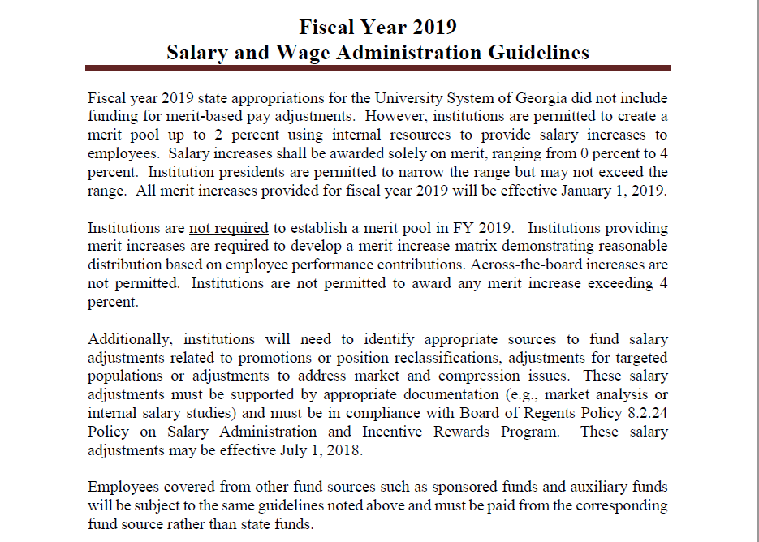
Open Budget Meeting

Slide 17
Summer Budget
CSU Annual Budget is divided into three parts: Fall/Spring/Summer
Summer 2018 Revenue is split about 30% for FY18 and 70% FY19

Slide 18
Open Budget Meeting

Slide 19
Discussion and Questions

