Slide 1
Open Budget Meeting
April 25, 2019

Slide 2

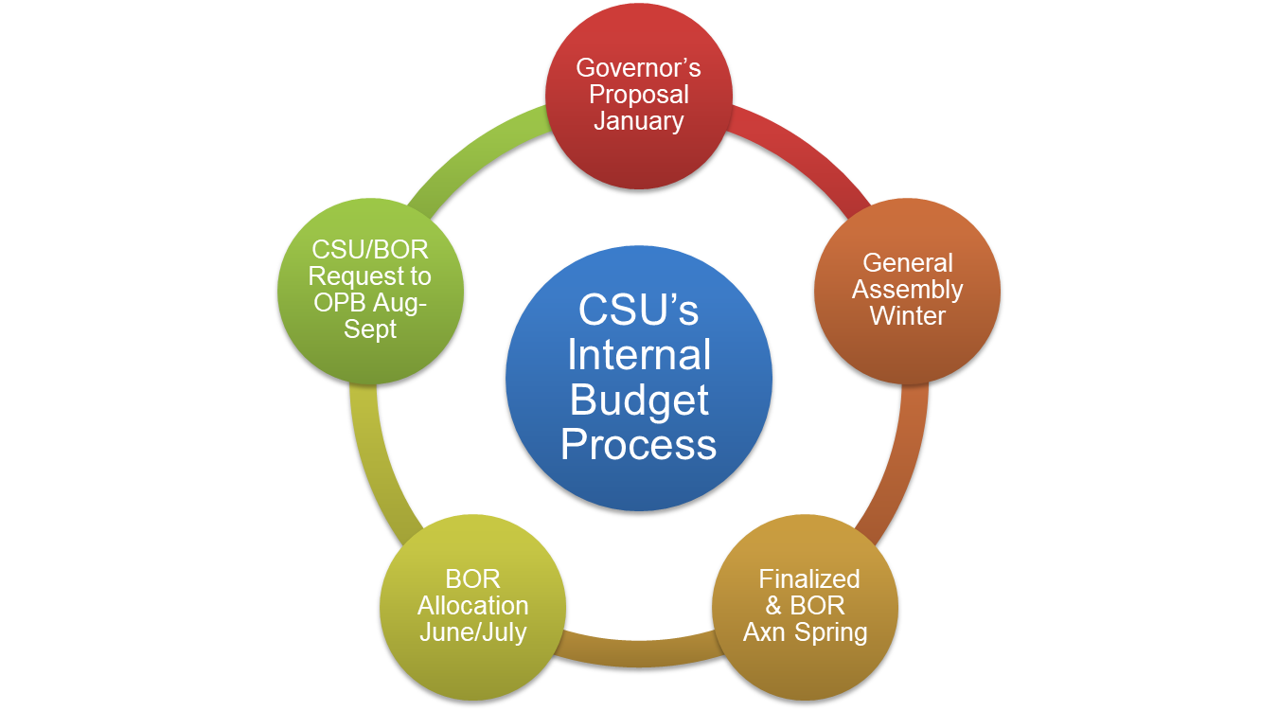

Slide 3
Open Budget Meeting

Slide 4
Clayton State University’s Resources
Uses
Restrictions
Realities
Salaries and Wages
Utilities
Supplies and Equipment
Technology
Facilities and Maintenance
Public Safety
Campus Activities and Services
Capital funds can not be used to pay for salaries and wages
State procurement guidelines must be followed
Student fees must be used in conjunction with specific services
Prudent fiscal management required for all sources
State Appropriation varies
Focus on Financial Ratios
Economic conditions have a direct impact on our ability to collect the revenues necessary to satisfy the needs and obligations of the University
Notes:
Budget- NEEDS UPDATE

Slide 6
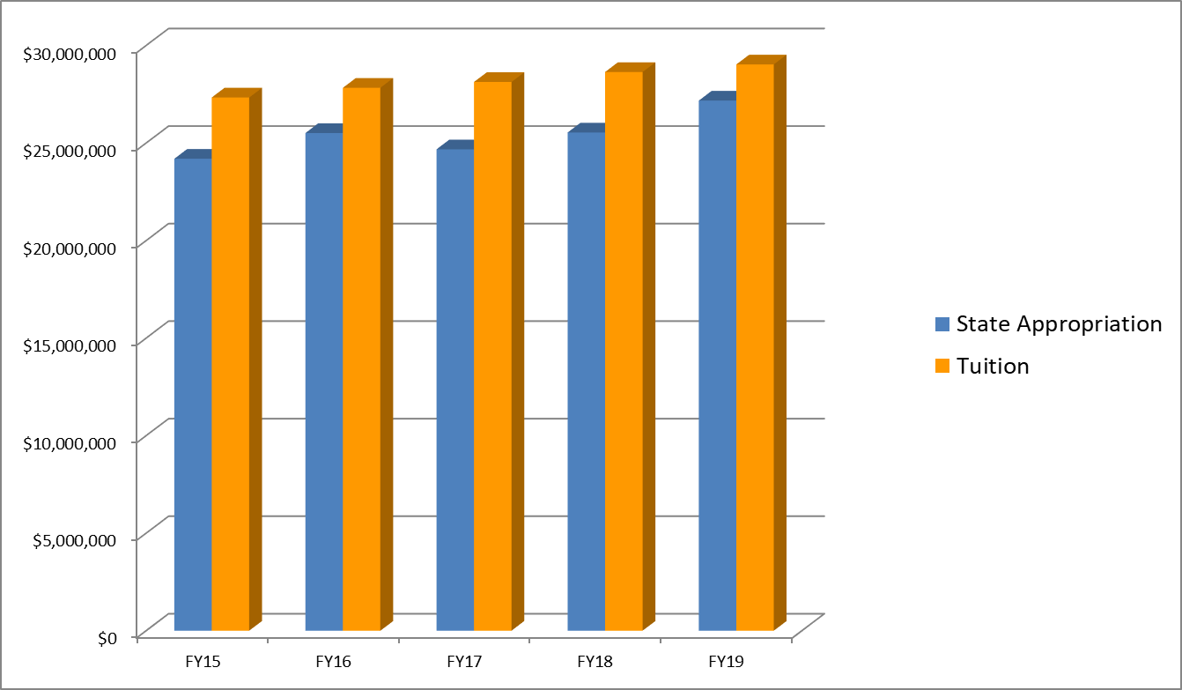
Open Budget Meeting
STATE APPROPRIATION & TUITION TRENDS FY15 - FY19
Fiscal Year | State Appropriation | Tuition
FY15 | $24,067,121 | $27,333,575
FY16 | $25,198,595 | $27,831,086
FY17 | $24,687,217 | $28,129,766
FY18 | $25,539,423 | $28,641,372
FY19 | $27,229,079 | $29,088,093*
* FY19 Tuition is projected
Notes:
done

Slide 7
Open Budget Meeting
Fall Enrollment 2012-2018
Notes:
done

Slide 8
Open Budget Meeting
Fees & Changes
Mandatory Fees
  No changes
Special Institutional Fees
  No changes
Other Fees
  Distance Learning-2nd phase of reduction at an additional 33.3%

Slide 9
Open Budget Meeting
Description | FY 2019 | FY 2020 Approved Rate
BSN Program Fee (Per Semester Nursing Majors) | $283 | $283
Family Nurse Practitioner Program Fee (paid 1st semester upon acceptance into program) | $1,029 | $481
Family Nurse Practitioner Course Fee | $0 | $469
Teacher Education Practicum | $300 | $300
Telecourse/Online Course Fee (Capped at $75/semester) | $25 | $15
Family Nurse Practitioner Program Fee reduced to $481
New Family Nurse Practitioner Course (NURS 6690) Fee approved for $469
Online Course Fee Reduced to $15 per course with maximum of $75 per term
Notes:
NEEDS UPDATE

Slide 10
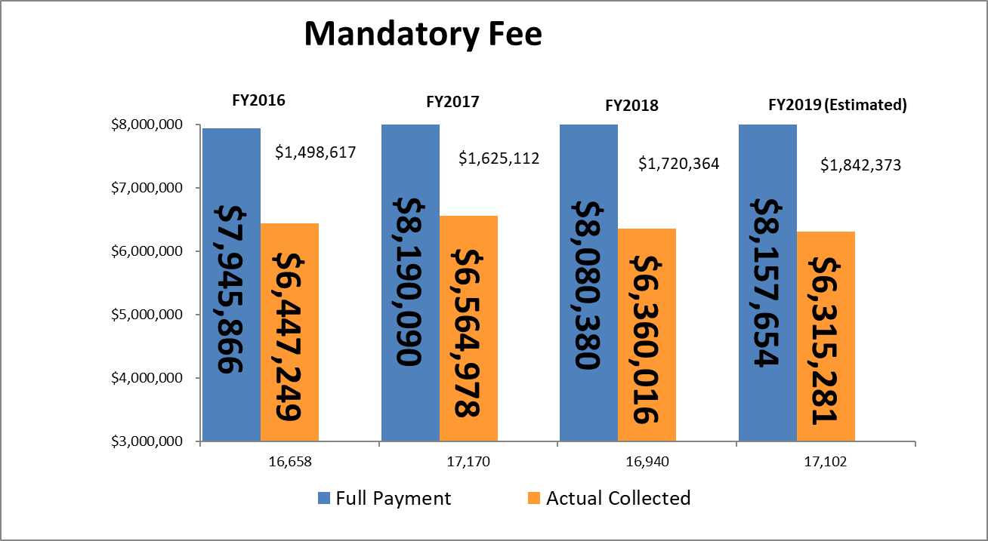
Open Budget Meeting
Total Students
Categories that pay less/none: Distance Learning, eCore, Employees/TAP, Fayette County, Henry County, Joint Enrolled, Main Campus - less than 3 hrs, Senior Citizens, WebBSIT
Notes:
NEEDS UPDATE

Slide 11
Open Budget Meeting
Notes:
NEEDS UPDATE

Slide 12
Open Budget Meeting
FY19 Budget Wrapping Up
Available Funds:
Estimated Salary & Benefits Savings Sweep $1,604,267
Budget Spend Estimate Sweep $ 300,000
Over realized Tuition $ 743,000
Total Funds Available $2,647,267
Uses of Funds:
Tuition Carry Forward $ 870,000
In-Kind SAC & CE (45/200) (Estimated) $ 245,000
Total Uses of Funds $1,115,000
Possible Funds Available for Various Year-End
Items Such as One-Time Funding Requests &
Unresolved Budget Issues $1,532,267
Notes:
NEEDS UPDATE

Slide 13
Open Budget Meeting
FY19 Year-End Spend Requests
Provost (10 Requests) | $ 303,038
Enrollment Management (1 Request) | $ 55,452
ITS (9 Requests) | $ 1,053,600
Business & Operations (55 Requests) | $ 1,013,173
University Advancement ( 2 Requests) | $ 60,733
Student Affairs (2 Requests) | $ 18,550
Spivey (2 Requests) | $ 900
Campus Wide (3 Requests) | $ 216,000
TOTALS | $ 2,721,446
Notes:
NEEDS UPDATE

Slide 14
Open Budget Meeting
UNRESOLVED BUDGET ISSUES
Distance Learning-Offering same level of services but at reduced rate |  | $79,591
Website phase 3 was on approved FY18 year end list but not completed |  | $80,000 |  | (Outsource or either hire PT workers to do website updates needed)
Stratification to ensure HVAC in Spivey Hall |  | $50,000
Road between main campus and CSU East estimated range |  | $180,000 | - | $200,000
FY18 Audit |  | $10,800
Mandated student health insurance |  | $3,968
Spivey Water Riser |  | $10,500
Laker Village-Gates |  | $4,096
Fingerprint machine |  | $15,000
Change orders associated with the MRR project to replace electrical heating mechanical system at Spivey Hall |  | $16,406
Utility shortfall |  | $250,000
Spivey Hall compressor replacement |  | $36,860
Elevator repairs in Lab Annex Bldg. |  | $12,094
RAVE Guardian Security system |  | $6,467
Public Safety fire damage |  | $80,000
Bad debt related to student accounts in FY18 & FY19 |  | $300,000
Academic Core transformer total cost 123K which will be reimbursed by GSFIC, but we have to pay up front |  | $31,000
Woodlands Hall water intrusion |  | $10,000
UC-Kitchen water leak repairs |  | $13,000
Electric car charging station repairs |  | $5,000
Potential litigation settlement |  | $9,000
Repairs needed in UC for a water leak in the walls |  | $5,000
Comprehensive Administrative Review Committee Recommendations |  | Unknown
Total |  | $1,208,782 | - | $1,228,782

Slide 15
CSU Internal FY20 Budget Meetings
FY20 Annual Spend Requests
Provost (8 Requests) $548,324
Enrollment Management (4 Requests) $191,342
Business & Operations (7 Requests) $183,850
ITS (5 Requests) $265,680
Student Affairs (4 Requests) $ 91,320
TOTALS $1,280,516

Slide 16
Open Budget Meeting
Allocation of State Appropriations FY2020
State Appropriation FY 2019 Base Budget $27,229,079
Formula Funding – Enrollment and Other Allocations
Enrollment Earnings (Loss) $ -
Enhancement for Student Success $ 40,000
Partial offset of e-tuition revenue $ 74,300
Maintenance & Operations (M&O) $ 17,072
Merit Allocation $663,709
Health Insurance & Retiree Change $142,542
Teacher’s Retirement System $ 26,419
Department of Administrative Services Premiums (DOAS) $ 3,782
Transfers & Other Adjustments (Know More, Borrow Less) $ 31,000
Total of Enrollment and Other Allocations $998,824
Total FY2020 State Funds Budget $28,227,903

Slide 17
CSU’s Budget Build
FY20 BUDGET BUILD SCENARIO
Revenue - 7,000 Fall Enrollment
 | FY20 Budget
State Appropriation | 28,227,903
Tuition | 29,296,125
Fees & Other General | 5,053,900
Carry Forward Funds | 870,000
 |  | 63,447,928
Expenditures
Updated current budget with 2% Merit Salary Increase |  | 62,305,858
Funding Available to Distribute |  | 1,142,070
Required Funding Items added:
University Contingency | 250,000
Increase in software licenses | 73,586
Benefits Associated with 2% Merit Salary Increase | 157,231
Faculty Promotions including benefits | 60,003
Stressors-Public Safety Retention | 8,000
 |  | 548,820
Additional Funds Available |  |  | 593,250

Slide 18
Open Budget Meeting
Fiscal Year 2020 Salary and Wage Administration Guidelines
The FY 2020 budget includes $47.0 million in state funds for merit-based pay adjustments and employee recruitment and retention initiatives. The merit increase is to be effective July 1, 2019. The FY 2020 Allocation Sheet reflects the institution’s share of these funds.
The Board of Regents allocated to each institution funds to provide for salary increases for employees. Salary increases shall be awarded solely on merit, ranging from 0% to a high of 4%. Institution presidents are permitted to narrow the range but may not exceed the range. Institutions are strongly encouraged to give priority to salary increases for teaching faculty. The established salary pool for merit may not exceed 2%.
Institutions are required to develop and submit a merit increase matrix demonstrating reasonable distribution based on employee performance. This matrix must align with your established performance management/evaluation rating scale. Across-the-board increases are not permitted. This matrix must be submitted as a part of the FY 2020 budget submission.
Employees covered from other fund sources such as sponsored funds and auxiliary funds will be subject to the same policy requirements noted above and must be paid from the corresponding fund source rather than state funds.
Institutions will need to identify other appropriate sources to fund salary adjustments related to promotions or position reclassifications, adjustments for targeted populations or adjustments to address market and compression issues. Institutions are encouraged to prioritize adjustments for lower paid employees contingent upon availability of funding. These salary adjustments must be supported by appropriate documentation (e.g., market analysis or internal salary studies) and must be in compliance with Board of Regents Policy 8.2.24 Policy on Salary Administration and Incentive Rewards Program. These salary adjustments may also be effective July 1, 2019.

Slide 19
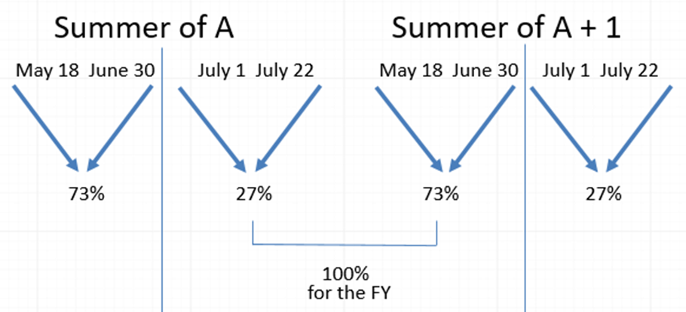
Summer Budget
CSU Annual Budget is divided into three parts: Fall/Spring/Summer
Summer 2019 Revenue is split about 27% for FY20 and 73% FY19

Slide 20
Open Budget Meeting

Slide 21
Discussion and Questions

