Slide 1
Conflicts of Interest, Conflicts of Commitment & Outside Activities
University System of Georgia Policy 8.2.18.2 Overview

Slide 2
Core Disclosures
Employees have a responsibility to fully disclose any relationships or activities that may compromise an employee’s objectivity & responsibilities.
Financial and business interests related to the USG employee’s expertise must be disclosed. This includes interests of:
  Employee
  Spouse or Partner
  Parent, Child, or Sibling
  In-laws

Slide 3
CONFLICTS OF INTEREST
Employees shall make every reasonable effort to avoid actual or apparent conflicts of interests.
An apparent conflict of interest exists when a reasonable person would conclude that the employee’s ability to protect public interest or perform public duties is compromised by a:
  Personal Interest
  Financial Interest
  Business Interest
An apparent conflict of interest can exist even in the absence of a legal conflict of interest.

Slide 4
CONFLICTS OF INTEREST
Employees have a responsibility to report and fully disclose ANY relationship or activity that has the potential to create an actual or apparent conflict of interest.
Under no circumstances should a grant, gift, contract, or other funding be accepted that limits employees from adhering to required standards in research.

Slide 5
CONFLICTS OF COMMITMENT
A USG employee shall not engage in any occupation, pursuit, or endeavor that will interfere with the regular and punctual discharge of that employee’s official duties.

Slide 6
OUTSIDE ACTIVITIES
Full-time, benefited employees must obtain written approval prior to engaging in compensated outside activities.
Such activities include but are not limited to:
  Consulting
  Teaching
  Speaking
  Business, Professional, or Service Enterprises

Slide 7
OUTSIDE ACTIVITIES
Employee’s direct supervisor and/or department head must approve.
Approval is also needed from the institution President or the President’s designee and use our reporting form.
USG employees must use appropriate leave for outside activities that occur during the employee’s work hours.

Slide 8
CONSULTING FOR USG VENDORS
Employees are generally prohibited from consulting with or receiving compensation from a current CSU vendor or entity seeking a vendor relationship with CSU.
Exceptions to this provision may be granted by the President (or President’s designee) for employees that do not supervise, regularly interact with, or participate in the selection of vendors for CSU.

Slide 9
POLITICAL ACTIVITIES
It is inappropriate for employees to manage or enter political campaigns while on duty or performing services for CSU.
Employees cannot hold elective political office at the state or federal level while employed by CSU.
Employees may seek and hold elective office at other than the state or federal level, or appointive office, when it does not conflict or interfere with the employee’s duties and responsibilities to CSU.

Slide 10
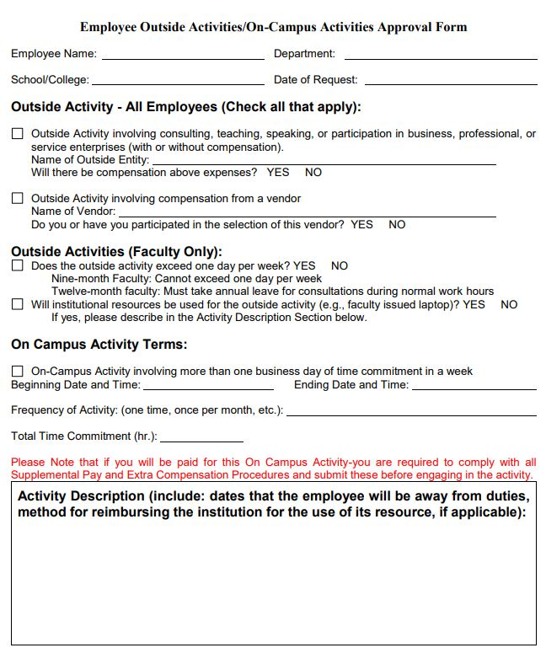

Slide 11
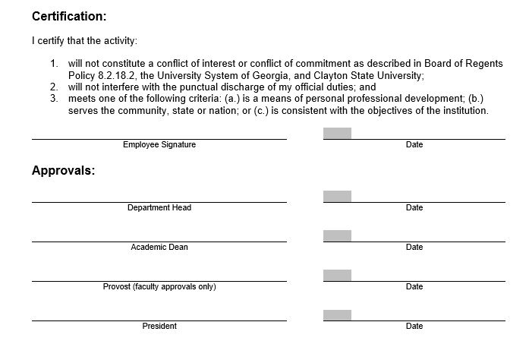

Slide 12
Questions

