Slide 1
Open Budget Meeting
April 27, 2017

Slide 2
Clayton State University’s Resources
State Appropriations 2017
Major Repair &
Renovation (MRR)
Tuition & Fees
Auxiliary Enterprises
CSU Foundation
  Endowments
  Scholarships
  Unrestricted Annual Giving
Sponsored Programs
Uses
Restrictions
Realities
Salaries and Wages
Utilities
Supplies and Equipment
Technology
Facilities and Maintenance
Public Safety
Campus Activities and Services
Capital funds can not be used to pay for salaries and wages
State procurement guidelines must be followed
Student fees must be used in conjunction with specific services
Prudent fiscal management required for all sources
State Appropriation varies
Focus on Financial Ratios
Economic conditions have a direct impact on our ability to collect the revenues necessary to satisfy the needs and obligations of the University

Slide 3
Open Budget Meeting
STATE APPROPRIATION & TUITION TRENDS FY13 - FY17
Fiscal Year | State Appropriation | Tuition
FY13 | $22,799,099 | $26,520,536
FY14 | $23,251,922 | $27,338,759
FY15 | $24,067,121 | $27,333,575
FY16 | $25,198,595 | $27,831,086
FY17 | $24,687,217 | $28,061,008*
* FY17 Tuition is projected

Slide 4
Open Budget Meeting
Fall Enrollment 2010-2016

Slide 5
Open Budget Meeting
Fees & Changes
Mandatory Fees
Special Institutional Fees
Other Fees

Slide 6
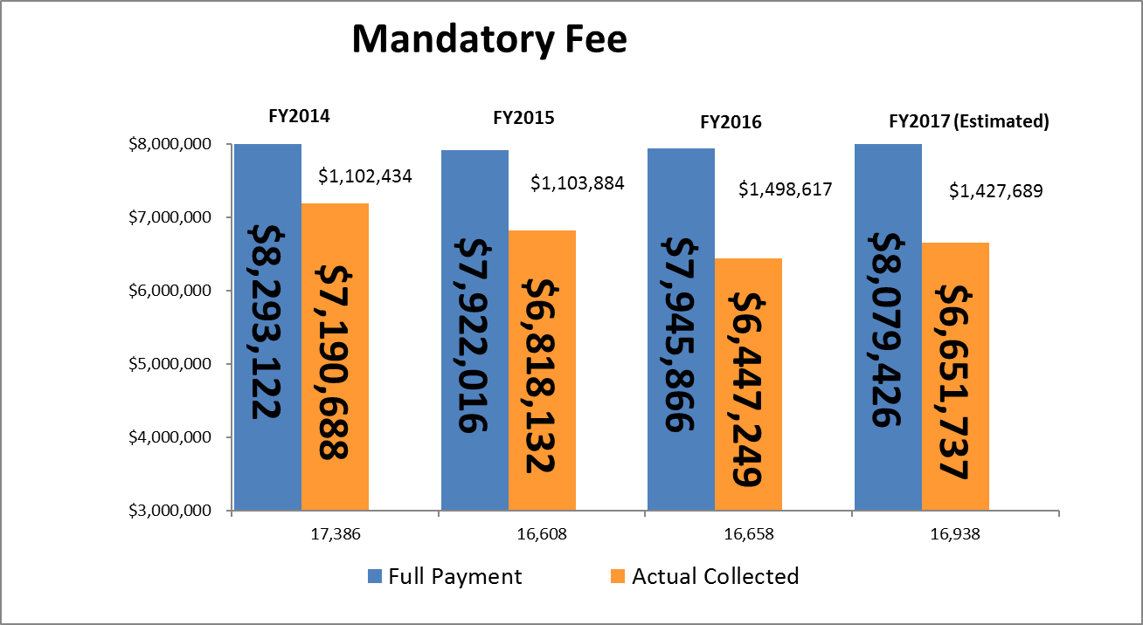
Open Budget Meeting
Total Students
Mandatory Fee Chart | FY 2014 | FY 2015 | FY 2016 | FY 2017
Laker Card | 20 | 20 | 20 | 20
Technology | 57 | 57 | 57 | 57
Student Activity | 60 | 60 | 60 | 60
Athletic | 160 | 160 | 160 | 160
Health | 46 | 46 | 46 | 46
Parking | 34 | 34 | 34 | 34
Student Activity Center | 100 | 100 | 100 | 100
Categories that pay less/none: Distance Learning, eCore, Employees/TAP, Fayette County, Joint Enrolled, Main Campus - less than 3 hrs, Senior Citizens, WebBSIT

Slide 7
Open Budget Meeting

Slide 8
Open Budget Meeting
BOR Approval Required Fees FY18
Fee | FY2017 (Estimated) | FY2018 (Projected)
BSN Program Fee | $ 115,000 | $ 110,000
Teacher Education Internship Fee | $ 3,500 | $ 3,000
Teacher Education Practicum Fee | $ 1,100 | $ 1,000
Telecourse/Online Course Fee | $ 500,000 | $ 500,000
FNP Program Fee | $ 20,580 | $ 20,580
Computing Systems Fee | $ 70,000 | $ 70,000
Dental Hygiene Application Fee | $ 1,100 | $ 1,200
Enrollment Management Fee | $ 35,000 | $ 35,000
HFMG Assessment Fee (NEW Fall 2017) | N/A | $ 14,250
Fee Rates
Fee | FY2017 | FY2018 (Proposed) | BOR Action
BSN Program Fee | $ 283 | $ 283 | APPROVED
Teacher Education Internship Fee | $ 100 | $ 100 | APPROVED
Teacher Education Practicum Fee | $ 300 | $ 300 | APPROVED
Telecourse/Online Course Fee | $ 35 | $ 35 | APPROVED
FNP Program Fee | $1,029 | $1,029 | APPROVED
Computing Systems Fee | $ 50 | $ 50 | DISCONTINUED
Dental Hygiene Application Fee | $ 25 | $ 25 | DISCONTINUED
Enrollment Management Fee | $ 15 | $ 15 | DISCONTINUED
HFMG Assessment Fee (NEW Fall 2017) | N/A | $ 475 | DENIED

Slide 9
Open Budget Meeting
FY17 Budget Wrapping Up
Available Funds:
Estimated Salary & Benefits Savings Sweep $1,470,000
Budget Spend Estimate Sweep $ 450,000
Possible Additional Summer Revenue $ 400,000
Total Funds Available $2,320,000
Uses of Funds:
Financial Reporting Needs $ 800,000
Tuition Carry Forward $ 830,000
In Kind SAC & CE (50/250) $ 300,000
Total Uses of Funds $1,930,000
Possible Funds Available for Various Year End
Items Such as One-Time Funding Requests &
Unresolved Budget Issues $ 390,000

Slide 10
Open Budget Meeting
FY17 Annual One-Time and Year-End Spend Requests
Provost (17 Requests) $ 472,955
Business & Operations (20 Requests) $ 404,914
ITS (30 Requests) $2,684,000
University Advancement (4 Requests) $ 200,000
Student Affairs (6 Requests) $ 238,586
Spivey (2 Requests) $ 108,013
TOTALS $4,108,468

Slide 11
Open Budget Meeting
Unresolved Budget Issues FY17
 | 1. | ADA for Web Conf. | $2,500
 | 2. | Power Outage | $75,000
 | 3. | Rave/Guardian | $14,000
 | 4. | Dalton--Consultants | $100,000
 | 5. | SBDC | $3,800
 | 6. | Water Main Break | $5,000
 | 7. | Spivey Sign | $3,000
 | 8. | Encryption | Delete 10K
 | 9. | Litigation | $20,000
 | 10. | Firewall & Load Balances | $182,000
 | 11. | Switches (3 Critical) | $406,000
 | 12. | 101 A&S ClassTile Repairs | $10,000
 |  | *Subtotal | $821,300
 | 13. | OneUSG | Delete 275K
 |  | Continuing Ed | $250,000
 |  | SAC | $50,000
 |  | TMR | $32,500
 |  | Dam Study | $20,000
 |  | AMAC Contract | $11,000
 |  | Total | $1,184,800
*As of 4/21/17

Slide 12
Open Budget Meeting
BOR Audit Engagement
Personnel Observations
The institution’s fiscal performance trend is weakening and characterized by flat to declining enrollment, thin reserves, and moderately increasing staffing levels and associated personnel costs. From 2012 to 2016, student headcount for fall enrollment dropped approximately 2%. Excluding Move On When Ready (MOWR) enrollment, the drop was 9%. From FY 2012 to 2016, full-time equivalent faculty and staff grew 9% and 7%, respectively, while part-time faculty and staff declined 12% and 11%, respectively. Associated personnel costs increased 15% during the period.

Slide 13
Open Budget Meeting

Slide 14
CSU Internal FY18 Budget Meetings
Divisions have been asked to redirect funds in order to fund strategic priorities.
The BOR asked us to prepare for a $533,000 budget cut due to enrollment decline, but the actual budget cut is only $354,552.
FY18 Funding Requests from Divisions
Provost $347,500
Business & Operations $439,417
ITS $ 13,824
University Advancement $ 20,000
Student Affairs $ 17,000
TOTALS $837,741

Slide 15
Open Budget Meeting
Allocation of State Appropriations FY2018
State Appropriation $24,687,217
Formula Funding – Enrollment and Other Allocations
Enrollment Earnings (Loss) $(354,552)
Maintenance & Operations (M&O) $29,041
Health Insurance & Retiree Fringes $151,903
Merit Based Pay Adjustments (State’s share of 2%) $632,885
Teacher’s Retirement System $472,002
Department of Administrative Services Premiums (DOAS) $(12,065)
Prior Year Health & Retiree Allocation Adjustment (50%) $(67,008)
Total of Enrollment and Other Allocations $852,206
Total FY2018 State Funds Budget $25,539,423

Slide 16
CSU’s Budget Build
Revenue - 7,000 Fall Enrollment
 | FY18 Budget
State Appropriation | 25,539,423
Tuition | 27,986,000
Fees & Other General | 5,470,500
Carry Forward Funds | 830,000
 |  | $59,825,923
Expenditures
Updated current budget | $58,574,045
Funding Available to Distribute |  | $1,251,878
Required Funding Items added:
University Contingency | 200,000
Increase in software licenses | 11,613
Faculty Promotions including benefits | 42,665
Estimated Funding for Merit Raises including benefits | 770,695
OneUSG (275K-400K 1/2 year) | 137,500-200,000
TMR-GA Power | 130,000
 |  | $1,292,473-$1,354,973
Additional Funds Needed |  |  | $(40,595)-$(103,095)

Slide 17
Open Budget Meeting
Merit Salary Increase
Salary and Wage Administration Policy
The Board of Regents allocated to each institution funds to provide for salary increases for employees. Salary increases shall be awarded solely on merit, ranging from 0% to a high of 4%. Institution presidents are permitted to narrow the range but may not exceed the range. Institutions are strongly encouraged to give priority to salary increases for teaching faculty. Institutions are required to develop a merit increase matrix demonstrating reasonable distribution based on employee performance contributions. Across-the- board increases are not permitted. Institutions must request prior approval from the Chancellor in writing of any merit increases exceeding four percent.
Institutions will need to identify other appropriate sources to fund salary adjustments related to promotions or position reclassifications, adjustments for targeted populations or adjustments to address market and compression issues. Additionally, such salary adjustments must be supported by appropriate documentation (e.g., market analysis or internal salary studies).
    Employees covered from other fund sources such as sponsored funds and auxiliary funds will be
    subject to the same policy requirements noted above and must be paid from the corresponding
    fund source rather than state funds.*
CSU amount—$632,885 from USG
$137,810 from CSU
Total 2% $618,913 (salary only for State funded positions)
Total 2% $151,782 (benefits only for State funded positions)
*Total 2% $89,086 (salary and benefits for Auxiliary and other non-State funded positions)

Slide 18
Summer Budget
CSU Annual Budget is divided into three parts: Fall/Spring/Summer
Summer 2017 Revenue is split about 60% for FY17 and 40% FY18
Enrollment Report as of April 21st – 3,049 Headcount

Slide 19
Open Budget Meeting

Slide 20
Pcard Policy
New Pcard policy has been approved and training is required for all Pcard holders and approvers.
Policy is much more restrictive.
Procedures more stringent.

Slide 21
Discussion and Questions

