Slide 1
Clayton State University

Slide 2
Presentation Overview
National Enrollment Trends
Georgia Enrollment Trends
Fall 2018
New Fall 2018 Enrollment
  Historical Comparison
  USG Comparison
  Highlights
  Opportunities and Strategies
Continuing Fall 2018 Enrollment
  Re-registration Rates
  Retention Rates
  Opportunities and Strategies
Other
Questions

Slide 3
Enrollment Management
Faculty
Admissions and Marketing
Advising
Financial Aid/Bursar
Residence and Student Life
Academic Support
Marketing
Auxiliary Services
Career Services
Registrar

Slide 4
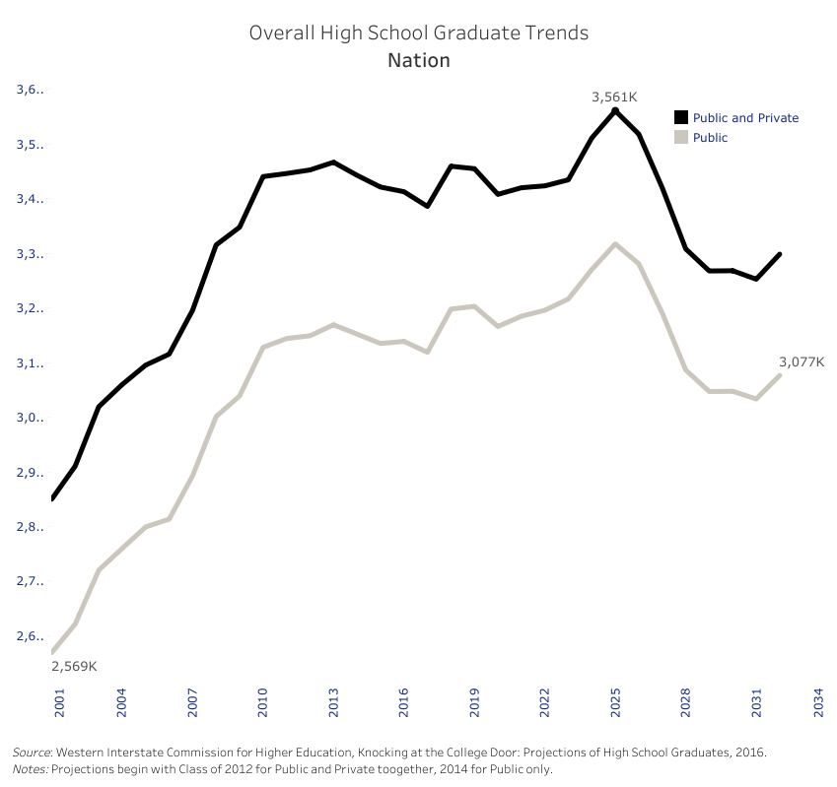

Slide 5
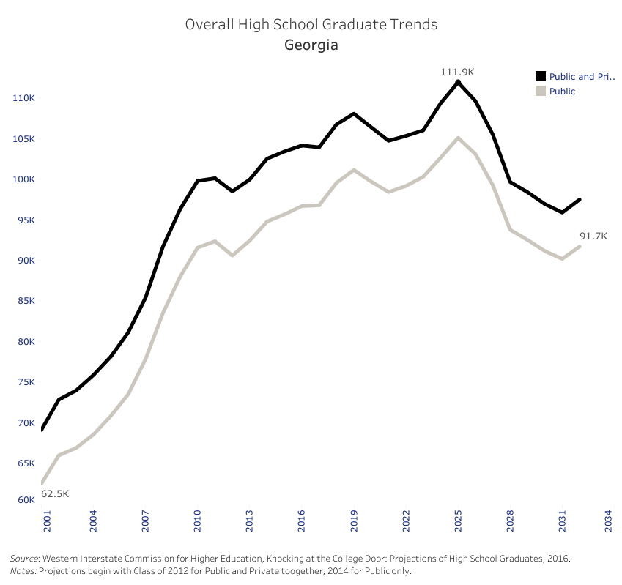

Slide 6
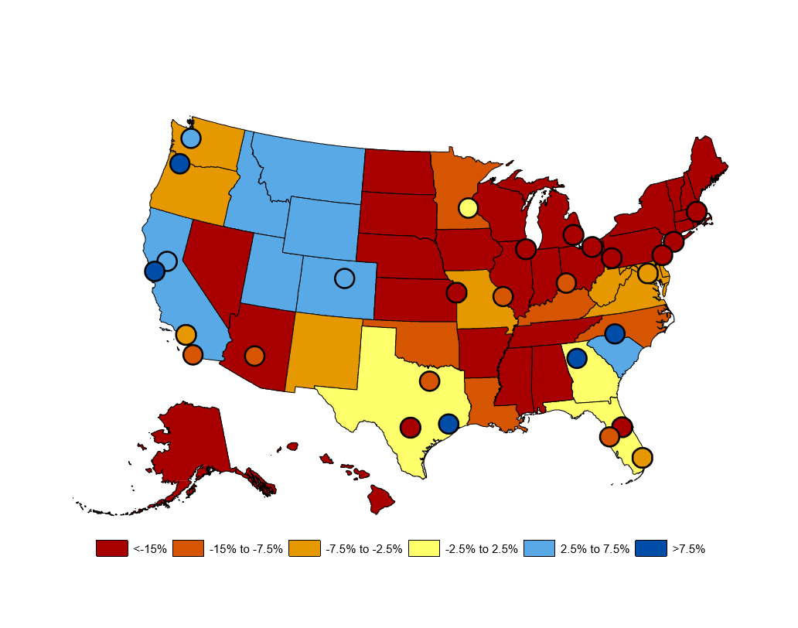
Forecasted Growth in Students Who Will Attend a Regional Four-Year Institution, 2012 to 2019
Grawe, N. D. (2018). Demographics and the Demand for Higher Education. Baltimore, MD: Johns Hopkins University Press.

Slide 7
Forecasted change in number of students who will attend a regional four-year institution from 2012 to 2029, by Census division and areas of largest increase and decrease
Grawe, N. D. (2018). Demographics and the Demand for Higher Education. Baltimore, MD: Johns Hopkins University Press.

Slide 8
USG Peer Fall
Enrollment Trends

Slide 9
Fall 2018 Enrollment
7,261
7,012
6,996
7,003
7,038

Slide 10
Fall 2018
2nd Consecutive Fall Increase
  +0.5% Headcount
  +1% FTE
  +1.1% Credit Hours
On Pace to Increase Fiscal Year Enrollment
Increase in Dual Enrollment (DE)
Increase in New Freshmen Enrollment
Increase in New Graduate Enrollment
Increase in Re-registration and Retention Rates
Transfer Decrease – Significant Opportunity

Slide 11
New Fall 2018
Historical Comparison

Slide 12
New Freshmen
 | Freshmen | Bridge | Early Start | Total
2014 | 509 | 0 | 0 | 509
2015 | 591 | 0 | 0 | 591
2016 | 526 | 38 | 0 | 564
2017 | 560 | 61 | 0 | 621
2018 | 536 | 89 | 8 | 627
Bridge One Year Retention
  Fall 2016 – 76.3%
  Fall 2017 – 75.4%

Slide 13
New Fall 2018
Historical Comparison

Slide 14
New Fall 2018
Historical Comparison
Transfer Enrollment
2015 | 2016 | 2017 | 2018
GA Perimeter-114 | GA Perimeter-85 | GA State- 68 | GA State- 99
GA State-37 | Atlanta Metro-39 | Gordon-55 | Gordon-39
Atlanta Technical-34 | GA State-38 | Atlanta Metro-53 | GA Military-33
Atlanta Metro-28 | Gordon-38 | GA Military-31 | Atlanta Metro-28
GA Military-27 | GA Military-33 | Kennesaw State-31 | West GA-28
GA Piedmont-27 | Atlanta Technical-29 | GA Perimeter-28 | Kennesaw State-24
Kennesaw State-24 | Southern Cresent-27 | GA Piedmont-25 | Middle GA-21
Gordon-20 | Kennesaw State-23 | Atlanta Technical-23 | Savannah State-21
GA Gwinnett-18 | GA Gwinnett-22 | Savannah State-23 | Albany State-20
Southern Cresent-18 | Savannah State-21 | West GA-23 | Atlanta Technical-17
 |  |  | Southern Cresent-17 GA Piedmont - 15

Slide 15
New Fall – USG Comparison
Fall | Beginning Freshman | Total Transfer | Total Undergraduate
Albany State University
2017 | 1430 | 375 | 1805
2018 | 1605 | 243 | 1848
Atlanta Metropolitan College
2017 | 341 | 297 | 638
2018 | 389 | 253 | 642
Columbus State University
2017 | 960 | 608 | 1568
2018 | 1043 | 514 | 1557
Georgia Gwinnett College
2017 | 2381 | 777 | 3158
2018 | 2309 | 720 | 3029
Gordon State College
2017 | 1198 | 142 | 1340
2018 | 865 | 171 | 1036
Middle Georgia State
2017 | 1125 | 546 | 1671
2018 | 1410 | 647 | 2057
Clayton State University
2017 | 560 | 802 | 1362
2018 | 536 | 724 | 1260

Slide 16
New Fall 2018
Applications
 | Traditional | Adult New | Transfer
Fall 2017 | 2,326 | 159 | 1,890
Fall 2018 | 2,218 | 115 | 1,657
Application to Enrollment Yield
 | Traditional | Adult New | Transfer
Fall 2018 | 22.8% | 26.1% | 45.3%
Fall 2017 | 21.9% | 31.4% | 44.3%

Slide 17
New Fall 2018
Opportunities and Strategies
Expand Partnerships with Corporations and Organizations
Achieve Atlanta Scholarship
Create Technical College Feeders
Increased Communication to Inquiries

Slide 18
Continuing undergraduate Enrollment
Fall to Spring Undergraduate Re-Registration Rates
2014 | 2015 | 2016 | 2017
90.4% | 89.1% | 89.5% | 89.8%
Spring to Summer Undergraduate Re-Registration Rates
2015 | 2016 | 2017 | 2018
39.1% | 42.7% | 40.8% | 47.7%
Spring and Summer to Fall Undergraduate Re-Registration Rates
2015 | 2016 | 2017 | 2018
77.5% | 78.8% | 77.1% | 78.1%
*Numbers in italics and underlined represents re-registration rates prior to clarification of
the state gratuity clause

Slide 19
Continuing undergraduate Enrollment
 | % Retained or Graduated After Year 1 | % Retained or Graduated After Year 2 | % Retained or Graduated After Year 3 | % Retained or Graduated After Year 4 | % Retained or Graduated After Year 5 | % Retained or Graduated After Year 6
Fall 2017 | 70.8 %
Fall 2016 | 67.8% | 54.9%
Fall 2015 | 71.3% | 54.0% | 44.8%
Fall 2014 | 70.0% | 51.1% | 41.7% | 38.4%
Fall 2013 | 68.0% | 50.0% | 43.7% | 38.9% | 38.2%
Fall 2012 | 72.3% | 53.8% | 44.4% | 39.8% | 35.5% | 37.7%
Fall 2011 | 67.8% | 50.8% | 42.9% | 38.9% | 37.7% | 34.4%
Fall 2010 | 65.8% | 52.9% | 43.9% | 41.1% | 39.3% | 37.6%
*Draft rates includes IPEDS cohort students pursuing 4-year and 2-year degrees

Slide 20
Continuing undergraduate Enrollment
Strategies Implemented Over the Past Year
  Expansion of the Early Alert initiative
  Laker Hall Academic Student Success Center
  Launch of the Momentum Year Initiative
  Implementation of Math pathways
  Clayton Success Initiative
Opportunities for the Upcoming Year
  Unpacking the Sophomore Year “Slump”
  Further implementation of the Momentum Year Initiative
  Reimagining the African American Male Initiative (AAMI)

Slide 21
Other Quick Updates
Seeking to expand supplemental instruction by 300% to include critical courses
Created SEOG award strategy for incoming housing freshmen
Created targeted GAP funding opportunity for students with balances between $100-$500
Improved Financial Aid verification process with technology

Slide 22
Questions?

