Slide 1
Open Budget Meeting
October 19, 2016

Slide 2
Open Budget Meeting

Slide 3
Budget Calendar & Timeline
CSU’s Internal Budget Process
Governor’s Proposal January
Finalized & BOR Axn Spring
BOR Allocation June/July
CSU/BOR Request to OPB Aug-Sept
General Assembly Winter

Slide 4
Clayton State University’s Resources
Tuition & Fees
State Appropriations 2017
Major Repair &
Renovations (MRR)
Auxiliary Enterprises
CSU Foundation
  Endowments
  Scholarships
  Unrestricted Annual Giving
Sponsored Programs
Uses
Restrictions
Realities
Salaries and Wages
Utilities
Supplies/Equipment & Travel
Technology
Facilities and Maintenance
Public Safety
Campus Activities and Services
Capital funds can not be used to pay for salaries and wages
State procurement guidelines must be followed
Student fees must be used in conjunction with specific services
Prudent fiscal management required for all sources
State Appropriation varies
Focus on Financial Ratios
Economic conditions have a direct impact on our ability to collect the revenues necessary to satisfy the needs and obligations of the University

Slide 5
Open Budget Meeting
STATE APPROPRIATION & TUITION TRENDS FY12-FY16
Fiscal Year | State Appropriation | Tuition
FY13 | $22,799,099 | $26,520,536
FY14 | $23,251,922 | $27,338,759
FY15 | $24,067,121 | $27,333,575
FY16 | $25,198,595 | $26,735,500
FY17 | $24,687,212 | $27,831,086*

Slide 6
Open Budget Meeting

Slide 7
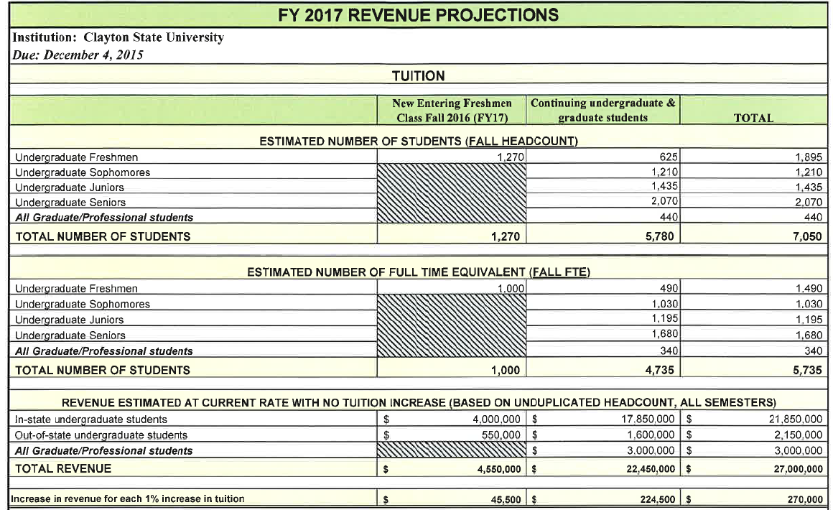
Open Budget Meeting

Slide 8
Open Budget Meeting
Enrollment Headcounts
 |  |  |  | PROJECTIONS
 | FY13 | FY14 | FY15 | FY16 | FY17* | FY18 | FY19 | FY20 | FY21
FY Total | 17,602 | 17,681 | 16,712 | 16,458 | 17,010 | 17,265 | 17,540 | 17,835 | 18,175
Fall | 7,140 | 7,261 | 7,022 | 7,012 | 6996# | 7,150 | 7,260 | 7,390 | 7,565
Spring | 6,954 | 6,976 | 6,747 | 6,675 | 6,850 | 6,950 | 7,050 | 7,145 | 7,260
Summer | 3,508 | 3,444 | 2,943 | 2,771 | 3,110 | 3,165 | 3,230 | 3,300 | 3,350
*FY17 includes Fall 2016, Spring 2017, and Summer 2017 |  |  |  |  | # Based on preliminary institutional counts (7050) projected

Slide 9
Open Budget Meeting
Description | Budget | Collected | Remaining
Fees Fall Semester | 269,087.00 | (284,540.36) | 15,453.36
Fee Waivers Fall Semester | 0.00 | 27,613.57 | (27,613.57) | (12,160.21) | Health Fee
Fees Fall Semester | 200,007.00 | (210,312.44) | 10,305.44
Fee Waivers Fall Semester | 0.00 | 20,410.03 | (20,410.03) | (10,104.59) | Parking Fee
Fees Fall Semester | 127,942.00 | (131,629.80) | 3,687.80
Fee Waivers Fall Semester | 0.00 | 16,840.60 | (16,840.60) | (13,152.80) | Laker Card Fee
Fees Fall Semester | 940,083.00 | (989,705.60) | 49,622.60
Fee Waivers Fall Semester | 0.00 | 96,088.80 | (96,088.80) | (46,466.20) | Athletic Fee
Fees Fall Semester | 352,128.00 | (371,139.60) | 19,011.60
Fee Waivers Fall Semester | 0.00 | 35,957.70 | (35,957.70) | (16,946.10) | Student Activity Fee
Fees Fall Semester | 598,190.00 | (634,663.50) | 36,473.50
Fee Waivers Fall Semester | 0.00 | 62,553.00 | (62,553.00) | (26,079.50) | SAC Fee
Fees Fall Semester | 349,673.00 | (386,149.35) | 36,476.35
Fee Waivers Fall Semester | 0.00 | 48,523.53 | (48,523.53) | (12,047.18) | Technology Fee
 |  |  |  | (136,956.58) | TOTAL

Slide 10
Open Budget Meeting
Revenue - 7,050 Fall Enrollment
 | FY17 Budget
State Appropriation | 24,687,217
Tuition | 27,000,000
Fees & Other General | 5,666,930
Carry Forward Funds | 800,000
 |  | 58,154,147
Expenditures
Updated current budget including cuts needed | 56,883,402
Funding Available to Distribute |  | 1,270,745
Required Funding Items added:
University Contingency | 99,000
Increase in software licenses | 11,311
Faculty Promotions including benefits | 48,175
Funding for Merit Raises including benefits | 1,112,259*
 |  | 1,270,745
Additional Funds Needed |  |  | 0
* 82% provided by BOR; 18% provided by CSU

Slide 11
Open Budget Meeting

Slide 12
Open Budget Meeting

Slide 13
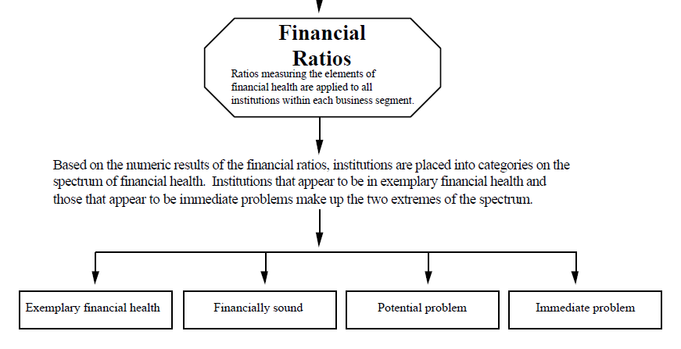
Four Categories of Fiscal Health
SACS 2013/14

Slide 14
Current
Cash
Viability
Ability to pay short-term & long-term. Can we pay our debt with our cash/cash equivalents like short-term investments?
CHECKING & SAVINGS /MONTHLY BILLS
Pay current liabilities with cash and cash equivalents.
CHECKING & SAVINGS ACCOUNT
Availability of expendable net assets to cover debt as of balance sheet date.
FUNDS TO PAY MORTGAGE/CAR NOTE/ALL OBLIGATIONS

Slide 15
Return on Net Assets
Primary Reserves
Capital Liability Burden Ratio
Measure of whether or not the institution's resources are growing. This ratio determines whether the institution is financially better off than in previous years by measuring total economic return. A decline in this ratio may be appropriate and even warranted if it reflects a strategy to better fulfill the institution's mission. An improving trend in this ratio indicates that the institution is increasing its net assets and is likely to be able to set aside financial resources to strengthen its future financial flexibility.
STOCK PORTFOLIO PAYING DIVIDENDS , HOME VALUE INCREASING
Measure of financial strength. How long could CSU use its expendable reserves to carry on business? Without relying on additional revenue.
STOCKS, BONDS, SAVINGS
Measures what percentage of an institution’s income is used to make PPV payments. Basically, the percentage of total revenues in any given fiscal year that are used to pay an institution’s capital lease payments associated with the PPV program.
APPLYING FOR A HOME LOAN AND THE DEBT TO INCOME RATIO

Slide 16
CSU Ratio Analysis
CSU Ratios | FY 2016 | FY 2015 | FY 2014 | FY 2013
Current Ratio | 1.81 | 1.96 | 2.31 | 2.07
Cash Ratio | 1.60 | 1.73 | 1.93 | 1.85
Return on Net Assets | .67 | -.064 | -.73 | -.057
Net Operating Revenue | .134 | -.022 | -.046 | -.039
Primary Ratio Reserve | -.207 | -.233 | .063 | .075
Viability Ratio | -.201 | -.214 | .076 | .088

Slide 17
CSU Ratio Analysis
CSU Ratios | FY 2016 | FY 2015
Primary Reserve Ratio Primary Reserve Ratio w/o Pension Aspire .15 to .25 | (.207) .063 | (.233) .058
Viability Ratio Viability Ratio w/o Pension Aspire .10 to .12 | (.201) .08 | (.214) .069

Slide 18
Open Budget Meeting

Slide 19
STEPS TO IMPROVE RATIOS
Decrease Expenses
Increase Revenues
Improve Reserves or Increase Fund balances that do not lapse
  Auxiliary Services Reserves
  DSS- Departmental Sales and Services
  Tuition Carry Forward
  Indirect Costs

Slide 20
DIAGNOSTICS
HIGH BLOOD PRESSURE
FINANCIAL RATIOS
Lack of Exercise
  Solution Increase Exercise
Overweight
  Cut Calories
Lack of Reserves
  Solution Increase Reserves
Expenditures
  Budget Cut

Slide 21
Open Budget Meeting

Slide 22
Open Budget Meeting

Slide 23
Open Budget Meeting

Slide 24
Discussion and Questions

