Slide 1
Open Budget Meeting
Town Hall
October 2, 2020 10:00 a.m.
Via Teams

Slide 2

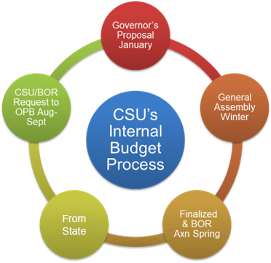

Slide 3
Open Budget Meeting
Overall All funding requests must be in alignment with the university’s strategic priorities. The use of funds and support of the University’s mission from the previous year(s) is considered in developing future budgets. Instructions and criteria for funding requests will be distributed at the start of the budget build process. The budget office will provide reports and timelines to assist in the preparation of funding requests. General Funds Process: Each Vice President will submit funding requests for the new fiscal year. Informal meeting occurs with each Vice President and the President, Vice President for Business and Operations, Assistant Vice President of Budget and Finance and the Director of Budgets; where the VP discusses their budget needs for the next year. Data gathered from sessions will be compiled and distributed to the Planning & Budget Advisory Council (PBAC). Each Vice President will be given the opportunity to review their request(s) before the PBAC meeting. Then each VP’s request goes before the PBAC members for discussion and to answer any questions that the PBAC may have. PBAC members will review the requests in light of the institution’s strategic priorities and assign each request as A; B; C; or D priority. Each priority level is assigned a point value: (5) A; (3) B; (2) C; (1) D All voting sheets are then tallyed and results reported to the PBAC. Results of the priority assignment are reported to the President as recommendations for funding. | The President retains final decision making authority as to what is funded in the new budget. Other Funds: Each director and/or VP will present their budget to the Vice President for Business and Operations, Assistant Vice President of Budget and Finance and the Director of Budgets. The President may elect to attend. The proposed budget will be reviewed for reasonableness and support of the strategic plan. The proposed budget requests/recommendations will be presented to the President for final approval. Budget Finalization: The Vice President for Business and Operations, Assistant Vice President of Budget and Finance and the Director of Budgets will conduct a final review for accuracy and completeness and then post information on the Budget and Finance and the Planning & Budget Advisory Council Websites. The Board of Regents processes will be followed for submission and implementation

Slide 4
Clayton State University’s Resources
Uses
Restrictions
Realities
Salaries and Wages
Utilities
Supplies and Equipment
Technology
Facilities and Maintenance
Public Safety
Campus Activities and Services
Capital funds can not be used to pay for salaries and wages
State procurement guidelines must be followed
Student fees must be used in conjunction with specific services
Prudent fiscal management required for all sources
State Appropriation varies
Focus on Financial Ratios
Economic conditions have a direct impact on our ability to collect the revenues necessary to satisfy the needs and obligations of the University
Notes:
Budget- NEEDS UPDATE

Slide 5
Open Budget Meeting
CSU’s PRIMARY RESOURCES
State Appropriation $25,342,784
Tuition $28,960,000
Fees
  Mandatory Fees $5,992,939
  Special Institutional Fees $3,650,000
  Other Fees $772,100
PBI Grant funded items $1,649,944

Slide 6
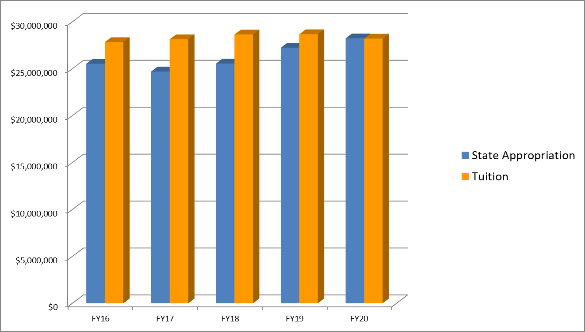
Open Budget Meeting
State Appropriation & Tuition Trends FY 2016-2019
* Tuition net of $1,034,004 allowance for uncollectable or bad debt
Notes:
done

Slide 7
Open Budget Meeting
Fall Enrollment 2014-2019-Impacts State Appropriation & Tuition Revenue
Notes:
done

Slide 8
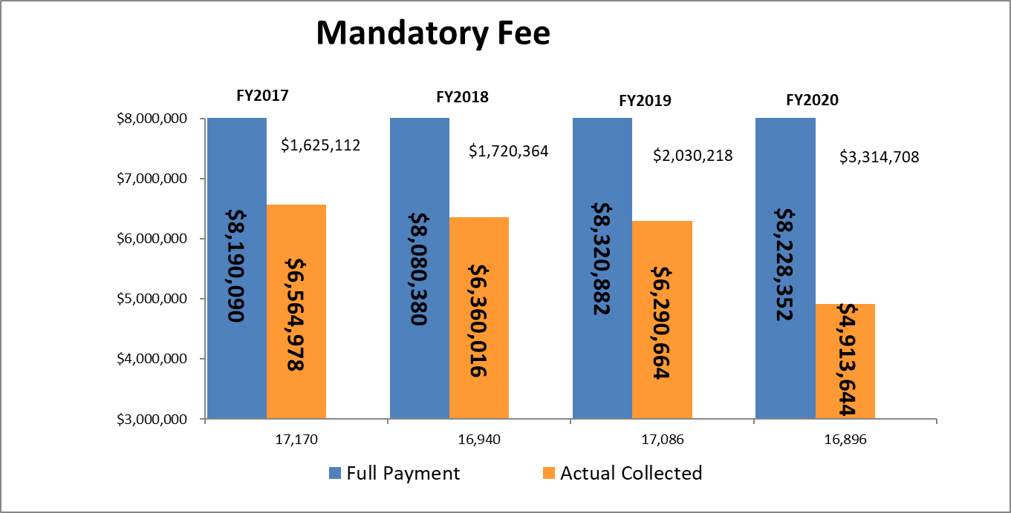
Open Budget Meeting
Total Students
Categories that pay less/none: Distance Learning, eCore, Employees/TAP, Fayette County, Henry County, Dual Enrolled, Main Campus - less than 3 hrs, Senior Citizens, WebBSIT, Military
Notes:
NEEDS UPDATE

Slide 9
Open Budget Meeting
Mandatory Fees Shortfalls
Categories that pay less/none: Distance Learning, eCore, Employees/TAP, Fayette County, Henry County, Dual Enrolled, Main Campus - less than 3 hrs, Senior Citizens, WebBSIT, Military
Notes:
NEEDS UPDATE

Slide 10
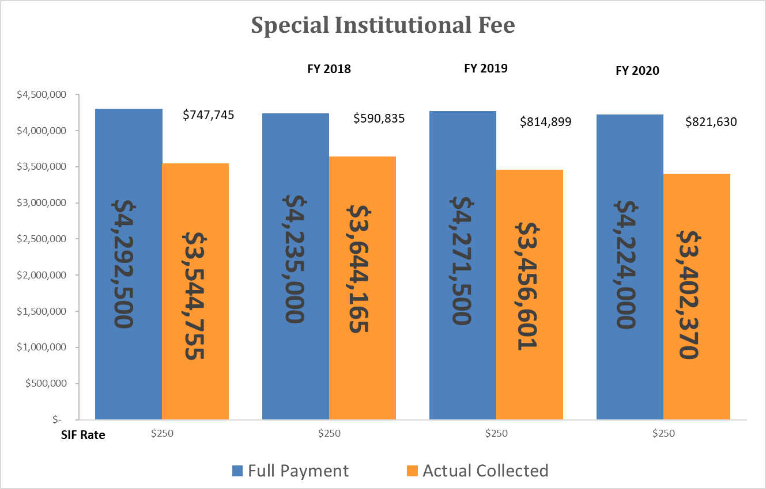
Open Budget Meeting
Notes:
NEEDS UPDATE

Slide 11
Open Budget Meeting
Description | FY 2020 | FY 2021 Approved Rate
BSN Program Fee (Per Semester Nursing Majors) | $283 | $283
Family Nurse Practitioner Program Fee (paid 1st semester upon acceptance into program) | $481 | $481
Family Nurse Practitioner Course Fee | $469 | $319
Teacher Education Practicum | $300 | $0
Telecourse/Online Course Fee (Capped at $75/semester) | $15 | $0
Family Nurse Practitioner Course (NURS 6690) Fee reduced to $319
Teacher Education Practicum Fee eliminated because edTPA no longer required by state
Online Course Fee eliminated by BOR
Notes:
NEEDS UPDATE

Slide 12
Open Budget Meeting
Fees & Changes
Mandatory Fees
  SAC $15/semester increase
Special Institutional Fees
  No change
Other Fees
  Distance Learning-last phase of reduction at 33.3%
  Dual Enrollment
    All fees eliminated
    Cap of # of classes
Summer 2020
No fees except technology and institutional

Slide 13
Open Budget Meeting
FY20 Budget Wrapping Up
July 1-2019 - June 30, 2020
Notes:
NEEDS UPDATE

Slide 14
Open Budget Meeting
FY20 Budget Wrap Up
Available Funds:
Estimated Salary & Benefits Savings Sweep $ 1,850,940
Budget Spend Estimate Sweep $ 1,594,885
Tuition under realized $( 75,598)
Bad debt related to tuition $(1,034,004)
Total Funds Available $ 2,336,223
Uses of Funds:
Tuition Carry Forward $ 870,000
In-Kind SAC $ 32,150
In-Kind CE $ 141,365
Return to Campus Covid-19 Needs $ 747,238
Total Uses of Funds $1,790,753
Funds Available for Various Year-End
Items Such as One-Time Funding Requests &
Unresolved Budget Issues $ 545,470
Notes:
NEEDS UPDATE

Slide 15
Open Budget Meeting
FY20 UNRESOLVED BUDGET ISSUES
Laker Village building repairs |  | $7,000
EAP program costs |  | $10,233
Dental Hygiene lab renovations and sterilization center for accreditation compliance |  | $101,028
OneUSG Careers Module enhancements |  | $4,400
OmniUpdate website conversion and hosting |  | $69,208
Dual enrollment students’ textbooks |  | $150,000
FLSA adjustments |  | $20,000
Huie chiller |  | $130,000
BOR ITS software license increases above budget |  | $27,419
ITS related maintenance costs |  | $49,439
Comcast network-Henry site |  | $5,293
GSFC audit |  | $17,034
ARMS maintenance agreement for emergency phones |  | $8,500
Alertus enhancement of emergency notification service |  | $9,960
Drain repairs |  | $17,000
Platesmart license plate reader maintenance agreement |  | $3,242
Total |  | $629,756

Slide 16
Open Budget Meeting
FY20 Year-End Spend Requests
Enrollment Management (3 Requests) | $ 80,510
ITS (7 Requests) | $ 1,019,923
Business & Operations (33 Requests) | $ 382,421
Academic Affairs ( 5 Requests) | $ 289,361
Student Affairs (1 Request) | $ 4,135
Dr. Hynes redirected from CARES 3(5 Requests) | $ 17,925
TOTALS | $ 1,794,274
Notes:
NEEDS UPDATE

Slide 17
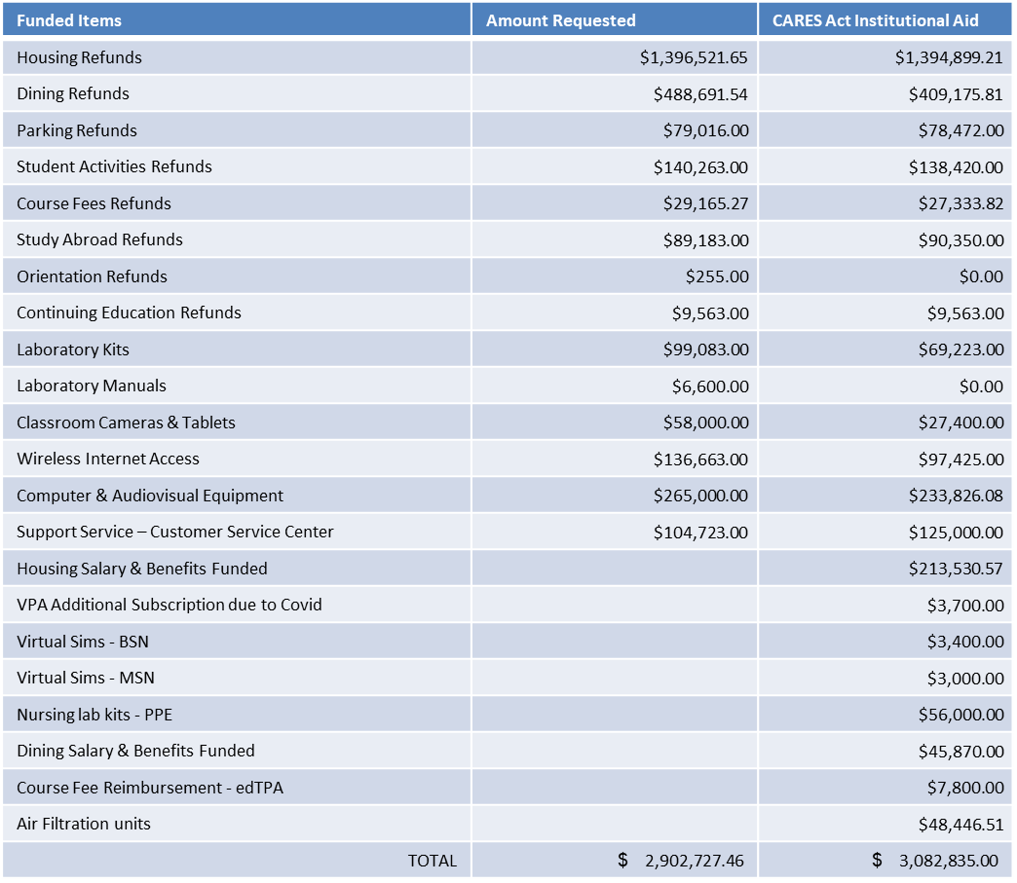
Open Budget Meeting
CARES ACT FUNDING
STUDENT GRANTS
  Under the Coronavirus Aid, Relief, and Economic Security (CARES) Act. $3,082,836 has been designated as Emergency Financial Aid Grants to students.
INSTITUTIONAL
Clayton State University will be provided $3,082,835
Funded Items | Amount Requested | CARES Act Institutional Aid
Housing Refunds | $1,396,521.65 | $1,394,899.21
Dining Refunds | $488,691.54 | $409,175.81
Parking Refunds | $79,016.00 | $78,472.00
Student Activities Refunds | $140,263.00 | $138,420.00
Course Fees Refunds | $29,165.27 | $27,333.82
Study Abroad Refunds | $89,183.00 | $90,350.00
Orientation Refunds | $255.00 | $0.00
Continuing Education Refunds | $9,563.00 | $9,563.00
Laboratory Kits | $99,083.00 | $69,223.00
Laboratory Manuals | $6,600.00 | $0.00
Classroom Cameras & Tablets | $58,000.00 | $27,400.00
Wireless Internet Access | $136,663.00 | $97,425.00
Computer & Audiovisual Equipment | $265,000.00 | $233,826.08
Support Service – Customer Service Center | $104,723.00 | $125,000.00
Housing Salary & Benefits Funded |  | $213,530.57
VPA Additional Subscription due to Covid |  | $3,700.00
Virtual Sims - BSN |  | $3,400.00
Virtual Sims - MSN |  | $3,000.00
Nursing lab kits - PPE |  | $56,000.00
Dining Salary & Benefits Funded |  | $45,870.00
Course Fee Reimbursement - edTPA |  | $7,800.00
Air Filtration units |  | $48,446.51
TOTAL | 2,902,727.46 | 3,082,835.00
Notes:
Table on slide is an image so it could be made to fit. The editable table is to the right of the slide. -Lisa

Slide 18
FY21 Budget Build Meetings

Slide 19
CSU Internal FY21 Budget Meetings
FY21 Spend Requests from Campus
Academic Affairs (8 Requests) | $ 757,150
Enrollment Management (4 Requests) | $ 166,200
ITS (4 Requests) | $ 302,700
Student Affairs (2 Requests) | $ 126,000
Business & Operations (10 Requests) | $ 219,535
University Advancement (2 Requests) | $ 95,415
Athletics (1 Request) | $ 75,000
TOTALS | $ 1,742,000

Slide 20
Open Budget Meeting
Allocation of State Appropriations FY2021
State Appropriation FY 2020 Base Budget $28,227,903
Formula Funding – Enrollment and Other Allocations
Enrollment Earnings (Loss) $ 146,533
FY 2021 Budget Reductions $(2,822,790)
Know More. Borrow Less. $ 30,500
Teacher’s Retirement System – Rate Change $ (238,098)
Adjustments for State-Wide Billing (GTA billing) $ (1,264)
Total of Enrollment and Other Allocations $(2,885,119)
Total FY2021 State Funds Budget $25,342,784

Slide 21
CSU’s Budget Build
FY21 BUDGET BUILD SCENARIO
 |  |  | Using 4.3M
Revenue – Enrollment (6,800 Fall; 6,650 Spring; 3,400 Summer)
 | FY21 Budget
State Appropriation | 25,342,784
Tuition | 28,960,000
Fees & Other General | 4,823,100
Carry Forward Funds | 870,000
 |  | 59,995,884
Expenditures in FY21 Original Budget |  | 59,938,097
Funding Available to Distribute |  | 57,787
Required Funding Items added:
Remove Furlough Plan | (969,081)
Budget Cut Plan Overage (Original 4.3M vs. Actual 2.8M) | 1,520,969
FY21 Must Fund Items | (448,915)
Additional Funding Available for Possible Distribution |  | 160,760

Slide 22
Open Budget Meeting

Slide 23
FY 21 FUNDING
MUST FUND ISSUES $448,915
1. BOR ITS cost increases $ 44,900
2. Additional CELT funding to cover decrease associated with Distance Learning Fees $178,700
3. PaymentWorks implementation mandated by BOR $ 5,000
4. Increase in lease for Fayette instructional site $ 5,960
5. Henry County instructional site network infrastructure $ 19,260
Increases in software licensing for programs in Academic Affairs $ 40,000
Increased costs for maintenance on IT network equipment on campus $143,600
ARMS maintenance agreement for Public Safety records $ 8,500
Equifax electronic onboarding program for HR $ 2,995

Slide 24
CSU FY 21 Budget
Cuts
Academic Affairs $ 806,670
Enrollment Management $ 286,127
ITS $ 349,949
Student Affairs $ 313,412
Business & Operations $ 980,855
University Advancement $ 79,946
Spivey Hall $ 14,800
Athletics $ 17,919
Other $ 525,000
TOTAL $3,374,678

Slide 25
Summer Budget
Note
  CSU’s Annual Budget is divided into three parts: Fall/Spring/Summer
  Summer Budget is split between fiscal years
    Summer 2020 Revenue split:
      74% FY20
      26% for FY21

Slide 26
Open Budget Meeting

Slide 27
Open Budget Meeting

Slide 28
Possible Challenges for FY 21
Covid-19 Related Expenses
  Cleaning
  Supplies/Equipment
  PPE
Auxiliary Units

Slide 29
Questions

