Slide 1
Clayton State University Strategic Priority 1B
Increase enrollment, retention, and graduation rates
b. Support Services for Student Success: Continue development of support services associated with student success…..
Mari Banks, Deborah Deckner-Davis, and Allen Ward

Slide 2
Provide a system of childcare access and support services for parents and families by analyzing service delivery data and implementation strategies.
The second year will focus on CAPS data capture on service utilization of 355 (4.7 % of student population) from FY17 and delivery strategies in the counseling center and demographics of uses; and development of strategy for institutionalizing communications on availability of services through SGA, Residence Hall Council and Student Activities Council.

Slide 3
Provide a system of childcare access and support services for parents and families by analyzing service delivery data and implementation strategies: Where are you with year-two priority goals and benchmark progress?
Launched with CSU late fall 2016
During the first 18 months
376 applications (266 completed)
accepted 72 student parents, fully enrolled 62 and serving 65 children
average enrollment duration 28 weeks currently
Per family average investment = $3780
Total investment to date in our student parents = $231,000

Slide 4
Preliminary impact of BOOST on student outcomes?
At CSU, parenting consistently reduces course load carried.
At CSU, parenting NOT consistently associated with a lower GPA, but BOOST seems to further benefit.
Noteworthy in light of recent national reports that carrying a “full-load” at least one term is a powerful predictor of degree completion ²
² Inside Higher Education

Slide 5
Boost Parents Enrolled Fall 16 and Fall 17

Slide 6
Provide a system of childcare access and support services for parents and families by analyzing service delivery data and implementation strategies: Will you need to identify more, fewer, or different specific indicators for outcome processes?
Measure first hand impact of services
Improve marketing (measure awareness…) and collaborate with different units to gather data
Orientation data from past few sessions indicates 24% of respondents have a child
Promote data sharing with other BOOST participating institutions

Slide 7
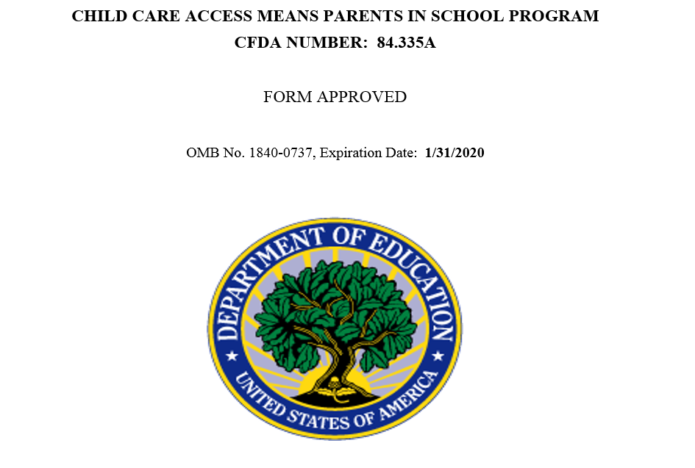
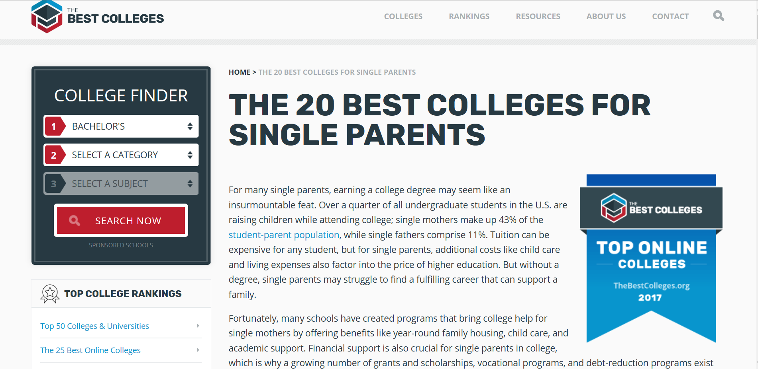
Provide a system of childcare access and support services for parents and families by analyzing service delivery data and implementation strategies: What are your activity plans for 2018—2019 (year-three)?
Increase and strengthen community partnerships
Diversify funding streams
Examine/Expand Focus to More Holistically Address Families Needs

Slide 8
The second year will focus on CAPS data capture on service utilization of 355 (4.7 % of student population) from FY17 and delivery strategies in the counseling center and demographics of uses; and development of strategy for institutionalizing communications on availability of services through SGA, Residence Hall Council and Student Activities Council. Where are you with year-two priority goals and benchmark progress?
First off, some of this is quite challenging due to legal and ethical standards around confidentiality…..
Wisconsin HOPE LAB Participating Institution
7.4% of students experienced some form of homelessness, 48% were housing insecure, and 48% had low or very low food security.
Sharing of meal plans – low cost, respectful
Evaluate barriers to accessing current services
Instrument developed with input from multiple campus stakeholder

Slide 9
The second year will focus on CAPS data capture on service utilization of 355 (4.7 % of student population) from FY17 and delivery strategies in the counseling center and demographics of uses; and development of strategy for institutionalizing communications on availability of services through SGA, Residence Hall Council and Student Activities Council. Will you need to identify more, fewer, or different specific indicators for outcome processes?
Yes….

Slide 10
The second year will focus on CAPS data capture on service utilization of 355 (4.7 % of student population) from FY17 and delivery strategies in the counseling center and demographics of uses; and development of strategy for institutionalizing communications on availability of services through SGA, Residence Hall Council and Student Activities Council. What are your activity plans for 2018—2019 (year-three)?
Collaborate with new leadership (We will miss Dr. Manglitz and her amazing calm, consistent, determination)
More deliberately work with Marketing and Communications to promote services
Still figuring it out….

Slide 11
Questions???

