Slide 1
Strategic Planning Goal 1A: SEM plan
Clayton State University

Slide 2
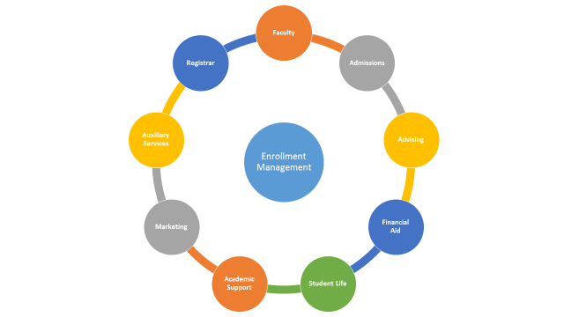

Slide 3
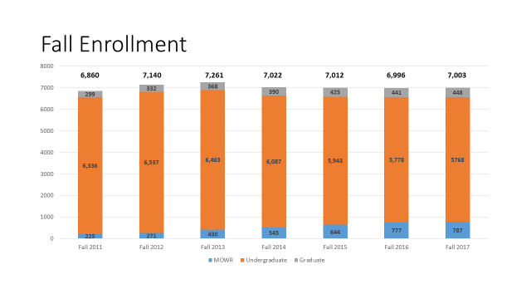

Slide 4
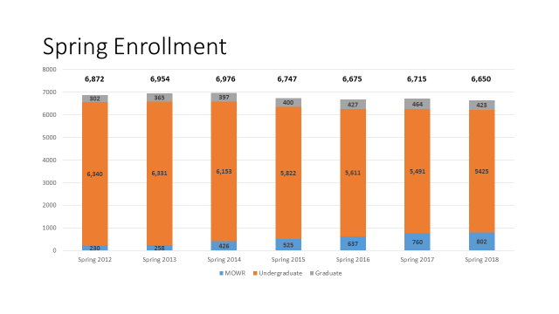

Slide 5
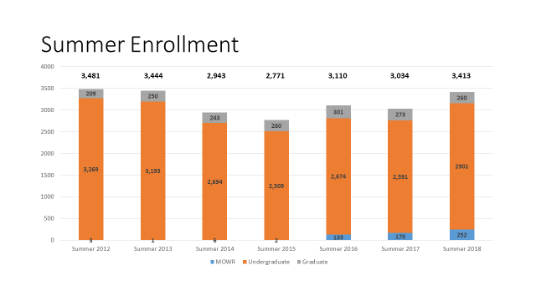

Slide 6
Goal: Increase MOWR/DE student enrollment to 815 for fall 2022.
Increase new students enrolled in MOWR/DE through the increase of leads, communication, and improvements in process.
Strategy | Timeline | Status
List Buys for ACT/SAT and Communication Plan | Year 1 | Completed and Ongoing
Development of University Collateral to Include MOWR/DE | Year 1 | Ongoing
HS MOWR Staff to Attend Counselor Appreciation Day | Year 1 | Ongoing
Develop Online Application | Year 1 | Completed with Ongoing Modifications
Update: Successfully implement the four strategies associated with this goal. While we were seeking to increase the pool of new DE students through these strategies, we eased the process for potential students to enroll but were not able to realize the overall enrollment increase. We increased our applicant pool by 2% but our new DE enrollment actually decreased from 518 in fall 2016 to 491 in fall 2017.

Slide 7
Goal: Increase MOWR/DE student enrollment to 815 for fall 2022.
Increase the percentage of MOWR/DE seniors who matriculate at Clayton State to 20%.
Strategy | Timeline | Status
Admissions to assist with Henry MOWR Orientation – Connect Recruitment Message | Year 2 | In Process
Communication Campaign for MOWR | Year 2 | In Process
Capture Intended Major and Develop Programmatic Conversion Strategies | Year 2 | In Process
Student Affairs Presentation to Henry and Fayette Sites of MOWR students | Year 2 | In Process
Student Affairs Post Card | Year 2 | In Process
Update: While all of these goals are associated with the second year of the SEM plan we were able to accomplish some in the first year. We have realized a challenge in comparing historical data to clearly understand if we are improving our conversion rates. This year we have discussed creating a consistent method in which to establish our historical conversion rates as well as implementing the remaining strategies associated with this goal.

Slide 8
Goal: Increase the undergraduate new student enrollment for fall, spring, and summer terms.
Increase communication to prospective students at the inquiry stage.
Strategy | Timeline | Status
SCU – Merge outbound calls with inbound calls. | Year 1 | Completed
SCU – Currently staffed with 5 student workers. Shift to: 1 FT – 2 student workers 2 FT – 2 student workers | Year 2 Year 3 | In Progress
SCU – Call inquiries Call all inquiries and push applications | Year 1 Year 2 | In Progress
Update: We were able to accomplish our year 1 strategies associated with this goal. Through this effort we were able to realize an increase from 28.7% to 30.9% of students who applied to enrolled. We will be adding a full-time employee to the SCU in FY19.

Slide 9
Goal: Increase the undergraduate new student enrollment for fall, spring, and summer terms.
Increase the reach and impact of the high school recruiting activities through greater inquiry conversion and increasing the generation of inquiries through targeted areas.
Strategy | Timeline | Status
Traditional – Add recruiter(s) | Year 2 | Completed
Traditional – Modify recruitment model | Year 1/2 | Completed
Traditional – Develop Low, Medium, High Impact School Strategy | Year 1/2 | Completed
Traditional – Add part-time recruiter | Year 1 | Completed – Done
Traditional – Strategic use of list buys. | Year 1 | Completed
Tours – Increase campus tours 25% each year 2015-2016 – 784 2016-2017 – 980 2017-2018 – 1,225 2018-2019 – 1,530 | Year 1 Year 2 Year 3 | Year 1 Completed
Develop opportunities for new students to start in the summer that would normally start in the fall (Bridge, Early Start) | Year 1/2 | Ongoing
Develop Staff and Faculty Recruiting Training Day | Year 2 | To be Addressed
Update: We were able to accomplish the strategies associated with this goal. Through this effort we realized a 9.8% increase in our freshman enrollment.

Slide 10
Goal: Increase the undergraduate new student enrollment for fall, spring, and summer terms.
Add technology which will benefit recruiting, processing, and reporting within the Admissions Office.
Strategy | Timeline | Status
Add a CRM for Admissions | Year 2 | Ongoing
Improve the speed and efficiency of lead and application processing. Introduce document readers and evaluate staffing levels (current 1 FT, 5 PT, 2 SW) | Year 2 | Ongoing
Update: We are using a new CRM, (Target X) and Captricity which is a software that scans lead cards and creates a database for us to upload in place of having them manually entered.

Slide 11
Goal: Increase the undergraduate new student enrollment for fall, spring, and summer terms.
Increase new international student enrollment by 15 for fall 2017 (above fall 2016 levels) with increases of 5 more each fall to reach a goal of 40 new international students in fall 2022 (above fall 2016 levels).
Strategy | Timeline | Status
International – Designate Recruiter Part-time Recruiter Travel Budget Name Purchase Add International Coordinator Utilize IEP Program as feeder for matriculated students and support for matriculated students. | Year 1 Year 1 Year 1 Year 1 Year 3 Year 2/3 | Completed
Update: We have accomplished the strategies associated with this goal. While we did increase the number of international student applications we did not realize a new international student enrollment growth of 5 for fall 2017. We remained flat due to the designation as a saturated enrollment level by the Saudi Arabian Cultural Mission (SACM).

Slide 12
Goal: Increase the undergraduate new student enrollment for fall, spring, and summer terms.
Grow transfer and non-traditional enrollment through the development of partnerships, articulation agreements, and strategic direct mailing efforts.
Strategy | Timeline | Status
Transfer – Develop partnership/articulation agreements with Southern Crescent, Atlanta Technical, and Georgia Piedmont | Year 2-3 | To be Addressed
Military Develop articulation agreement with Air Force Community College Utilize BAS Program with change in block transfer credit criteria | Year 2 Year 1/2 | In Progress
Add 2 Enrollment Corporate Partnerships per year Dedicated corporate partnership outreach – PT staff by Year 2 and move to 1 FT staff by Year 3 | Year 1 Year 2 Year 3 | In Progress
AJC Marketing Push | Year 1 | Completed
Update: These strategies proved more challenging to accomplish. We are currently seeking to hire a corporate recruiter who will be focused on this work. We were still able to realize a 10.1% enrollment growth due to other efforts associated with growing our transfer student enrollment.

Slide 13
Goal: Increase the undergraduate new student enrollment for fall, spring, and summer terms.
Revisit new student and parent orientation programs.
Strategy | Timeline | Status
Develop a more engaging and interactive onsite and online orientation | Year 1/2 | In Progress
Develop a parent multi-week orientation | Year 2 | To be Addressed
This fall we created more opportunities to engage students and parents in our orientation program. These strategies continue to be in progress for year two.

Slide 14
Goal: Increase undergraduate student retention.
Strategy | Timeline | Status
Develop formal support system for at-risk students | Year 2 | Ongoing
Develop academic support course/program for students residing on campus with a GPA below 2.0. | Year 2 | In Progress
Review current policies and practices interfering with student progression (withdrawal, major change, course sub) | Year 1/2 | Ongoing
Develop student engagement opportunities on weekends. | Year 2 | Reassessed
Report on retention rates by student type, sub student populations, and major annually aiming to develop strategies for each population. | Year 1/2 | In Progress
New students enroll in math, 2 English, and 3 courses within major in first two semesters. | Year 2 | In Progress
Develop block schedule for at-risk incoming students. | Year 3 | To be Addressed

Slide 15
Goal: Increase Undergraduate Student Retention
Strategy | Timeline | Status
Develop mid-term and other academic support communication | Year 2 | Ongoing
Create a University Retention Action Team to provide immediate action for low retention populations | Year 2/3 | In Progress
Move entirely to Degree Works | Year 1/2 | Completed
Develop Degree Course Maps | Year 2 | In Progress
Leverage SSC Campus Software and data analytics in identifying at-risk students, developing interventions, and to inform institutional student support services. | Year 2/3 | In Progress

Slide 16
Goal: Increase Undergraduate Student Retention
We launched an early alert program.
We created a Clayton Success Initiative targeting support to students thought to be at-risk upon entry into Clayton State. We launched an Academic Support Program in Laker Hall as well as to enhance the Early Alert Program through this effort in spring 2018. This program will seek to provide a mandatory academic support program for students residing on campus with a GPA below 2.0.
We developed course maps which will demonstrate opportunities for students to enroll in math, 2 English, and 3 courses within their major to be launched for the entering fall 2018 freshmen. We made significant efforts this fall to ensure students were advised and registered for the appropriate math courses for their major.
In our efforts to fully utilize degree works and move away from a manual advising and degree completion process, we realized that we needed to update our Degree Works platform. This has been in the works for fall 2017 and is now in utilization.
We have reworked our student course withdrawal process which will permit faculty and support staff the opportunity to know a student has expressed an interest in withdrawing in order for us to act on that withdrawal.

Slide 17
Goal: Increase Graduate Student enrollment
Strategy | Timeline | Status
Expand Online Options | Year 2/3 | In Progress
Develop additional Graduate Programs | Year 3-5 | To be Addressed
Combine undergraduate and graduate recruitment efforts and processes. | Year 2 | In Progress
Move duplicated functions of Graduate Office to the duplicating office (graduation certification, catalog development) | Year 2/3 | In Progress
Update: We relocated the School of Graduate Studies this spring into Edgewater Hall and are reorganizing duplicated responsibilities. We are launching the MBA program online for fall 2018 and added additional Nursing faculty to increase the fall 2017 new enrollment.

Slide 18
Goal: Improve administrative functions associated with student progression
Strategy | Timeline | Status
Audit Communication to Students FA Award Letter Automated Emails Based on Major Student Bill and account communication Major Changes/Withdrawals Nudges to Accept Aid or Process Documents | Year 2 | In Progress
Review SAP Policy, Process, and Support | Year 2/3 | Ongoing
Add verification software in the Financial Aid Office. | Year 2 | In Progress
Enhance Academic Support for Students who Need It | Year 2/3 | In Progress
Utilize Texting to Communicate with Potential and Current Students | Year 2 | In Progress
Continue to Evaluate Staffing Levels to Support Serve Students as Enrollment Increases | Ongoing | Ongoing
Review Institutional Aid Awards and Student Success to Ensure Funds are having a Positive Impact on Student Degree Progression | Year 2/3 | Ongoing

Slide 19
Goal: Improve administrative functions associated with student progression
We have identified multiple process improvement opportunities within Financial Aid. To date we have modified our method of loan processing to automate a significant amount of the tasks. We have moved from a paper parent loan application to an electronic application and we are currently working to implement Campus Logic, a software which assists with student FASFA verification which impacts approximately 28% of our students.
We have begun work with a Registrar, Bursar, and Financial Aid task force to review communication to students, cross train staff, seek methods to decrease the students dropped, improve service, and have a positive impact on enrollment.
We reworked our Satisfactory Academic Progress policy relating to financial aid. The new policy provides students with an opportunity to improve and adjust to college life while ensuring Federal compliance.
We have launched the use of texting.

