Slide 1
Human Resources Updates

Slide 2
Agenda
Welcome
Benefits and Open Enrollment Updates
Well-Being Program Update - $200 Incentive
Mandatory Training Updates
Payroll Updates
ePerformance Rollout
Critical Vacancy Process
Overview of Hiring Process
Eligibility for Rehire Policy
Parental Leave Policy
Questions

Slide 3
Benefits and Open Enrollment Updates

Slide 4
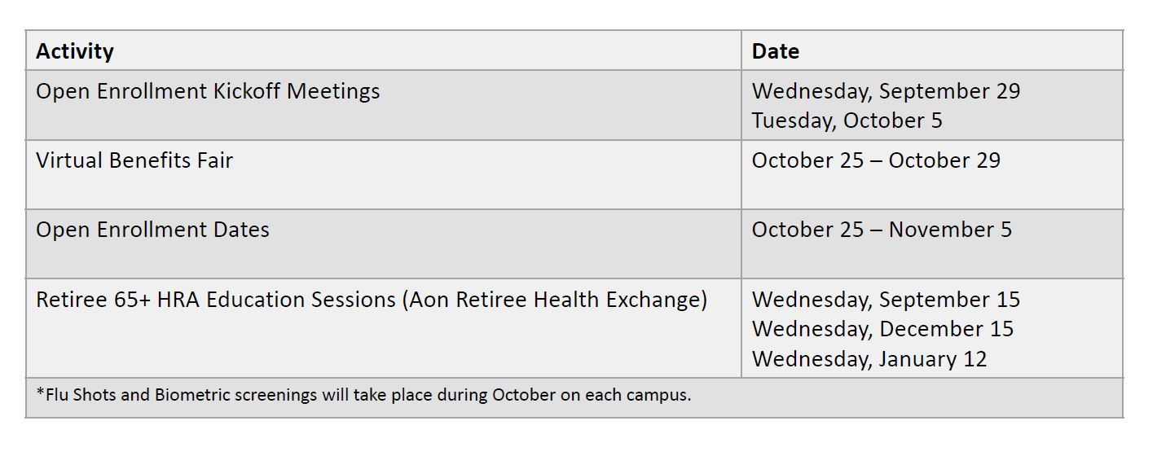
Open Enrollment Dates

Slide 5
Spending Accounts update
Effective January 1, 2022, HSA Bank will replace OptumBank as the spending account provider for HSA, FSA, etc.
Contributions beginning Jan. 1 will be remitted to HSA Bank.
Employees with an HSA balance as of Dec. 31, 2021, will need to approve the transfer of funds to HSA Bank.
These are individual accounts and employees must approve liquidation of investments and transfer of funds.
Employees will receive a $50 credit once they approve the transfer, and the funds are moved to HSA Bank.
More information will be provided during the OE Kickoff meetings

Slide 6
Retirement upDates

Slide 7
Well-Being Program Update

Slide 8
Well-being vaccine credit
To encourage eligible employees and their spouses to receive the vaccine and to reward those who have already received the vaccine, the 2021 & 2022 USG Well-being program credit maximum is increasing from $100 to $200 effective August 30, 2021.
To receive the credit, the employee/spouse must be eligible for the USG Well-being program (healthcare enrolled employees and their spouses) and registered on the USG Well-being platform.
If an employee/spouse is unable to receive the COVID-19 vaccine due to health concerns –there are additional ways to earn the $200 well-being credit.

Slide 9
Well-being vaccine credit
If an employee/spouse has already been rewarded the $10 well-being credit for the COVID-19 vaccine in the 2021 earning period, they will receive the additional credit on their rewards page, bringing them to the max $200 well-being credit, before the end of September.
Vaccines received after September and before December 2021 will count towards the 2022 earning period.
Employees/spouses must complete their vaccine and attestation by December 31, 2021.
The requirement to complete the Health Assessment Survey to be eligible to earn the 2021 well-being credit is waived, however, completing it is still encouraged.

Slide 10
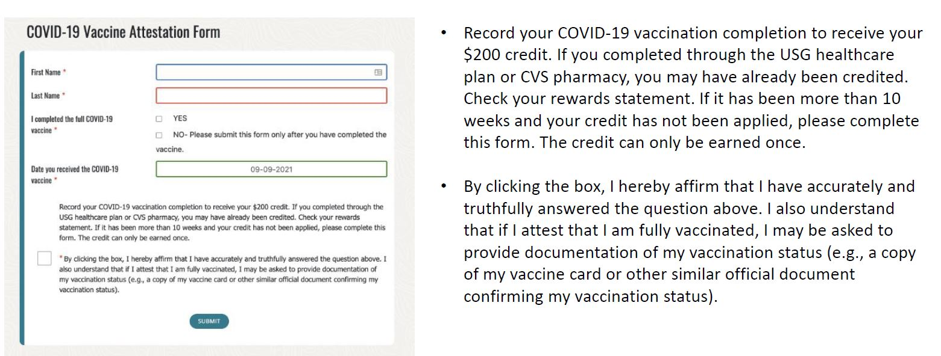
Well-being vaccine credit

Slide 11
Mandatory Training Update

Slide 12
Training Updates
Clayton State has migrated to SkillSoft Percipio for mandatory training and professional development courses.
Mandatory training will launch on September 22, 2021. Email will be sent from Human Resources.
Welcome email from Percipio was sent to campus on Tuesday, September 14, 2021. Accounts are already set up. Log in with your Clayton State credentials.
Things you’ll find in Percipio:
Highlight areas of interest in your professional development.
Personalized recommendations will be sent to you.
Create playlists and learning programs.
See upcoming assignments.

Slide 13
Cybersecurity Training
USG Cybersecurity partnered with KnowBe4 to deliver cybersecurity training.
System wide, three-year contract.
Will enhance and increase the efficiency of data collection and reporting capabilities.
Will provide integrated tools for gauging risk.
Transition already in progress at 15 institutions.
Targeted implementation completion October 1.
Additional services will be phased in after October.
You will have to access another training system to complete this training, but we will work on putting the link inside of Percipio to assist with the ease of completion.

Slide 14
Payroll Updates
Welcome to our new payroll team members!
Shannon Thompson, Senior Payroll Associate
Phone: 678-466-4235
Latasha Jordan, Payroll Associate
Phone: 678-466-4236
Please send all payroll related inquires to:
PAYROLL@CLAYTON.EDU

Slide 15
Payroll Updates
Beginning the 1st bi-weekly pay period in December, timesheets and absence requests will be due by Friday at 3:00 p.m. with exceptions approved based on business needs.
The payroll schedule is you friend! Please try to adhere to the due date to Human Resources.

Slide 16
Eperformance

Slide 17
Eperformance Module
WHAT IS IT?
Self-Service evaluation management application for managers and employees housed within OneUSG HCM system.
WHAT’S DIFFERENT?
Five Point Standardized Rating Scale
Option of nominating or adding additional evaluators to provide input.
Optional mid-year checkpoints to facilitate discussion.
Additional sections for goals, USG core values and institutional values.

Slide 19
Eperformance sections
Rating Scale | Criteria | % of Evaluation
Goals | Completion of last year’s goals Creation of goals for upcoming evaluation period. | 25% to 30%
Job Duties | Assigned job duties located in job description (job profile) Additional assigned tasks | 40%
Performance Factors | Job Knowledge Quality of Work Communication Critical Thinking Initiative Reliability/Attendance Adherence to Policies Interpersonal Relationships Customer Service Innovation | 15% to 20%
Leadership Factors (Additional Factors added to Leadership Evaluation) | Strategic Planning Fiscal/Budget Management Delegates/Directs Effectively | 15% to 20%
USG Core Values/Institutional Values | USG Core Values Clayton State Institutional Values | 15%

Slide 20
Behavior Anchored rating scale
Rating Scale | Definition | Behavioral Indicators
Exemplary | Outstanding performance that consistently exceeds milestones. | Displays advanced knowledge and skills Proactively seeks new challenges.
Superior | Good, solid performance that fully meets milestones and on occasion exceeds milestones. | Demonstrates strong, consistent leadership. Results add value.
Successful | Good solid performance that meets all milestones. | Shares knowledge and skills appropriately. Meets expectations.
Partially Successful | Performance falls short of the minimum criteria and standards of milestones. Immediate and substantial improvement is needed to address this area. | Work behavior occasionally fall below required levels. Improvement is required. Could be attributed to newness on the job, missing skills, etc.
Not Successful | Performance in this area is inconsistent and does not meet milestone. Performance feedback and efforts to reinforce competency may provide the tools to achieve success | Lacks the knowledge of the position to accomplish goals. Has not demonstrated the ability to retain key job knowledge. Does not seek development opportunities.

Slide 21
Implementation timeline
Task | Timeline | Actions to Be Taken
Project Kick-Off | Week of September 9, 2021 | Project Team Planning Meetings ePerformance Committee Meeting
Change Management Campaign | September 17, 2021 – December 31, 2021 | Divisional Meetings Trainings Job Aids Videos
Data Clean-up and Job Profile Updates | September 20, 2021 – November 30, 2021 | Verify Reports-To Information Update Job Descriptions
User Acceptance Testing | November 1, 2021 – November 30, 2021 | Testing Scenarios Recording Results of Tests
Go Live | January 1, 2022 | Announcement to Campus of Go-Live Campus Wide Training with Demo

Slide 22
Screenshot

Slide 23
Critical vacancy process

Slide 24
Critical vacancy Guidelines
Any new or replacement REGULAR faculty and staff above 19.5 hours must be reviewed and approved by Cabinet.
Positions at or below $74,999.99 must be reviewed and approved by Cabinet and Vice President of Business and Operations.
Positions at or above $75,000 must be reviewed and approved by Cabinet and approved by the President prior to posting.
Only after necessary approvals can recruitment of position begin.

Slide 25
Critical vacancy Process
Complete Critical Vacancy form located on Human Resources web page under “Current Employees” and “Forms”.
Human Resources will receive and review request and forward to Budget for approval.
After Budget review, Human Resources will send the form and associated documents back to requester to present to his/her Division Vice President for Cabinet review.
Once approved and necessary signatures obtained, the assistant for the VP or President will forward the signed documents to Human Resources.
Human Resources will notify requester and normal posting procedures will proceed.

Slide 26
Documents Required
Justification Statement
Reclassification Approval (If reclassification is requested)
Old Job Description and New Job Description
Old Organizational Chart and New Organizational Chart
Proposed Salary and Funding Source

Slide 27
Quick Overview of the Hiring process

Slide 28
Hiring Process Flow
 | Step 1 – Request Offer Letter Utilizing Service Now Portal. OFFER LETTER | STEP 2 – Request an ACCURATE background investigation (BI). BI REQUEST | STEP 3 – Candidate completes information requested by Accurate (Check Email). | STEP 4 – Candidate completes Criminal Self-Disclosure and Security Questionnaire | STEP 5 – Once BI is cleared*, hiring manager is notified via Service Now email. | STEP 6 – Manager is prompted to request a electronic new hire packet for candidate.** | STEP 7 – Manager completes ePAF via ServiceNow. Contact HR for transfers. ePAF | STEP 8 – HR hires candidate in OneUSG. New hire email sent to manager & candidate.**
Candidate |  |  |  | (3 Days)
Hiring Manager
Human Resources
*BI may require review by Background Investigation Committee per USG Policy.
** I-9 Documentation required.

Slide 29
Eligibility for Rehire policy

Slide 30
Policy Statement
USG employees that separate voluntarily or involuntarily from employment with the USG will receive one of three rehire eligibility designations as follows:
Eligible for Rehire
Ineligible for Rehire
Conditional
A designation into one of the three categories will be made regardless of the separation reason (resignation, retirement, discharge, job abandonment or other).

Slide 31
Definitions
Eligible for Rehire: Employees who separate from the USG and who have complied with relevant Board of Regents policies and procedures are eligible for immediate rehire consistent with other legal and/or policy restrictions.
Ineligible for Rehire: Employees who separate for serious misconduct, major policy violations, or criminal behavior should be deemed ineligible for rehire for a minimum of three years from the date of separation.
Conditional: Employees who separate from the USG with a less than satisfactory work record due to violations of relevant BOR policies and procedures, including resignations in lieu of discharge, or who are terminated for reasons other than criminal behavior, acts of violence or serious policy violations, are generally not rehire eligible for at least 12 months from the date of separation.

Slide 32
Process and Procedures
Employee’s immediate supervisor will initiate the eligibility review at the time of separation. Human Resources will incorporate this within the current termination processes.
Conditional designations must be approved by the college or division’s highest level administrator (such as dean or vice president) and the institutions CHRO or respective designee(s).
Ineligible for rehire designations must also be approved by the institution’s president or designee(s), and must be submitted to the University System Office Human Resources Department for approval.

Slide 33
Eligibility Change Request
After the requisite period of time has passed since the conditional or ineligible for rehire designation, a former employee may submit a letter to the University System Office HR Department requesting removal of the designation.
The request will be reviewed and the former institution will be consulted regarding the request.
The System Office HR department will also be responsible for responding to the former employee within ten (10) business days of the request. Should the request be granted, the System Office HR department will submit the designation change through the appropriate protocols (including system updates).
This decision may be appealed through the established institutional and USG procedures.

Slide 34
Eligibility verification
As part of the recruitment process, each institution is required to include a prior USG employment question on their employment application.
If the applicant answer’s yes:
The institution is required to confirm the rehire eligibility designation before considering the applicant.
For applicants deemed “eligible for rehire,” the hiring institution must also conduct reference checks, including at least one reference from the former USG institution.
If the applicant’s designation status is ineligible for rehire or conditional, the hiring institution must notify the applicant and direct them to the System Office Human Resources department to submit an eligibility designation change request.
Under no circumstances will an institution consider an applicant designated ineligible for rehire or conditional.

Slide 35
Parental Leave Policy

Slide 36
Key Provisions
In accordance with the state law enacted in May 2021, USG policy provides eligible employees up to a maximum of 120 hours of paid leave for care and bonding with a newborn or a newly adopted or newly placed foster child of an eligible employee.
Employee Eligibility: Full time regular employees and part time and/or temporary employees who are employed by the university system for a minimum of six (6) continuous months and have worked a minimum of 700 hours within the six months period are eligible for paid parental leave and may request such leave for a qualifying event as defined below.
Qualifying Event: The birth of a child of an eligible employee; the placement of a minor child for adoption with an eligible employee; and the placement of a minor child for foster care with an eligible employee.
Employee must provide notice for leave at least 30 days prior to the proposed leave date or as soon as possible. Must complete required forms.

Slide 37
Key Provisions
Leave Type, Amount, Timing and Expiration:
Parental leave is paid leave.
The maximum amount of parental leave that may be taken by an eligible employee during any rolling 12-month period is 120 hours, regardless of the number of qualifying life events that occur within such period and regardless of transfers between USG institutions.
No portion of any such leave that remains 12 months after the qualifying life event shall carry over for future use.
Unused paid parental leave has no cash value at the time of the eligible employee's separation from the institution.
Leave Usage: Leave may be requested continuously or intermittently as needed. Employee may not concurrently use with other leave such as vacation, sick leave, holidays, or other Paid Time Off (PTO).
FMLA: Paid parental leave will run concurrently with unpaid leave under Family and Medical Leave Act (FMLA).

